Slide 1
Course Title: Early Childhood Education unit:1 part:2 theories of development
Ms.Iqra Asim
B.Ed (Hons)
Spring, 2020

Slide 2
Constructivist Theory
A theory that emphasizes active learning, such as: Group activities. Constructing knowledge rather than acquiring it.
Children learn by doing.
Children understand by reflecting on their experiences.
Children construct their own understanding of a topic or problem when they actively participate in the learning process by using critical thinking skills to analyze a problem.

Slide 3
Constructivist Theorists
Jean Piaget
Demonstrated that children’s minds were not empty, but were constantly processing the material they were presented.
John Dewey
Emphasized the significance of experience in education.
Len Vygotsky
Most significant theorists for social constructivism.
Observed that children rarely did as well when performing alone than they did when working collaboratively with an adult.

Slide 5
Cognitive Constructivism
Piaget's theory of constructivism argues that people produce knowledge and form meaning based upon their experiences.
Two of the key components which create the construction of an individual's new knowledge are accommodation and assimilation.
Assimilating causes an individual to incorporate new experiences into the old experiences. This causes the individual to develop new outlooks, rethink what were once misunderstandings, and evaluate what is important, ultimately altering their perceptions.
Accommodation, on the other hand, is reframing the world and new experiences into the mental capacity already present. Individuals conceive a particular fashion in which the world operates. When things do not operate within that context, they must accommodate and reframing the expectations with the outcomes.

Slide 6
Cont…
According to Piaget, people organize their experience into schemes that help them make sense of their experiences and achieve equilibrium (Eggen & Kauchak, 2013).
New experiences are assimilated if they can be explained with existing schemes (Eggen & Kauchak, 2013).
Accommodation and a change in thinking are required if new experiences can’t be explained with existing schemes

Slide 7
Social Constructivism
Vygotsky describes cognitive development as the interaction between social interaction, language, and culture (Eggen & Kauchak, 2013).
Culture gives the child the cognitive tools needed for development.
Adults such as parents and teachers are conduits for the tools of the culture, including language.
The tools culture provides a child include cultural history, social context, and language.

Slide 8
Key component: Social Interaction
Vygotsky felt social learning anticipates development. He states: “Every function in the child’s cultural development appears twice: first, on the social level, and later, on the individual level;
first, between people (inter psychological)
and then inside the child(intra psychological).”
He believes that young children are curious and actively involved in their own learning and the discovery and development of new understandings.

Slide 9
More Knowledgeable Other(MKO)
The MKO refers to someone who has a better understanding or a higher ability level than the learner, with respect to a particular task, process, or concept.
For example: Teachers, Other adults, Advanced students, sometimes even computers.
Many times, a child's peers or an adults children may be the individuals with more knowledge or experience.

Slide 10
Zone of Proximal Development (ZPD)
This is an important concept that relates to the difference between what a child can achieve independently and what a child can achieve with guidance and encouragement from a skilled partner.
According to Vygotsky learning occurs here. Vygotsky sees the ZPD as the area where the most sensitive instruction or guidance should be given, allowing the child to develop skills they will then use on their own, developing higher mental functions.

Slide 11
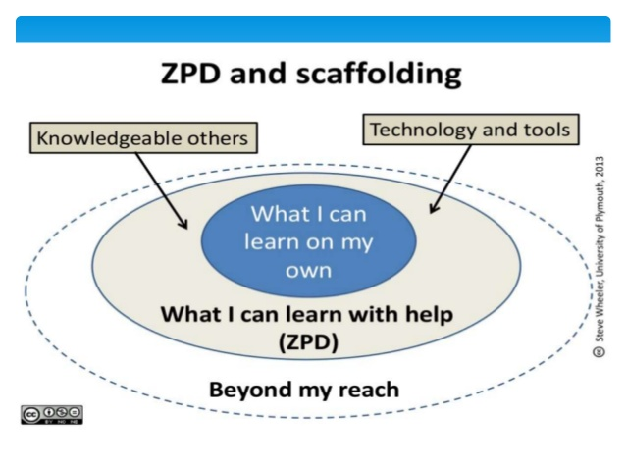
Scaffolding
"Vygotsky scaffolding" is a teaching method that helps students learn more by working with a teacher or a more advanced student to achieve their learning goals.

Slide 12
Thank You

