Slide 1
RESEARCH METHODS IN Education
Course Code: Maj/B.Eds-312
Instructor: Dr. Ghazala Noureen Associate Professor
Department of Education(Planning & Development)
Lahore College for Women University, Lahore.
B.Ed(Hons) Secondary
Semester VI Session(2017-21)
Spring 2020

Slide 2
Unit.7
Survey Research

Slide 3
What is Survey
Researchers are often interested in the opinions of a large group of people about a particular topic or issue. They ask a number of questions, all related to the issue, to find answers. For example, imagine that the chairperson of the counseling department at a large university is interested in determining how students who are seeking a master’s degree feel about the program. She decides to conduct a survey to find out. She selects a sample of 50 students from among those currently enrolled in the master’s degree program and constructs questions designed to elicit their attitudes toward the program. She administers the questions to each of the 50 students in the sample in face-to-face interviews over a two-week period. The responses given by each student in the sample are coded into standardized categories for purposes of analysis, and these standardized records are then analyzed to provide descriptions of the students in the sample. The chairperson draws some conclusions about the opinions of the sample, which she then generalizes to the population from which the sample was selected, in this case, all of the graduate students seeking a master’s degree in counseling from this university.

Slide 4
This example illustrates the three major characteristics that most surveys possess. 1 . Information is collected from a group of people in order to describe some aspects or characteristics (such as abilities, opinions, attitudes, beliefs, and/or knowledge) of the population of which that group is a part. 2. The main way in which the information is collected is through asking questions; the answers to these questions by the members of the group constitute the data of the study. 3. Information is collected from a sample rather than from every member of the population

Slide 5
Why Are Surveys Conducted?
The major purpose of surveys is to describe the characteristics of a population. In essence, what researchers want to find out is how the members of a population distribute themselves on one or more variables (for example, age, ethnicity, religious preference, attitudes toward school). As in other types of research, of course, the population as a whole is rarely studied. Instead, a selected sample of respondents is surveyed and a description of the population is inferred from what is found out about the sample. For example, a researcher might be interested in describing how certain characteristics (age, gender, ethnicity, political involvement, and so on) of teachers in inner-city high schools are distributed within the group. The researcher would select a sample of teachers from inner-city high schools to survey. Generally, in a descriptive survey such as this, researchers are not so much concerned with why the observed distribution exists as with what the distribution is.

Slide 6
Types of Surveys
There are two major types of surveys—a cross-sectional survey and a longitudinal survey.
CROSS-SECTIONAL SURVEYS A cross-sectional survey collects information from a sample that has been drawn from a predetermined population. Furthermore, the information is collected at just one point in time, although the time it takes to collect all of the data may take anywhere from a day to a few weeks or more. Thus, a professor of mathematics might collect data from a sample of all the high school mathematics teachers in a particular state about their interests in earning a master’s degree in mathematics from his university, or another researcher might take a survey of the kinds of personal problems experienced by students at 10, 13, and 16 years of age. All these groups could be surveyed at approximately the same point in time. W hen an entire population is surveyed, it is called a census . The prime example is the census conducted the Govt of Pakistan.
When selected group of people are used it is called sample survey.

Slide 7
LONGITUDINAL SURVEYS In a longitudinal survey, on the other hand, information is collected at different points in time in order to study changes over time. In a longitudinal survey study, data are collected at two or more times. These surveys are extremely useful for studying the dynamics of a topic or issue over time. Longitudinal studies require an extended commitment by the researcher and the participants— some difficulties in conducting longitudinal studies include keeping track of sample members over time and maintaining sample members’ willingness to participate in the study.

Slide 8
Types of longitudinal survey
Longitudinal survey studies can be categorized into four basic types. All collect data multiple times; however, they differ in how the researcher samples the population and administers the survey.
A trend survey
examines changes over time in a particular population defined by some particular trait or traits, such as fourth graders, 12-year-olds, or females from California who are currently graduating from high school and who are valedictorians of their classes. Using a trend survey, the researcher is able to analyze changes in the attitudes, beliefs, or behaviors within that particular population over time. For example, assume a researcher wants to study trends in female valedictorians’ attitudes toward gender equality. To provide information about the trend of the valedictorians’ attitudes, the researcher would select a sample of the female valedictorians in the current year and then select another sample each successive year until the study is complete. In other words, the survey would be administered annually, and each annul sample would include female valedictorians graduating that year.

Slide 9
A cohort survey involves one population selected at a particular time period (e.g., female valedictorians of 2005—the first class to graduate after having spent four years of high school under the No Child left Behind legislation) but multiple samples taken and surveyed at different points in time. For example, the researcher could identify 1,400 female valedictorians in 2005 and send surveys to 300 randomly selected participants. Then, in 2006, the researcher would return to the same population of 1,400 valedictorians and again randomly select 300 participants to survey. Each sample could be composed of different valedictorians (although random sampling may result in some overlap), but all samples would be selected only from the population of female valedictorians from 2005.

Slide 10
A panel survey involves a sample in which the same individuals are studied over time. For example, in a 3-year panel study of female valedictorians of the class of 2000 who graduated from inner-city high schools in Los Angeles and San Francisco, the exact same individuals would be surveyed in each of the 3 years of the study. A frequent problem with panel studies (and cohort studies to a lesser degree) is loss of individuals from the study because of relocation, name change, lack of interest, or death. This attrition is especially problematic the longer a longitudinal study continues.

Slide 11
A follow-up survey addresses development or change in a previously studied population, some time after the original survey was given. For example, a researcher who wanted to study female valedictorians in California a number of years after the original study was concluded would identify individuals who had participated in the original study and survey them again to examine changes in the attitudes, behaviors, or beliefs.

Slide 12
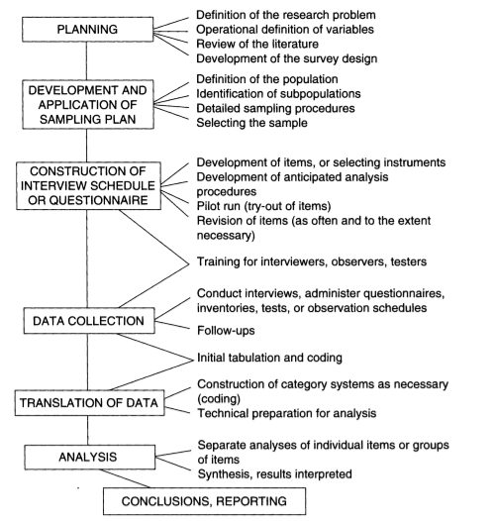
Steps in Conducting Survey

Slide 13
Stating the Problem
The problem or topic studied and the contents of the questionnaire must be of sufficient significance both to motivate potential respondents to respond and to justify the research effort in the first place. Questionnaires dealing with trivial issues, such as the color of pencils preferred by fifth graders or the make of car favored by teachers, usually end up in potential respondents’ circular files.
In defining the topic, the researcher should set specific objectives indicating the kind of information needed. Specific aspects of the topic, as well as the kind of questions to be formulated, should be described. For example, suppose a school superintendent wants to know how high school teachers perceive their schools. He wants to conduct a study to help identify areas in the high schools that can be improved.

Slide 14
cont
It is useful for the superintendent to begin by identifying important aspects of his general question; then he can select questions to address each aspect. He can perhaps focus on four subtopics: (1) respondent demographics (to compare the perceptions of males and females, experienced and new teachers, and teachers in different departments), (2) teacher perceptions of the quality of teaching, (3) teacher perceptions of available educational resources, and (4) teacher perceptions of the school curriculum. Breaking the general topic into a few main areas helps to focus the survey and aid decision making in succeeding steps in the research sequence.

Slide 15
Developing a Questionnaire
Development of a valid questionnaire requires both skill and time. As a general guideline, a questionnaire should be attractive, brief, and easy to respond. Constructing a survey questionnaire is an art. Numerous decisions must be made about the content of questions, their wording, format, and sequencing, all of which can have important consequences for the survey responses.

Slide 16
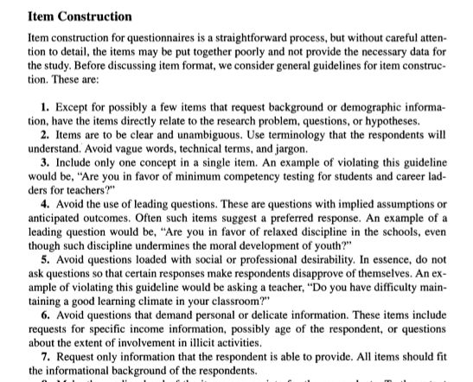

Slide 17
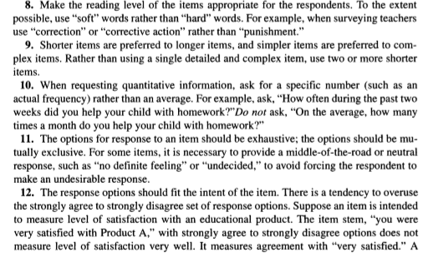

Slide 18
Questions Format
Response formats. Survey questions may be structured or unstructured. Responses to structured questions are captured using one of the following response formats:
Dichotomous response, where respondents are asked to select one of two possible choices, such as true/false, yes/no, or agree/disagree. An example of such a question is: Do you think that the death penalty is justified under some circumstances (circle one): yes / no.
Nominal response, where respondents are presented with more than two unordered options, such as: What is your industry of employment: manufacturing / consumer services / retail / education / healthcare / tourism & hospitality / other.
Ordinal response, where respondents have more than two ordered options, such as: what is your highest level of education: high school / college degree / graduate studies.
Interval-level response, where respondents are presented with a 5-point or 7-point Likert scale, semantic differential scale, or Guttman scale.
Continuous response, where respondents enter a continuous (ratio-scaled) value with a meaningful zero point, such as their age or tenure in a firm. These responses generally tend to be of the fill-in-the blanks type.

Slide 19
Evaluating Questionnaire
After construction it should be evaluated on following points
Is the question clear and understandable
Is the question worded in a negative manner
Is the question ambiguous
Does the question have biased or value-laden words:
Is the question double-barreled:
Is the question too general
Is the question too detailed

Slide 20
Question sequencing
In general, questions should flow logically from one to the next. To achieve the best response rates, questions should flow from the least sensitive to the most sensitive, from the factual and behavioral to the attitudinal, and from the more general to the more specific. Some general rules for question sequencing:
Start with easy non-threatening questions that can be easily recalled. Good options are demographics (age, gender, education level) for individual-level surveys and firmographics (employee count, annual revenues, industry) for firm-level surveys.
Never start with an open ended question. • If following an historical sequence of events, follow a chronological order from earliest to latest.
Ask about one topic at a time. When switching topics, use a transition, such as “The next section examines your opinions about …”

Slide 21
Examples of Poor and Better Questions
Poor: Do you spend a lot of time studying?
Better: How much time do you spend each day studying?
Poor: Who do you think are more satisfied with teaching in elementary and secondary schools, men or women? a. Men are more satisfied. b. Women are more satisfied. c. Men and women are about equally satisfied. d. Don’t know.
Better: Who do you think are more satisfied with teaching in elementary schools, men or women? a. Men are more satisfied. b. Women are more satisfied. c. Men and women are about equally satisfied. d. Don’t know.

Slide 22
Poor: What do you think is the principal reason schools are experiencing increased student absenteeism today? a. Problems at home. b. Lack of interest in school. c. Illness. d. Don’t know.
Better: W hat do you think is the main reason students are absent more this year than previously? a. Problems at home. b. Lack of interest in school. c. Illness. d. Don’t know.
Poor: Do you support the superintendent’s “no smoking” policy on campus grounds while school is in session? a. I support the policy. b. I am opposed to the policy. c. I don’t care one way or the other about the policy. d. I am undecided about the policy.
Better: Do you support a “no smoking” policy on campus grounds while school is in session? a. I support the policy. b. I am opposed to the policy. c. I don’t care one way or the other about the policy. d. I am undecided about the policy.

Slide 23
Consideration for Respondents
Do unto your respondents what you would have them do unto you. Be attentive and appreciative of respondents’ time, attention, trust, and confidentiality of personal information. Always practice the following strategies for all survey research:
People’s time is valuable. Be respectful of their time. Keep your survey as short as possible and limit it to what is absolutely necessary. Respondents do not like spending more than 10-15 minutes on any survey, no matter how important it is. Longer surveys tend to dramatically lower response rates.
Always assure respondents about the confidentiality of their responses, and how you will use their data (e.g., for academic research) and how the results will be reported (usually, in the aggregate).

Slide 24
For organizational surveys, assure respondents that you will send them a copy of the final results, and make sure that you follow up with your promise.
Thank your respondents for their participation in your study.
Finally, always pretest your questionnaire, at least using a convenience sample, before administering it to respondents in a field setting.

Slide 25
Pilot Testing the Questionnaire
Before distributing the questionnaire to participants, try it out in a pilot study. Few things are more disconcerting and injurious to a survey than sending out a questionnaire only to discover that participants didn’t understand the directions or many of the questions. Pilot testing the questionnaire provides information about deficiencies and suggestions for improvement. Having three or four individuals complete the questionnaire will help identify problems. Choose individuals who are thoughtful, critical, and similar to the intended research participants That is, if research participants are superintendents, then individuals critiquing the questionnaire should be superintendents

Slide 26
Encourage your pilot test group to make comments and state suggestions concerning the survey directions, recording procedures, and specific items. They should note issues of both commission and omission. For example, if they feel that certain important questions have been left out or that some existing topics are not relevant, they should note this. Having reviewers examine the completeness of the questionnaire is one way to determine its content validity. All feedback provided should be carefully studied and considered. The end product of the pilot test will be a revised instrument ready to be mailed to the already selected research participants.

Slide 27
Preparing a Cover Letter
Every mailed and emailed questionnaire must be accompanied by a cover letter that explains what is being asked of the respondent and why
The cover letter should explain the purpose of the study, emphasizing its importance and significance. Give the respondent a good reason for cooperating—the fact that you need the data for your thesis or dissertation is not a good reason. Good reasons relate to how the data will help the respondent and the field in general. If possible, the letter should state a commitment to share the results of the study when completed. Include a mailing address, phone number, or email address where you can be reached in case potential respondents want to ask questions.

Slide 28
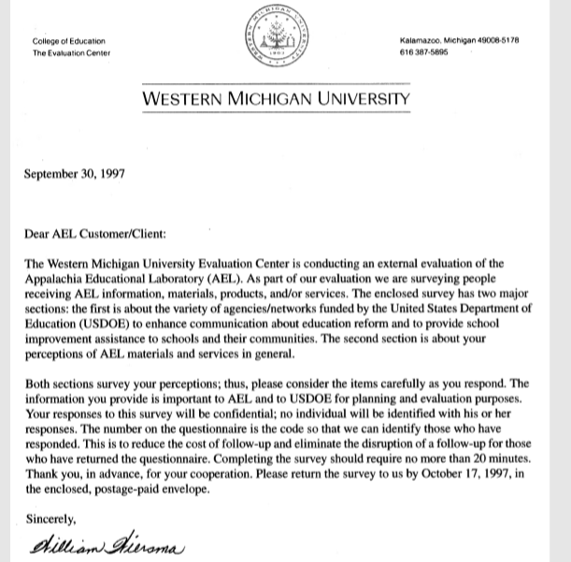
Example of Covering Letter

Slide 29
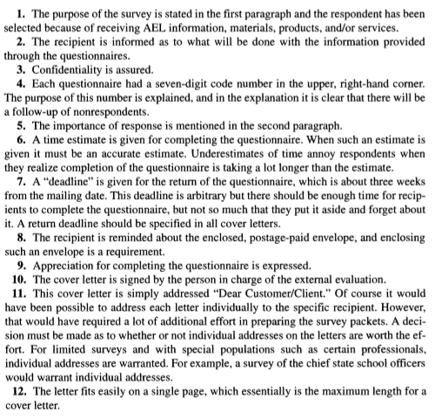
Structure of the covering letter

Slide 30
Administering the Questionnaire
Selecting Participants
Survey participants should be selected using an appropriate sampling technique. Although simple random and stratified random sampling are most commonly used in survey research, cluster, systematic, and nonrandom samples are also used. In some rare cases, when the population is small, the entire group may make up the sample. The selected research participants must be able and willing to provide the desired information to the researcher. Individuals who possess the desired information but are not sufficiently interested or for whom the topic under study has little meaning are not likely to respond. It is sometimes worth the effort to do a preliminary check of a few potential respondents to determine their receptivity.

Slide 31
The target population for the study is likely to be all high school teachers in the province. Such a group is too large a group to survey reasonably, so the participants must select from the accessible population. In this case, the likely accessible population is high school teachers from the schools in a district. A sample, perhaps stratified by gender and department, can be randomly selected and asked to complete the questionnaire.

Slide 32
Distributing the Questionnaire
An important decision faced by all survey researchers is, what method should I use to collect data? There are five approaches: mail, email, telephone, personal administration, and interview
Each approach has its advantages and disadvantages.

Slide 33
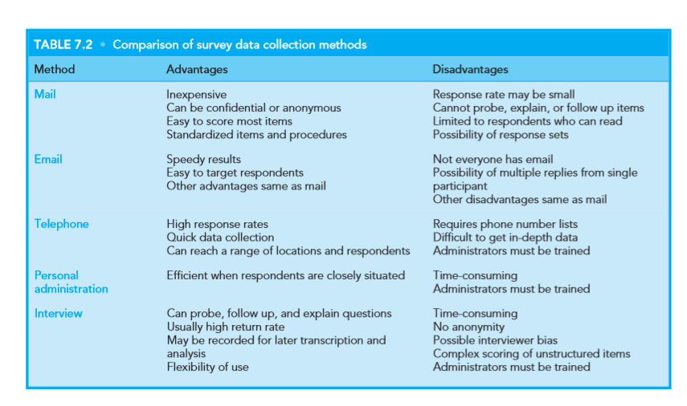
Advantages and Disadvantages of each approach

Slide 34
Non Response
In almost all surveys, some members of the sample will not respond. This is referred to as nonresponse. It may be due to a number of reasons (lack of interest in the topic being surveyed, forgetfulness, unwillingness to be surveyed, and so on), but it is a major problem that has been increasing in recent years as more and more people seem (for whatever reason) to be unwilling to participate in surveys. Why is nonresponse a problem? The chief reason is that those who do not respond will very likely differ from the respondents on answers to the survey questions. Should this be the case, any conclusions drawn on the basis of the respondents’ replies will be misleading and not a true indication of the views of the population from which the sample was drawn.

Slide 35
Suggestion for Increasing Response
1. Administration of the questionnaire or interview schedule:
Make conditions under the questionnaire administered, as simple and convenient as possible for each individual in the sample.
Be sure that the group to be surveyed knows something about the information you want to obtain.
Ask questions in a very polite manner if you are using telephone
Do not use threating tone.

Slide 36
2. Format of the questionnaire :
• Be sure that sufficient space is provided for respondents to fill in the necessary biographical data that is needed (age, gender, grade level, and so on).
• Specify in precise terms the objectives the questionnaire or interview schedule is intended to achieve—exactly what kind of information is wanted from the respondents?
• Be sure each item in the questionnaire or interview schedule is related to one of the objectives of the study—that is, it will help obtain information about the objective.
• Use closed-ended (e.g., multiple-choice) rather than or in addition to open-ended (e.g., free response) questions.
• Ensure that no psychologically threatening questions are included.

Slide 37
How Much response Rate?
If your topic is of interest, your questionnaire well constructed, and your cover letter well written, you should get at least an adequate response rate. Research suggests that first mailings will typically result in a 30% to 50% return rate, and a second mailing will increase the percentage by about 20%; mailings beyond a second are generally not cost effective in that they each increase the percentage by about 10% or less. After a second mailing, it is usually better to use other approaches to obtain an acceptable percentage of returns.
The rule of thumb for your survey response rate, based on a good sample, is 50%. Anything above 50% will increase the confidence with which you speak about your findings as generalizable to the population from which your sample was developed

Slide 38
Tabulating Questionnaire Responses
The easiest way to tabulate questionnaire responses is to have participants mark responses to closed ended questions on a scannable answer sheet. If scannable answer sheets are not an option, then each respondent’s answers will have to be entered one by one into a computer spreadsheet (e.g., Excel or Lotus) or a statistical program (e.g., SPSS or SAS). If you design a questionnaire that will be hand tabulated, make sure that the format is easy to follow and allows respondents to mark answers clearly so that you can enter data quickly, without having to search for information

Slide 39
Data Analysis in Survey Research
After the answers to the survey questions have been recorded, there remains the final task of summarizing the responses in order to draw some conclusions from the results. The total size of the sample should be reported, along with the overall percentage of returns. The percentage of the total sample responding for each item should then be reported. Finally, the percentage of respondents who chose each alternative for each question should be given. For example, a reported result might be as follows: “For item 26, regarding the approval of a no-smoking policy while school is in session, 80 percent indicated they were in favor of such a policy, 15 percent indicated they were not in favor, and 5 percent said they were neutral

