Slide 1
Critical Thinking & Reflective Practices Maj/B.EDs-103
Ms Madiha Zahid
B. Ed. (Hons) Secondary
Semester II

Slide 2
Unit 8
Action Research

Slide 3
description
Action research is action –and-research(Dick,2000). Action research combines twin aims in single process. Action researchers wish to improve some aspect of professional practices or social process, while generating new knowledge at the same time. Action research is not action for research ( doing something to increase understanding),
Using a reflective lens to look at some problem and then determine a methodical set of step to research that problem and to take action (increasing knowledge to be applied later). These two purposes come together in a single project. Huges(2004).
The action research process is collaborative and investigative where teachers work together to design and follow through with research on practical problems in their classrooms. Teachers are involved in the process of inquiry to improve educational practice.
Reflective practice can be more formally encouraged and directed as action research (Kember & Kelly, 1993). Action research involves systematically changing your teaching using ‘on the ground’ evidence that suggests the changes you make are in the right direction and enhancing student learning (Biggs & Tang, 2007). The target of action research is the teacher, not the change that’s being implemented.

Slide 4
Characteristic of Action Research
Action research may be informal
It is flexible type
It deals with some situational problem which is a real problem
Its goal is to bring about improvement in the situation
Action research is self evaluative
Uses of action research are direct and immediate
The systematic action research process is a cyclical step by-step process.
Teachers who engage in the action research process are immersed in examining “what it means to make disciplined—as opposed to intuitive—statements about teaching”

Slide 5
The reflective practitioner engaging in action research
Action research is a form of staff development that encourages and develops the skills of educators to become more reflective practitioners, more methodical problem solvers, and more thoughtful decision makers (Sparks & Simmons, 1989).
Sagor (2000) believed that an important purpose for action research was “building the reflective practitioner” . He explained that “when reflections on the findings from each day’s work inform the next day’s instruction, teachers can’t help but develop greater mastery of the art and science of teaching.
Why Action Research?
For the Reflective Practitioner it is important to accomplish the following:
1. Professionalize teaching.
2. Enhance the motivation and efficacy of a weary faculty.
3. Meet the needs of an increasingly diverse student body.
4. Achieve success with ―standards-based‖ reforms.

Slide 6
Reasons to do action research
1. Teaching does change as a result of the research conducted. The teacher is able to focus on specific areas which need improvement.
2. Discussions with colleagues help develop ideas.
3. Action research projects and related practices allow teachers to modify teaching practices and have an impact on student achievement.
4. Teachers are able to use better strategies for facilitating students to become better learners. 5. Teachers feel confident about themselves as researchers and the research piece in general.
6. Research supported practice leads to personal and professional growth
7. Action research allows some teachers the opportunity to make connection between practice and research.
8. Teachers as adult learners transfer their knowledge about action research to future teaching practices.
9. Action research provides the teachers with the needed practical skills.
10. It gives them an opportunity to develop a philosophy of education.

Slide 7
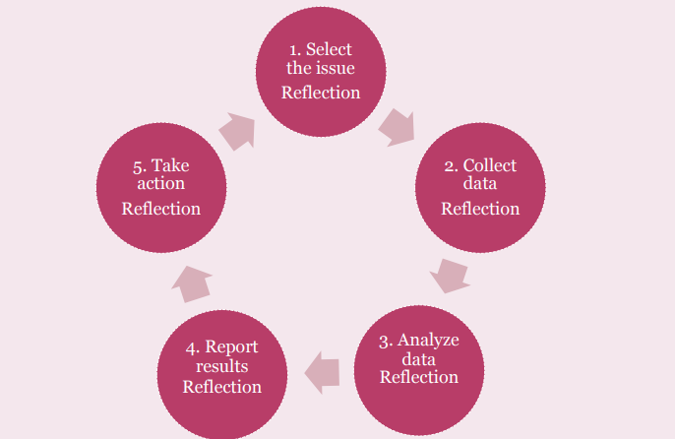
Integrated Action research model

Slide 8
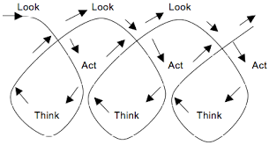
Action research for continuous improvement
Action research can make the teachers feel very proud of their research. They find it as having an added advantage even worthwhile mentioning in their curriculum vitae and during job interviews. As such teachers do recognize the significance of their research.
Different method for personal reflection, such as, journal writing, mentally walking through the day, jotting notes on her lesson plans, or talking to colleagues helps.

