Slide 1
Critical Thinking and Reflective Practices Maj/B.Eds-103

Slide 2
Unit 6: Introduction to Reflection

Slide 3
Meaning of Reflection on Practice
Reflection on practice is defined as reflection that comes AFTER experience.
Reflection on practice helps the practitioner in skills of self awareness, confidence and personal/professional development.

Slide 4
Reflection

Slide 5
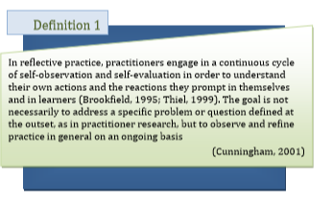
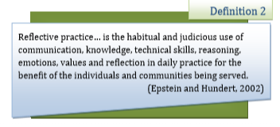

Slide 6
Reflective Practice

Slide 7
Reflective Teaching
Reflecting teaching means looking at what you do in the classroom, why you do it and thinking about if it works.

Slide 8
Typology of Reflection
The typology profiles three dimensions of reflective thought:
Descriptive reflection
Comparative reflection
Critical reflection

Slide 9
Conti..
1. Descriptive reflection
It involves the intellectual process of “setting the problem” that is, determining what it is that will become the matter for reflection.
2. Comparative reflection
It involves thinking about the matter for reflection from a number of different frames or perspectives.
3. Critical reflection
It describes the result of carefully considering a problem that has been set in light of multiple perspectives.

Slide 10
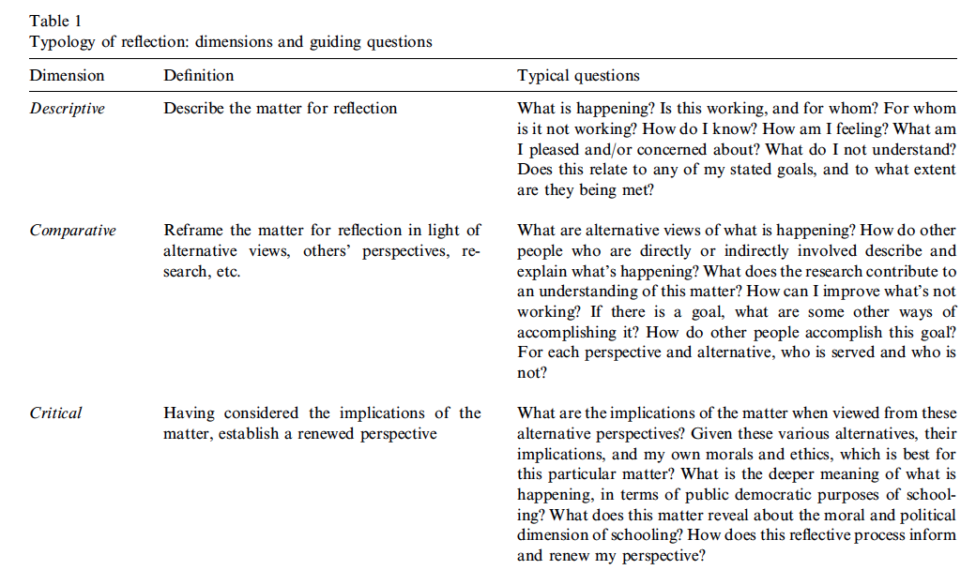

Slide 11
Types of Reflection

Slide 12
