Slide 1
Critical Thinking and Reflective Practices Maj/B.Eds-103
B. Ed. (Hons) Secondary
Semester II

Slide 2
Unit 3: Critical Analysis

Slide 3
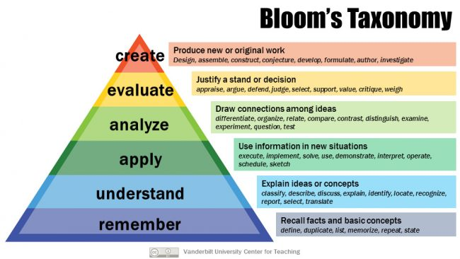
Blooms taxonomy

Slide 4
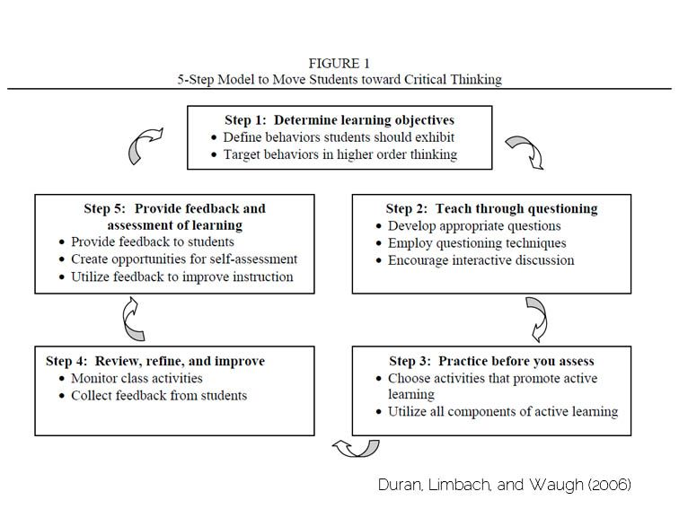
5-Step Model for Teachers to Move Towards Critical Thinking

Slide 5
Halpern’s Framework for Critical Thinking
Halpern referred to the thinking skills needed to compete in a global economy and in the exercise of citizenship, but chose to focus on what is often referred to as ‘higher-order thinking’, i.e. thinking that is reflective, sensitive to context and monitored.

Slide 6
Conti…
Halpern used the following category headings:
Verbal reasoning skills
Argument analysis skills
Skills in thinking as hypothesis testing
Using likelihood and uncertainty
Decision-making and problem solving skills

Slide 7
Verbal Reasoning Skills
Skills that are needed to comprehend and defend against the persuasive techniques that are embedded in everyday language.
a. recognizing and defending against the use of emotional and misleading language
b. detecting misuse of definitions
c. employing questioning and paraphrase as a skill for the comprehension of text and oral language
d. producing and using a graphic representation of information provided in prose form

Slide 8
Argument Analysis Skills
Skills that are needed to judge how well reasons and evidence support a conclusion.
a. identifying premises (reasons) and conclusions
b. making strong arguments that show good thinking and communication
skills
c. judging the credibility of an information source and judging the
difference between expertise in factual matters and in value matters
d. understanding the difference between opinion, reasoned judgment,
and fact
e. remembering to consider what could be missing from an argument

Slide 9
Skills in Thinking as Hypothesis Testing
Skills used in scientific reasoning – the accumulation of observations, formulation of beliefs or hypotheses, and then using the information collected to decide if it confirms or disconfirms the hypotheses.
a. recognizing the need for and using operational definitions
b. understanding the need to isolate and control variables in order to make strong causal claims
c. checking for adequate sample size and possible bias in sampling when a generalization is made
d. being able to describe the relationship between any two variables as positive, negative, or unrelated

Slide 10
Using likelihood and uncertainty Thinking Skills
These skills are related to the correct use of objective and subjective estimates of probability
a. recognizing regression to the mean
b. understanding and avoiding conjunction errors
c. utilizing base rates to make predictions
d. thinking intelligently about unknown risks

Slide 11
Decision-making and Problem Solving Skills
These skills involve the generation and selection of alternatives and judging among them.
a. framing a decision in several ways to consider different sorts of
alternatives
b. generating alternatives
c. evaluating the consequences of various alternatives
d. recognizing the bias in hindsight analysis
e. restating the problem and the goal to consider different sorts
of solution
f. recognizing the critical role of persistence
g. using a quality representation of a problem (e.g. graphs, trees, matrices,
and models)
H. understanding world-view constraints
I. selecting the best strategy for the type of problem

