Slide 1
Critical Thinking and Reflective Practices Maj/B.Eds-103
Ms. Anam Noshaba
B. Ed. (Hons) Secondary
Semester II

Slide 2
Unit 3: Recognizing, Analyzing, Evaluating the Argument

Slide 3
What is an Argument?
An argument is simply claim defended with reasons.
Arguments are composed of one or more premises and a conclusion.
Example: It is cold outside, so you should wear a jacket.
Premise: It is cold outside
Conclusion: you should wear a jacket

Slide 4
What is not an Argument?
A passage which did not include one or more premises and a conclusion is not an argument.
Types of non-argumentative discourse:
Reports
Unsupported assertions
Conditional statements
Illustrations
Explanations

Slide 5
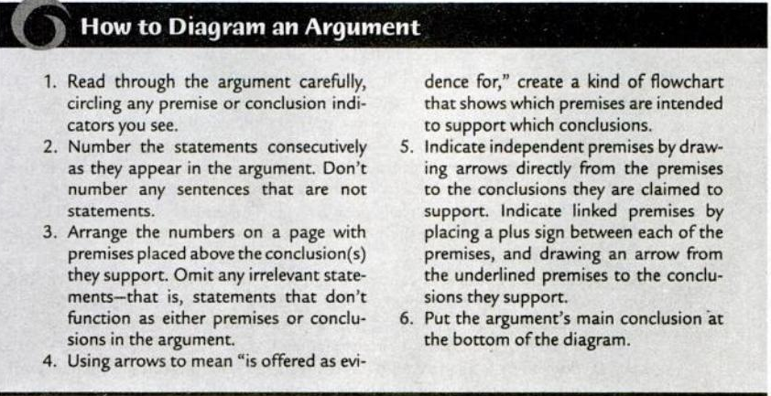
Diagramming Short Arguments

Slide 6
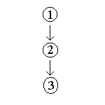
Conti..
Example: Jim is a senior citizen (1). So, Jim probably doesn’t like hip-hop music (2). So, Jim probably won’t be going to the Ashanti concert this weekend (3).

Slide 7
Summarizing Longer Arguments
Summarizing involves the skill of “paraphrasing”.
Paraphrasing is restating argument’s main points briefly, clearly and accurately.
Example:
Original Passage: High-quality learning environments are a necessary precondition for facilitation and enhancement of the ongoing learning process.
Paraphrase: Children need good schools if they are to learn properly.

Slide 8
Exercise 3.1
Diagram the following arguments.
No member of the volleyball team like rap music. Ali is a member of the volleyball team. So, Ali doesn’t like rap music.
Bertie probably is not home. His car is not in the driveway, and there are no lights on in this house.
Lahore College is a really great college. The students are friendly. The faculty really care about the students. The campus is beautiful, and the athletic facilities are great.

