Slide 1
Critical Thinking and Reflective Practices Maj/B.Eds-103
Ms Madiha Zahid
B. Ed. (Hons) Secondary
Semester II

Slide 2
Unit 02 A Critical Thinking Framework

Slide 3
Stages of Critical Thinking

Slide 4
Critical Thinking:
Is using the mind in a disciplined, sequential way to shape beliefs and actions

Slide 5
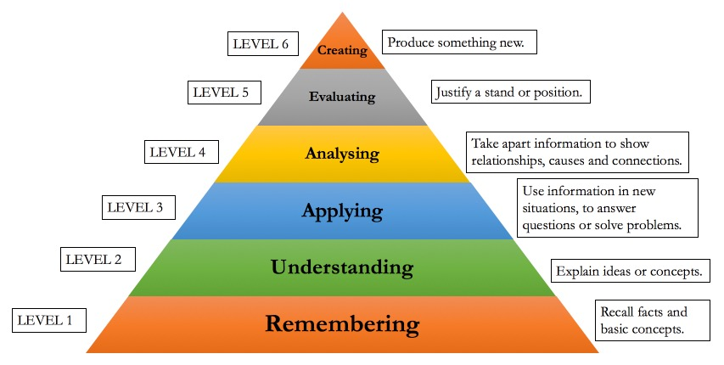
Accomplished thinker
Advanced thinker
Practicing thinker
Beginning thinker
Challenged thinker
Un Reflective thinker
Blooms Taxonomy (Cognitive Domain)
Stages of Critical Thinking

Slide 6
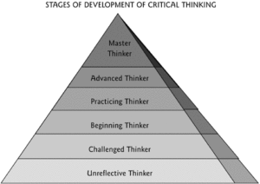

Slide 7
Stage #1
Un Reflective thinkers:
(Remembering)
Do not evaluate their thoughts or the way those thoughts affect their actions and beliefs.
Teacher Response:
Facilitate awareness of personal thought processes

Slide 8
Stage #2
Challenged thinkers:
(Comprehension)
Becomes aware of thinking and aware of problems that occur because of poor thinking
Teacher Response:
Model thinking and explain that no one is a known-it-all

Slide 9
Stage #3
Beginning Thinkers:
(Application)
Want to be critical thinkers but lack skills to do so
Teacher Response:
Encourage good habits and teach the “Universal Intellectual Standards”

Slide 10
Steps to Problem Solving
Clarity: can you tell me more?
Accuracy: is it true?
Precision: what are the details?
Relevance: how does it relate?
Depth: are all the factors addressed?
Breadth- what is another point of view?
Logic: does it make sense?

Slide 11
Stage #4
Practicing thinkers:
(Analysis)
Are aware of and begin working on their thinking flaws
Teacher Response:
To encourage looking at the issue from many point of view

Slide 12
Edutopia Article
Questions, questions, questions
Prompt and unpack
Communication tools
Model
Encourage constructive controversy
Choose high-interest topics
Set up Socratic discussions
Assess reasoning with discussions, essays and speeches
Student evaluation
Teacher step back

Slide 13
Stage #5
Advanced Thinkers:
(Synthesis)
Have good habits for thinking but are not always consistent
Teacher Response:
Discuss valuable intellectual traits

Slide 14
Valuable intellectual traits:
Intellectual Humility
Intellectual Courage
Intellectual Empathy
Intellectual Integrity
Intellectual Perseverance
Intellectual Faith and reason
Intellectual Fair-mindedness

Slide 15
Stage #6
Accomplished Thinkers:
(Evaluation)
Are in charge of their thinking and continually improving
Teacher Response:
Inform of the goal

