Slide 1
Critical Thinking and Reflective Practices Maj/B.Eds-103
Ms Madiha Zahid
B. Ed. (Hons) Secondary
Semester II

Slide 2
Unit 11 The Dialogic process in Reflective Practice

Slide 3
Dialogue as a self- assessment tool
Dialogue is a self-assessment tool to assess knowledge and practice evident to assessment, to assess the quality of learning. The Reflective practices can engage the dialogic process to develop their practice.
What is Reflective writing?
Reflective writing is evidence of reflective thinking. In an academic context reflective thinking usually involves:
looking back at something (often an event i.e. something that happened, but could also be an idea or object)
analyzing the event or idea (thinking in depth and from different perspectives, and trying to explain, often with reference to a model or theory from your subject)
thinking carefully about what the event or idea means for you and your ongoing progress as a learner and/or practicing professional.

Slide 4
Dialogue as a self- …….
Reflection is widely accepted as being at the core of teacher education and development. However, teachers often struggle to engage in reflective practice, citing that it takes time to write journal entries and, in an already busy schedule, it is one of those tasks that goes to the bottom of the list.
However, research in teacher education is attempting to change these views. It is promoting the importance of teachers as active practitioners, and encouraging us to see reflection in new ways.

Slide 5
Types of Reflective writing
A journal requires you to write weekly entries throughout a semester. May require you to base your reflection on course content.
A learning diary is similar to a journal, but may require group participation. The diary then becomes a place for you to communicate in writing with other group members.
A logbook is often used in disciplines based on experimental work, such as science. You note down or 'log' what you have done. A log gives you an accurate record of a process and helps you reflect on past actions and make better decisions for future actions.
A reflective note is often used in law. A reflective note encourages you to think about your personal reaction to a legal issue raised in a course.
a peer review usually involves students showing their work to their peers for feedback.
A self-assessment task requires you to comment on your own work

Slide 6
A Structure for Reflective Writing
Maughan and Webb (2001) state that while reflective thinking and writing can be an unstructured process, the individual is commonly required to demonstrate some editorial skills in the presentation and structure of the final diary/journal. As a result they propose a three-part structure to produce reflective writing: description, interpretation and outcome:

Slide 7
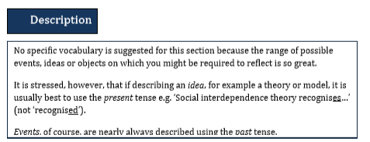
Vocabulary for Reflective Writing
Based on the structure above, Maughan and Webb (2001) provide a few suggestions for words and phrases for reflective writing (see Figure). While using any of these words and phrases will not automatically result in ‘good reflection’ they do help with the vocabulary required in this style of writing.
Suggested Wording for the Description of Reflective Practices

Slide 8
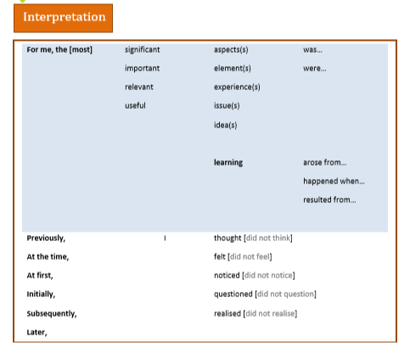
Suggested Wording for the Interpretation of Reflective Practices

Slide 9
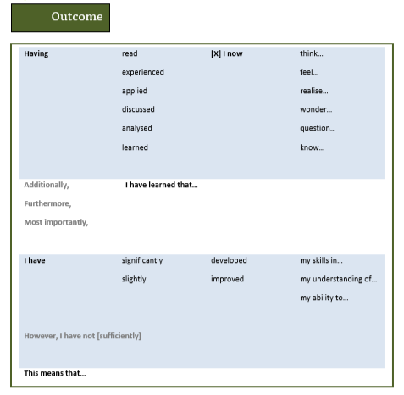
Suggested Wording for the Outcome of Reflective Practices

