Slide 1
LEMI’s Theorem

Slide 2
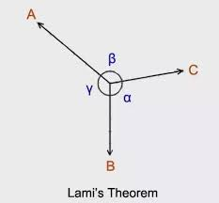
Lami’s Theorem Statement:
Lami's theorem is an equation relating the magnitudes of three coplanar, concurrent and non-collinear forces, which keeps an object in static equilibrium, with the angles directly opposite to the corresponding forces.

Slide 3
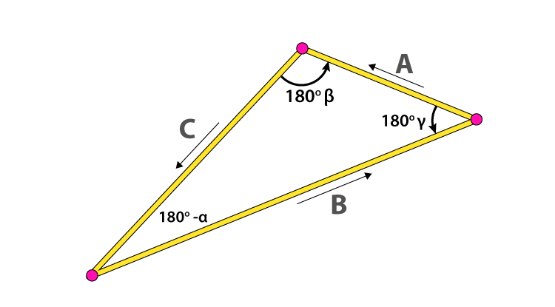
Derivation:
Now, let’s see how the theorem’s equation is derived.
Let FA, FB, and FC be the forces acting at a point. As per the statement of the theorem, we take the sum of all forces acting at a given point which will be zero.

Slide 4
i.e. FA + FB + FC = 0
We write angles in terms of complementary angles and use triangle law of vector addition. Then, by applying the sine rule we get,
$\frac{A}{sin⁡(180−α)}$ = $\frac{B}{sin⁡(180−β)}$ = $\frac{C}{sin⁡(180−γ)}$
Then,
$\frac{A}{sinα}$ = $\frac{B}{sinβ}$ = $\frac{C}{sinγ}$
Hence, it is clearly seen that by applying sine rule to complementary angles we arrive at the required result for Lami’s theorem.

Slide 5
Examples:
Let 45 degrees be the angle made by the strings with the signboard having a mass of 6 kg, then what is the value of the tension T in both the strings?
Given, m = 6 kg, g = 9.8 m/s², 𝜃 = 45 degrees
Using the derived formula from example 1, we get,
T = mg / 2cosθ
i.e. T = 6 x 9.8 / 2cos45 = 41.6 N
So, the tension in both the strings to hold the signboard exactly horizontal is 41.6 N.

Slide 6
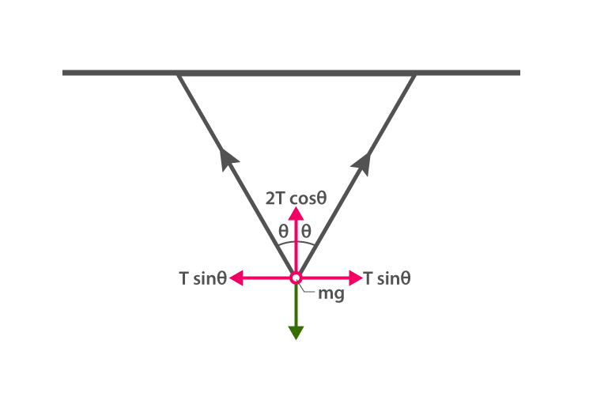
2: Consider an advertisement board hangs with the help of two strings making an equal angle with the ceiling. Calculate the tension in both the strings in this case?
Resolving the forces we will apply the required theorem to get the value of tension in both the strings. Here, the weight of the signboard is in a downward direction, and the other force is the tension generated by the signboard in both the strings. In this case, the tension T in both the strings will be the same as the angle made by them with the signboard is equal.

Slide 7
Above figure represents the free body diagram of the signboard. Applying the Lami’s Theorem we get,
$\frac{T}{sin⁡(180−∂)}$ = $\frac{T}{sin⁡(180−∂)}$ = $\frac{mg}{sin⁡(2∂)}$
Since sin (180 – θ) = sin θ and sin (2θ) = 2sinθ cosθ
So, we get, final tension force in the string T as,

Slide 8
$\frac{T}{sin∂}$ = $\frac{mg}{2sin∂ cos∂}$
I.e. T = mg / 2cosθ
The similar concept and equations can be applied for a boy playing on a swing, and we arrive at the same result.

