Slide 1
Unit 2: Morphology of Plants Topic: Stem B.Ed (Hons) Secondary Semester III Subject: Advance Biology I Course Title: Plant Systematics and Anatomy Represented By: Ms Sidra Younis Department of Education (Planning and Development) Lahore College for Women University, Lahore

Slide 2
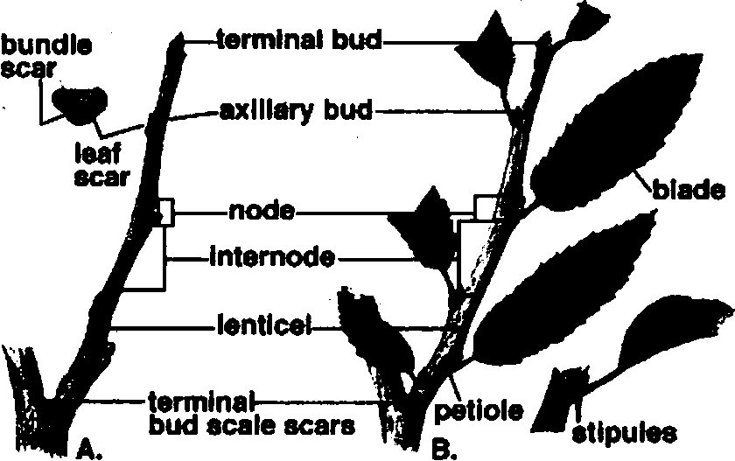
Morphological Characteristics of Stem
The portion of the primary axis of plant which develops from which plumate is called main stem. The axis with leaves is called shoot. Stein has node and internodes. The part of stem from leave arises is called node. The part of stem between two nodes is called internodes.

Slide 3
Types of Plants
Types of plants on the basis of growth seasons: Plants are divided into three types on the basis of seasonal growth: Annual. Biennials and Perennials.
I. Annuals: The, plants which live only for single growing season are called annuals. They die after this season. Most herbaceous plants are annuals like tomato, wheat, rice etc.
Biennials: The plants which live for two growing seasons are called biennials. They develop leaves on short stem in first growing season. They store food in their tuberous tap roots. The leaves die away at the end of the growing season (in winter). They use this stored food to develop flowers and fruits in the second growing season (after winter). Examples: radish, turnip, carrot.
Perennials: The plants which live for several years are called perennials, All woody plants are perennials.
Types of plants on the basis of structure of stem: The plants are divided into three types on the basis of structure of stern. These are:
1.Herb: An annual green small sized plant is called herb. They have son and usually green stem. e.g. radish.

Slide 4
2.Shrub: The woody green plant whose main stem cannot be distinguished from its branches is called shrub. Its size is less than 6 feet. Example rose
3.Tree: It is perennial green woody plant with a distinct upright (straight) stem of 6 feet or more is called tree. Example mango.
Descriptive terms of stems
Following descriptive terms are used for stem.
Herbaceous stem: Soft and green stem that can be easily bent is called herbaceous stern.
Woody stem: Hard woody stem which cannot be easily bent is called wood stem.
Fistular: If the internodes of the plants are hollow, then the stern is called fistular. Example: bamboo.
Solid: If stem is not hollow at internodes then it is called solid: Jointed: The stems swollen at internodes are called jointed. Example: stems of grasses.
Cylindrical: Straight and rounded stem is called cylindrical. Example: rose
Angular: The stein with alternate ridges and furrows is called
angular. Example: Ocimum

Slide 5
Flattened: Flat and plant like stein is called flattened. Example Opuntia
Succulent: Thick and fleshy stern is called succulent. Example: Etiphorbia
Hairy: The stem having hair on its surface is called hairy. Example: sunflower.
Spiny: With spines or thorns on the surface. Example: Acacia (kikar) Prickly: Stem with prickles on the surface. Example: rose
Types of stem
Sterns have following forms: Aerial stems, underground stein
(i) Aerial stem
The stem which grows above the ground in the exposed air is called aerial stem. Aerial stem may be:
I.Reduced aerial stem: In this case, stem is very reduced and present in the form of green structure above the thick roots. These stems are so–small, that the leaves appear to be arised from root directly. Example: stem of radish, turnip etc.
2.Erect stem: In this case, stem is thick and strong. It grows upward. Such stems are present in trees.
3.Weak stems: These stems are much weak. They are unable to grow erect. Therefore, they become climber or spread on the ground. Plants are divided into different groups on the basis of structure of their weak stems.

Slide 6
A. Climbing plants or Climbers
These plants have weak and slender stem. Therefore, they adopt different methods to get support. These plants may be:
Twiners: The plants whose stem twin or coil around some support are called twiners. They do not have any special organ for climbing. Example: Cuscuta
Tendril climbers: These plants develop long slender tendrils for climbing up in the support. The tendril may be modified stem or leaves. It is very sensitive to support. As soon as it touch some support. It coils around it. Example: melons, cucumbers etc.
Root climbers: These plants attach to the support by means of small adventitious roots. Example: pepper.
Hook Climbers: These plants develop hooks to attach with the support. The hooks are uncurved. Example: Bougainvillea
B. Trailer plants or Trailers
In these plants, the sterns spread out or trail on the ground. Their stein is called prostate stem. There are following types of prostate stems:
(a) Creeper: In this case, the main stein spreads out on the ground and develops adventitious root Example: ground ivy.

Slide 7
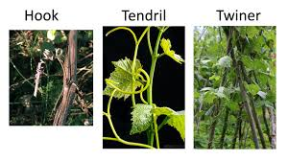

Slide 8
Runner: Runner is a slender stem It runs along the surface of the ground. Examples: grasses
Stolon: Stolon is a much elongated runner. It bends downward and enters into soil or touches it. Example: Jasmine
Offset: It is short, thick runner which runs at its ends and gives off adventitious roots into soil. Example: Agave
Sucker: Sucker is an underground runner or shoots. It arises from an axillary bud develop on the underground stern. It grows upward and gives rise to aerial branches. It gives off adventitious roots into soil. Thus a new plant is formed.
Example: mint
(ii) Underground stems
These stems grow underground. They are often thick and swollen with a large amount of stored food. Underground stems are formed in perennial herbs. The underground sterns resemble roots. But these stems have nodes and internodes or scale leaves. They always arise from the axils of leaves. There are different types of underground stems. These are rhizome. corm. bulb and stem tubers.

Slide 9
I. Rhizome: The elongated, horizontal, thick and fleshy underground stem is called rhizome. It has a large amount of stored food. It has distinct nodes and internodes. Nodes give off adventitious roots. It also gives off aerial branches. Examples:
ginger (..S,M. There are different types of rhizomes:
Straggling rhizome: The elongated less branched rhizome which grows horizontally is called straggling rhizome. It is found in water grasses (typha).
Sobole rhizome: In this case, the rhizome is long, slender and has long ‘memories. Such ‘rhizomes are called sobole rhizomes. These are found in many grasses.
(c)Monpodial rhizome: They are arranged like racemose. They have single axis v,hich give rise to lateral branches. It is found in wood sorrel (Oxalis).
(d) Sympodial rhizome: In this case, the rhizomes are arranged in cymose pattern. In this case, each branch give rises to new axis. It is found in ginger.

Slide 10
Corm: The thick solid, rounded, condensed underground stem with few internodes is called corm. It is covered with number of loose Sheathing scale leaves. One or more bud is present in the axil of each leave. Each bud form new corm. This new corm lies on the top of old corm. The aerial portion dies in unfavorable conditions. The corm passes unfavorable condition. It grows to form new plant in the growing season. Sometimes, corms of three or more generations remain connected together. Example: Colocasia
Bulb: A specialized much reduced short underground stem composed of broadly conical disc is called bulb. Large fleshy leaves are borne on the upper surface of bulb. These leaves contain stored material. The fleshly leaves may be small scale leaves like onion. Or they may have broad basal portion with upper green part die away. The disc bears an apical bud and some axillary buds on its upper surface. The apical bud lies in the centre. The lateral buds lie in the axil of fleshy leaves. The apical bud grows in the growing season and form new plant. It develops adventitious roots. There are two types of bulbs:

Slide 11
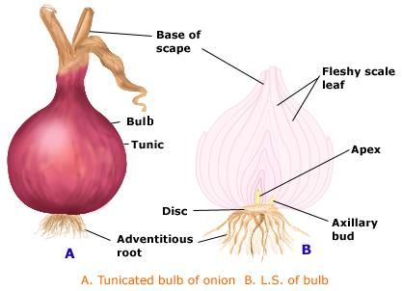
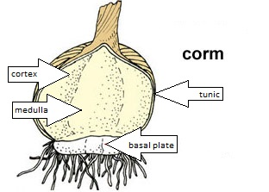

Slide 12
Special types of stems
Some stems are highly modified. They even do not look like stems.
They perform different functions. These are:
I. Stem tendrils: These are slender thread like structures. They are highly specialized climbing organs. they are found in climbing plants like vines. he arc sensitive to contact. They twins around an support.
Phylloclade and Cladode: In some dry plants, true leaves are reduced to scales. It presents transpiration. Their stems become flattened. green and leaf like. They perform the formation of leaf. Such leases like steins are called phylloclade and cladode. Phylloclades are composed of more than one internode. They are found in Opuntia.
Cladodes are composed of single internode. They are found in Euphorbia. Phylloclades and cladodes are used to store a large amount of water. They also carry out the function. They help plants to conserve water supply.

Slide 13
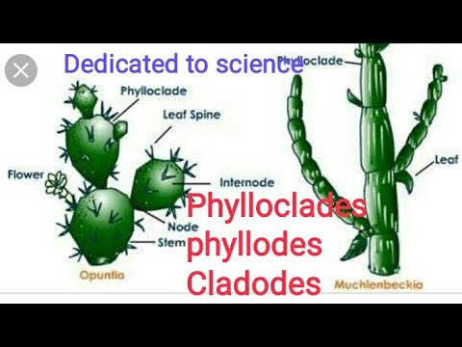

Slide 14
Functions of Stem
A stem performs a variety of functions which are important for various biochemical processes including photosynthesis.
Gives an accurate structure and foundation for a plant that later develops into a tree.
The stem’s main role is to hold onto the plant buds, flowers, leaves, and fruits.
A stem helps the plants together with the roots, helping them to stand up straight and perpendicular to the ground
It is the component that transports water and mineral from the root to many other areas of the tree and prepares food from leaves.
Stems are one of the plant storerooms where the prepared food is processed in starch form.
Few stems help to replicate by vegetative propagation and also help to grow flowers and fruit.

