Slide 1
Unit 3: Plant Families Topic: Fabaceae B.Ed (Hons) Secondary Semester III Subject: Advance Biology I Course Title: Plant Systematics and Anatomy Represented By: Ms Sidra Younis Department of Education (Planning and Development) Lahore College for Women University, Lahore

Slide 2
Introduction
Pea family of flowering plants
Third largest family of angiosperms
700 genera and 20,000 species
Divided into 3 Sub-families
Papilionaceae
Caesalpiniaceae
Mimosaceae

Slide 3
CLASSIFICATION
Kingdom: | PLANTAE
Class: | DICOTYLEDONS
Sub class: | POLYPETALAE
Order: | FABACALES
Family: | FABACEAE
Distribution:
Found in tropical Rain forests.
Its fruit called legume. e.g peanut

Slide 4
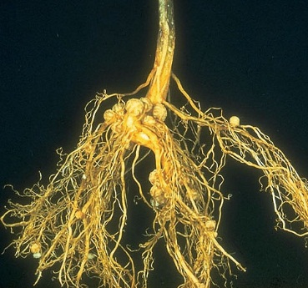
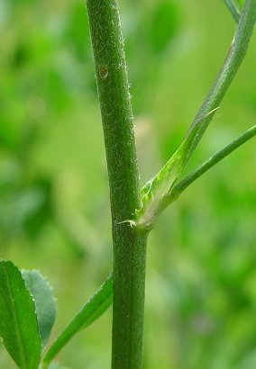
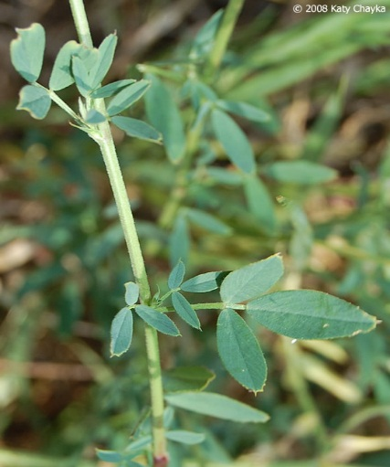
Morphology ‘‘vegetative characters’’
Habit:
Root:
Stem:
leaves:
Annual or perennial.
Plants show variation
Nitrogen fixing bacteria live in nodules.
Plant grow to enrich the soil
Herbaceous, woody or climber with tendrils.
Tendrils are wiry, coiled and thread like structure
Alternate and stipulate leaves.
Leaves are partially or completely modified.
Modified into spines.
Leaves form tendrils for climbing purposes

Slide 5
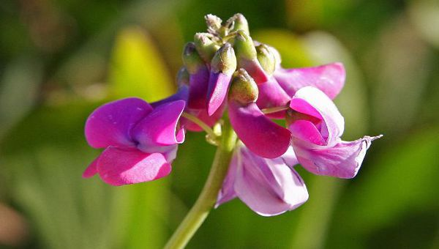
‘‘Floral Characters’’
Inflorescence:
Flowers:
Racemose
Solitary axillary
Bisexual, Zygomorphic
Bracteate/ebracteate
Pedicellate, Perigynous
Pentamerous and papilionaceous flowers
Hermaphrodite, complete

Slide 6
Calyx:
Corolla:
5 sepals
Gamosepalous
Ascending imbricate aestivation
Odd sepal anterior
Sepaloid
Hairy
5 clawed petals (polypetalous)
Posterior petal large
Descending imbricate or vexillary aestivation
Papilionaceous corolla
Standard or Vexillum
Wings
Keel or Carina

Slide 7
Androecium:
Gynoecium:
Stamens 10 or rarely nine Dalbergia
Posterior stamen is free
Filaments of nine are fused
In Arachis ten stamens are monadelphous
In Sophora all ten stamens are free
Monocarpellary
Ovary superior
Unilocular
Marginal placentation
Ovules on the ventral suture
Style long slightly bent at the apex
Flattened
Hairy or without hair
Stigma simple or capitate Mucuna

Slide 8
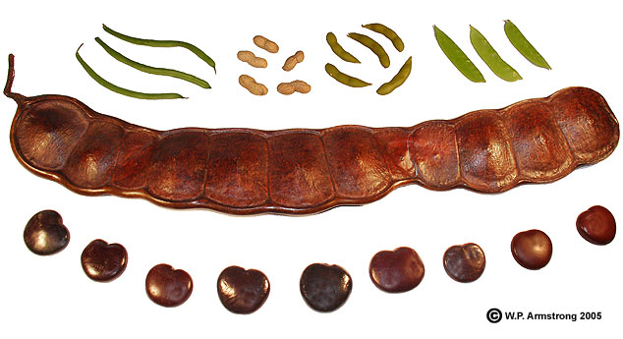
Fruit:
Seed:
Ovary develops into a legume (dry fruit)
Common name ‘‘Pod’’ Dalbergia
One or more
Non-endospermic
Pollination:
Entomophilous

Slide 9
Floral Diagram:

Slide 10
‘‘Important Genera’’
Garden pea (Pisum sativum)
Alfalfa (Medicago sativa)
Locust (Genus robinia)
Shisham (Dalbergia sisso)
Amaltas (Casiaa fistula)

Slide 11
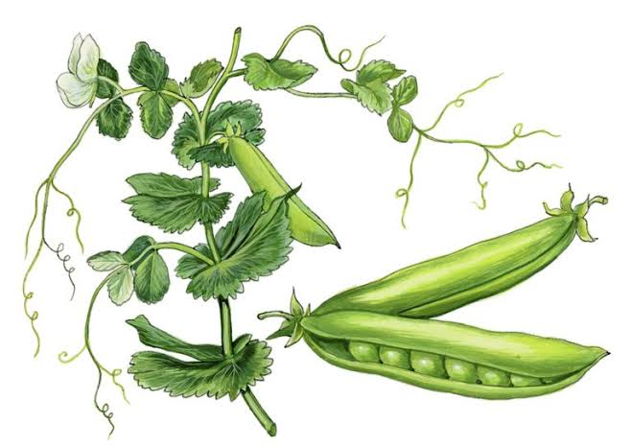
Garden pea
Leguminous plant of genus Pisum, with small white flowers.
Green pods containing edible green seeds.
It is an annual plant,erect or climbing stems.
Length is 15-300 cm long.
Having well developed taproot upto 120 cm long.
Grown in temperate zone and also in tropics.
USES
Edible use:
Sweet flavours, but beneath thin layer of flesh with a fibrous is present.
Immature seeds, sweet and delicious.
Medicinal use:
Used for skin complaint including skin acne

Slide 12
‘‘Economic Importance’’
Plant uses as food:
Large number of plants are source of pulses which rich in proteins. e.g Pisum sativum, glycine max.
Plant uses for oils:
Oil can be extract form ground nut, soybean.
Plants used for ornamental plants:
Sweet pea (lathyrus odomtus), lupin (lupinus) etc are used as ornamental plants.
Plants giving timber and fibres:
Shishum (dalbergia sisso), Dalbergia latifolia (India rosewood) are important
Plants used for medicine:
Plant butterfly pea is used for medicinal purposes Glycyrrhiza glands used for cough and cold

