Slide 1
Unit 3: Plant Families Topic: Poaceae B.Ed (Hons) Secondary Semester III Subject: Advance Biology I Course Title: Plant Systematics and Anatomy Represented By: Ms Sidra Younis Department of Education (Planning and Development) Lahore College for Women University, Lahore

Slide 2
INTRODUCTION
Poaceae, formerly called Gramineae, grass family of monocotyledonous flowering plants. The Poaceae are the world’s single most important source of food. They rank among the top five families of flowering plants in terms of the number of species, but they are clearly the most abundant and important family of the Earth’s flora.
Distribution and abundance:
The family is commonly known as grass family. It is one of the largest among the angiospermic families. It consists of 620 genera and 6,000 species. The members are cosmopolitan in distribution. The plants represent all the 3 ecological types as hydrophytes, xerophytes and mesophytes. They grow on all continents, in desert to freshwater and marine habitats, and at all but the highest elevations.

Slide 3
VEGETATIVE CHARACTERS
Habit:
Herbs, annuals or perennials or shrubs, sometimes tree like (Bambusa, Dendrocalamus).
Root:
Adventitious, fibrous, branched, fascicled or stilt (Zea mays).
Stem:
Underground rhizome in all perennial grasses, cylindrical, culm with conspicuous nodes and internodes, internodes hollow, herbaceous or woody, glabrous or glaucous, vegetative shoots are arising from the base of aerial stem or from underground stems are called tillers.
Leaves:
Alternate, simple, exstipulate, sessile, ligulate (absent in Echinochloa), leaf base forming tubular sheath, sheath open, surrounding internode incompletely, ligule is present at the junction of the lamina and sheath, entire, hairy or rough, linear, parallel venation.

Slide 4
FLORAL CHARACTERS
Inflorescence:
Compound spike which may be sessile or stalked. Each unit of inflorescence is spikelet. The spikelets are arranged in various ways on the main axis called rachilla. A compound inflorescence may be spike of spikelets (Triticum), panicle of spikelets (Avena).
At the base of rachilla two sterile scales, called glumes, are present. The glumes are placed one above the other on opposite sides. The lower one is called first glume and the upper is called second glume. Both the glumes are boat shaped and sterile. Above the glumes a series of florets are present. Each floret has an inferior palea or lemma and above it a superior palea. The lemma frequently bears a long, stiff hair called awn.

Slide 5
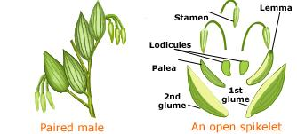

Slide 6
FLORAL CHARACTERS
Flower:
Bracteate and bracteolate, sessile, incomplete, hermaphrodite, or unisexual (Zea mays), irregular, zygomorphic, hypogynous, cyclic.
Perianth:
Represented by membranous scales called the lodicules. The lodicules are situated above and opposite the superior palea or may be absent, or many (Ochlandra), or 2 or 3.
Androecium:
Usually stamens 3, rarely 6 (Bambusa, Oryza) and one in various species of Anrostis, Lepturus; polyandrous, filaments long, anthers dithecous, versatile, linear, extrorse; pollen grains dry.
Gynoecium:
Monocarpellary, according to some authors carpels 3, of which 2 are abortive, ovary superior, unilocular with single ovule, basal placentation, style short or absent; stigmas two feathery or papillate and branched.

Slide 7
FLORAL CHARACTERS
Fruit:
Caryopsis (achene with pericarp completely united or adherent with the seed coat) or rarely nut (Dendrocalamus) or berry (Bambusa).
Seed:
Endospermic and containing a single cotyledon called scutellum, which is shield shaped and pressed against the endosperm.

Slide 8
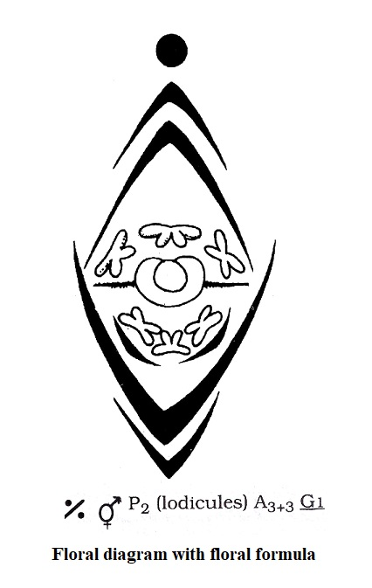

Slide 9
IMPORTANT GENERA
Some important plants of the family:
Oryza sativa (Rice)
Zea mays (maize)
Triticum aestivum (wheat)
Avena sativa (Oats)

Slide 10
ECONOMIC IMPORTANCE
This family has greater importance than all other families of the flowering plants. It has importance both for man and animals.
Oryza sativa, Zea mays, Triticum aestivum are used as food for mankind.
Zea mays, Cynodon, Poa are used as fodder.
Saccharum officinarum is the source of sugar.
Cymbopogan citratus gives reddish yellow oil with strong odour used in soaps and in medicine.
Hordeum vulgaree barley water is used to expel stone from the kidney.
Citronella oil is used as external insecticide.
Andropogan odoratus yields ginger oil, which is used as digestive.
Poa, Agrostris, Cynodon are ornamental plants.

