Slide 1
Unit 3: Plant Families Topic: Brassicaceae B.Ed (Hons) Secondary Semester III Subject: Advance Biology I Course Title: Plant Systematics and Anatomy Represented By: Ms Sidra Younis Department of Education (Planning and Development) Lahore College for Women University, Lahore

Slide 2
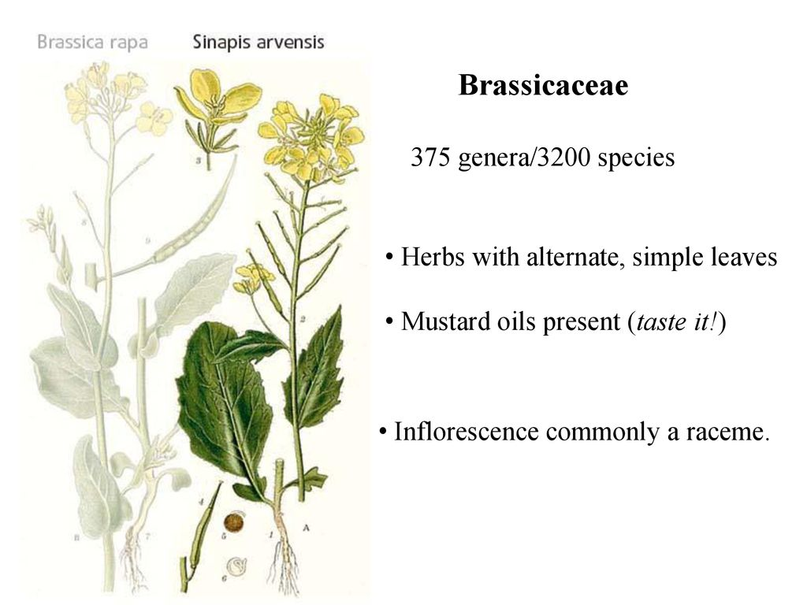
Introduction
General information:
Mustard family
375 genera and 3200 species
Propagation type:
Fruit, partial fruit, seed

Slide 3
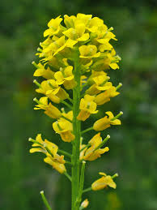
Distribution
World-wide
Grow in temperate and cold parts
Cultivated for vegetables
Oil yielding seed

Slide 4
Vegetative Characters
HABIT:
Annual ,biennial ,perennial
Herbs , rarely shrub
Terrestrial and aquatic
Produce pungent watery juice

Slide 5
Vegetative Characters
Root:
Swollen
Storage of food
Stem:
Aerial erect ,cylindrical ,hairy , branched or un branched
Herbaceous , rarely woody
Reduced
Stellate unicellular hairs

Slide 6
Vegetative Characters
Leaves:
Cauline and ramal, sometimes radical , exstipulate, alternate,
simple, rarely pinnately compound
Margin entire or divided, dentate.
Often sessile and auriculate , radical leaves form the
rosettes on the reduced stem.
Lower leaves petiolate and lyrate in some cases
Venation- reticulate unicostate.

Slide 7
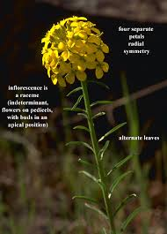
Floral Characters
Inflorescence
Racemose-raceme,
Corymb
Corymbose racem

Slide 8
Floral Characters
Flower:
Pedicellate
Ebracteate
Complete Bisexual
Actinomorphic, Zygomorphic
Hypogenous and tetramerous

Slide 9
Floral Characters
Calyx:
Sepals-4, present in two whorls (2+2)
Polysepalous
Inner lateral sepals saccate at the base.
Aestivation- imbricate

Slide 10
Floral Characters
Corolla
Petals-4, free, cruciform
Rarely absent
usually equal but sometimes unequal
Aestivation valvate or imbricate

Slide 11
Androecium
Stamens-6
Polyandrous
Tetradynamous(2+4)-arranged in two whorls
2 outer short
2 inner long
2 outer stamens missing in some case
In some present and in some 16 are present
Anthers are 2 celled rarely 1 celled, introse, dehiscing, longitudinally, basi or drosified

Slide 12
Gynoecium
Bicarpellary
Syncarpous
Superior
Unilocular but becomes bilocular due to the development of a false septum or replum
Rarely tricarpellary or tetra carpellary
Placentation parietal, ovules 2 many on each placenta
Style short, stigma bifid or simple, and capitate

Slide 13
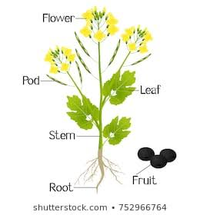
Fruit
Siliqua or silicula
Achene like and one-seeded
Seed
Contains large embryo
Little or no endosperm
Cotyledons are oily

Slide 14
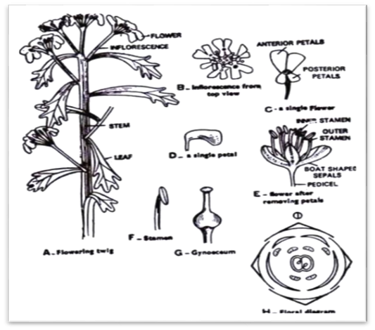

Slide 15
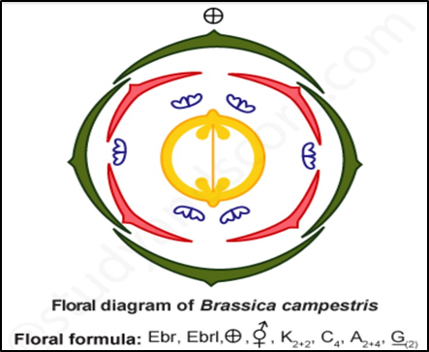
Floral formula

Slide 16
Important plants of Brassicaceae
Brassica campestris (Mustard)
Brassica alba (White mustard)
Brassica napus (Rape seed)
Brassica nigra (Black mustard)

Slide 17
Economic Importance
Food crops such as raddish, turnip etc use as vegetables.
Brassica compestris (sarson), B.napa (turnip) etc species are used for extraction of oils.
Seeds of Ibeis amara (candytuff) , Rorippa indica are used in asthema.
Some species of plants are used as ornamental plants in gardens such as Iberis amara etc.

