Slide 1
China Pakistan Economic Corridor: Prospects and Challenges for Regional Integration

Slide 2
Introduction
The China Pakistan Economic Corridor (hereafter CPEC) is the flagship of China’s One Belt One Road (OBOR) initiative
Envisioned by president Xi Jinping
In 2013
Objective: the economic integration of Eurasia through belts and roads and other infrastructure initiatives.
The OBOR is part of China’s grand strategy of its peaceful rise as a great power on the global stage through financial initiatives of $ 40 billion Silk Road Fund and the 57 members Asian Infrastructure Investment Bank
(AIIB) to generate new growth engines along the New Silk Road with a
win-win and cooperative approach.
Notes:
Win-win is a game which is designed in a way that all participants can profit it in one way or the other.

Slide 3
Introduction
The OBOR has two international trade connections namely the land based ‘Silk Road Economic Belt’ and oceangoing ‘21st –Century Maritime Silk Road’; the CPEC is the part of the former one.
With the former launch of CPEC between China and Pakistan in April 2015 by President Xi Jinping, the CPEC has got a status of “game changer” or “fate changer” and nationalistic fervor in the political, media and public discourses in Pakistan.
The multibillion dollar (US$ 46 bn) CPEC is a network of roads, railway tracks, oil and gas pipelines, fiber optics for communication, dams, ports, airports and economic zones linking the Western part of China to the Gawadar Port in Balochistan, Pakistan running some 3000 km from Xinjiang to Balochistan via Khunjerab Pass in the Northern Parts of Pakistan.
Notes:
Fervor: intense and passionate feeling, enthusiasm.
Xinjiang, an autonomous territory in northwest China

Slide 4
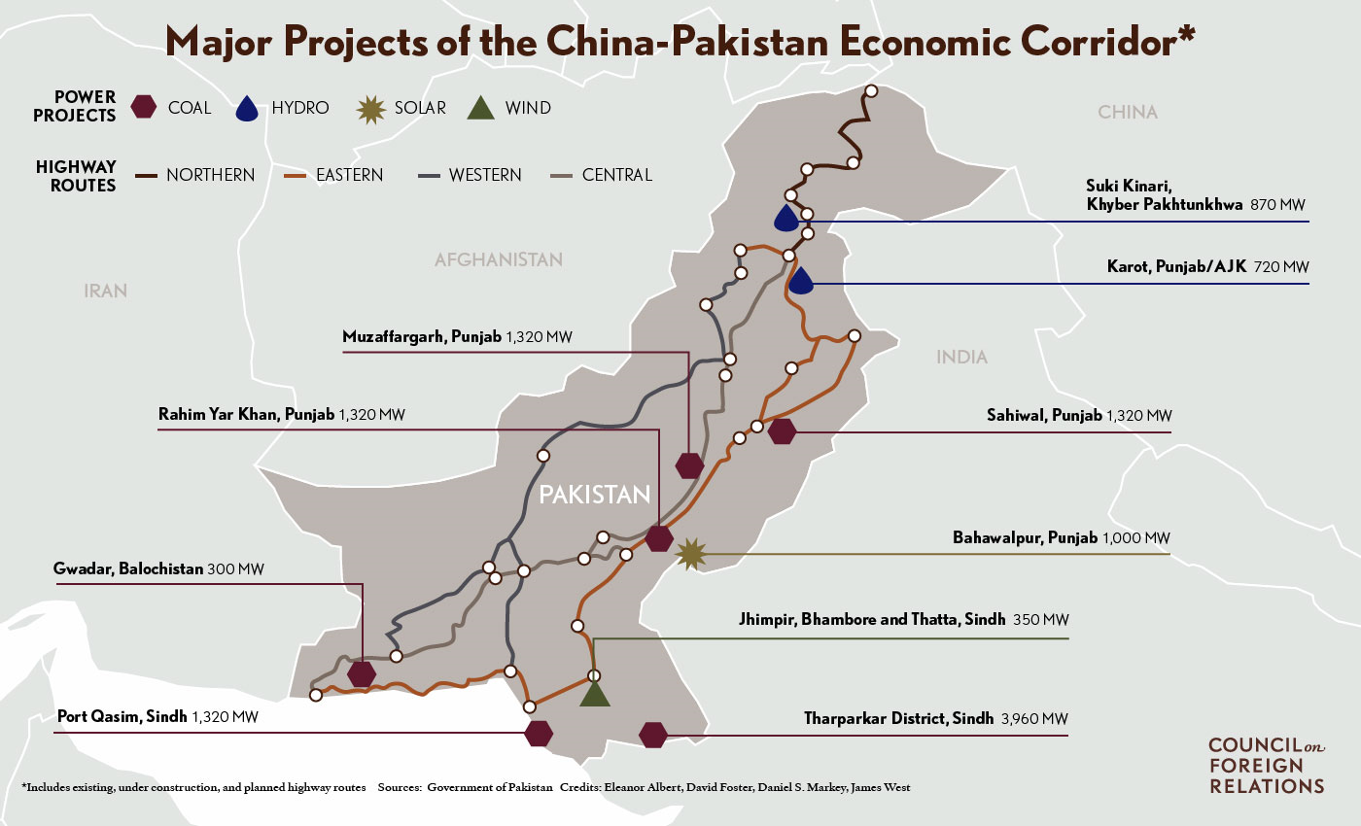

Slide 5
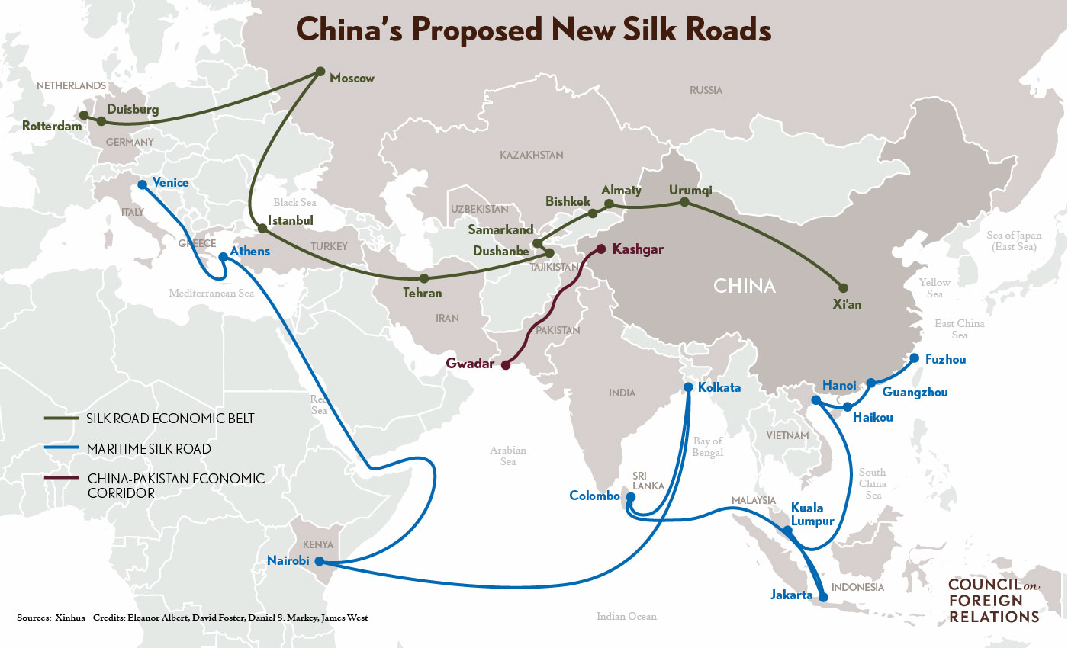

Slide 6
Introduction
The CPEC is strategically and economically important both for China and Pakistan.
It will pave the way for China to access the Middle East and Africa from Gawadar Port, enabling China to access the Indian Ocean and in return China will support development projects in Pakistan to overcome the latter’s energy crises and stabilizing its faltering economy.
Additionally, the CPEC could serve as the driver for trade and economic integration between China, Pakistan, Iran, India, Afghanistan and the Central Asian States provided the frosty political atmosphere between Pakistan, India and Afghanistan and to some extent Iran gets improved in the near future.
Under the CPEC US$ 10 billion will be spent on infrastructure development alone that could rejuvenate Pakistan’s shabby communication and infrastructure, overcome energy crisis and could transport trade goods from Pakistan to China, Middle East and cross the regional states and global level.
At this stage CPEC seems to be a bilateral initiative between China and Pakistan, however in the long run it has the prospects to be a multilateral project.
Notes:
Faltering: fluctuating, halting (hesitate, pause)
Frosty: unfriendly, inhospitable, unwelcoming.
Rejuvenate: revive, renew, regenerate, restore.

Slide 7
Regional Trade and Economic Integration
Geopolitically Pakistan is the most suitable economic corridor for trade and transit activities providing a gateway to Central Asia, South Asia, East Asia and West Asia.
It can act as an important economic geography for regional trade.
However, Pakistan failed miserably to take economic advantage of its strategic location and geography in the region.
The existing bilateral trade volume between China and Pakistan is miserably low.
The CPEC if extended to India will further enhance trade between China, India and Pakistan.
Inclusion of India to the CPEC will further enhance the bilateral trade between China and India to new heights.

Slide 8
Regional Trade and Economic Integration
The CPEC passing through the regions of China and Pakistan bordering many states could be extended to the countries Central Asia, Afghanistan and West Asia and India.
The landlocked and resource rich countries of Central Asia have always set their eyes to access regional markets including Pakistan, China, India and the countries of West Asia.
Both Afghanistan and Tajikistan have transit agreements; CPEC will provide them the opportunity to transport their goods and market them more competitively to the regional and global market fostering regional economic and trade connectivity.

Slide 9
Regional Trade and Economic Integration
Similarly, Pakistan has the desire to access the resource rich region of Central Asia via Afghanistan to meet its energy needs and transports goods to Central Asia.
The area through which the PCEC passes is at the crossroad of Asia, South Asian and Central Asia.
The changing geopolitical environment demands Pakistan to reorient its trade policy to more export oriented and must search for new markets in its neighborhood including India to boost its economy and the CPEC seems to be the best opportunity for Pakistan to expand its trade with the region of South and Central Asia including China and India.

Slide 10
Regional Trade and Economic Integration
India has had always desired to have transit route to Afghanistan and Central Asia via Pakistan. However, given the political rivalry between India and Pakistan, the later has denied transit route to India through Pakistan.
India as an alternative has focused on Chahbahr Port in Iran to access Afghanistan and Central Asia via Iran reducing its long lasting dependence on Pakistan to access Central Asia.
India, Iran and Afghanistan have recently inaugurated the Chabahar Port under the trilateral frame work signaling bypassing Pakistan for a regional trade connection between the three countries.
However, the Chahbahar Port is not likely to be a zero-sum game for Pakistan, Pakistan can also be part of Chabahar trilateral arrangement and both Gwadar and Chabahar ports could be linked as regional ports fostering regional trades.
The Iranian side has already offered Pakistan to be part of the Chabahar Port trilateral arrangement and not to consider the port as rival to Gwadar Port

Slide 11
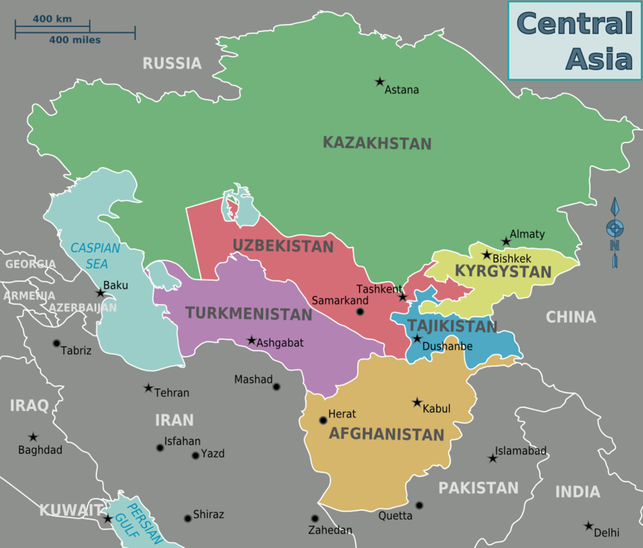
Central Asia

Slide 12
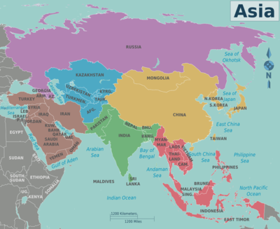
Asia

Slide 13
Can CPEC be Transformed into IICPEC?
To address this question one has to understand the recent geopolitical and economic developments in the region of South and Central Asia that could foster the regional environment to transform the CPEC into the IICPEC.
The TAPI (Turkmenistan, Afghanistan, Pakistan, and India) gas pipeline agreement signed in December 2015 between India, Pakistan, Turkmenistan and Afghanistan signifies the melting of the long existing cold attitude and trust deficit between India and Pakistan and Pakistan and Afghanistan.
The concept of TAPI was an old one but did not get materialize due to the political rivalry between the aforementioned states.
Under the TAPI framework, gas will be transported from Turkmenistan to Afghanistan to Pakistan and further to India.
The TAPI agreement is the harbinger that a similar arrangement can be formed to extend the CPEC to Afghanistan, Central Asia and India.
Notes:
Harbinger: indicator, sign.

Slide 14
Can CPEC be Transformed into IICPEC?
The CPEC seems to be an opportunity for India, Pakistan, Afghanistan and Central Asian States to have North South regional trade connectivity in addition to creating economic avenues for Pakistan.
Currently the anathema between India and Pakistan could prevent India to be part of the CPEC.
However, India’s inclusion to CPEC can be mutually beneficial move for regional cooperation and trust building that could ultimately be stimulating in resolving political disputes between India, China and Pakistan.
The joint security of the CPEC between China, Pakistan and India can usher a new economic beginning in the region and can bring the countries more closely.
China has already indicated that CPEC is not a bilateral move, rather a regional and cross regional move.
Notes:
Anathema: hateful, offensive.

Slide 15
Can CPEC be Transformed into IICPEC?
The connectivity between the Chabahr Port of Iran and the Gawadar Port and CPEC and Bangladesh China India Myanmar (BCIM) can foster a new economic and trade beginning between the South, West, Central and East Asia.
Iran has already shown its interest for such an arrangement between Gawadar Port and Chahbar Port.
The region of South Asia has remained the least integrated one in the world despite having potential for accelerating economic growth and is rich in natural resources yet faces the energy crises that affect its economy badly.

Slide 16
Challenges to CPEC
Regional and Internal Security Challenges
Regional security could be the biggest issue to the CPEC as it passes through some of the areas facing the biggest security challenges.
The biggest challenged to the CPEC is the regional security environment; specifically the Afghanistan conundrum.
China’s huge investment in the region is hinged on the peace and stability both in Pakistan, Afghanistan and Western parts of China.
This is why China is actively pursuing to bring the Taliban to negotiating table within the quadrilateral framework between China, Pakistan, US and Afghanistan.
The security situation in Afghanistan is getting worse day by day and even could be devastating after the withdrawal of NATO forces from Afghanistan as the Taliban have refused to come to the negotiating table initiated by the quadrilateral forum among China, Pakistan, Afghanistan and USA.
Notes:
Conundrum: difficulty, dilemma

Slide 17
Challenges to CPEC
2. Balochistan Conundrum
The long existing insurgency in Balochistan can pose constrains to the execution of CPEC and its related projects including the Gawadar Port.
The rising insurgency in Balochistan is a challenge to the CPEC as well as to the federation of Pakistan and resolving it is imperative for the secure trade corridor between China and Pakistan.
Lately, many non-locals, businesses and multinational companies’ personnel have come under attack in the restive Balochistan region.
A debate is already going on in the indigenous populace of Balochistan that the CPEC will benefit only the Chinese interest and could convert the local population into a minority.
Such feelings of deprivation coupled with foreign involvement in the province as has been claimed by Pakistan recently, can be a serious challenge to CPEC.
Addressing the concerns of Baloch people is imperative for the success of the CPEC and that could be done through a sane policy of integrating the least integrated Balochistan and its people in the political process of Pakistan.
The political and economic deprivation is one of the major causes of uprising in Balochistan and meeting these deprivations is pertinent for the peace in Balochistan.
Notes:
Insurgency: active revolt

Slide 18
Challenges to CPEC
2. Balochistan Conundrum (Cont…)
The CPEC will also pass through some parts of FATA and in future the extension of CPEC to Afghanistan is linked with the stability in the FATA region of Pakistan.
Therefore security of Gawadar and the whole region is a serious concern for China and its interests in Balochistan. In addition to Balochistan issue, the people of Gilgit Balistan are also demanding their part in the CPEC.
The region has recently witnessed protests and strikes demanding political and economic rights including a fair share in the CPEC as it is the entry point of CPEC.

Slide 19
Challenges to CPEC
3. Political Discontent in Pakistan
The political controversy among various political parties is yet another challenge to overcome for the smooth functioning of the CPEC in Pakistan.
The discontentment is mainly for route selection, dividends and allocations of funds for projects under the CPEC.
Although the ruling regime through the APCs (All Party Conferences) has tried to ally the grievances of the provinces mainly of KPK and Balochistan, yet it seems the issue has not been resolved.
The political differences over the CPEC among various political parties are deep rooted in the history of political economy of Pakistan where the allocation of resources has always been politicized for political gains.
The smaller provinces have concerns over the policies of the federal government where the resources including the federal budget are allocated on the bases of population rather than the backwardness and poverty conditions in the respective federating units.
Given the magnitude and scope of the CPEC, Pakistan needs more highly skilled labor to execute various projects of the CPEC.
The existing labor skills are not enough to pursue the CPEC and its related projects in Pakistan.

Slide 20
Challenges to CPEC
3. Political Discontent in Pakistan
The issues pertaining to transparency about CPEC related projects are also on rise.
The political parties and other stakeholders have shown their concerns over the lack of transparency and have demanded that all agreements related to CPEC be made public.
However, the concerned ministries are reluctant to make it public which further increases the doubts about the transparency of the project

