Slide 1


By
Dr. Zaryab Khalid
Class: BS Botany
Semester: 7th
Subject: Research Methodology

Slide 2


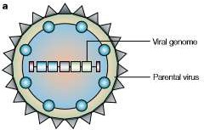
A vehicle (e.g. a plasmid) used to transfer the genetic material such as DNA sequences from the donor organism to the target cell of the recipient organism
Schematic diagram of a
generic viral vector

Slide 3
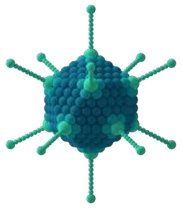
A viral vector is a virus which has been modified in a laboratory environment for purpose of introducing genetic material into a cell.
To form a viral vector, remove the genes in the virus that cause disease.
Then replace those genes with genes encoding the desired effect (for instance, insulin production in the case of diabetics)..
This procedure must be done in such a way that the genes which allow the virus to insert its genome into its host's genome are left intact

Slide 4
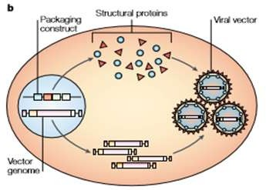
Converting a virus into a vector
A packaging (helper) construct, containing viral genes derived from the parental virus that encode structural proteins and proteins that are required for vector genome replication, is introduced into a packaging cell line along with a construct that contains the vector genome
The helper DNA can be delivered as a plasmid or helper virus, or it can be stably integrated into the chromatin of the packaging cell.

Slide 5
Pathogenicity functions and the sequences that are required for encapsidation are eliminated from the helper construct so that it cannot be packaged into a viral particle.
The vector genome contains the transgenic expression cassette and is flanked by inverted terminal repeats and cis acting sequences that are required for genome encapsidation.
Some vector genomes retain viral genes that are relatively inactive, as a result of the elimination of viral early genes that are required for their transcription.
Viral structural proteins and proteins that are required for replication of the vector DNA are expressed from the packaging construct and the replicated vector genomes are packaged into virus particles

Slide 6




















Reporter genes:
Origin of replication
Antibiotic resistance
Targeting
sequence
Promoter
Cloning site
Protein purification tags
Genetic markers
Epitope
6

Slide 7






Origin of replication
for replication and maintenance of vector in host cell.
to drive transcription of vector's transgene
Also to drive transcription of other genes in vector such as the antibiotic resistance gene
Promoter
Cloning site
allow for the insertion of foreign DNA into the vector through ligation
7

Slide 8






Reporter genes:
that allow for identification of plasmid that contains inserted DNA sequence.
Targeting sequence
that directs the expressed protein to a specific organelle in the cell or specific location
Protein purification tags
Some expression vectors include proteins or peptide sequences that allows for easier purification of expressed protein.
8

Slide 9





allow for survival of cells that have taken up the vector in growth media containing antibiotics through antibiotic selection.
Antibiotic resistance
allows for antibody identification of cells expressing the target protein.
Epitope
Genetic
markers
allow for confirmation that the vector has integrated with the host genomic DNA.
9

Slide 10
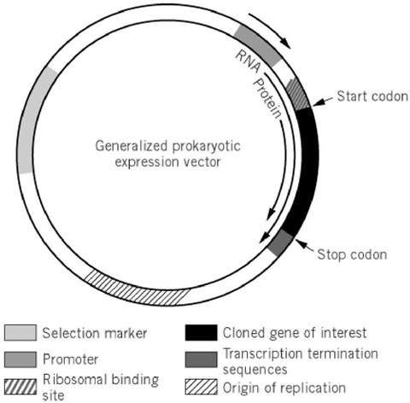
Vectors perform their functions in two ways mostly:
Transcription:
Expression:
there are two types of expression vector:
  Prokaryotes expression vector
  Eukaryotes expression vector
Prokaryotes expression vector:
Promoter
Ribosome Binding Site (RBS)
Translation initiation site

Slide 11
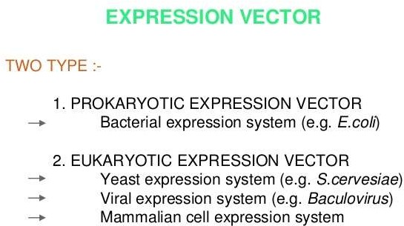

Slide 12
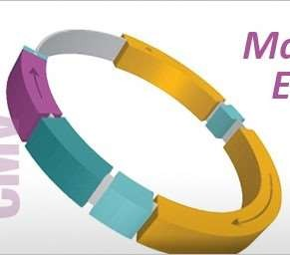
Eukaryotes expression vectors:
These require sequences that encode for:
Polyadenylation tail
Minimal UTR length
Kozak sequence
Viruses are highly evolved natural vectors for the transfer of foreign genetic information into cells.
But to improve safety, they need to be replication defective.
So the viruses can be used as vehicles to carry 'good' genes into a human cell.

Slide 13






Key properties for a viral vector
Safety
Cell type specificity
Low toxicity
Stability
Identification
1/7/2017
13

Slide 14

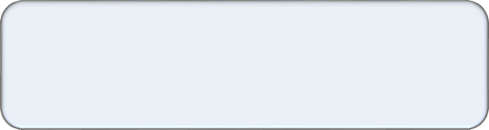


Viral vector should be modified in such a way as to minimize the risk of handling them.
Usually involves the deletion of a part of the viral genome critical for viral replication
Safety
viral vector should have a minimal effect on the physiology of the cell it infects.
Low toxicity
Some viruses are genetically unstable & can rapidly rearrange their genomes.
This is detrimental to predictability and reproducibility of work conducted using a viral vector and is avoided in their design.
Stability
1/7/2017
14

Slide 15




Most viral vectors are engineered to infect as wide a range of cell types as possible.
viral receptor can be modified to target the virus to a specific kind of cell. Viruses modified in this manner are said to be pseudo typed.
Cell type specificity
Viral vectors are often given certain genes that help identify which cells took up the viral genes. These genes are called Markers
Identification
1/7/2017
15

Slide 16
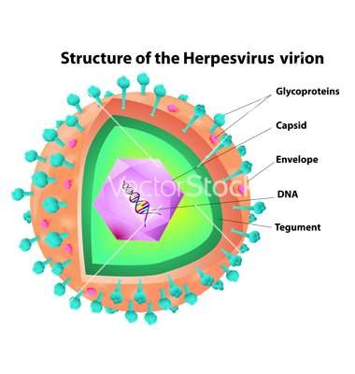
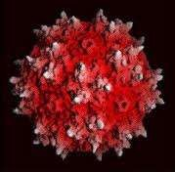
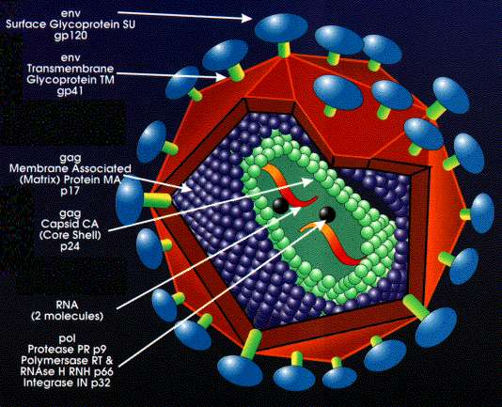
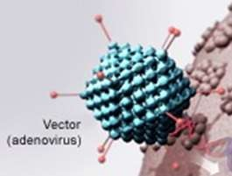
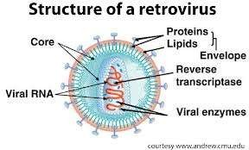
What are main types of viral vectors?
DNA viral vectors
Adenovirus
Adeno-Associated virus (AAV)
Herpes virus
RNA viral vectors
Lentivirus
Retrovirus
1/7/2017
16

Slide 17
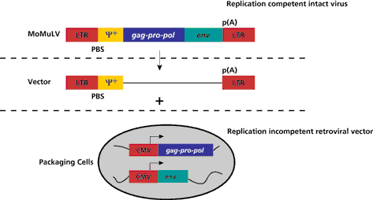
Retroviral Vectors
Retroviral vectors are commonly used and known to integrate into the genome of the infected cell in a stable and permanent fashion.
Reverse transcriptase in the virus allows integration into the host genome.
There are two types of retroviral vectors:
replication-competent and
replication defective.
Usually replication-defective vectors are preferred in practice as they allow for several rounds of replication due to their coding regions.

Slide 18
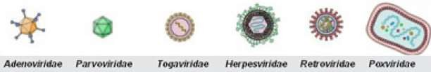
Applications;
Cancer- transfer suppressor gene
Immunology-Transduce haemotopoietic stemcell(HSC)
Stem cell biology -Transfer Human stemcell
Main applications of viral vectors
  In Gene therapy
In vaccines production:
1/7/2017 ₂₂

Slide 19
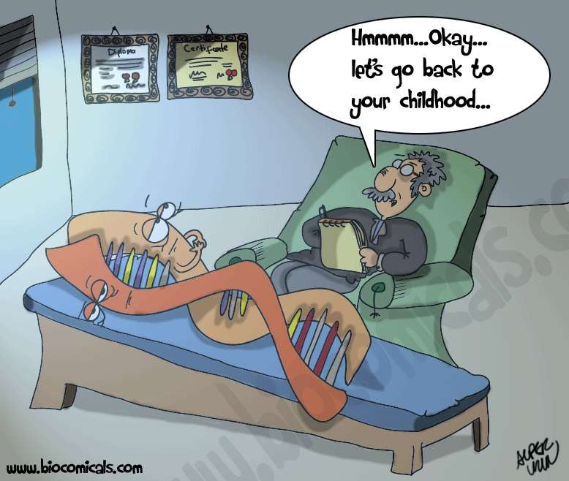
In Gene therapy:
Gene therapy is a technique for correcting defective genes responsible for disease development.
There are following delivery system for gene therapy:
  Physical methods
  Non-viral vectors
  Viral vectors
Virus is usually “crippled” to disable its ability to cause disease and viral methods have proved to be the most efficient to date
1/7/2017
23

Slide 20
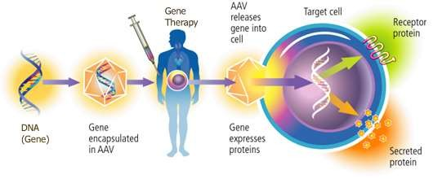
In Gene therapy:
If the pathogenicity of a specific virus, such as adenovirus, can be eliminated while the efficiency of gene transfer and expression is retained, the gene may be well suited for gene therapy.
25

Slide 21
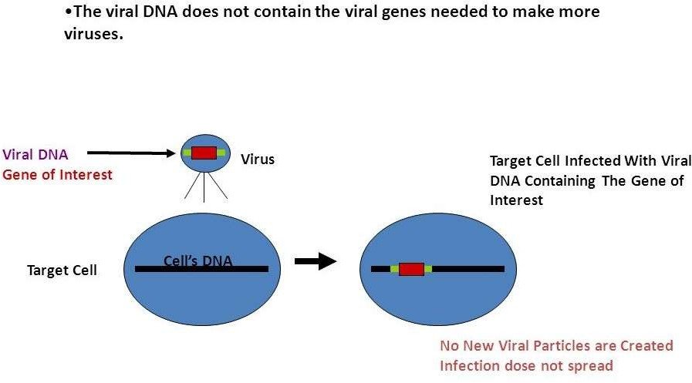

Slide 22

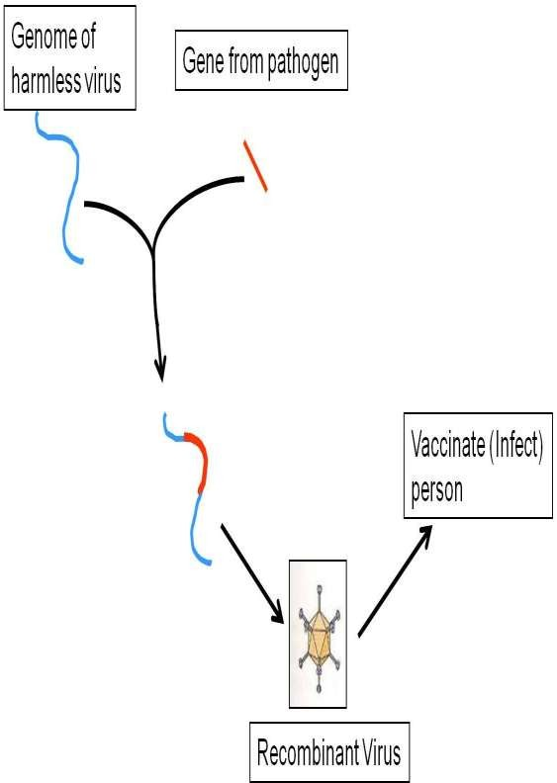
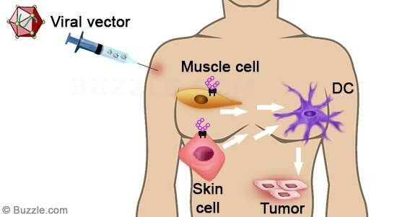

Slide 23
In vaccines production:
Viruses expressing pathogen proteins are currently being developed as vaccines against these pathogens, based on the same rationale as DNA vaccines.
T-lymphocytes recognize cells infected with intracellular parasites
based on the foreign proteins produced within the cell.
A viral vaccine induces expression of pathogen proteins within host cells. Since viral vaccines contain only a small fraction of pathogen genes, they are much safer and sporadic infection by the pathogen is impossible.
Adenoviruses are being actively developed as vaccines.
28

Slide 24
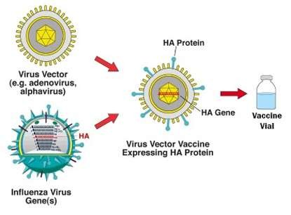
This vaccine approach involves:
inserting influenza virus genes into a different carrier virus, or vector, that is used as a vaccine.
DNA or RNA-encoding influenza proteins, such as hemagglutinin, are
engineered into a vector that infects humans but does not cause disease.
1/7/2017
29

Slide 25

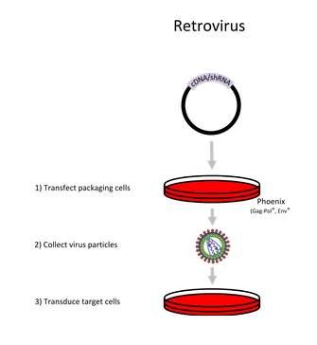
Retroviral mediated gene transfer:
Transfection of
packaging cell line
Virus Collection
Transduction in
target cells
33

Slide 26
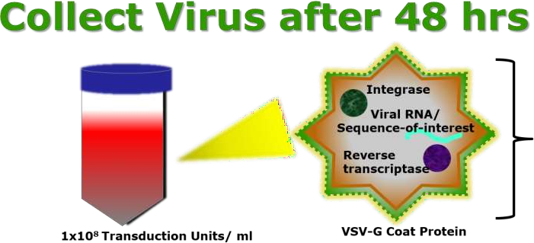
2-Virus Collection
The packaging cells produce infectious particles, whose genome only encodes sequences from the transfer plasmid, which can be used to transduce the target cells.
The highest concentration of virus is typically produced between 48-72 hours.
To collect the virus, remove the supernatant from the packaging cell line.
The purified virus containing the desired gene can be stored at -80 °C until needed.
1/7/2017
35

Slide 27
3-Transduction in target cells
Viral Envelope glycoprotein interacts with the cellular receptor and enters the actively dividing cells.
The viral dsDNA of retroviruses is not capable of passing through the nuclear pore complex and requires breakdown of the nuclear membrane during mitosis for integration of nucleic acid.
The viral genome enters the nucleus and desired gene sequence is integrated into the host genome through the activity of restriction enzymes and Integrase while the other portion of viral genome is self inactivated and replication defective.
Some transfer vectors also contain a marker such as a fluorescent reporter or drug selection marker for the selection of transduced cells.
36

Slide 28
