Slide 1
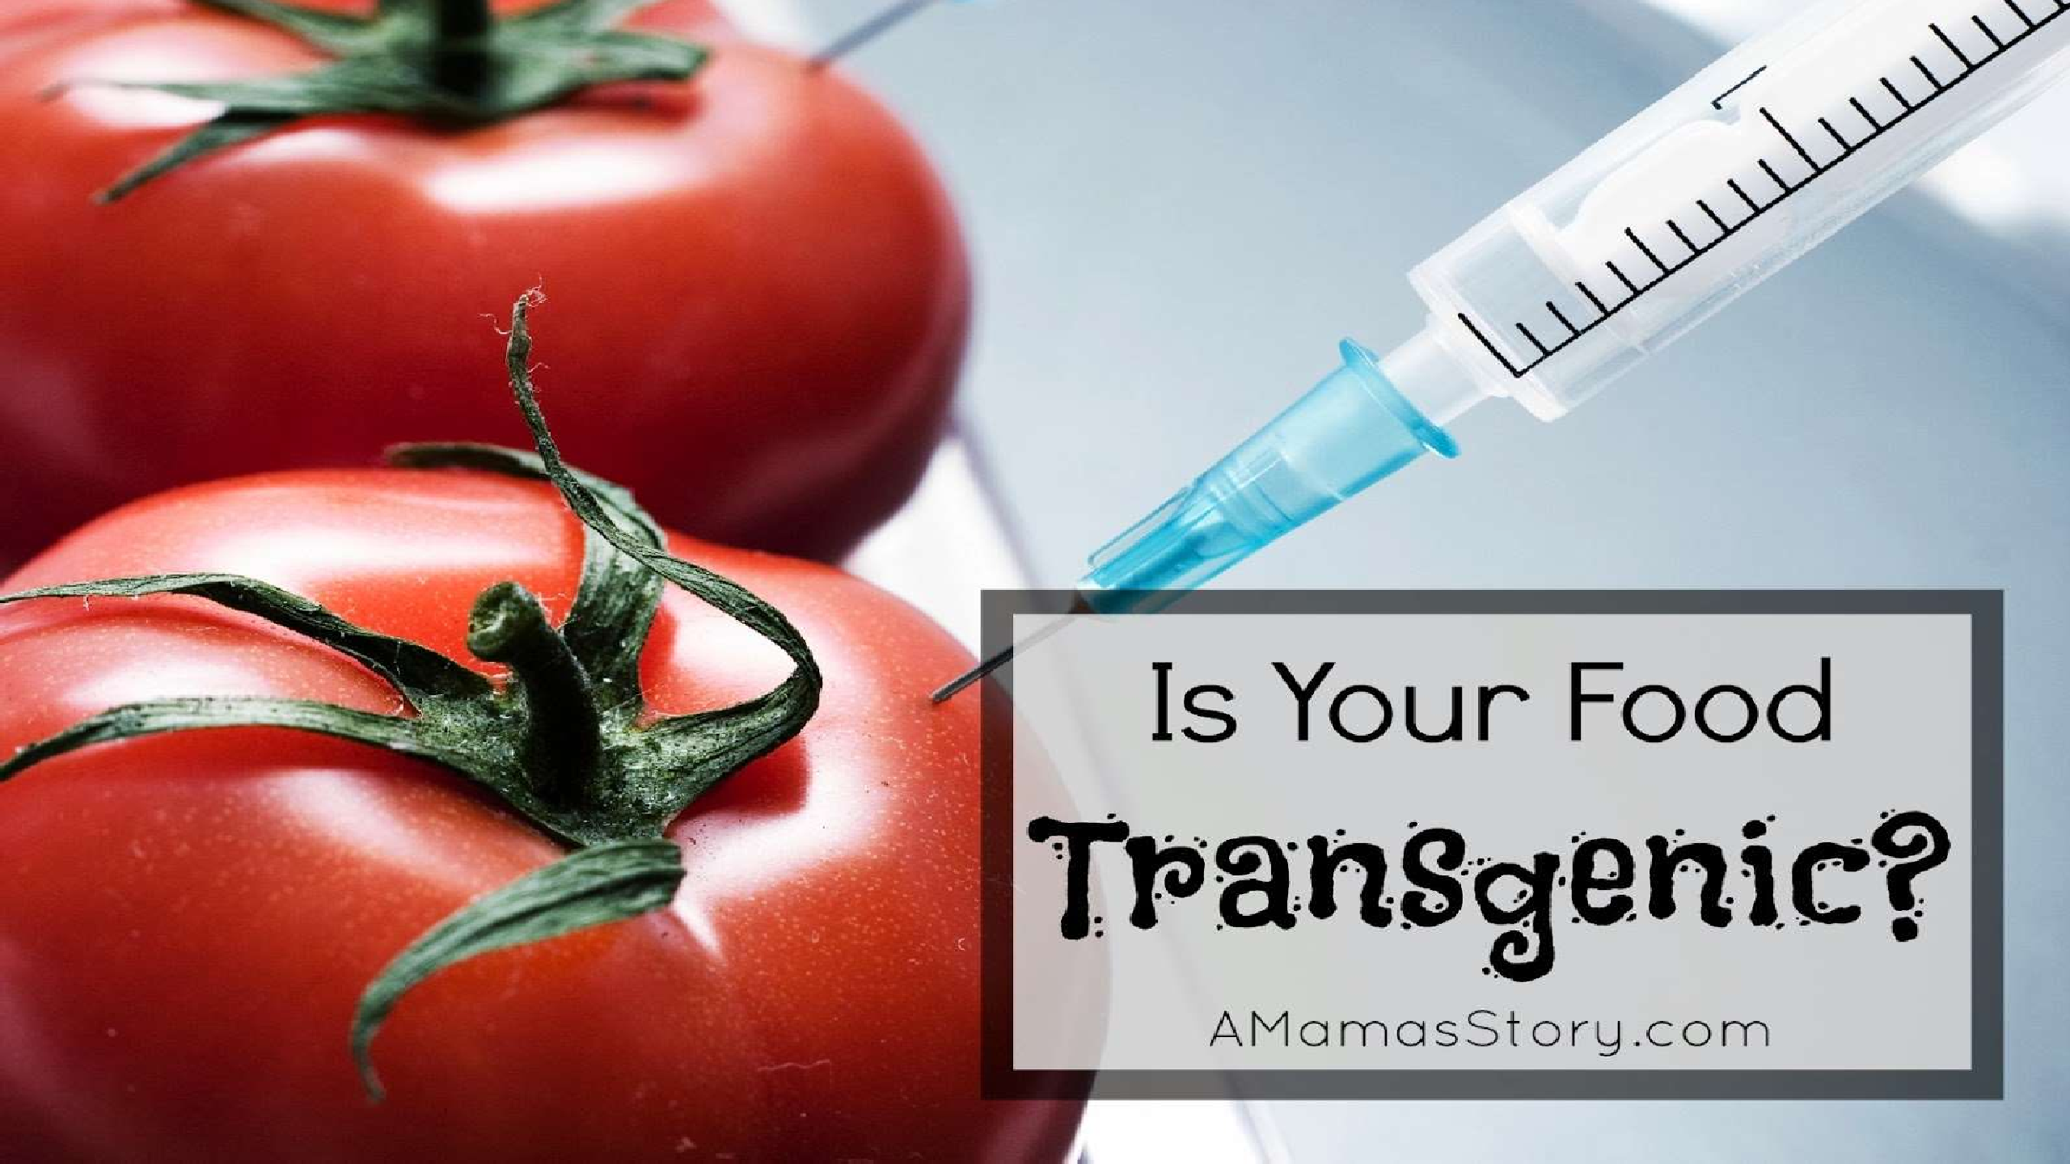
1

Slide 2
TRANSGENIC PLANTS
By
Dr. Zaryab Khalid
Class: BS Botany
Semester: 7th
Subject: Research Methodology

Slide 3



















TRANSGENESIS:-is the process of introducing an Exogenous gene called a Transgene into a living organism, so that the organism will exhibit a new property and transmit that property to its offspring.
HISTORY
In 1983 the first genetically engineered plant - Michael W Bevan, Richard B Flavell and Mary Dell Chilton.
They infected tobacco with Agrobacterium transformed, with an antibiotic resistance gene and through tissue culture techniques were able to grow a new plant containing the resistance gene.
In 2000, vitamin A-enriched golden rice, was the first plant
developed with increased nutrient value.
3

Slide 4


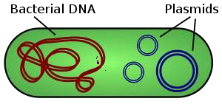

TRANSGENIC PLANTS: Genetically modified plants in which foreign/source genes have been introduced/inserted into desired/targeted plants
Generation of transgenic plants are referred as Transformation (i.e., uptake of foreign DNA by plant cells.) and this technique is known as Transformation technique
It is also known as genetic engineering or genetic modification
3 STEPS OF GENETIC ENGINEERING
  Isolation of gene
  Finding a vector
  Placing the vector
Digesting DNA by means of Restriction Endonuclease and clone those genes. Isolate m-RNA &
carryout m-RNA directed DNA synthesis through reverse transcriptase (c-DNA) Binary vector- plasmid
4

Slide 5

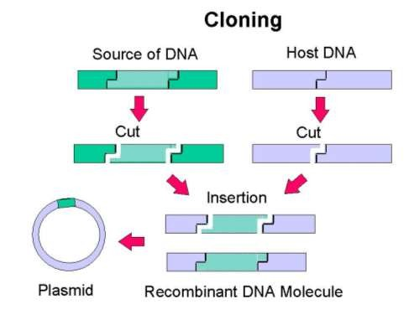
Inserting the DNA into the vector-open plasmid and then introduce the foreign DNA and now plasmid is ready for introduction into the host cell
5

Slide 6
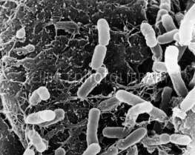

TRANSFORMATION TECHNIQUE
AGROBACTERIUM MEDIATED GENE TRANSFER (INDIRECT)
DIRECT GENE TRANSFER
Used for engineering DICOTS
For MONOCOT 2 methods are used
Chemical
Physical
Micro/Macro injection
Biolistics
6
Electroporation

Slide 7
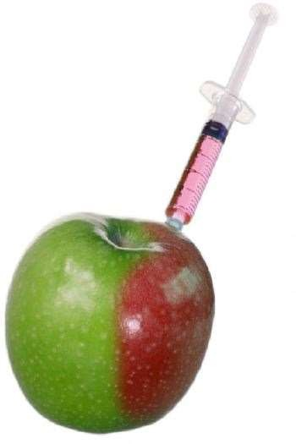


Or the methods used for producing transgenic plants can be categorized as……………
I. INDIRECT
a) BIOLOGICAL
Agrobacterium mediated Virus mediated
II. DIRECT
PHYSICAL
Gene gun/biolistics
Micro/Macro injection Electrophoresis Pressure
Laser mediated Using pollen tubes
Silica/ carbon fibers (fiber mediated DNA delivery)
CHEMICAL
Artificial lipids (lipofection)
PEG
Proteins Dendrimers Dextran
7

Slide 8





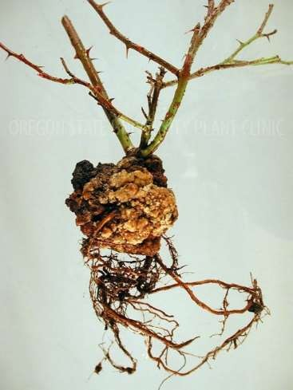
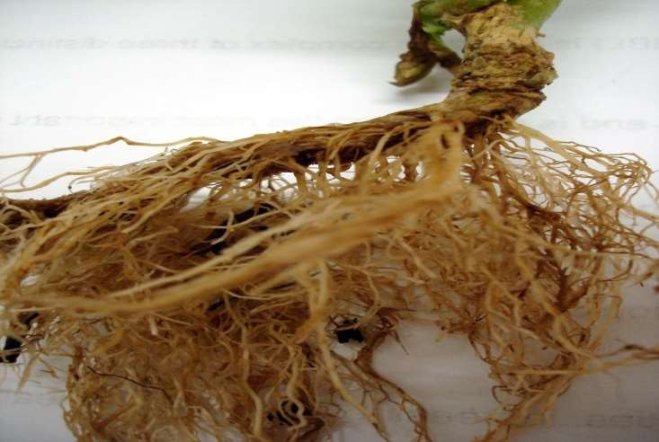
TRANSFORMATION TECHNIQUE
I. INDIRECT GENE TRANSFER
a) USE OF AGROBACTERIUM SPECIES
Agrobacterium-a self styled natural genetic engineer
A. Tumeifaciens , A. Righogenes & A. vitis are 3 gram negative soil bacteria often found near the soil level
A. Tumeifaciens : causes crown gal disease A. Righogenes : cause hairy root disease
8

Slide 9
Agrobacterium-mediated T-DNA transfer is widely used as a tool in Biotechnology.
Agrobacterium mediated transformation is the easiest and most simple plant transformation.
It contain Ti and Ri plasmid
It has an ability to integrate new genetic material called as T- DNA into plants
Foreign gene used for inserting into the Ti-plasmid has similar function to the already present gene but with different DNA
sequences.
9

Slide 10





Ti-PLASMID(pTi)
Plasmid is a small DNA molecule within a cell-Replicate independently
Ti plasmid –Tumour inducing plasmid of Agrobacterium tumefaciens/A.species which aids in the development of modified plants
The Ti plasmid is lost when Agrobacterium is grown above 28 °C -such cured bacteria do not induce crown galls-become avirulent
Size of the plasmid: ~25K bp &it has 196 genes that code for 195 proteins.
10

Slide 11
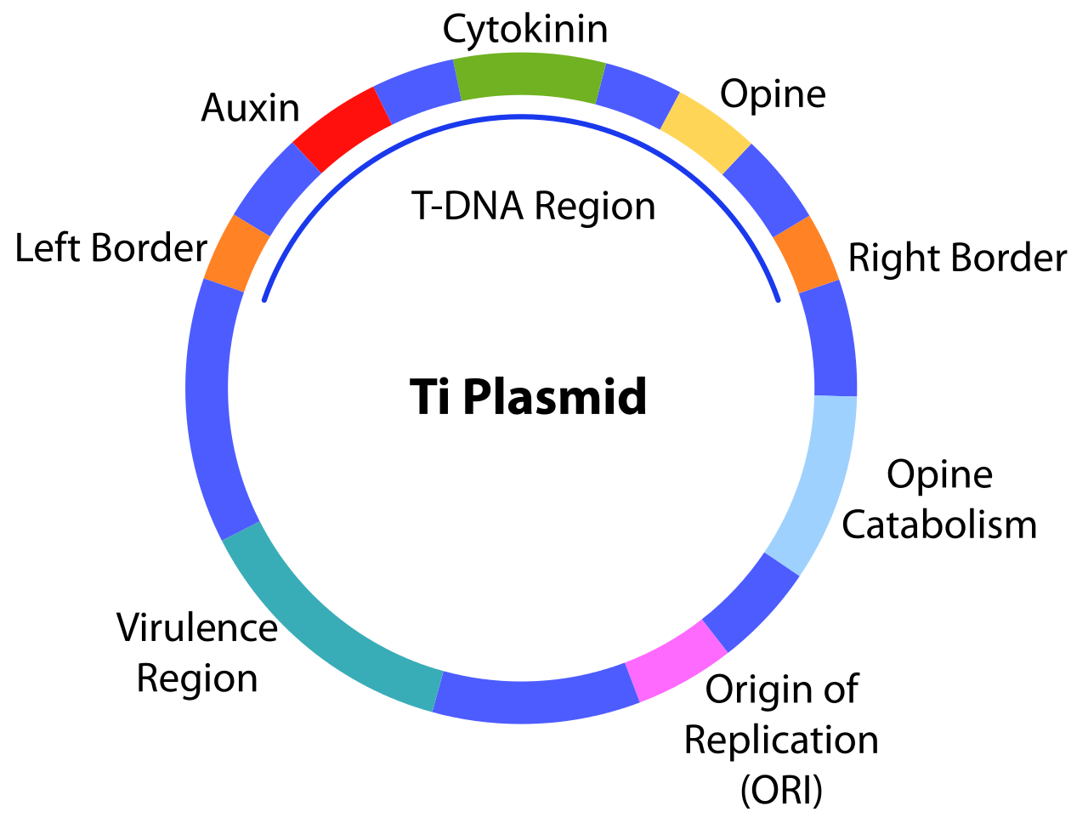
11

Slide 12



pTi is a circular DNA, contains;
T-DNA (has gene for phytohormones)
Virulence region (has gene for T-DNA transfer)
Origin of replication
Opine catabolism (has gene for opine utilization)
T-DNA
Is the transferred DNA of the tumor-inducing (pTi) plasmid of some species of
Agrobacterium
This T-DNA is responsible for crown gall formation in plants
The T-DNA is bordered by 25-base-pair repeats on each end. Transfer is initiated at the right border and terminated at the left border and requires the vir genes of the Ti
plasmid
12

Slide 13
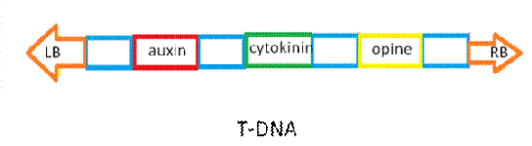
The bacterial T-DNA is about 24,000 base pairs long and contains genes that code for enzymes synthesizing opines and phytohormones.
Auxin & cytokinin gene induces cell division & proliferation
Opine synthesize opine-amino acid
LB &RB are required for transfer
13

Slide 14
VIR REGION
Transfer the T-DNA to plants
Acetosyringone(AS) –flavonoid released by wounded plant cells, activate vir genes.
Vir region organized into 8 operons- vir A-H
Has approximately 25 genes
OPINES
Derivatives of amino acid synthesized by T-DNA
pTi are categorized based on the type of opine produced by their genes-
octopine, nopaline, agropine, succinamopine and leucinopine
14

Slide 15
LEFT & RIGHT BORDER SEQUENCE
Required for T-DNA integration
RB enable LB to produce single stranded DNA PROCEDURE
Plant tissue (often leaves) are cut into small pieces, e.g. 10x10mm, and soaked for 10 minutes in a fluid containing suspended Agrobacterium.
The bacteria will attach to many of the plant cells exposed by the cut.
15

Slide 16
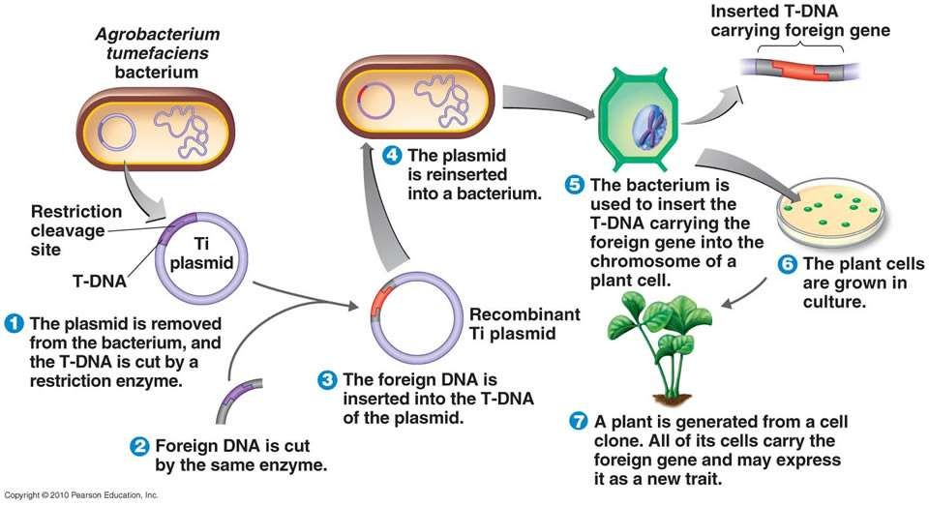
16

Slide 17
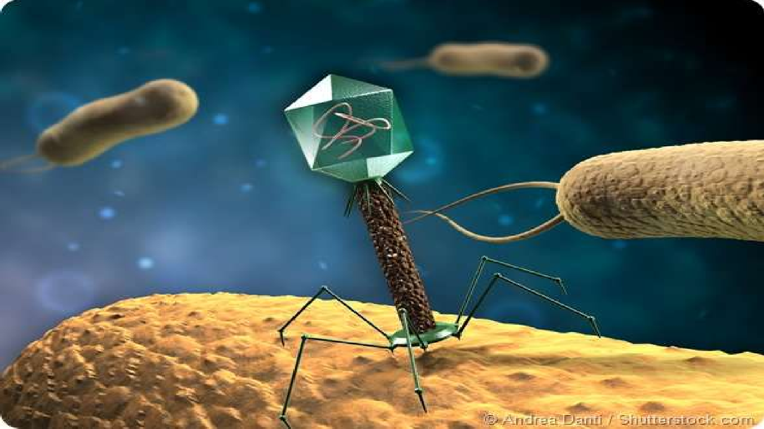



b) VIRAL TRANSFORMATION
Viral transformation is the change in growth, phenotype, or indefinite reproduction of cells caused by the introduction of inheritable material.
Through this process, a virus causes harmful transformations of an in vivo cell or cell culture. The term can also be understood as DNA transfection USING A VIRAL VECTOR
In order for a cell to be transformed by a virus, the viral DNA must be entered into the host cell. The simplest consideration/ e.g; is viral transformation of a bacterial cell. This process is called lysogeny.
A bacteriophage(Entero bacteriophage/lambda phage) lands on a cell and pins itself to the cell. The phage can then penetrate the cell membrane and inject the viral DNA into the host cell.
The viral DNA can then either lay dormant until stimulated by a source¹s⁷uch as UV light

Slide 18
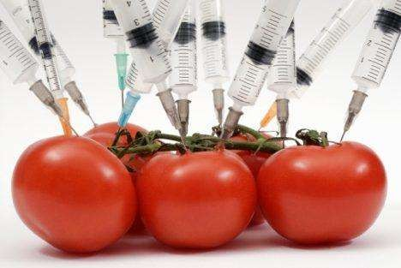
II. DIRECT GENE TRANSFER
Is a Vector less DNA transfer systems
Naked DNA is introduced into the plant/animal cells
DNA can be introduced by the following methods;
  Chemical
  Microinjection
  Electroporation
  Particle bombardment (Biolistic)
a) Chemical-induced transformation
Usually one cell lacking walls are used
Protoplast are incubated with a solution of DNA and PEG (in case of PEG mediated transfer)
Catechol was the most potent, inducing transformation at concentrations of 1–₁₈30 μm, followed by hydroquinone (3–30 μm), phenol (10–100 μm) and benzene (only at 100 μm)

Slide 19
b) Micro injection
Introduction of cloned genes into plant cells by means of very fine needles or glass micropipettes,(dia:0.5-10μm).
The microinjection technique is a direct physical approach, and therefore host- range independent, for introducing substances under microscopical control into defined cells without damaging them.
Is a limited technique only one cell can be injected at a time
these two facts differentiate this technique from other physical approaches, such as biolistic transformation and macroinjection
different parameters affecting the DNA transfer via microinjection, such as the
nature of microinjected DNA, and cell cycle stage, etc.,
19

Slide 20
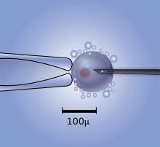
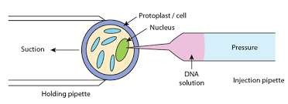
Advantages
Frequent stable integration of DNA is far better when compared to other methods
Method is effective in transforming primary cells as well as cells in established cultures
The DNA injected in this process is subjected to less extensive modifications
Mere precise integration of recombinant gene in limited copy no. can be obtained
20

Slide 21

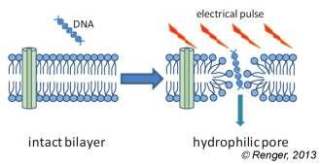
c) Electroporation
Uses electrical pulses (high intensity electric field) to produce transient pores in the plasma membrane (destabilizes the membrane) there by allowing DNA in to the cells
These pores are known as electro-pores
When the electric field is turned off, the pores in the membrane reseal, enclosing the DNA inside.
Advantages
Easy to perform
High efficiency
Don’t alter biological structures/ cell functions
Can be used for wide range of cell type
Disadvantages
Cell mortality (if using sub-optimal conditions)
21

Slide 22
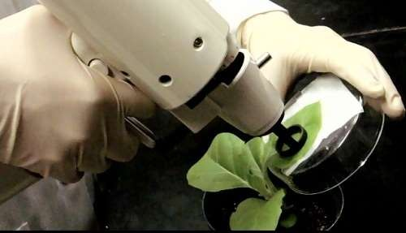
d) Gene Gun Method
A biolistic particle delivery system, originally designed for plant transformation,
Device for delivering exogenous DNA (transgenes) to cells
It was invented and used by John C Sanford, Ed Wolf and Nelson Allen at Cornell university, and Ted Klein of Dupont, between 1983 and 1986, to transform epidermal cells of Allium cepa.
This method is mainly used for cereal transformation
22

Slide 23

APPLICATION
Herbicide resistance
Insect resistance
Virus resistance
Altered oil content
Delayed fruit ripening
Drought, cold, salinity resistance
Pollen control
Enhanced shelf life
Pharmaceutical & edible vaccines
Biotic & Abiotic stress tolerance
Nutritional quality
23

Slide 24
a. Bromoxynil Resistance
1. HERBICIDE RESISTANCE
A gene encoding the enzyme Bromoxynil nitrilase (BXN) is transferred from Klebsiella pneumoniae bacteria to plants.
Nitrilase inactivates the bromoxynil before it kills the plant.
Sulfonylurea
  Kills plants by blocking an enzyme needed for synthesis of the amino acids valine, leucine, and isoleucine.
  Resistance generated by mutating a gene in tobacco plants, and transferring the mutated
gene into crop plants.
INSECT RESISTANCE
  The Bt toxin isolated from Bacillus thuringiensis has been used in plants. The gene has been placed in corn, cotton, and potato, and has been marketed.
  Alkaline protein degrades gut wall of lepidopteran larvae
    Corn borer catepillars
    Cotton bollworm catepillars
Tobacco hornworm catepillars
Gypsy moth larvae
Sprayed onto plants – but will wash off
24

Slide 25
3. VIRUS RESISTANCE
Chemicals are used to control the insect vectors of viruses, but controlling the disease itself is difficult because the disease spreads quickly.
Plants may be engineered with genes for resistance to viruses, bacteria, and fungi.
Virus-resistant plants have a viral protein coat gene that is overproduced, preventing the virus from reproducing in the host cell, because the plant shuts off the virus’ protein coat gene in response to the overproduction.
Coat protein genes are involved in resistance to diseases such as cucumber mosaic virus, tobacco rattle virus, and potato virus x.
ALTERED OIL CONTENT
  Oil content in plants are altered by modifying an enzyme in the fatty acid synthesis pathway (oils are lipids, which fatty acids are a part of).
  Varieties of canola and soybean plants have been genetically engineered to produce
oils with better cooking and nutritional properties.
  Genetically engineered plants may also be able to produce oils that are used in25 detergents, soaps, cosmetics, lubricants, and paints.

Slide 26
5. DELAYED FRUIT RIPENING
Allow for crops, such as tomatoes, to have a higher shelf life.
Tomatoes generally ripen and become soft during shipment to a store.
Tomatoes are usually picked and sprayed with the plant hormone ethylene to induce ripening, although this does not improve taste
Tomatoes have been engineered to produce less ethylene so they can develop more taste before
ripening, and shipment to markets.
POLLEN CONTROL
  Hybrid crops are created by crossing two distantly related varieties of the same crop plant.
  The method may generate plants with favorable traits, such as tall soybean plants that make more seeds and are resistant to environmental pressures.
  For success, plant pollination must be controlled. This is usually done by removing the male flower parts by hand before pollen is released. Also, sterilized plants have been genetically engineered with a gene from the bacteria Bacillus amyloliqueifaciens (barnase gene). This gene is dominant gene for male sterility
26

Slide 27

RISKS OF GMO/GMCs……..
Can be dangerous & cause allergies
E.g.. Soybean containing gene of brazil nut
Indirectly promote Antibiotic resistance (Resistance of microbes)
Weed shows herbicide resistance & resistance to viral disease
Change in chemistry of soil
Genetically engineered plant cross pollinate non- engineered plants
27

Slide 28
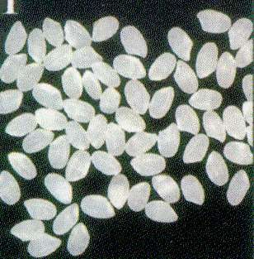
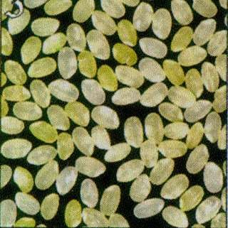
1. Soybeans.
EXAMPLES OF GM CROPS……….
Corn
Canola.
Cotton.
Papaya, rice,
Tomato,
Sugar beet, and
Red heart chicory.
Golden rice
Normal Rice
Transgenic technology produced a type of rice that accumulates beta-carotene in rice
grains. Once inside the body, beta-carotene is converted to vitamin A.
28
Golden Rice

Slide 29

29

