Slide 1
DATA COLLECTION PRIMARY & SECONDARY
By
Dr. Zaryab Khalid
Class: BS Botany
Semester: 7th
Subject: Research Methodology

Slide 2
INTRODUCTION
Data collection is a term used to describe a process of preparing and collecting data
Systematic gathering of data for a particular purpose from various
sources, that has been systematically observed, recorded, organized.
Data are the basic inputs to any decision making process in business

Slide 3
PURPOSE OF DATA COLLECTION
The purpose of data collection is-
to obtain information
to keep on record
to make decisions about important issues,
to pass information on to others

Slide 4
CLASSIFICATION OF DATA
TYPES
PRIMARY
DATA
SECONDARY DATA

Slide 5
PRIMARY DATA
The data which are collected from the field under the control and supervision of an investigator
Primary data means original data that has been collected specially for the purpose in mind
This type of data are generally afresh and collected for the first time
It is useful for current studies as well as for future studies
For example: your own questionnaire.

Slide 6
Primary Research Methods & Techniques
Primary Research
Quantitative Data
Qualitative Data
Surveys
Personal interview (intercepts)
Mail
In-house, self-
administered
Telephone, fax, e-mail, Web
Experiments
Focus groups
Mechanical observation
Individual depth interviews
Human
observation
Simulation
Case studies

Slide 7
Primary Research Methods & Techniques
Quantitative and Qualitative Information:
Quantitative – based on numbers – 56% of 18 year olds drink alcohol at least four times a week - doesn’t tell you why, when, how.
Qualitative – more detail – tells you why, when and how!

Slide 8
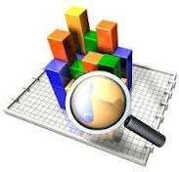
Primary Research Categories
Quantitative Research
Numerical
Statistically reliable
Projectable to a broader population

Slide 9
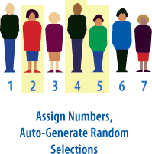
Quantitative Research Categories
Sampling Methods:
Random Samples – equal chance of anyone being picked
May select those not in the target group – indiscriminate
Sample sizes may need to be Large to be representative
Can be very expensive

Slide 10
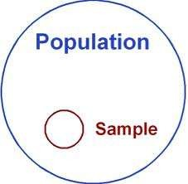
Quantitative Research Categories
Stratified or Segment Random Sampling
Samples on the basis of a representative strata or segment
Still random but more focussed
May give more relevant information
May be more cost effective

Slide 11
Quantitative Research Categories
Quota Sampling
Again – by segment
Not randomly selected
Specific number on each segment are interviewed, etc.
May not be fully representative
Cheaper method

Slide 12
Qualitative Research Categories
Qualitative Research
In-depth, insight generating
Non-numerical
‘Directional’
Common Techniques
Personal interviews (depth, one-on-one)
Focus groups (8-12) and mini-groups (3-
6)

Slide 13
METHODS
OBSERVATION METHOD
Through personal observation
PERSONAL INTERVIEW Through Questionnaire
TELEPHONE INTERVIEW
Through Call outcomes, Call timings
MAIL SURVEY
Through Mailed Questionnaire

Slide 14
SECONDARY DATA
Data gathered and recorded by someone else prior to and for a purpose other than the current project
Secondary data is data that has been collected for another purpose.
It involves less cost, time and effort
Secondary data is data that is being reused. Usually in a different context.
For example: data from a book.

Slide 15
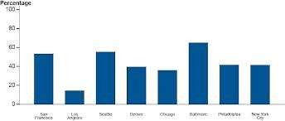
SOURCES
INTERNAL SOURCES
Internal sources of secondary data are usually for marketing application-
Sales Records
Marketing Activity
Cost Information
Distributor reports and feedback
Customer feedback

Slide 16
SOURCES
EXTERNAL SOURCES
External sources of secondary data are usually for Financial application-
Journals
Books
Magazines
Newspaper
Libraries
The Internet

Slide 17
Advantages & Disadvantages of Primary Data
Advantages
Targeted Issues are addressed
Data interpretation is better
Efficient Spending for Information
Decency of Data
Proprietary Issues
Addresses Specific Research Issues
Greater Control

Slide 18
Advantages & Disadvantages of Primary Data
Disadvantages
High Cost
Time Consuming
Inaccurate Feed-backs
More number of resources is required

Slide 19
Advantages & Disadvantages of Secondary Data
Advantages
Ease of Access
Low Cost to Acquire
Clarification of Research Question
May Answer Research Question

Slide 20
Disadvantages & Disadvantages of Secondary Data
Disadvantages
Quality of Research
Not Specific to Researcher’s Needs
Incomplete Information
Not Timely

Slide 21
Data Collection Flow

