Slide 1
Cytokinins: Regulators of Cell Division

Slide 2
INTRODUCTION
THE CYTOKININS WERE DISCOVERED in the search for factors that stimulate plant cells to divide (i.e., undergo cytokinesis). Since their discovery cytokinins have been shown to have effects on many other physiological and developmental processes, including leaf senescence, nutrient mobilization, apical dominance, the formation and activity of shoot apical meristems, floral development, the breaking of bud dormancy, and seed germination.
Cytokinins also appear to mediate many aspects of light-regulated development, including chloroplast differentiation, the development of autotrophic metabolism, and leaf and cotyledon expansion.
Although cytokinins regulate many cellular processes, the control of cell division is central in plant growth and development and is considered diagnostic for this class of plant growth regulators.

Slide 3
CELL DIVISION AND PLANT DEVELOPMENT
Plant cells form as the result of cell divisions in a primary or secondary meristem. Newly formed plant cells typically enlarge and differentiate but once they have assumed their function—whether transport, photosynthesis,
support, storage, or protection—usually they do not divide again during the life of the plant. In this respect they appear to be similar to animal cells, which are considered to be terminally differentiated. However, this similarity to the behavior of animal cells is only superficial.
Almost every type of plant cell that retains its nucleus at maturity has been shown to be capable of dividing. This property comes into play during such processes as wound healing and leaf abscission.
Differentiated Plant Cells Can Resume Division
Diffusible Factors May Control Cell Division
Plant Tissues and Organs Can Be Cultured

Slide 4
THE DISCOVERY, IDENTIFICATION, AND PROPERTIES OF CYTOKININS
A great many substances were tested in an effort to initiate and sustain the proliferation of normal stem tissues in culture. Materials ranging from yeast extract to tomato juice were found to have a positive effect, at least with some tissues.
However, culture growth was stimulated most dramatically when the liquid endosperm of coconut, also known as coconut milk, was added to the culture medium Philip White’s nutrient medium, supplemented with an auxin and 10 to 20% coconut milk, will support the continued cell division of mature, differentiated cells from a wide variety of tissues and species, leading to the formation of callus tissue (Caplin and Steward 1948). This finding indicated that coconut milk contains a substance or
substances that stimulate mature cells to enter and remain in the cell division cycle. Eventually coconut milk was shown to contain the cytokinin zeatin, but this finding was not obtained until several years after the discovery of the cytokinins (Letham 1974).
The first cytokinin to be discovered was the synthetic analog kinetin.

Slide 5
Kinetin Was Discovered as a Breakdown Product of DNA
In the 1940s and 1950s, Folke Skoog and coworkers at the University of Wisconsin tested many substances for their ability to initiate and sustain the proliferation of cultured tobacco pith tissue. They had observed that the nucleic acid base adenine had a slight promotive effect, so they tested the possibility that nucleic acids would stimulate division in this tissue. Surprisingly, autoclaved herring sperm DNA had a powerful cell division–promoting effect.
After much work, a small molecule was identified from the autoclaved DNA and named kinetin. It was shown to be an adenine (or aminopurine) derivative, 6-furfurylaminopurine

Slide 6
Natural and Synthetic Cytokinins
Zeatin Is the Most Abundant Natural Cytokinin

Slide 8
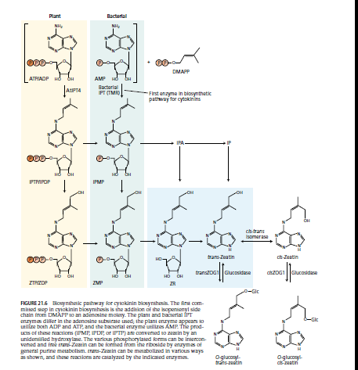
BIOSYNTHESIS, METABOLISM, AND TRANSPORT OF CYTOKININS

Slide 9
Cytokinins from the Root Are Transported to the Shoot via the Xylem
Root apical meristems are major sites of synthesis of the free cytokinins in whole plants. The cytokinins synthesized in roots appear to move through the xylem into the shoot, along with the water and minerals taken up by the roots.
Roots are not the only parts of the plant capable of synthesizing cytokinins. For example, young maize embryos synthesize cytokinins, as do young developing leaves, young fruits, and possibly many other tissues.

Slide 10
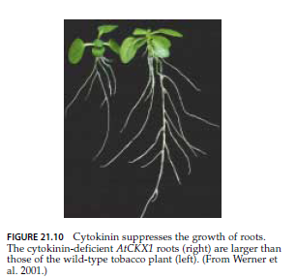
THE BIOLOGICAL ROLES OF CYTOKININS
Cytokinins Regulate Cell Division in Shoots and Roots
Cytokinins Regulate Specific Components of the Cell Cycle

Slide 11
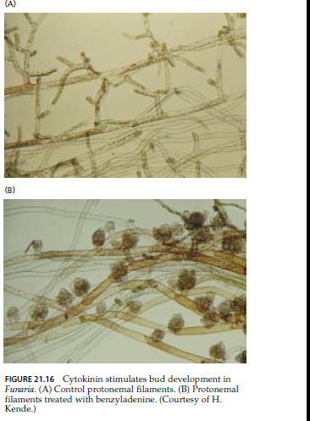

Slide 13
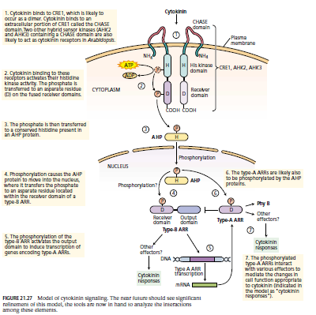
Signal Transduction

