Slide 1
Gene Mapping In Bacteria and Bacteriophages

Slide 2
Genetic Analysis of Bacteria
Bacteria transfer genetic material by three different processes. In all cases, transfer is unidirectional, and
no complete diploid stage is formed. The processes are:
  Conjugation.
  Transformation.
  Transduction.
Much of the study of genetic transfer has been done in E. coli. Some important features of this organism
are:
  It grows readily on defined medium that is either solid or liquid.
  It is easily manipulated using standard microbiology techniques.
  It can be titered by dilution and plating on solid medium.
Mutations in biosynthetic pathways are identified using minimal medium. The minimal medium for a particular species supports growth of wild-type cells (prototrophs), which are able to synthesize everything else needed from the precursors in the minimal medium.
  Auxotrophs are mutants that are unable to synthesize all needed nutrients. Auxotrophs thus do not grow on minimal medium.
  If the minimal medium is supplemented with the nutrient that the auxotroph is unable to synthesize, the auxotroph will be able to grow.
  For example, E. coli with the genotype trp ade thi⁺ will be unable to grow on minimal medium unless it is supplemented with tryptophan and adenine. It has the wild-type allele for thiamine and does not need supplementation of this vitamin.
Mutations also occur in utilization pathways, preventing the mutant from using various nutrients.
  For example, E. coli with the genotype lac⁺ will be able to use lactose as a carbon source, while a mutant strain (lac) cannot.
  Varying nutrients in media can detect such mutations.
To detect parental and progeny phenotypes in E. coli, colonies are tested for their growth requirements. Replica plating is useful, because otherwise it is difficult to recover bacteria whose phenotype is “no growth” on a particular medium.

Slide 3
Genetic Mapping in Bacteria by Conjugation
Conjugation requires direct contact between
cells for unidirectional transfer of genetic material.
  A segment of donor chromosome is transferred to the recipient, and may integrate into the recipient’s chromosome by homologous recombination.
b.The recipient is called a transconjugant.
Animation: Mapping Bacterial Genes by Conjugation

Slide 4
Discovery of Conjugation in E. coli
Lederberg and Tatum discovered conjugation (1946) using two E. coli
auxotrophic mutant strains:
  Strain A’s genotype was met bio thr⁺ leu⁺ thi⁺. It grows on minimal medium supplemented with methionine and biotin.
  Strain B’s genotype was met⁺ bio⁺ thr leu thi. It grows on minimal medium supplemented with threonine, leucine and thiamine.
  Strains A and B were mixed, and plated onto minimal medium. About 1/10⁶ cells produced colonies with the phenotype met⁺ bio⁺ thr⁺ leu⁺ thi⁺ (Figure 14.2).d.
so the new phenotype resulted from recombination. WHY???
Neither strain produced colonies when plated alone onto minimal medium,
Davis tested whether cell-to-cell contact was required: HOW???
  Strain A cells were placed on one side of a filter, and strain B on the other. Cells could not move through the filter but molecules moved freely, encouraged by alternating suction and pressure.
  No prototrophic colonies appeared when the cells were plated on minimal medium. This indicates that cell-to-cell contact is required, and the genetic recombination results from conjugation.

Slide 5
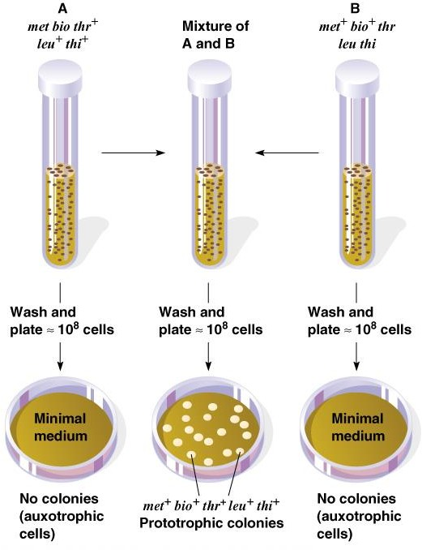
Fig. 14.2 Lederberg and Tatum experiment showing that sexual recombination occurs between cells of E. coli
Peter J. Russell, iGenetics: Copyright © Pearson Education, Inc., publishing as Benjamin Cummings.

Slide 6
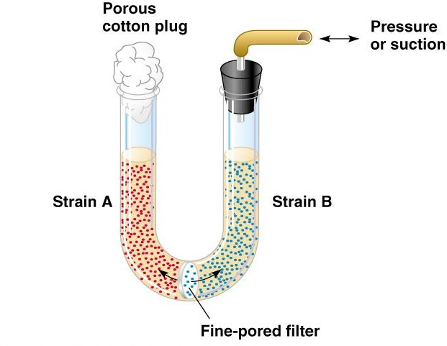
Fig. 14.3 Davis’s U-tube experiment
Peter J. Russell, iGenetics: Copyright © Pearson Education, Inc., publishing as Benjamin Cummings.

Slide 7
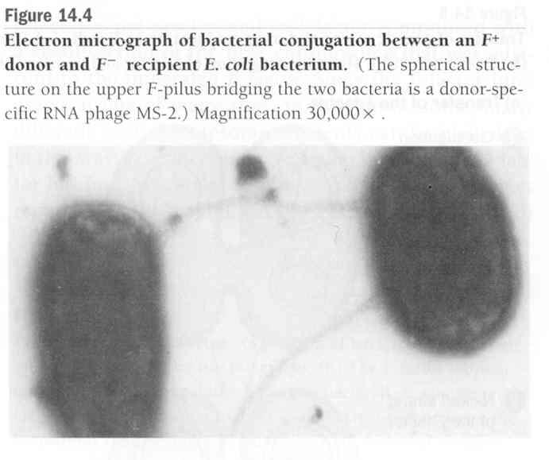
The Sex Factor F
Hayes (1953) showed that genetic transfer is unidirectional from donor to recipient, mediated by a donor sex factor called F. The donor is F⁺, and the recipient is F⁻.
  F is a plasmid with an origin of DNA transfer, and several genes, including
those for the F-pilus (plural F-pili).
  Conjugation occurs when F⁺ donor cells are mixed with F⁻ recipients. It does not occur between cells of the same mating type (Figure 14.4).
  Genetic transfer begins when one strand of the F plasmid is nicked at the origin, replication begins and a single strand of DNA is transferred to the recipient cell (Figure 14.5).
  The donor plasmid stays double-stranded due to replication. In the recipient a complementary strand is synthesized, making the transferred DNA double-stranded as well.
When DNA transfer is complete, both cells are F ⁺.
No chromosomal DNA is transferred.

Slide 8
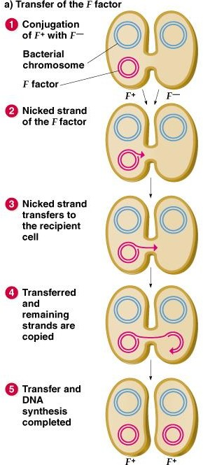
Fig. 14.5a Transfer of genetic material during conjugation in E. coli
Peter J. Russell, iGenetics: Copyright © Pearson Education, Inc., publishing as Benjamin Cummings.

Slide 9
High-Frequency Recombination Strains of E. coli
Chromosomal recombination involves F⁺ strains with the plasmid integrated into the bacterial chromosome. Known as Hfr (high frequency of recombination), these strains replicate the F plasmid as part of their chromosome.
Hfr cells can conjugate with F⁻ cells. The F DNA is nicked at its origin, and transfer moves some F sequences, and then chromosomal DNA.
Double crossover inserts the donor DNA into the recipient chromosome, and allelic recombination occurs.
In Hfr X F⁻ the recipient virtually never acquires the Hfr phenotype, because this would require transfer of the entire chromosome, taking about 100 minutes at 37°C. Mating pairs generally separate sooner due to Brownian motion.
In an F⁺ E. coli population, only 1/10⁴ will become Hfr by integration
of the F plasmid into the chromosome

Slide 10
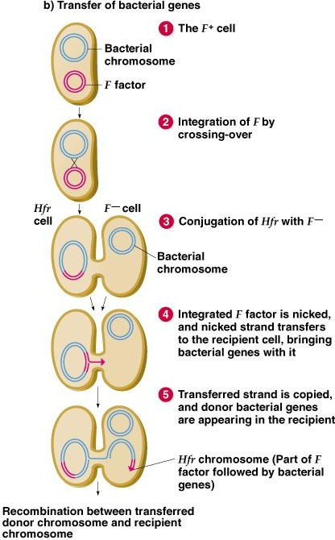
Fig. 14.5b Transfer of genetic material during conjugation in E. coli
Peter J. Russell, iGenetics: Copyright © Pearson Education, Inc., publishing as Benjamin Cummings.

Slide 11
Fʹ Factors
Excision of F from the chromosome also occurs spontaneously at low frequency.
If excision of F from the chromosome is not precise, a small section of host chromosome may be carried with the plasmid, creating an Fʹ (F-prime) plasmid.
An Fʹ plasmid is named for the gene(s) it carries, e.g., Fʹ (lac).
3. Fʹ cells can conjugate with F⁻ cells, and thus introduce the bacterial gene(s) it carries. The recipient already has a set of bacterial genes, and so will be merodiploid (partially diploid) for those that are introduced. This is F- duction (sometimes called sexduction).

Slide 12
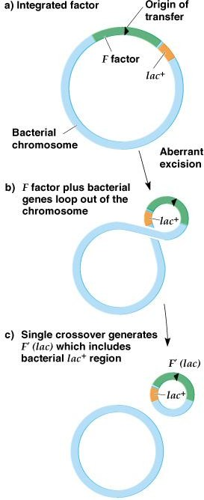
Fig. 14.6 Production of an F′ factor
Peter J. Russell, iGenetics: Copyright © Pearson Education, Inc., publishing as Benjamin Cummings.

Slide 13
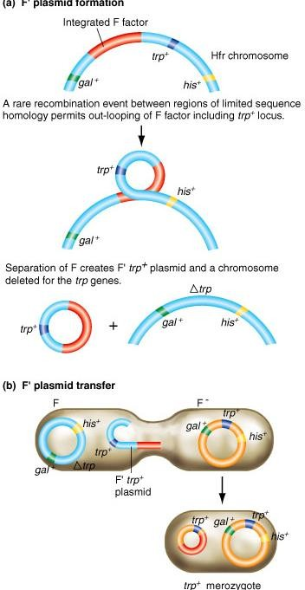
F’ plasmid formation and transfer
Fig. 14.18 a, b

Slide 14
Using Conjugation to Map Bacterial Genes
Conjugation experiments to map genes begin with appropriate Hfr strains selected from the progeny of F⁺ X F⁻ crosses.
Jacob and Wollman (1950s) used Hfr donor strains with allelic differences from the F⁻ recipient strains, in interrupted-mating experiments. An example (Figure 14.7):
  Donor: Hfr thr⁺ leu⁺ azi^{R} ton^{R} lac⁺ gal⁺ str^{R}.
  Recipient: F⁻ thr leu azi^{S} ton^{S} lac gal str^{S}.
  The 2 cell types are mixed in liquid medium at 37°C. Samples are removed at time points and agitated to separate conjugating pairs.
  Selective media are used to analyze the transconjugants. Results in this experiment:
    The 1st donor genes to be transferred to the F⁻ recipient are thr⁺ and leu⁺, and their entry time is set as 0 minutes.
    At 8 minutes, azi^{R} is transferred, and ton^{R} follows at 10 minutes.
    At about 17 minutes lac⁺ transfers, followed by gal⁺ at about 25 minutes.
  Recombination frequency becomes less at later time points, because more pairs have already broken apart before the sample was taken.
The transfer time for each gene is reproducible, indicating its chromosomal position. A map may be constructed with the distance between genes measured in minutes. (The E. coli chromosome map spans about 100 minutes.)

Slide 15
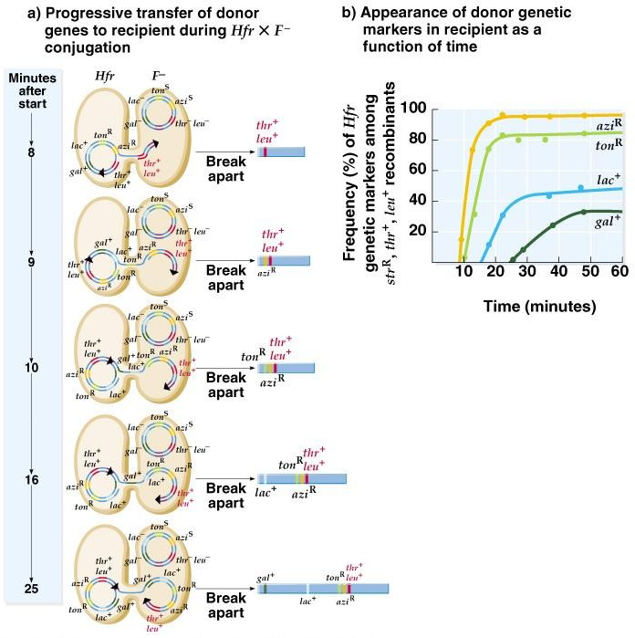
Fig. 14.7 Interrupted-mating experiment
Peter J. Russell, iGenetics: Copyright © Pearson Education, Inc., publishing as Benjamin Cummings.

Slide 16
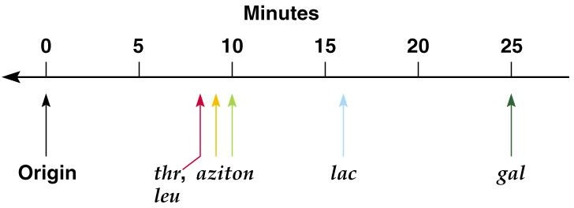
Fig. 14.8 Genetic map of genes in the experiment in Fig. 14.7
Peter J. Russell, iGenetics: Copyright © Pearson Education, Inc., publishing as Benjamin Cummings.

Slide 17
Circularity of the E. coli Map
Each Hfr strain chromosome has one F plasmid integrated into its chromosome. Location and
orientation of F integration vary between strains (Figure 14.9).
Overlaps in the transfer maps for each strain allow a complete chromosomal map to be constructed and confirmed. The most logical map is a circular one (in contrast to the linear maps of eukaryotes).
iActivity: Conjugation in E. coli

Slide 18
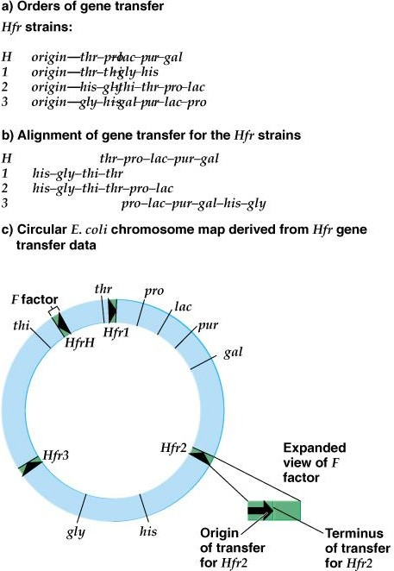
Fig. 14.9 Interrupted-mating experiments with a variety of Hfr strains, showing that the E. coli linkage map is circular
Peter J. Russell, iGenetics: Copyright © Pearson Education, Inc., publishing as Benjamin Cummings.

Slide 19
Genetic Mapping in Bacteria by Transformation
Transformation is used to map genes in situations where mapping by conjugation or transduction is not possible.
  Donor DNA is extracted and purified, broken into fragments, and added to a recipient strain of bacteria. Donor and recipient will have detectable differences in phenotype, and therefore genotype.
  If the DNA fragment undergoes homologous recombination with the recipient’s chromosome, a new
phenotype may be produced. Transformants are detected by testing for phenotypic changes.
Some bacterial cells take up DNA naturally (e.g., Bacillus subtilis), while others require engineered transformation for efficient transfer (e.g., E. coli).
Completed transformation occurs in a small proportion of the cells exposed to new DNA.
Bacillus subtilis is an example (Figure 14.10):
  Donor is wild-type (a⁺). Recipient is mutant (a).
  One of donor DNA strands is degraded, leaving ssDNA with the a⁺ allele.
  The donor ssDNA pairs with homologous DNA in recipient’s chromosome, forming a triple-stranded region.
  A double crossover event occurs, replacing one recipient DNA strand with the donor strand.
  The recipient now has a region of heteroduplex DNA. One strand has the recipient’s original a allele
and the other strand has the new a⁺ allele.
  DNA replication will produce one chromosome with the original (a) genotype, and one with the recombinant (a⁺) genotype.
  The cell with the recombinant genotype is then selected by its phenotypic change.

Slide 20
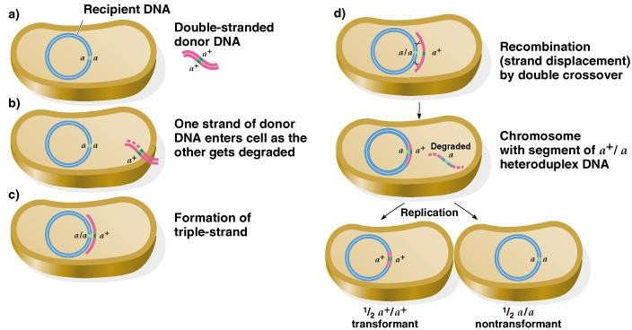
Fig. 14.10 Transformation in Bacillus subtilis
Peter J. Russell, iGenetics: Copyright © Pearson Education, Inc., publishing as Benjamin Cummings.

Slide 21
4. Transformation experiments are used to determine:
Whether genes are linked (physically close on the bacterial chromosome).
  Transformation works best with small DNA fragments that hold only a few genes.
  Cotransformation is an indication that two genes are near each other. It is
analyzed mathematically.
    Experimentally, if cotransformation is more frequent than would be expected randomly (the product of the transformation rates for each gene), the genes must be close together.
    If the cotransformation rate is close to the transformation rate for each gene alone, the genes are not linked.
The order of genes on the genetic map.
  Suppose two genes (e.g., p and q) cotransform and are thus linked. One of them (e.g., q) often cotransformations with another gene (e.g., o).
  Determining the distance between p and o involves analyzing their cotransformation frequency.
    If p and o rarely cotransform, the gene order is p-q-o.
    If p and o frequently cotransform, the gene order is p-o-q.
The map distance between genes. Recombination frequencies are used to infer map distances.

Slide 22
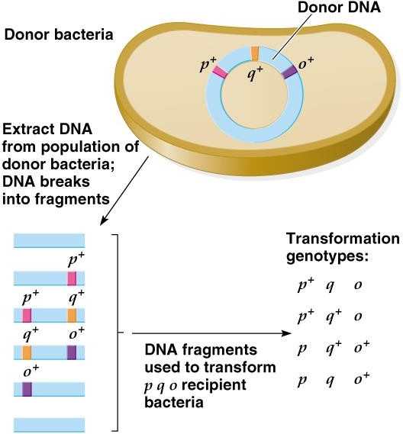
Fig. 14.11 Demonstration of determining gene order by cotransformation
Peter J. Russell, iGenetics: Copyright © Pearson Education, Inc., publishing as Benjamin Cummings.

Slide 23
Genetic Mapping in Bacteria by Transduction
Some bacteriophage carry genes from former
host to new host, transferring genes between bacterial cells.
The DNA capacity of these phage vectors is limited to ~1% of the host chromosome.
Once introduced into a new host, the recombinant viral DNA undergoes homologous recombination into the chromosome of the new host (transductant).

Slide 24
Bacteriophages: An Introduction
T-phages and λ are familiar examples of DNA bacteriophages.
  T2 and T4 are virulent phages. When their DNA enters a cell, its genes take control, causing the cell to devote all available resources to producing new virus particles. The progeny phages eventually lyse their host cells, resulting in a phage lysate.
  Lambda has two possible courses of action when it infects E. coli (Figure 14.12):
    A lytic cycle like that of the T phages.
    Lysogeny, where the λ chromosome inserts itself into the E. coli
chromosome (similar to F plasmid integration).
      In the lysogenic pathway, the prophage DNA (integrated λ chromosome) is replicated each time the E. coli chromosome replicates.
      The λ prophage will be inherited by all descendants of the originally infected E. coli cell.
      The λ repressor protein prevents expression of l genes needed in the lytic cycle. When the repressor is destroyed (e.g., by UV light) the lytic cycle is induced.
      The λ prophage DNA is excised from the E. coli chromosome, and the lytic cycle proceeds, producing progeny λ phages.

Slide 25
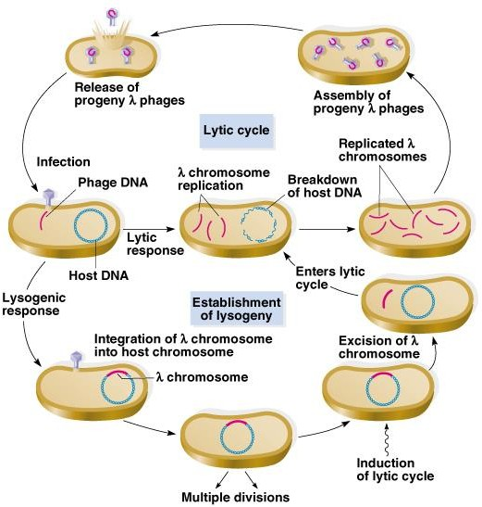
Fig. 14.12 Life cycle of a temperate phage, such as λ
Peter J. Russell, iGenetics: Copyright © Pearson Education, Inc., publishing as Benjamin Cummings.

Slide 26
Transduction Mapping of Bacterial Chromosomes
1.Two types of transduction occur: a.Generalized, which can transfer any gene. b.Specialized, which transfers only specific genes
(similar to imperfect excision that creates F’).

Slide 27
Generalized Transduction
Generalized transduction was discovered by Lederberg and Zinder (1952), in an experiment with Salmonella typhimurium bacteria.
  Experiment was similar to the E. coli conjugation experiment, in which bacterial strains are separated by a ifiter to prevent physical contact.
  S. typhimurium, unlike E. coli, produced recombinants in this experiment. The filterable agent moving genes was the temperate phage P22.
Another example of a generalized transducing phage is P1 in E. coli (Figure 14.13):
  P1 enters and integrates as a prophage.
  If the lysogenic state is not maintained, P1 enters a lytic cycle and produces progeny phages.
  The bacterial chromosome is degraded during lytic infection, and rarely, bacterial DNA is packaged as if it were a P1 chromosome, producing a transducing phage.
  The transducing phage DNA enters the host cell in the normal P1 way, and may be incorporated into the host’s chromosome by homologous recombination. The resulting bacteria are transductants.
Transduction experiments use genetic markers to follow gene movement.
  Selectable markers allow detection of low frequency events. For example,
auxotrophic recipients can easily be detected if they convert to the donor’;s
prototrophic phenotype, because they alone can grow on minimal media.
  Other markers in the experiment are called unselected markers.

Slide 28
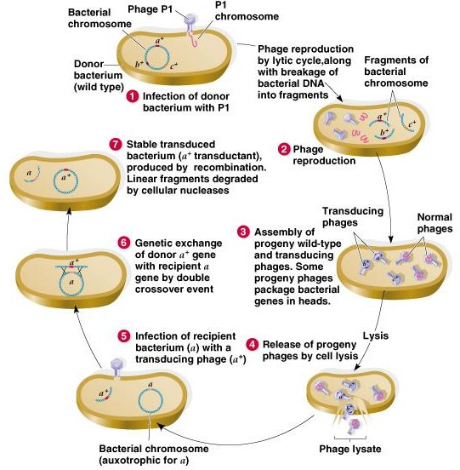
Fig. 14.13 Generalized transduction between strains of E. coli
Peter J. Russell, iGenetics: Copyright © Pearson Education, Inc., publishing as Benjamin Cummings.

Slide 29
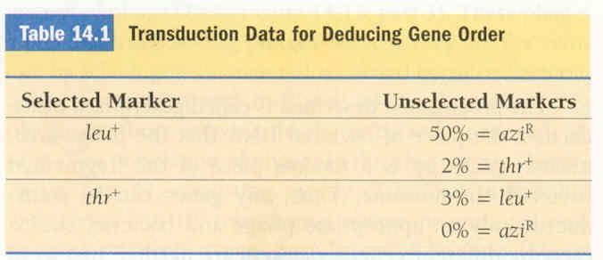
4. Closely linked genes are cotransduced at high frequency, allowing a detailed genetic map to be generated. For example:
a. P1 was used to map E. coli genes.
Donor strain is able to grow on minimal medium, and is also resistant to the metabolic poison sodium azide (leu⁺ thr⁺ azi^{R}).
Recipient strain can’t make leucine or threonine, and is poisoned by sodium azide (ieu thr azi^{S}).
P1 lysate grown on donor cells is used to infect recipient cells.
Transductants can be selected for any of these traits (e.g., leu⁺, and then checked for the unselected markers (e.g., thr⁺ azi^{R}) (Table 14.1).
For example:
  Of the leu⁺ selected transductants, 50% have azi^{R} and 2% have thr⁺.
  Of the thr⁺ selected transductants, 3% have leu⁺, and 0% have azi^{R}.
  This gives the map order: thr—leu--azi.
5. Map distances are calculated from the cotransduction frequency of gene pairs. It is effective only with genes located near each other on the chromosome.

Slide 30
Specialized Transduction
Some phages transduce only certain regions of the chromosome, corresponding with their integration site(s). An example is λ in E. coli (Figure 14.14):
  Phageλ integrates by a single crossover into the attλ site on the E. coil K12 chromosome. The attλ site is located
between the gal and bio genes. The prophage is maintained by a phage repressor protein.
  In this example, the E. coil K12 strain that integrates theλ prophage is gal⁺ (a phenotype easily detected with specific culture medium).
  If this E. coli K12(λ) is induced to the lytic cycle, theλ prophage DNA is excised by a single cross-over event.
    Excision is usually precise.
    Rarely excision results in genetic exchange, with a fragment ofλDNA remaining in the E. coli
chromosome, and some bacterial DNA (e.g., gal⁺) added to theλchromosome.
    The resulting transducing phage is designated λd gal⁺ (d for defective, since not all phage genes are present).
    λd gal⁺ can replicate and lyse the host cell, since allλgenes are present either on the phage or bacterial chromosome.
  Because transducing phage are only rarely produced, a low- frequency transducing (LFT) lysate results.
Infection of gal bacterial cells results in two types of transductants (Figure 14.14):
    Unstable transductants result when wild-typeλintegrates first at its normal attλsite. λd gal⁺ then integrates into the wild-typeλ, producing a double lysogen with both types ofλintegrated.
      The host bacterium is now heterozygous (gal⁺ / gal), and can ferment galactose.
      The transductant is unstable because the wild-typeλcan be induced into the lytic cycle. Both wild-typeλand λd gal⁺ are replicated, producing a high-frequency transducing (HFT) lysate.
    Stable transductants are produced when a cell is infected only by a λd gal⁺ phage, and the gal⁺ allele is
recombined into the host chromosome by double cross-over with gal.
Specialized transduction is useful for moving specific genes between bacteria, but not for general genetic mapping.

Slide 31
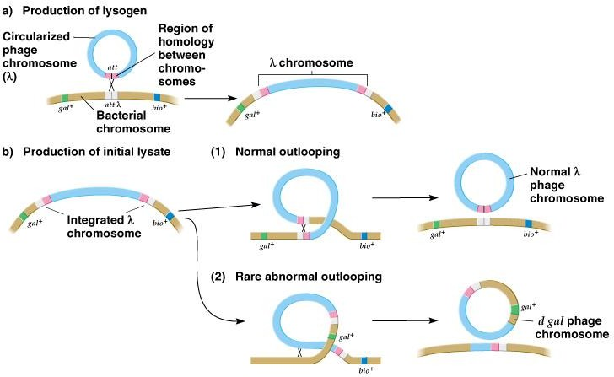
Fig. 14.14a, b Specialized transduction by bacteriophage λ
Peter J. Russell, iGenetics: Copyright © Pearson Education, Inc., publishing as Benjamin Cummings.

Slide 32
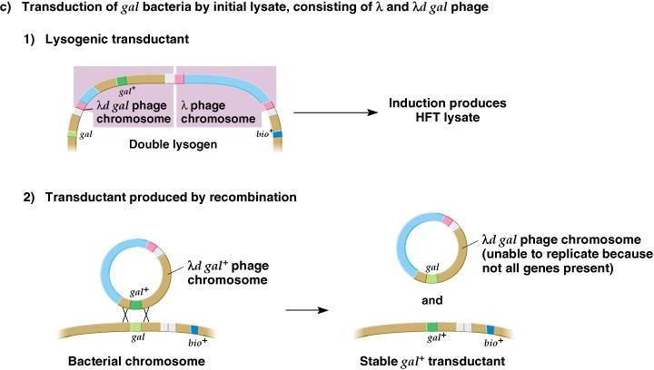
Fig. 14.14c Specialized transduction by bacteriophage λ
Peter J. Russell, iGenetics: Copyright © Pearson Education, Inc., publishing as Benjamin Cummings.

Slide 33
Mapping Genes of Bacteriophages
Phage genes are mapped by 2-, 3- or 4-gene crosses, involving bacteria infected with
phages of different genotypes.
  Progeny phage are counted using a plaque assay in which each phage produces a cleared area in a bacterial lawn.
  Distinguishable phage phenotypes include mutants with different plaque morphology. An example is strains of T2 differing in plaque morphology and/or host range.
    One T2 strain has the genotype h⁺ r (h⁺ lyses E. coli strain B, but not strain B/2, and r is a
mutant producing large distinct plaques).
    The other T2 strain has the genotype h r⁺ (h lyses both B and B/2 E. coli, and r⁺ produces the wild-type small plaque with fuzzy borders).
    When the E. coli lawn includes both B and B/2 strains, T2 with h produce clear plaques, while T2 with h⁺ produce cloudy plaques (due to uninfected strain B/2).
  The h and r genes are mapped by infecting E. coli strain B simultaneously with two phages, h⁺ r and
h r⁺ (Figure 14.16).
    Crossover can occur between the 2 types of T2 DNA, producing recombinant T2 chromosomes (h⁺ r⁺ and h r).
    Recombinant chromosomes are assembled into phage, as are parental-type chromosomes.
    The resulting lysate is plated on a mixed lawn E. coli strains B and B/2. The resulting
plaques have 4 possible phenotypes (Figure 14.17):
      Parental type h r⁺ has small clear plaques with a fuzzy border.
      Parental type h⁺ r has large cloudy plaques with a distinct border.
      Recombinant type h⁺ r⁺ has small cloudy plaques with a fuzzy border.
      Recombinant type h r has large clear plaques with a distinct border.
    Recombination frequency reflects the relative genetic distance between the phage genes
under study.

Slide 34
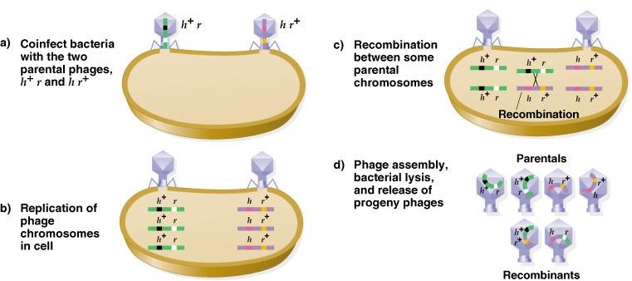
Fig. 14.16 The principles of performing a genetic cross with bacteriophages
Recombination frequency reflects the relative genetic
distance between the phage genes under study.
Peter J. Russell, iGenetics: Copyright © Pearson Education, Inc., publishing as Benjamin Cummings.

Slide 35
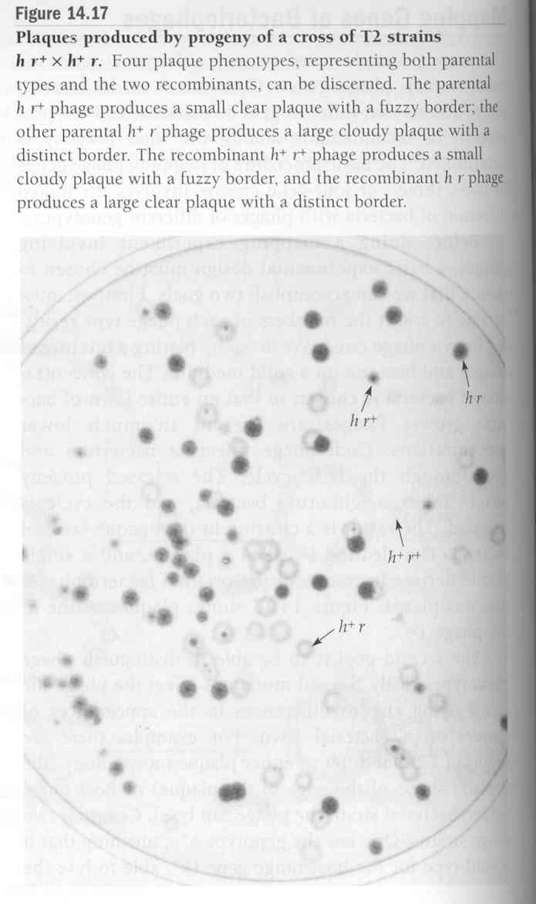

Slide 36
Fine-Structure Analysis of a Bacteriophage Gene
Intragenic mapping determines mutation sites within genes, using the same principles used for mapping the distance between genes.
Oliver (1940) showed that genes are subdividible by mutation and recombination, by experiments with Drosophila mutants in the X- linked lozenge (lz) locus. The two alleles are lz^{A} and lz^{B}
  Heterozygous femal flies have a mutant lozenge-shaped eye shape.
  When heterozygous females are crossed with male flies hemizygous for either allele (e.g., lz^{A} + / + lz^{B} X lz^{A} + ) wild-type progeny result about 0.2% of the time.
  Recombination between the alleles in the female had produced + +
gametes, resulting in wild-type progeny.
Benzer’s fine-structure mapping of phage T4 used similar experiments
involving the rII gene.
  Different rII mutations of T4 were used, each with the characteristic large clear plaques and limited host range.
  T4 with the wild-type r⁺ gene infects E. coil strains B and K12(λ). For
rII T4, strain B is permissive but K12(λ) is nonpermissive.

Slide 37
Recombination Analysis of rII Mutants
Benzer’s fine-structure mapping involved 60 independently isolated rII mutants, which were crossed in all possible combinations, using E. coli B as the permissive host (Figure 14.18).
  A sample of the progeny from each cross was plated on E. coli B (permissive) to determine the phage titer.
  Another sample was plated on E. coli K12(λ) (non-permissive), where only the rare r⁺ recombinants could grow. These plaques represent 1⁄2 of the recombination frequency between the pair of rII alleles. The reciprocal recombinants are double rII mutants, and will not grow on E. coli K12(λ).
  Reversions also occur, restoring an rII mutant to r⁺. The control for this is to plate each rII parent alone on both E. coli strains, B and K12(λ), allowing calculation of the reversion frequency.
  Reversion frequency is subtracted from the computed recombination frequency to make the map more accurate.
A linear map was constructed from the recombination data from all crosses of the 60 rII
mutants. (Figure 14.19).
  Some pairs produced no r⁺ recombinants when crossed, and so had mutations at exactly the same site (homoallelic).
  Most pairs of rII mutants produced r⁺ recombinants when crossed, and so had changes in different base pairs within the gene (heteroallelic).
  Lowest detectible recombination frequency was 0.01%. Correlating this with the T4 genetic map, it
was calculated that the smallest recombination distance observed was about three base pairs.
Later experiments have observed recombination between adjacent base pairs, indicating that the base pair is both the unit of mutation and the unit of recombination. This replaced the older idea that the gene was indivisible.

Slide 38
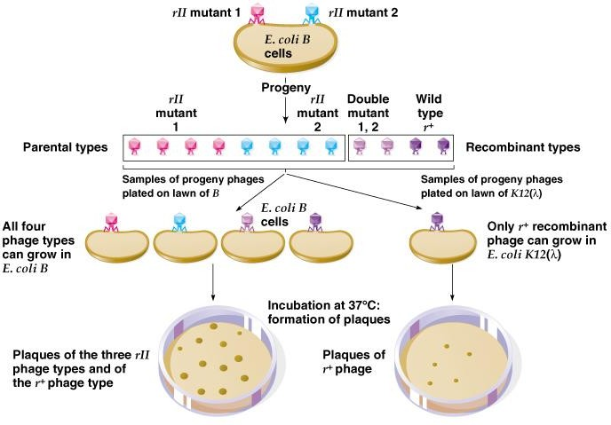
Fig. 14.18 Benzer’s general procedure for determining the number of r⁺ recombinants from a cross involving two rII mutants of T4
Peter J. Russell, iGenetics: Copyright © Pearson Education, Inc., publishing as Benjamin Cummings.

Slide 39
Deletion Mapping
Benzer eventually mapped over 3,000 rII mutants. A deletion mapping technique was used to simplify these studies. -
  Some of the mutants did not revert, nor did they recombine to produce r⁺ phage in
crosses with a variety of rII mutants. These were deletion mutants (Figure 14.20).
  The systematic approach crossed each unknown rII mutant with a set of seven standard deletion mutants defining the seven main segments of the rII region.
    No r⁺ recombinants will be produced in crosses where the other parent is deleted for the same region of DNA as in the new mutation.
    The pattern of nonrecombinants indicates the approximate site of the new mutation.
  Once a region for the mutation was known, the new mutant was crossed with members of the relevant secondary set of reference deletions. Analysis of recombination or nonrecombination enabled more precise localization of the mutation site.
Deletions divide the rII region into 47 segments. (Figure 14.21).
  Any rII point mutant can be localized to one of these segments in three sequential sets of crosses with deletion mutants.
  After localization, crosses with point mutants provide more detailed mapping.
Benzer’s work with > 3,000 mutants divided the rII region into > 300 mutable sites separable by recombination. Certain sites in the region (hot spots) have high rates of independent point mutations. (Figure 14.22).

Slide 40
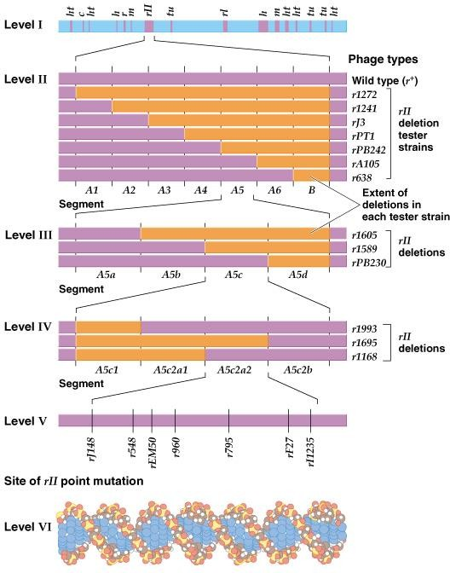
Fig. 14.20 Benzer’s experiment: Segmental subdivision of the rII region of phage T4 by means of deletion
Peter J. Russell, iGenetics: Copyright © Pearson Education, Inc., publishing as Benjamin Cummings.

Slide 41
Defining Genes by Complementation (Cis- Trans) Tests
Animation: Defining Genes by Complementation Tests
The complementation test determines how many genes are involved in a set of mutations that produce a given phenotype.
The T4 rII region has two genes, rIIA and rIIB. A mutation in either gene produces the rII phenotype for both plaque morphology and host range.
In Benzer’s work, nonpermissive strain K12(λ) was infected with pairs of rII mutants. Neither can grow alone in
this strain.
  If progeny are produced, the two mutants have complemented each other by providing different gene functions, either by genetic recombination (producing a few plaques) or complementation (lysing the entire lawn) (Figure 14.23).
    Infect bacterium with two phage genomes. Genotype of one is rIIA⁺ rIIB, and of the other is rIIA rIIB⁺.
    One phage provides the rIIA product, the other the rIIB product, and so the phage lytic cycle occurs.
  If no progeny are produced, both mutations are in the same functional unit. Both mutants produce the same defective product (e.g.,
the rIIA product), and so the phage lytic cycle cannot occur.
  Benzer’s work showed two functional units for the rII phenotype, the complementation groups rIIA and rIIB. Both gene products must be produced for the lytic cycle to occur.
    The fine-structure map indicates the boundaries of rIIA and rIIB.
    Point mutants and deletion mutants in both rIIA and rIIB give the same results in complementation tests.
    Deletions that span rIIA and rIIB do not complement either rIIA or rIIB.
  Alleles may be arranged two different ways in cis-trans complementation experiments:
    When the mutant alleles are on two different chromosomes, as in the complementation experiment above, they are in the
trans configuration.
    A control for the experiment is to coinfect E. coli K12(λ) with an rII mutant carrying both mutations, and a wild-type T4 (expected result is wild-type). This rII mutant phage carries the mutations in the cis configuration.

Slide 42
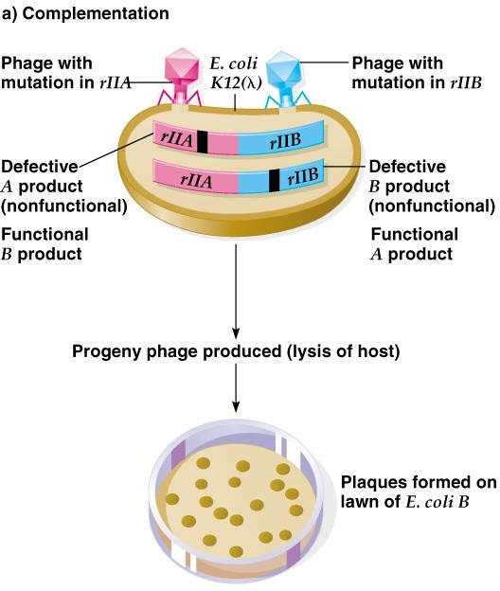
Fig. 14.23a Complementation tests for determining the units of function in the rII
region of phage T4
Peter J. Russell, iGenetics: Copyright © Pearson Education, Inc., publishing as Benjamin Cummings.

Slide 43
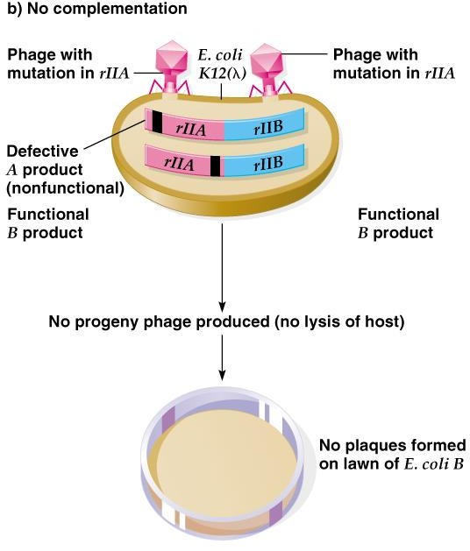
Fig. 14.23b Complementation tests for determining the units of function in the rII
region of phage T4
Peter J. Russell, iGenetics: Copyright © Pearson Education, Inc., publishing as Benjamin Cummings.

Slide 44
4. Benzer called the genetic unit of function defined by a cis-trans complementation test a cistron. Defined as the smallest segment of DNA encoding an RNA, cistrons are now usually referred to as genes.
Complementation tests are used in many types of organisms, with adjustments for the organism’s life style. In these examples no DNA recombination is needed for complementation to occur:
  Yeast matings involve two haploid cells of different mating types (a and α), each with the phenotype of interest. The diploid produced by mating is then analyzed for complementation of the two mutations.
  Animal cells with the same mutant phenotype may be fused and analyzed for a wild- type phenotype that indicates complementation.
  A Drosophila example involves two true-breeding mutant strains with black bodies instead of wild-type grey-yellow. (Figure 14.24).
    When two mutant black strains are crossed, the F₁ all have wild-type bodies.
This rules out both mutations being in a single gene for body color.
    The simplest explanation is complementation between two genes, both involved in producing body color.
      On one autosome is the recessive ebony (e) gene, producing black body color when homozygous.
      On another autosome is a different recessive gene, black (b), also producing black body when homozygous.
    The cross is therefore e/e b⁺/ b⁺ X e⁺/ e⁺ b / b. The F₁ are e⁺/ e b⁺/ b (mutant alleles are in trans), and display the wild- type phenotype.

Slide 45
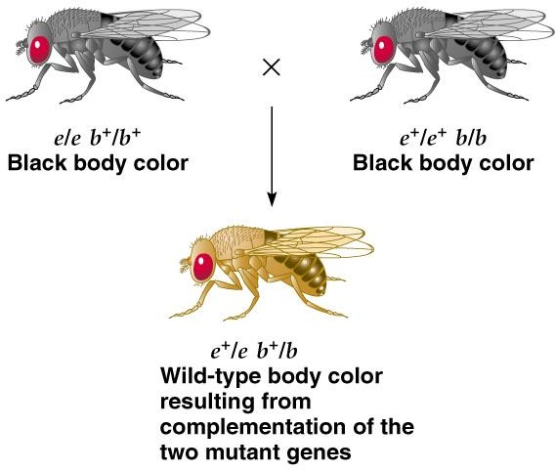
Fig. 14.24 Complementation between two black body mutations of Drosophila melanogaster
Peter J. Russell, iGenetics: Copyright © Pearson Education, Inc., publishing as Benjamin Cummings.

Slide 46
