Slide 1


Slide 2
Significance of anatomical Characters in Taxonomy
By Dr. Shabnum Shaheen

Slide 3
What are the Anatomical characters?
Internal form and structure of plant organs
Anatomical characters can be studied by
LM
SEM
TEM

Slide 4
History of Anatomy in Plant Taxonomy
Nehemiah Grew (1682)
The Anatomy of Plants
Hans Solereder (1899)
Systematische Anatomie der Dicotyledonen
C.R. Metcalfe & L. Chalk (1950)
Anatomy of Dicotyledons

Slide 5
History of Anatomy in Plant Taxonomy
Esau (1965)
Endress, Bass and Gregory in 2000
Rudall in 2007

Slide 6
Parts of plants used as taxonomic tools
Wood
Leaves
Flower
Nodes
Mineral inclusions

Slide 7
1. Wood Anatomy
Wood = secondary xylem
Wood is mixture of
Tracheids and vessel element
Fibers
Rays

Slide 8
Trends of evolution in the parts of xylem
1. Increase in F/V ration
length of vessel elements = V
length of tracheids (or fibre)= F
F/V=1:00 to 1:20
Primitive angiosperms
F/V=4:00
Most specialized woods

Slide 9
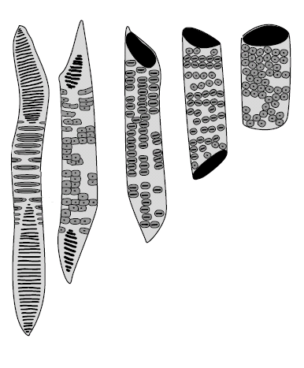
Trends of evolution in the parts of xylem
2.Perforation plate morphology specialization
Primitive vessel
Elongated and numerous scalariform perforation
Advanced vessel shorter and with simple perforation

Slide 10
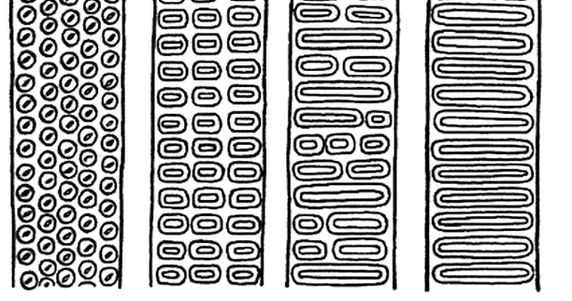
Trends of evolution in the parts of xylem
3.Lateral wall specialization
Scalariform pitting in Primitive plants
Alternate circular pitting in Advanced plants

Slide 11
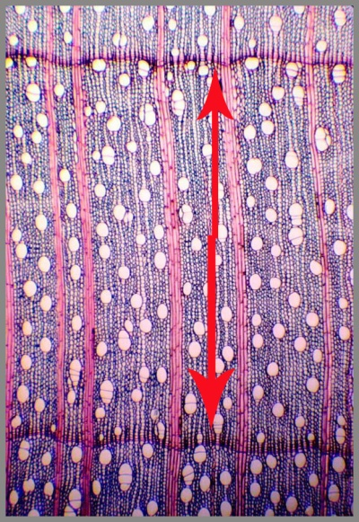
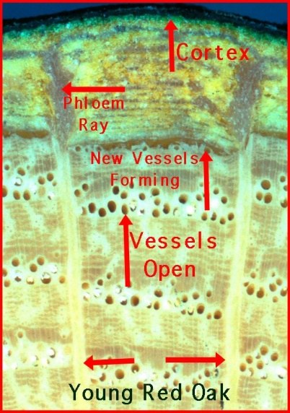
Trends of evolution in the parts of xylem
4. Vessel abundance
Advanced
Ring-porous wood
Primitive
Diffuse-porous wood

Slide 12
Example of use of wood anatomy in taxonomy
Specialized features of Amentiferae
Primitive features of Magnoliales
All members with
vessels
Simple perforation
plates
Ring porous wood
Some genera of Magnoliales are vesselless
Vessels are long with narrow diameter
Vessels have oblique end walls
Scalariform pitting on lateral walls of vessels
Scalariform perforation plates on vessels
Diffuse porous wood

Slide 13
2. Foliar Anatomy
Epidermis
Stomata
Trichomes

Slide 14
Epidermis
systematically valuable characters
Epidermal cell,
size,
shape
occurrence of papillae
contents
wall thickness

Slide 15
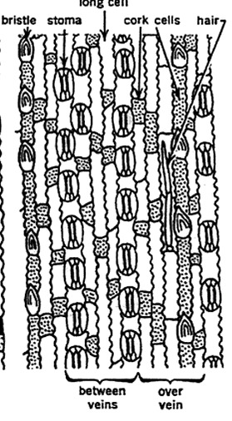
Example of use of epidermal character in taxonomy
Lower epidermal cells of Sacchrum

Slide 16
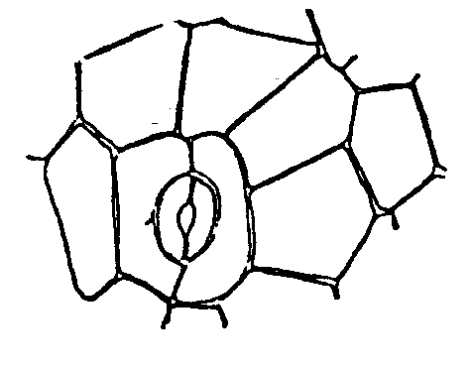
Stomata
Ranunculaceous or Anomocytic stomata
Rubiaceous or Paracytic

Slide 17
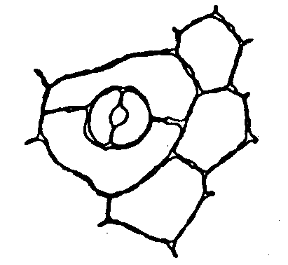
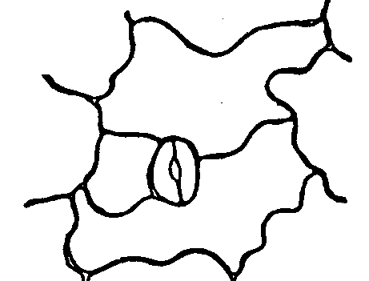
Stomata
Caryophyllaceous or Diacytic
Cruciferous or Anisocytic

Slide 18
Examples of use of stomatal character in taxonomy
Dumbbell-shaped
Guard cells
Gramineae
Absence of
Subsidiary cells
Liliales

Slide 19
Reliability of stomata as taxonomic tool
Lippia nodiflora is an example where all the four types of stomata have been reported to occur on the same leaf.

Slide 20
Trichomes
Family | Type of trichome
Malphigiaceae | T shaped unicellular hairs
Urticaceae | Stinging hairs
Bromeliaceae | Scale hairs
Malvaceae | Stellate and tufted hairs

Slide 21
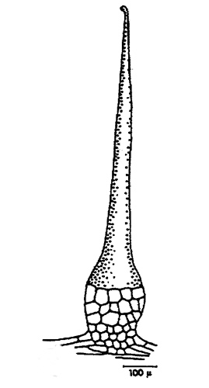
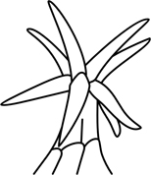
Comparison of two Different types of trichomes
Stinging Hair
Stellate trichome

Slide 22
3.Floral Anatomy
Floral anatomy of Annonaceae, Calycanthaceae and Menispermaceae confirms that all these families originated from Ranunculaceae
Formerly Cyperaceae and Gramineae were considered in one single order. But Hutchison separated them in two different orders, Cyperales and Graminales on the basis of floral anatomical evidences.

Slide 23
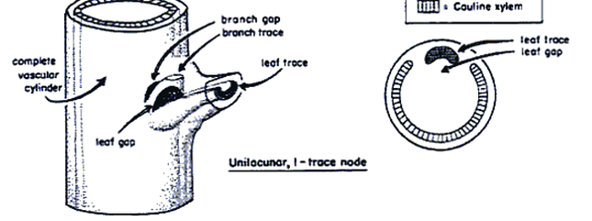
4. Nodal Anatomy
Advanced
Unilacunar,
Magnoliales, Piperales and Asterales.
multiilacunar.
Laurales, Caryophyllales, Ericales

Slide 24
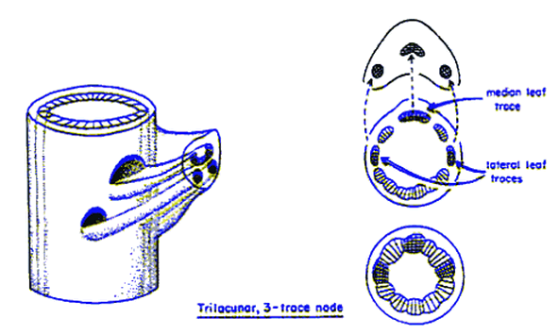
Primitive
trilacunar,
majority of dicotyledons

Slide 25
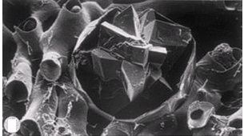
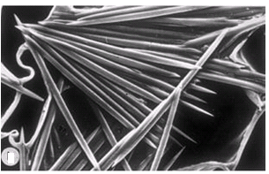
5. Mineral inclusions
Crystals
Druses of Nerium oleander
Raphides of Vanilla Root
More common in dicotyledons
More common in monocotyledons

Slide 26
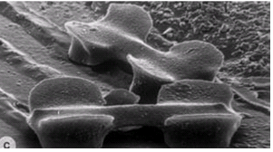
Silica bodies
Silica bodies are always absent in Juncaceae but always present in the family Thurniaceae. So this character can be used as taxonomic tool for identification and classification
Silica bodies & the epidermis of Schizachyrium sanguineum

Slide 27


