Slide 1
Evaluation and selection of Ectomycorrhizal Fungi

Slide 2
All potential host fungus pairs should ideally be tested for all the following characteristics
Rapidity and extent of mycorrhization
Host response
Efficiency of inorganic nutrient uptake
Water relation
Tolerence of temperature extreme
pH extremes that will be experienced after outplanting
Tolerance of air pollution or soil toxicity
stability of the partnership of the fungus
Disease resistance

Slide 3
Mycelial strands formation by the fungus
Ease of isolating fungus in pure culture
Ease and rapidity with which large quantities of inoculum can be produced
Edibility of the fruit bodies of the fungus

Slide 4
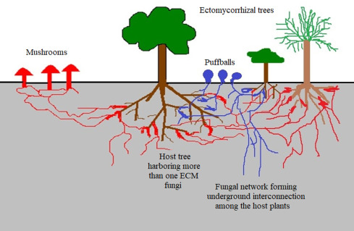
Rapidity and Extent of Mycorrhization
Ectomycorrhizas can be seen with the eye and can be readily quantified. Entire root systems of seedlings can be examined in older trees only a sample obtained by soil coring or local excavation can be studied. The percentage of mycorrhizal short roots can be determined usually and the weights of the structures determined.
Results may be expressed as number and weight of ectomycorrhizal structures per unit area or per unit volume of soil.

Slide 5
Host response
An easy non-destructive method is to follow seedling survival expressed as percentages of the initial un-inoculated and inoculated populations such data can be gathered at various ages. Before and after outplanting. Other non-destructive measures are plant height thickness of stalk at ground level, number of leaves, leaf length and leaf area.
Most definite measurements involve determining the dry weight of whole plant or of separate root and shoot systems.
Measurements of stem height and stem diameter at soil line are eventually replaced by diameter at the breast height (1.4m) in older trees.

Slide 6
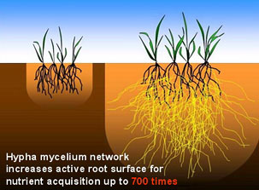
A’Mycorrhizal influence value (MIV) can be determined for any parameter by expressing the mean value for non-inoculated plant as 100, and calculating the value for mycorrhizal plants as an integer relative to that 100. Does the MIV would be a percentage of the control value in each case (usually greater than 100%).

Slide 7
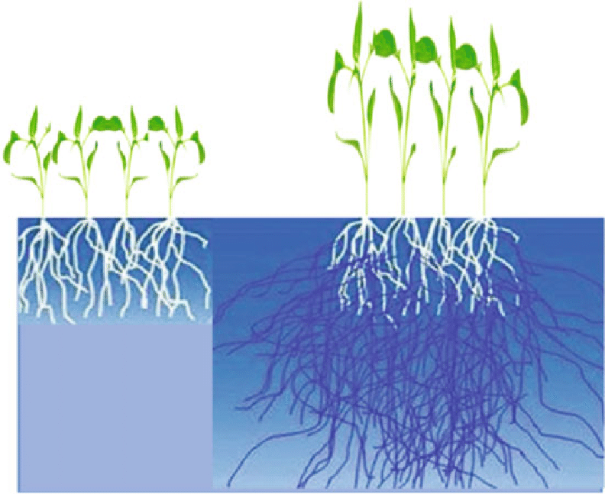
Water Relation
The fungus Cenococcum geophilum is especially tolerance of low water potential which corelates well with its propensity for forming ectomycorrhizas in dry area. In fact, because cenococcum grows best at water potential of -15bars. It can be difficult to establish in irrigated nurseries where it may be replaced by Thelephora Terrestris.

Slide 8
Temperature
Pinus Cembru destined for high altitude out planting is inoculated with a cold adapted strain of Suillus Plorans. Other fungi, Pisolitlues Tinctorius, have been found to be adapted to high temperature. Cenococcum Geophilum appear to tolerate both extremes relatively well.

Slide 9
pH
Pine seedlings with Pisolitlius Trunctorius ectomycorrhizae survive and grow better on acid coal mine spoils than do nonmycorrhizal seedlings. This fungus can tolerate a pH range of 2.6 - 8.4 .
Cenococcum Geophilum forms mycorrhizas from pH 3.4 – 7.5. Other ectomycorrhizal fungi improve the growth of pines in alkaline soil.

Slide 10
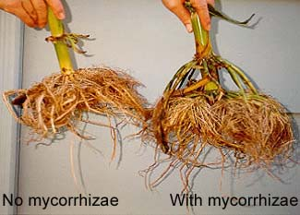
Toxicity
EM fungi have been shown to destroy heat formed phytotoxins in the soil. In view of the selective absorption of various ions by mycorrhizal fungi and their capacity of storing ions in the mantle. They may be active in ameliorating marginal soil toxicities. There is still little publish work in this area but studies in the progress on the spoils derived from nickel mining at Sudbury, Ontario indicates that some EM Fungi can tolerate fairly high levels of heavy metals in the substrate.

Slide 11
Persistence
The stability of the partnership need be established only in the short term, since the choice of mycorrhizal partner for a tree should be probably be based on immediate benefits it bestows.
Although, the initial mycobiont has in many cases be shown to be supplanted by other EM fungi after the seedling has been out planted, it’s presence in the early days may well make the difference between death and survival of very young seedlings.

Slide 12
Selection of mycobiont adapted to the conditions of the out planting sites. And preferably already stablished there, as determined by the occurrence of its basidiomata or ascomata, may produce the best results.

Slide 13
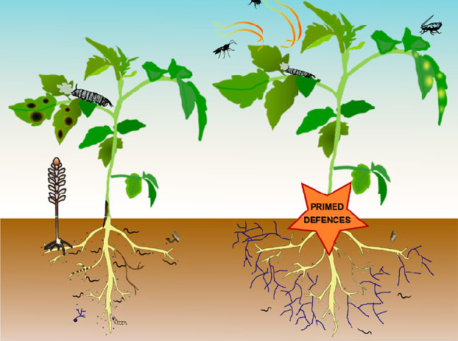
Disease Resistance
The presence of EM fungi on the roots of trees give them some protection against the attack of several serious root pathogenic fungi.
The effects of pathogen Mycelium Radicis Atrovirens on Picea Mariana and Pinus Resinosa were markedly reduced by the presence of Suillus Granulatus. This effect is not fully explained, but may be due to competition between fungi for the nutrients and for access to the root.

Slide 14
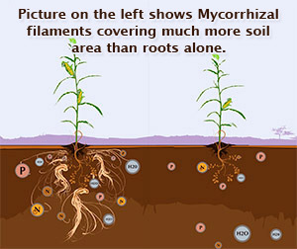
Mycelial Strand Formation
These aggregations of parallel hyphae serve as effective agents for the spread of the fungi through the soil, and in the long distance translocation of phosphate and other nutrients to the mycorrhiza. Other things being equal, it would seem reasonable to choose a strand forming fungus, such as Pisolithus Tinctorius, over one that didn’t produce these structures.

Slide 15
Ease of Isolation
Pure cultures of ectromycorrhizal fungi are usually derived from fruit body tissue, though they can also be obtained from surface sterilized mycorrhizal roots, selerotia, rhizomorphs or mycelial strands. It is difficult to germinate basidiospores, and this is rarely attempted.
Isolation from fruit bodies allows precise identification of the fungus at the outset.

Slide 16
Large scale Inoculum Production
Since Pisolithus tinctorius has been shown to establish mycorrhizas with almost fifty different tree species, thrives over a wide range of soil pH, tolerates high temperature well and can establish mycorrhiza in the poorest soils. It will also the first EM fungus to be made available in the form of commercially produce mycelial inoculum.
Some recent work suggests that Pisolithus is soon replaced by indigenous species. Attempts are being made to scale up production of mycelial inoculum of Cenoccum geophilum, Rhizopogan spp, Smllus spp, Thelephora terrestris and others.

Slide 17
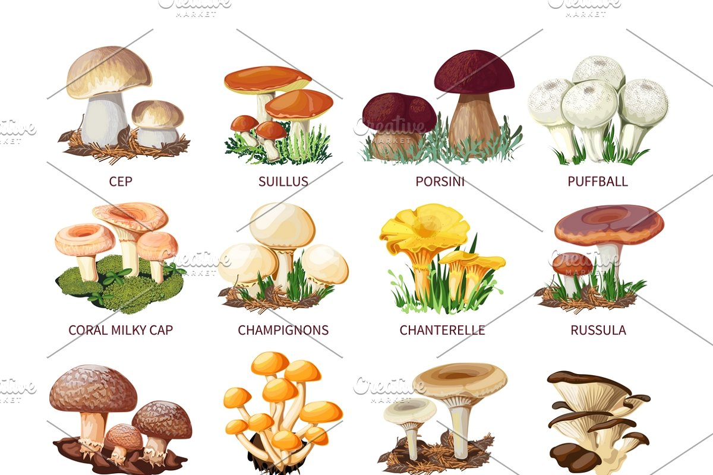
Edibility
If several potential partners seem more or less equivalent, the ultimate choice may be dictated by secondary though non negligible factors such as edibility or otherwise of the fruit bodies and availability. For example, if a hypothetical choice lay between a specie of Amanita known to be highly toxic and another agaric, such as Boletus edulis, that was edible and choice, the decision would be straight forward.

Slide 18
References
Kendrick, B. The Fifth Kingdom, British columbia, Canada

