Slide 1



.

Slide 2

2
Introduction.
Chemicals effects on human.
Classification of hazardous materials. 4- Notes about all types of H. M. .
5- Labeling of H. M. . 6- HMIS system.
7- References.

Slide 3


3
Inhalation (breathing in)
Breathing in of vapors and dust is the main way.
In the lungs, chemicals are absorbed from the air directly into the bloodstream and are carried to all parts of the body.
Dust particles can penetrate the lung and remain there
Skin or eye contact
Some chemicals can enter the body easily through the surface of the skin while others can enter through cuts or scratches on the skin.
Eating or drinking
People can swallow food and drink which has been contaminated with chemicals in the workplace, or through chemicals on their hands. Dust particles in the air can be swallowed.

Slide 4



4
.
Headaches
Dizziness
Sleepiness
Itchiness / rash
Nausea (feeling sick)
Burns to skin or eyes
Vomiting
Hard to breathe
Coughing
Cancer
Unconsciousness
Death

Slide 5

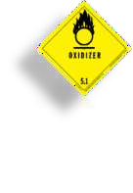

5
.
Explosives (E)
Oxidizing agents (O)
Flammable substances (F), highly flammable (F+)
Toxic substances classified as very toxic (T+) or toxic (T)
Harmful substances or preparations (Xn)
Corrosive substances or preparations (C)
Irritants (Xi)
Sensitizers
Carcinogens classified into three categories (Carc.)
Mutagens classified into three categories (Mut.)
Substances that are toxic for reproduction (Repr.)
Substances or preparations that are dangerous for the environment (N)

Slide 6



6
Explosive,
is a substance that contains a great amount of stored energy
that can produce an explosion.
Chemical Composition
A chemical explosive may consist of either a chemically pure compound, such as nitroglycerin, or a mixture of an fuel and a oxidizer, such as black powder or grain dust and air.

Slide 7

7
Keep away from heat, sparks and flame.
Keep container closed.
Use only with adequate ventilation.

Slide 8

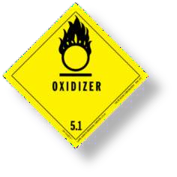
8
A chemical compound that readily transfers oxygen atoms,
or a substance that gains electrons in a redox chemical reaction
Examples
Sulfuric acid.
Hydrogen peroxide.
Oxygen.

Slide 9

9
Keep from contact with clothing, and other combustible materials.
Avoid contact with skin.
Remove and wash contaminated clothing promptly.
Store in tightly closed container.
Wash thoroughly after handling.
FIRST AID
In case of contact, immediately flush skin with plenty of water.
Remove contaminated clothing and shoes.
Call a physician if irritation develops and persists.
Wash clothing and thoroughly clean shoes before reuse.
In case of fire, soak with flooding quantities of water Before using,
read Material Safety Data Sheet (MSDS) for this chemical.

Slide 10


10
Flammability is defined at how easily something will burn or ignite, causing fire or combustion
Flammable liquid is a liquid that can catch fire flammable liquids classified according to flash point and a boiling point to:-(I II III) A and B
Common name | CAS Number | Flash point | Class | Auto ignition Temperature
Acetone | 67-64-1 | −17 °C (1.4 °F) | IB | 465 °C (869 °F)
Biodiesel | n/a mixture | >130 °C (266 °F) | IIIB
Diesel | n/a mixture | >62 °C (144 °F) | IIIA | 210 °C (410 °F)
Ethanol | 64-17-5 | 12.8 °C (55.0 °F) | IB | 365 °C (689 °F)
Gasoline | n/a mixture | <−40 °C (−40.0 °F) | IB | 246 °C (475 °F)
Jet fuel | n/a mixture | >38 °C (100 °F) | II | 210 °C (410 °F)
Methanol | 67-56-1 | 11 °C (52 °F) | IB | 464 °C (867 °F)

Slide 11
11
Keep away from heat, sparks, pilot lights, welding operations and open flame.
Do not taste or swallow.
Keep container tightly closed.
Ground all equipment
Do not breathe vapors.
Do not get in eyes, on skin, or on clothing.
Use only with adequate ventilation.
Wash thoroughly after handling.
Do not eat, drink or smoke in areas where this material is used.
FIRST AID
EYES: Immediately flush eyes with a directed stream of water for at least 15 minutes. Get medical attention.
SKIN: Immediately flush skin with plenty of water. Remove contaminated clothing and shoes. Get medical attention.
Wash clothing and shoes before reuse.
INHALED: If inhaled, remove to fresh air. If not breathing, give artificial respiration. If
breathing is difficult, give oxygen. Get medical attention.

Slide 12

12
Do not taste or swallow.
Do not take internally. Wash thoroughly after handling.
Keep away from heat, sparks and flame.
Keep container closed.
Use only with adequate ventilation.
FIRST AID
If swallowed, do NOT induce vomiting unless directed to do so by medical personnel.
Never give anything by mouth to an unconscious person. Keep out of reach of children

Slide 13

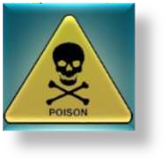
13
Toxicity is the degree to which a substance is able to damage an exposed organism.
types of toxic
Chemicals inorganic substances such as lead, asbestos and chlorine gas, organic compounds such as methyl alcohol, most medications, and poisons from living things.
Biological bacteria and viruses
Physically sound and vibration heat and cold
non-ionizing electromagnetic radiation such as infrared and visible light as X-rays

Slide 14

14
Avoid contact with eyes, skin and clothing.
Avoid breathing vapor. Use only with adequate ventilation.
Wash thoroughly after handling.
Remove and wash contaminated clothing before reuse.
First Aid
  Eyes: Flush eyes with plenty of water for at least 15 minutes. Get medical attention.
  Skin: In case of contact, immediately flush skin with soap and plenty of water. Remove contaminated clothing and shoes.
Wash clothing before reuse. Discard shoes.
  Ingestion: If swallowed, do NOT induce vomiting unless directed to do so by medical personnel. Never give anything by mouth to an unconscious person.
Get medical attention.
  Inhalation: Remove to fresh air. If respiration stops, have a trained person administer
artificial respiration.

Slide 15


15
A corrosive substance is one that will destroy or irreversibly damage another substance with which it comes into contact.
Common corrosive chemicals:-
Strong acids
sulfuric acid, nitric acid and hydrochloric acid (H₂SO₄, HNO₃ and HCl, respectively).
Strong Bases
Caustics or alkalis, such as sodium hydroxide (NaOH)
and potassium hydroxide (KOH)

Slide 16

16
Do not get on skin.
Avoid breathing (dust, vapor, mist gas).
Keep container tightly closed.
Use only with adequate ventilation.
Wash thoroughly after handling.
FIRST AID:
In case of contact, immediately flush skin.
with plenty of water for at least 15 minutes while
removing contaminated clothing and shoes.
Get medical attention immediately.
Call a physician or poison control center immediately.
Wash clothing before reuse.
Destroy contaminated shoes.
Thoroughly clean shoes before reuse.

Slide 17


17
Irritation or exacerbation
Is a state of inflammation or painful reaction to allergy
or cell-lining damage.
Irritation - an uncomfortable feeling of mental painfulness or distress

Slide 18

18
Avoid breathing (dust, vapor, mist, gas).
Keep container closed.
Use only with adequate ventilation.
FIRST AID:
If inhaled, remove to fresh air. If not breathing, give
artificial respiration. If breathing is difficult, give oxygen.
Get medical attention.
Get medical attention immediately.
Call a physician.

Slide 19
19
Sensitizer
Is a chemical compound, capable of light emission
after it has received energy from a molecule,
which became excited previously in the chemical reaction .

Slide 20
20
Do not breathe (dust, vapor, mist, gas).
Keep container closed.
Use only with adequate ventilation.
FIRST AID:
If inhaled, remove to fresh air. If not breathing, give artificial
respiration. If breathing is difficult, give oxygen.
Get medical attention1)
Get medical attention immediately.
Call a physician.

Slide 21

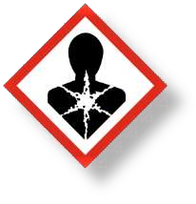
21
A carcinogen is any substance, radionuclide or radiation that is an agent directly involved in the exacerbation of cancer or in the increase of its propagation
Group A1: Confirmed human carcinogen
Group A2: Suspected human carcinogen
Group A3: Confirmed animal carcinogen with unknown relevance to humans
Group A4: Not classifiable as a human carcinogen
Group A5: Not suspected as a human carcinogen

Slide 22
22
Use personal protection equipment:
Gloves, safety glasses, and a coat are required.
Use disposable sleeve protectors and disposable lab or smock, as appropriate.
Follow emergency procedures for exposure and spills.
Follow proper waste disposal procedures
Access to the controlled area is prohibited.
When your work is completed, follow these steps:
Remove all protective clothing and immediately wash your hands, forearms, face, and neck.
Dispose of any contaminated disposable protective apparel or equipment as hazardous chemical waste, clearly labeled as carcinogenic.
Thoroughly wash non-disposable apparel and equipment before removing it from the controlled area.
Thoroughly clean all surfaces in the controlled area before removing the carcinogen warning sign and
resuming other work.

Slide 23


23
Is a physical or chemical agent that changes the genetic material, usually DNA, of an organism and thus increases the frequency of mutations above the natural background level.
Mutagens are usually chemical compounds or ionizing radiation. Mutagens can be divided
into different categories according to their effect on DNA replication:
Some mutagens act as base analogs and get inserted into the DNA strand during replication in place of the substrates.
Some react with DNA and cause structural changes that lead to miscopying of the template strand when the DNA is replicated.
Some work indirectly by causing the cells to synthesize chemicals that have the direct mutagenic effect.

Slide 24

24
Only handle mutagen in the fume hood.
Keep a hazardous waste bag in the fume hood.
Dispose of most objects (gloves, towels, pipettes, etc.) in this bag (which might have come in contact with
the
mutagen).Arrange with Environmental Health and Safety for disposal of this bag following the experiment.
Cover the working surfaces and the floor with absorbent paper. Dispose of these papers in the hazardous waste
bag after the experiment.
Wear gloves at all times and change them frequently. Specifically, change your gloves whenever you suspect contact
with the mutagen or whenever you leave the fume hood. Wash your hands (and face) periodically during the
experiment.
Inactivate the mutagen following the experiment by pouring the mutagen and rinses into an equal volume of 20%
sodium thiosulfate, 1% NaOH. Make a separate inactivation bath to soak those items (beakers, mouse

Slide 25

25
Substances and preparations which are dangerous for
the environment: substances and preparations which, were they to enter the environment, would present or may present an immediate or delayed danger for one or more components of the environment.

Slide 26


26
Reproductive toxicity
Is a hazard associated with some chemical substances, that they will interfere in some way with normal reproduction.
It includes adverse effects on sexual function and fertility in adult males and females, as well as developmental toxicity in the offspring

Slide 27


27

Slide 28

28
American National Standard (ANSI) Z-129.1,
U.S. Occupational Safety and Health Administration, (OSHA) 29 CFR 1910.1200:
U.S. Environmental Protection Agency, (EPA) 40 CFR Part 156
U.S. Consumer Product Safety Commission, (CPSC) 16 CFR 1500:
U.S. Department of Transportation, (DOT) 49 CFR Part 107:
National Fire Protection Association (NFPA) 704,
National Paint and Coatings Association, (NPCA) Hazardous Materials Identification System,

Slide 29
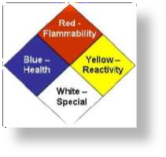
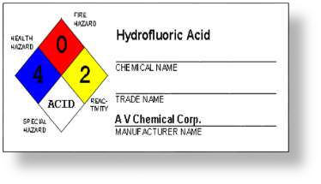
NFPA (U.S.A.)
29
HMIS “hazardous material identification system”
Health Hazard: 4
Fire Hazard: 0
Reactivity: 2
Personal Protection: Acid equipments

Slide 30


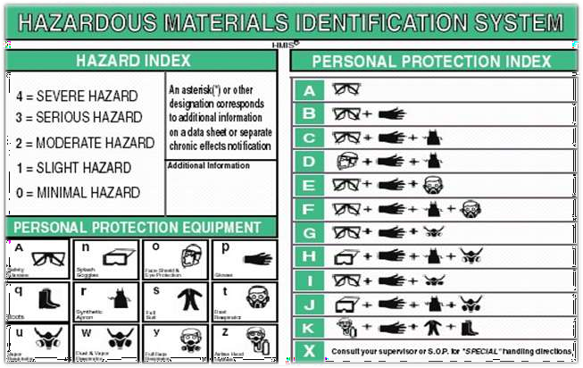
30

Slide 31
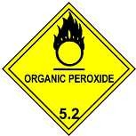
31
European Economic Community (EEC) amending for the seventh time
Directive 67/548/European Economic Community, (packaging and labeling of dangerous preparations).
Controlled Products Regulation, Hazardous Products Act, Canada Gazette, Part II,
Australia Work safe, National Occupational Health and Safety Commission,
NORMA Oficial Mexicana NOM-114-STPS-1994.
Korean Ministry of Labor Notice 1997-27 .
Japanese Official Notice of Ministry of Labor No. 60 .

Slide 32

IMDG
32
The objective of the
International Maritime Dangerous Goods (IMDG) Code is to:
Enhance the safe transport of dangerous goods.
Protect the marine environment.
Facilitate the free unrestricted movement of dangerous goods.

Slide 33

IMDG
33
The 9 classes:
Class 1
Class 2
Class 3
Class 4
Class 5
Class 6
Class 7
Class 8
Class 9
Explosives Gases
Flammable liquids
Flammable solids
Oxidizing substances and organic peroxides Toxic and infectious substances
Radioactive material Corrosive substances
Miscellaneous dangerous substances and
articles

Slide 34
IMDG
34
e.g.
Class 2: Gases
Class 2.1: flammable gases
Class 2.2: non-flammable, non-toxic gases Class 2.3: toxic gases

Slide 35

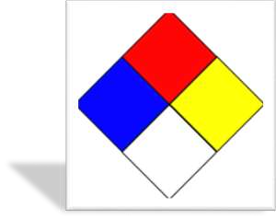
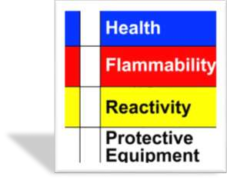
35
NFPA and HMIS shapes

Slide 36

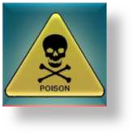
36
In the latest version of HMIS, the blue Health bar has two spaces,
4. Life-threatening, major or permanent.
3. Major injury likely unless prompt action is taken and medical treatment is given.
2. Temporary or minor injury may occur.
1. Irritation or minor reversible injury possible.
0. No significant risk to health.

Slide 37
37
4. Flammable gases, or very volatile flammable liquids with flash points below 73 °F (23 °C), and boiling points below 100 °F (38 °C). Materials may ignite spontaneously with air (eg., Propane).
3. Materials capable of ignition under almost all normal temperature conditions. Includes flammable liquids with flash points below 73 °F (23 °C) and boiling points
above 100 °F (38 °C), as well as liquids with flash points between 73 °F and 100 °F.
2. Materials which must be moderately heated or exposed to high ambient
temperatures before ignition will occur. Includes liquids having a flash point at or above 100 °F (38 °C) but below 200 °F (93 °C) (eg., Diesel fuel).
1. Materials that must be preheated before ignition will occur. Includes liquids, solids and semi solids having a flash point above 200 °F (eg., Canola oil).
0. Materials that will not burn (eg., Water).

Slide 38

38
Common name | CAS Number | Flash point | Class | Auto ignition Temperature
Flammable gases | 67-64-1 | −17 °C (1.4 °F) | 4 | 465 °C (869 °F)
Biodiesel | n/a mixture | >130 °C (266 °F) | 3
Diesel | n/a mixture | >62 °C (144 °F) | 2 | 210 °C (410 °F)
Ethanol | 64-17-5 | 12.8 °C (55.0 °F) | 1 | 365 °C (689 °F)
Gasoline | n/a mixture | <−40 °C (−40.0 °F) | 0 | 246 °C (475 °F)

Slide 39

39
4. Materials that are readily capable of explosive water reaction, detonation or explosive
decomposition,
polymerization, or self-reaction at normal temperature and pressure
3. Materials that may form explosive mixtures with water and are capable of detonation or explosive
reaction
in the presence of a strong initiating source. Materials may polymerize, decompose, self-react, or
undergo
other chemical change at normal temperature and pressure with moderate risk of explosion.
2. Materials that are unstable and may undergo violent chemical changes at normal temperature and pressure
with low risk for explosion. Materials may react violently with water or form peroxides upon exposure to air.
1. Materials that are normally stable but can become unstable (self-react) at high temperatures and pressures.
Materials may react non-violently with water or undergo hazardous polymerization in the absence of inhibitors.

Slide 40
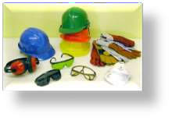

40
This is by far the largest area of difference between the NFPA and HMIS systems. In the NFPA system,
the white area is used to convey special hazards whereas HMIS uses the white section to indicate what personal protective equipment (PPE) should be used when working with the material.

Slide 41






41
safety glasses
safety glasses and gloves
safety glasses, gloves and an apron D face shield, gloves and an apron
safety glasses, gloves and a dust respirator
safety glasses, gloves, apron and a dust respirator G safety glasses, a vapor respirator
H I J
splash goggles, gloves, apron and a vapor respirator safety glasses, gloves and a dust/vapor respirator splash goggles, gloves, apron and a dust/vapor
respirator
K airline hood or mask, gloves, full suit and boots
L – Z custom PPE specified by employer

Slide 42
42
Basel Convention
DOT: GHS:
Department of Transportation
Globally Harmonized System of Classification and Labeling of Chemicals.
Hazard Communication Standard
HCS:
IMDG: the International Maritime Dangerous Goods. OSHA: Occupational Safety and Health Administration MSDS: Material Safety Data Sheet
UNCETDG: United Nations Committee of Experts on the Transport of Dangerous Goods
WHMIS: Workplace Hazardous Materials Information System

