Slide 1
BIOREMEDIATION
By
Dr. Zaryab Khalid
Class: MS Botany
Semester: II
Subject: Environmental Biotechnology

Slide 2
What is BIOREMEDIATION ?
BIO
REMEDIATION
microbial
method to fix
Using microorganisms to clean up pollution in the environment

Slide 3
Biogeochemical cycle influenced by man

Slide 4
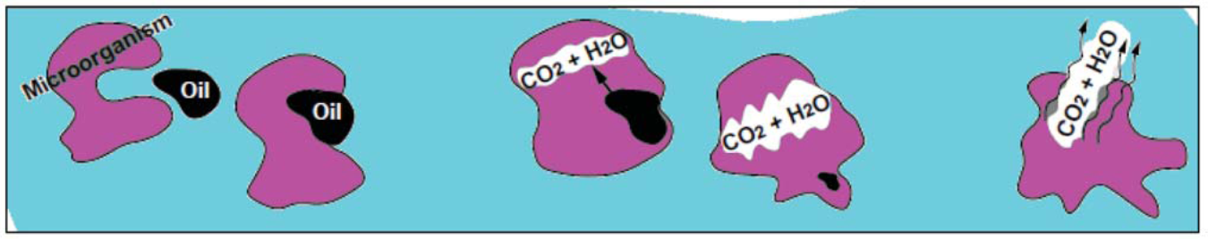
DEFINTION !!
“Use of living organisms to transform, destroy or immobilize contaminant”
Goal: Detoxification of the parent compound(s) and conversion to products that are no longer hazardous to human health and the environment

Slide 5
Biodegradation Vs. Bioremediation
Biodegradation refers to the natural process whereby bacteria or other microorganisms alter and break down organic molecules into other substances , such as fatty acids and carbon dioxide.
bioremediation is the act of adding materials to contaminated environments, such as oil spill sites, to cause an acceleration of the natural biodegradation process.
-- it include Fertilization and seeding

Slide 6
History
1972 - First commercial application: Sun Oil pipeline spill in Ambler, Pennsylvania
1970s - Continuing bioremediation projects by Richard Raymond of Sun Oil
mid-1980s - emphasis on bioengineering organisms for bioremediation. This technology did not live up to its initial promise
1990s - emphasis switched to greater reliance on natural microorganisms and techniques to enhance their performance

Slide 7
Bioremediation Background
Natural Attenuation is Not fast enough, Not complete enough, Not frequently occurring enough to be broadly used for some compounds, especially chlorinated solvents
The current trend is to stimulate/enhance a site’s indigenous subsurface microorganisms by the addition of nutrients and electron donor
In some cases, bioaugmentation is necessary when metabolic capabilities are not naturally present.

Slide 9
Why Microbes ??
Typically very rapid if food (carbon source) is present: population doubles every 45 minutes
Pristine soils contain 100 to 1000 aerobic bacteria per gram of soil
Increases to 10⁵ within one week if carbon source is introduced

Slide 10

Examples of microbes used for bioremediation include:
Deinococcus radiodurans bacteria have been genetically modified to digest solvents and heavy metals, as well as toluene and ionic mercury from highly radioactive nuclear waste.
Geobacter sufurreducens bacteria can turn uranium dissolved in groundwater into a non-soluble, collectable form.
Dehalococcoides ethenogenes bacteria are being used in ten states to clean up chlorinated solvents that have been linked to cancer. The bacteria are naturally found in soil.

Slide 11

Uranium reduction leads to uranium precipitation and immobilization
U⁶⁺_{sol}
U⁴⁺_{insol}
U⁶⁺_{sol}
U⁶⁺_{sol}
U⁴⁺_{insol}

Slide 12
Thermus brockianus :An enzyme from this bacterium,, found in Yellowstone National Park, breaks down hydrogen peroxide 80,000 times faster than current chemicals in use.
The bacterium, Alcaligenes eutrophus, naturally degrades 2,4-D, the third most widely used herbicide in the U.S.

Slide 13
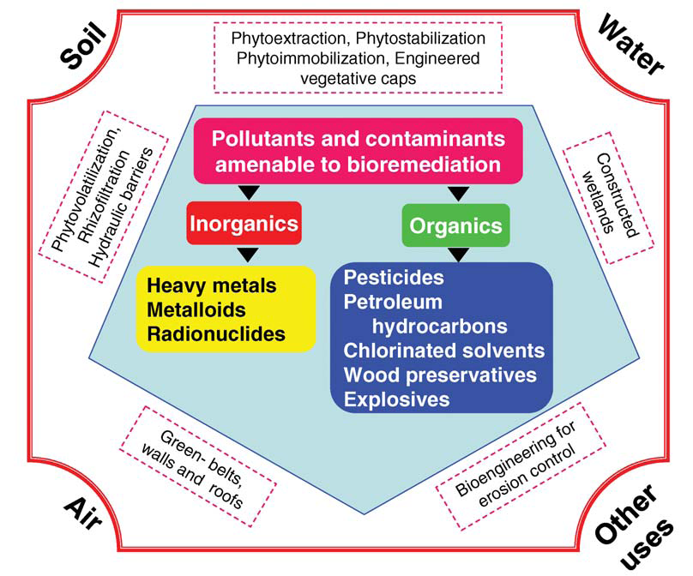
Method depending on nature of contaminants

Slide 14
Types of bioremediation
In-situ bioremediation
If the process occurs in the same place
affected by pollution then it is called
in-situ bioremediation.
ex- Bioventing
In situ biodegradation
Bio stimulation
Bio sparging
Bio augmentation
Natural Attenuation

Slide 15
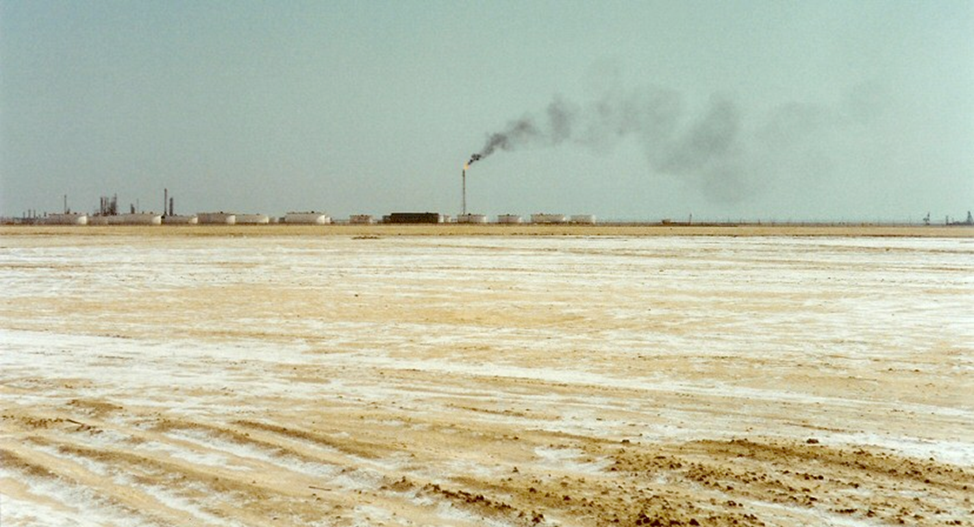
degradation of crude oil by halophilic Archaea

Slide 17
Continue…
2.Ex-situ bioremediation:-
deliberate relocation of the contaminated material (soil and water) to a different place to accelerate bio catalysis is referred to as ex-situ bioremediation
  Land farming
  Composting
  Biopiles
  Bioreactors

Slide 18
Continue…
3. Intrinsic Bioremediation :-
bioremediation can be accomplished without human intervention by microorganisms that are naturally found in the contaminated matrix.
-the rate of contaminant degradation sud exceed the rate of contaminant migration.
-the bioavailability of contaminants,
levels of nutrients,
the pH of the matrix,
adequate levels of electron acceptors (either oxygen , nitrate, ferric iron, or sulfate),
and site specific contamination migration rates.

Slide 19
Continue…
4.Engineered Bioremediation :-
it may be desirable to construct engineered systems to supply nutrients, electron acceptors or other materials that enhance the rate or extent of contaminant degradation.
This is to achieve faster rate
To translocate the final product
When there is a threat of migration of contaminants
All the factor of natural attenuation remains same

Slide 20
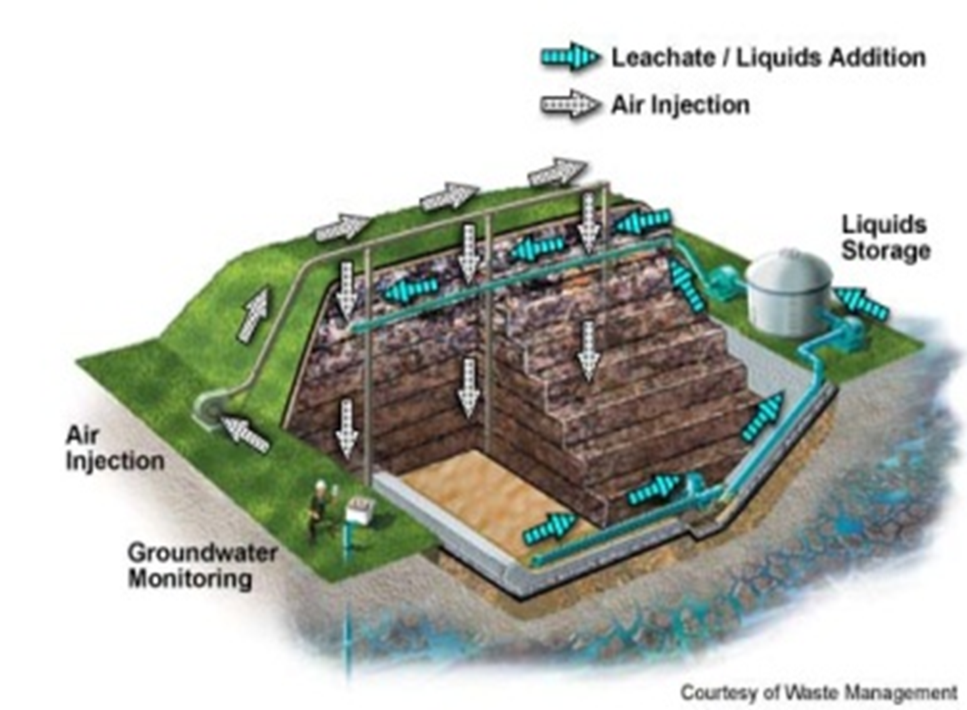

Slide 21
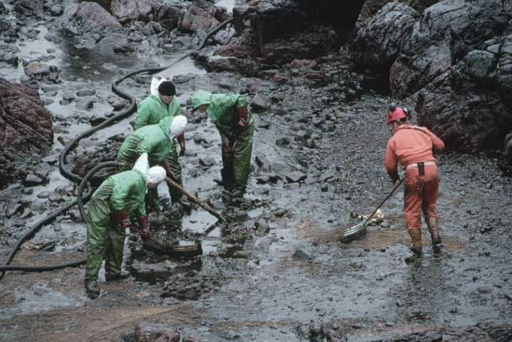
In-situ bioremediation

Slide 22
Bioventing
The system supplies oxygen by injecting air directly into the residual contamination .
bioventing uses low airflow rates to provide only enough oxygen to sustain microbial activity.
Optimal flow rates maximize biodegradation as vapors move slowly through biologically active soil while minimizing volatilization of contaminants.
It works for simple hydrocarbons and can be used where the contamination is deep under the surface.
A basic bioventing system includes
a well and
a blower---which pumps air through the well and
into the soil.

Slide 24
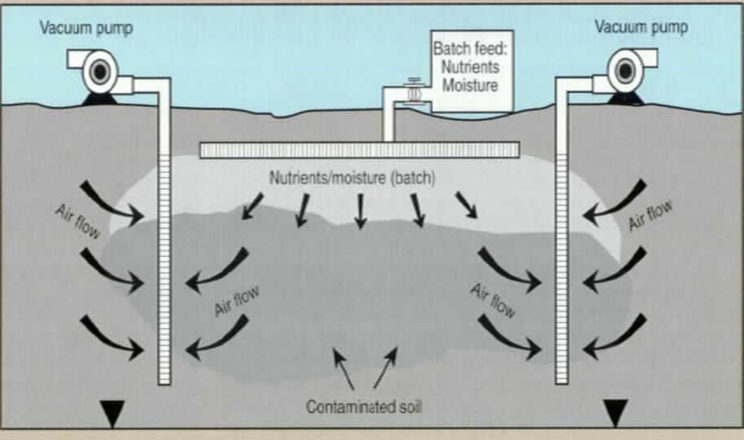
  One of the most common approaches in soil
  Supply air and nutrients via wells
  Takes advantage of indigenous microorganisms

Slide 25
In situ biodegradation
Supply air and nutrients by circulating aqueous solutions through contaminated soils or groundwater
Contaminants are composed of simple carbons.
Can be attenuated by natural microrganism.
Some limiting factors like aeration etc is provided

Slide 26
Bio stimulation
“bioremediation method of adding nutrients, such as nitrogen and phosphorus, to a contaminated environment to stimulate the growth of indigenous microorganisms”.
This approach is also termed nutrient enrichment or fertilization.
It also utilizes natural microflora & fauna.
Natural attenuation is going on but rate is extremely slow

Slide 27
Biosparging
injection of air under pressure below the water table to increase groundwater oxygen concentrations and enhance the rate of biological degradation of contaminants by naturally occurring bacteria.
The ease and low cost of installing small-diameter air injection points allows considerable flexibility in the design and construction of the system.

Slide 28
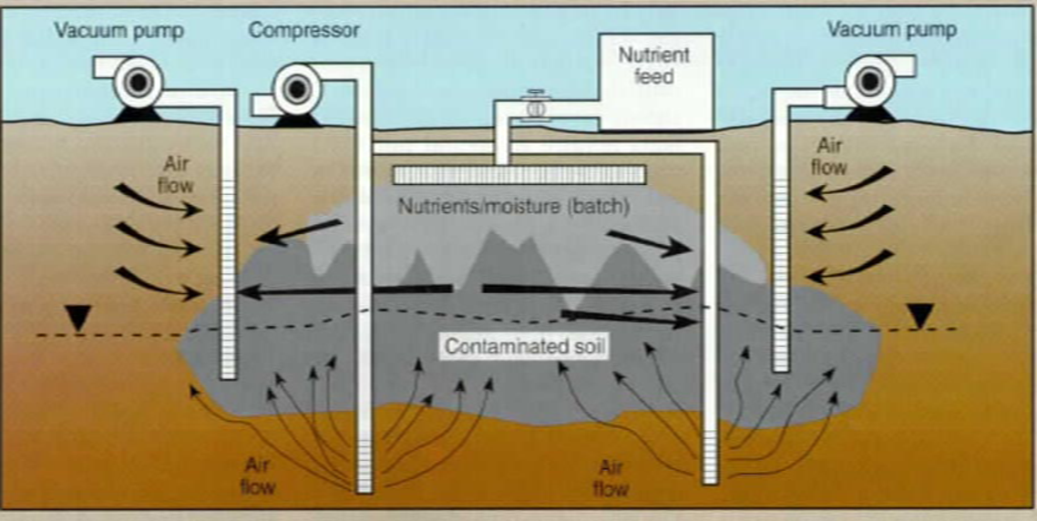

Slide 29
Bio augmentation
addition of microorganisms indigenous or exogenous to the contaminated sites for better remediation and faster rate.
Two factors limit the use of added microbial cultures in a land treatment unit:
1) nonindigenous cultures rarely compete well enough
with an indigenous population to develop and sustain
useful population levels and
2) most soils with long-term exposure to biodegradable
waste have indigenous microorganisms that are
effective degrades if the land treatment unit is well
managed.
Provide a chance of utilizing efficient strain of microbes.

Slide 30
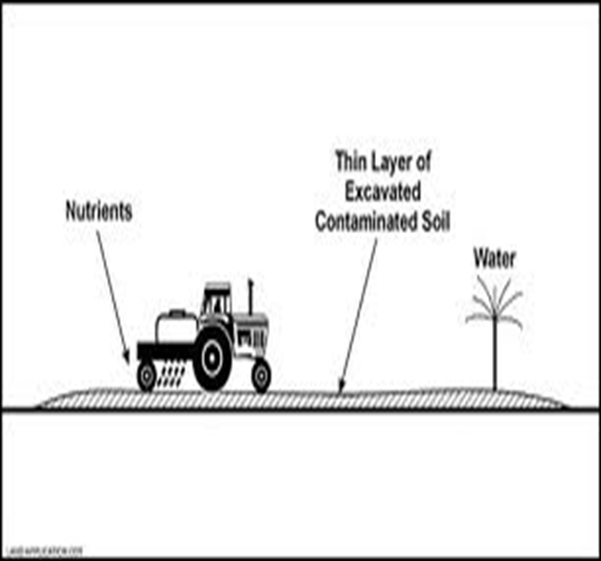
Land farming
Contaminated soil is excavated and spread over land
Soil is periodically tilled to improve aeration
Remediation due to indigenous microorganisms, as well as chemical and physical processes
Generally limited to the superficial 10–35 cm of soil
Can reduce monitoring and maintenance costs

Slide 31
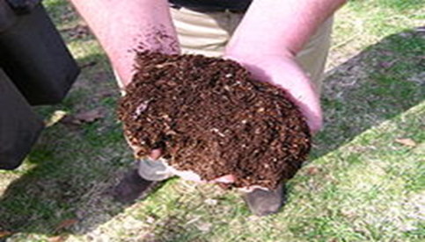
Composting
No need to waste time

Slide 32
Biopiles
are a hybrid of landfarming and composting.
engineered cells are constructed as aerated composted piles.
Typically used for treatment of surface contamination with petroleum hydrocarbons
they are a refined version of landfarming that tend to control physical losses of the contaminants by leaching and volatilization.
Biopiles provide a favorable environment for indigenous aerobic and anaerobic microorganisms

Slide 33
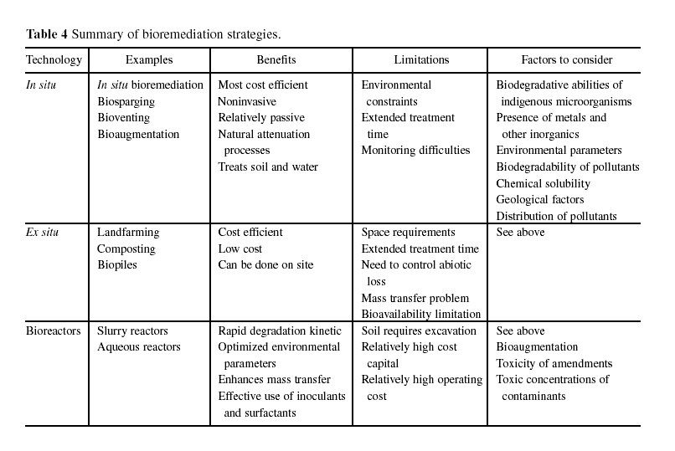

Slide 34
FACTORS AFFECTING CONTAMINANT BIODEGRADABILITY
Simple hydrocarbons and petroleum fuels
degradability decreases as molecular weight and degree of
branching increase
Aromatic hydrocarbons
one or two ring compounds degrade readily, higher
molecular weight compounds less readily
Alcohols, esters Nitrobenzenes and ethers
degrade slowly
Chlorinated hydrocarbons
decreasing degradability within increasing chlorine
substitution – highly chlorinated compounds like PCBs
and chlorinated solvents do not appreciably degrade
aerobically
Pesticides
are not readily degraded
b I o d e g r a d I b i l i t y

Slide 35
REQUIREMENTS FOR BIOREMEDIATION
MICROORGANISMS
ENERGY
SOURCE
ELECTRON
ACCEPTOR
MOISTURE
pH
NUTRIENTS
TEMPERATURE
ABSENCE OF
TOXICITY
REMOVAL OF
METABOLITIES
ABSENCE OF
COMPETITIVE
ORGANISMS
BIOREMEDIATION

Slide 36
Metabolism of a Pollutant-degrading Bacterium
Fe(III)
ACETATE
*U(VI)
*Co(III)
*Cr(VI)
*Se(VI)
*Pb(II)
*Tc(VII)
*Benzoate
*Toluene
*Phenol
*p-Cresol
*Benzene
ATP
CO₂
Fe(II)
*CCl₄
*Cl-ethenes
*Cl-aromatics
*Nitro-aromatics

Slide 37
Site evaluation for bioremediation
There are at least five critical factors that should be considered when evaluating the use of bioremediation for site clean up.
Magnitude, toxicity, and mobility of contaminants
Proximity of human and environmental receptors
Degradability of contaminants.
Planned site use
Ability to properly monitor

Slide 38
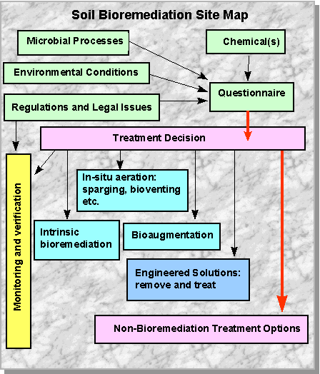

Slide 39
Potential Advantages of bioremediation
Lower cost than conventional technologies.
Contaminants usually converted to innocuous products.
Contaminants are destroyed, not simply transferred to different environmental media.
Nonintrusive, potentially allowing for continued site use.
Relative ease of implementation.

Slide 40
Disadvantages of Bioremediation
May be difficult to control.
Amendments introduced into the environment to enhance bioremediation may cause other
contamination problems.
May not reduce concentration of contaminants to required levels.
Requires more time.
May require more extensive monitoring.
Lack of (hydraulic) control.
Dynamic process, difficult to predict future effectiveness

