Slide 1
DNA and Protein Markers
Class MS Semester II
Course Title: Molecular advances in phyto-systematics
Instructor: Dr. ARUSA AFTAB
Department of botany
Lahore college for women university Lahore

Slide 2
“A gene or other fragment of DNA whose location in the genome is known is called DNA marker”
DNA markers are also known as molecular markers or genetic markers.
It refers to any unique DNA sequence which can be used in DNA hybridization, PCR or restriction mapping experiments to identify that sequence is called DNA marker.
Most commonly used DNA markers are RFLP, RAPD, AFLP, SNPs, SCAR, EST, SSCP, STS,CAPS microsatellites etc.

Slide 3
Properties of DNA marker:
Polymorphism: Markers should exhibit high level of polymorphism. In other words, there should be variability in the markers. It should demonstrate measurable differences in expression between trait types and/or gene of interest.
Co dominant: Marker should be co-dominant. It means, there should be absence of intra-locus interaction. It helps in identification of heterozygotes from homozygotes.
Multiallelic : The marker should be multi-allelic. It useful in getting more variability/ polymorphism for a character

Slide 4
No epistasis: There should be absence of epistasis. It makes Identification of all phenotypes (homo- and heterozygotes) easy.
Neutral: The marker should be neutral. The substitution of alleles at the marker locus should not alter the phenotype of an individual. This property is found in almost all the DNA markers.

Slide 5
No effect of environment: Markers should be insensitive to environment. This property is also found in almost all the DNA markers

Slide 6
Applications of DNA markers:

Slide 7
DNA markers are useful in the assessment of genetic diversity in germplasm, cultivars and advanced breeding material.
DNA markers can be used for constructing genetic linkage maps.
DNA markers are useful in identification of new useful alleles in the germplasm and wild species of crop plants.
DNA markers are used in the marker assisted or marker aided selection. MAS has several advantages over straight selection.
DNA markers are useful in the study of crop evolution.

Slide 8
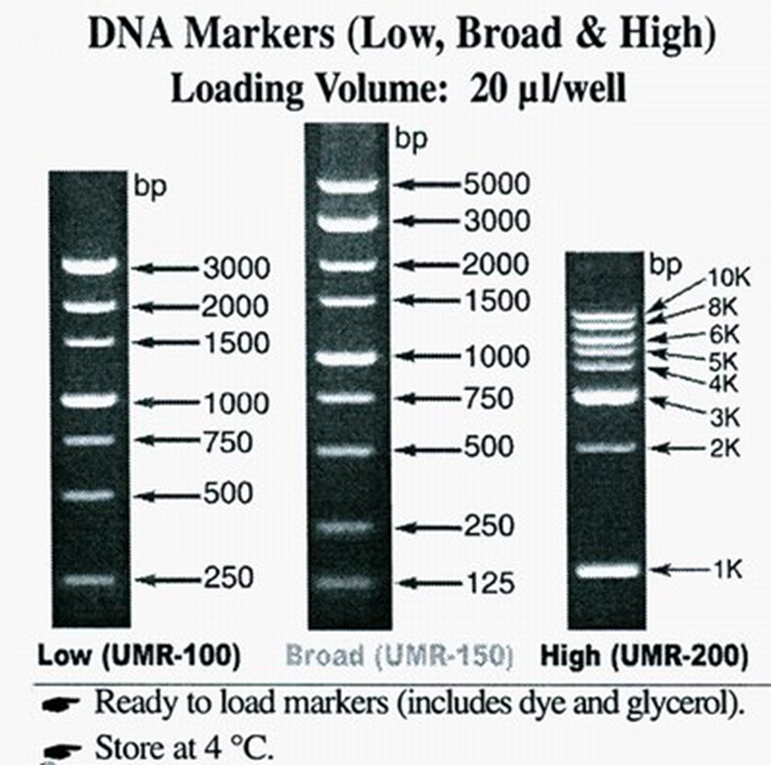
DNA markers are highly polymorphic. They have simple inheritance (often co-dominant).
They abundantly occur throughout the genome.
They are easy and fast to detect and exhibit minimum pleiotropic effect.
Their detection is not dependent on the developmental stage of the organism.

Slide 9
TYPES OF DNA MARKERS
I. Restriction Fragment Length Polymorphism(RFLP):
RFLPs refer to variations found within a species in the length of DNA fragments generated by specific endonuclease.
RFLPs are first type of DNA markers developed to distinguish individuals at the DNA level.
The majority of RFLP markers are co dominant and have locus specificity. These are powerful tool for comparative and synatny mapping.

Slide 11
II. Amplified Fragment Length Polymorphism (AFLP):
AFLPs are differences in restriction fragment lengths caused by SNPs or INDELs that create or abolish restriction endonuclease recognition sites.
AFLP assays are performed by selectively amplifying a pool of restriction fragments using PCR. RFLP technique was originally known as selective restriction fragment amplification.
AFLP markers are used in varietal identification, germplasm characterization, gene tagging and marker assisted selection.

Slide 12
III. Random Amplified Polymorphic DNA (RAPDs):
RAPD refers to polymorphism found within a species in the randomly amplified DNA generated by restriction endonuclease enzyme.
RAPDs are PCR based DNA markers. RAPD marker assays are performed using single DNA primer of arbitrary sequence.
RAPD primers are readily available being universal. RAPD markers can be used for varietal identification, DNA fingerprinting, gene tagging and construction of linkage maps.
It can also be used to study phylogenetic relationship among species and sub-species and assessment of variability in breeding populations.

Slide 13
IV. Simple Sequence Repeats (SSRs):
Simple sequence repeats (SSRs) or microsatellites are tandemly repeated mono-, di-, tri-, tetra-, penta-, and hexanucleotide motifs.
SSR length polymorphisms are caused by differences in the number of repeats. SSR loci are individually amplified by PCR using pairs of oligonucleotide primers specific to unique DNA sequences flanking the SSR sequence.
SSR markers tend to be highly polymorphic. The genotyping throughput is high.Thsee are used for gene mapping in eukaryotes.

Slide 14
V. Single Nucleotide Polymorphism (SNP):
The variations which are found at a single nucleotide position are known as single nucleotide polymorphisms or SNP.
SNP markers are highly polymorphic and mostly bialleleic. The genotyping throughput is very high. SNP markers are locus specific.
SNP markers are excellent long term investment.These markers can be used to pinpoint functional polymorphism.
They have been used in preparing human genetic maps.

Slide 15
VI. Cleaved Amplified Polymorphic Sequences (CAPS):
CAPS polymorphisms are differences in restriction fragment lengths caused by SNPs or INDELs that create or abolish restriction endonuclease recognition sites in PCR amplicons produced by locus-specific oligonucleotide primers.
This is straightforward way to develop PCR-based markers from the DNA sequences of previously mapped RFLP markers.
It is a simple method that builds on the investment of an RFLP map and eliminates the need for DNA blotting.

Slide 16
PROTEIN MARKERS

Slide 17
A protein marker is a marker for specific proteins. This usually deals with running an experiment (assay) to determine the presence, absence, and with some markers, abundance of a specific protein.
Example: For example, We can use a protein marker to mark an extracellular protein such as a Lipopolysaccharide (LPS) on bacteria. The marker would specifically bind to LPS and induce some type of visual response.

Slide 18
Protein molecular weight markers, sometimes identified as protein standards or protein ladders, are used to estimate the molecular weight of proteins of interest, to monitor the progress of electrophoretic separation or transfer, and as a positive control for analysis conditions.
The marker provides a set of references optimized for consistent migration that can easily be compared to experimental gel run results.
Protein markers can come unstained or prestained.

Slide 19
Prestained markers allow easy tracking of separation and transfer. Unstained markers provide more precise determination of molecular weight.
Conditions such as buffers, charge/voltage, and concentration should be taken into account when selecting a protein marker.

Slide 20
Types of protein marker:
I. Prestained protein markers:
The Prestained Protein Marker (Triple color, EDTA free, 10-250 kDa) is a prestained mixture of ten recombinant proteins ranging from 10 kDa to 250 kDa.
Three different chromophores are bound to the proteins, 9 bands with blue, one red at 70 kDa and one green at 25 kDa.
Three different chromophores are bound to the proteins, 9 bands with blue, one red at 70 kDa and one green at 25 kDa.

Slide 21
The Prestained Protein Marker is applied for observing protein separation during SDS-PAGE electrophoresis, verification of western transfer efficiency on membranes, and identifying the size of proteins. The marker can also be used in fluorescent imaging of membranes.
Prestained ladders are visible during electrophoresis, enabling the researcher to monitor the progress of separation for the range of protein sizes that are most relevant to the particular experiment.

Slide 22
II. Un stained protein markers:
Unstained Protein Molecular Weight Marker is a mixture of seven native proteins (14.4 to 116 kDa) for use as size standards in protein electrophoresis (SDS-PAGE)
Unstained protein ladders are not visible during electrophoresis and must be stained with the rest of the gel to be seen.

Slide 23
LINKS:
http://www.biologydiscussion.com/dna/dna-markers/dna-markers-definition-properties-and-applications/37972
https://www.sigmaaldrich.com/life-science/proteomics/protein-electrophoresis/molecular-weight-markers.html.
http://www.biologydiscussion.com/dna/dna-markers/top-10-types-of-dna-markers-genetics/37969

