Slide 1
POLLUTION:
air, water, land, thermal, radiation and noise

Slide 2
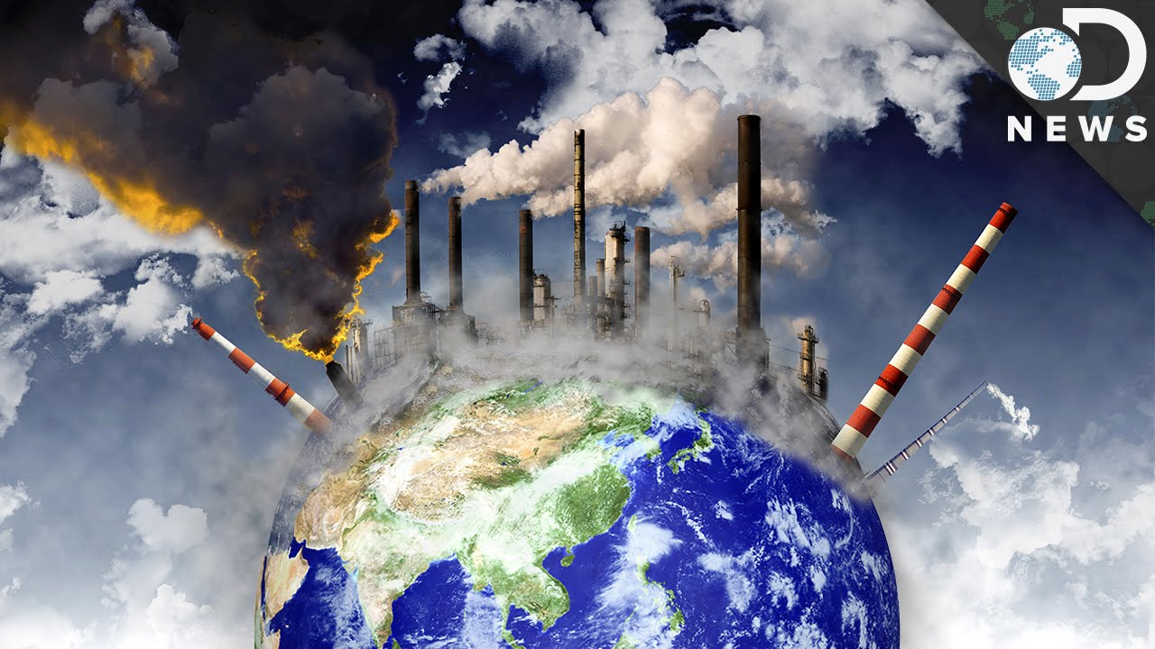
WHAT IS POLLUTION?
“Pollution is the introduction of contaminants into the natural environment that cause adverse change”.
Pollution can take the form of chemical substances or energy, such as noise, heat or light.
Pollutants, the components of pollution, can be either foreign substances/energies or naturally occurring contaminants.”

Slide 3
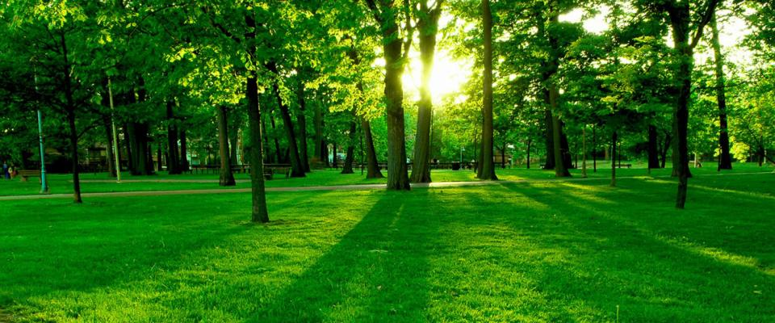
NOISE POLLUTION
RADIOACTIVE POLLUTION
THERMAL POLLUTION
LAND POLLUTION
POLLUTION
AIR POLLUTION
WATER POLLUTION

Slide 4
INTRO
WHAT
IS AIR
POLLUTION?

Slide 5
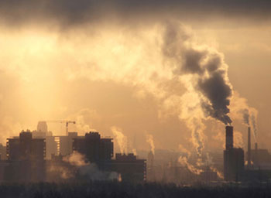
WHAT IS AIR POLLUTION?
“Air pollution occurs when harmful or excessive quantities of substances including the gases (CO₂, CO, SO₂, NO, CH₄, CFC, Radon, etc.) particles (both organic and inorganic) and biological molecules are introduced into Earth's atmosphere.
It may cause diseases, allergies and even death to humans.
It may also cause harm to other living organisms such as animals and food crops, and may damage the natural or built environment.
Both human activity and natural processes can generate air pollution.”

Slide 6
TYPES OF AIR POLLUTION
Fine particles produced by the burning of fossil fuels
Household products and chemicals, building materials, outdoor indoor allergens
OUTDOOR
INDOOR
COMMON
EXAMPLE
EXAMPLE
exposures to particulates, carbon oxides, and other pollutants carried by indoor air or dust
exposures that take place outside of the built environment
Noxious gases, tobacco smoke

Slide 7
CAUSES OF AIR POLLUTION
Methane is a more potent global gas than carbon dioxide
dust and chemicals are released in the air causing massive air pollution
THE BURNING OF FOSSIL FUELS
EXHAUST FROM INDUSTRIES
WASTE
AGRICULTURAL ACTIVITIES
MINING OPERATIONS
Sulfur dioxide emitted from the combustion of fossil fuels
They release a large amount of carbon monoxide, hydrocarbons
40 percent of waste is openly burned
166 out of 193 countries

Slide 8
EFFECTS OF AIR POLLUTION
With increased temperatures, increase in sea levels and melting of ice, loss of habitat have already signaled
A high amount of nitrogen present in some pollutants gets developed on sea’s surface and turns itself into algae
RESPIRATORY AND HEART PROBLEMS
EFFECT ON WILDLIFE
ACID RAIN
GLOBAL WARMING
EUTROPHICATION
Acid rain can cause great damage to human, animals, and crops from the burning of fossil fuels
Toxic chemicals present in the air can force wildlife species to move to a new place and change their habitat
Million are known to have died due to direct or indirect effects of Air pollution

Slide 9
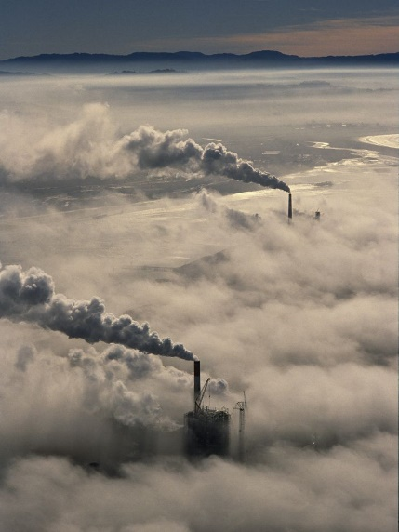
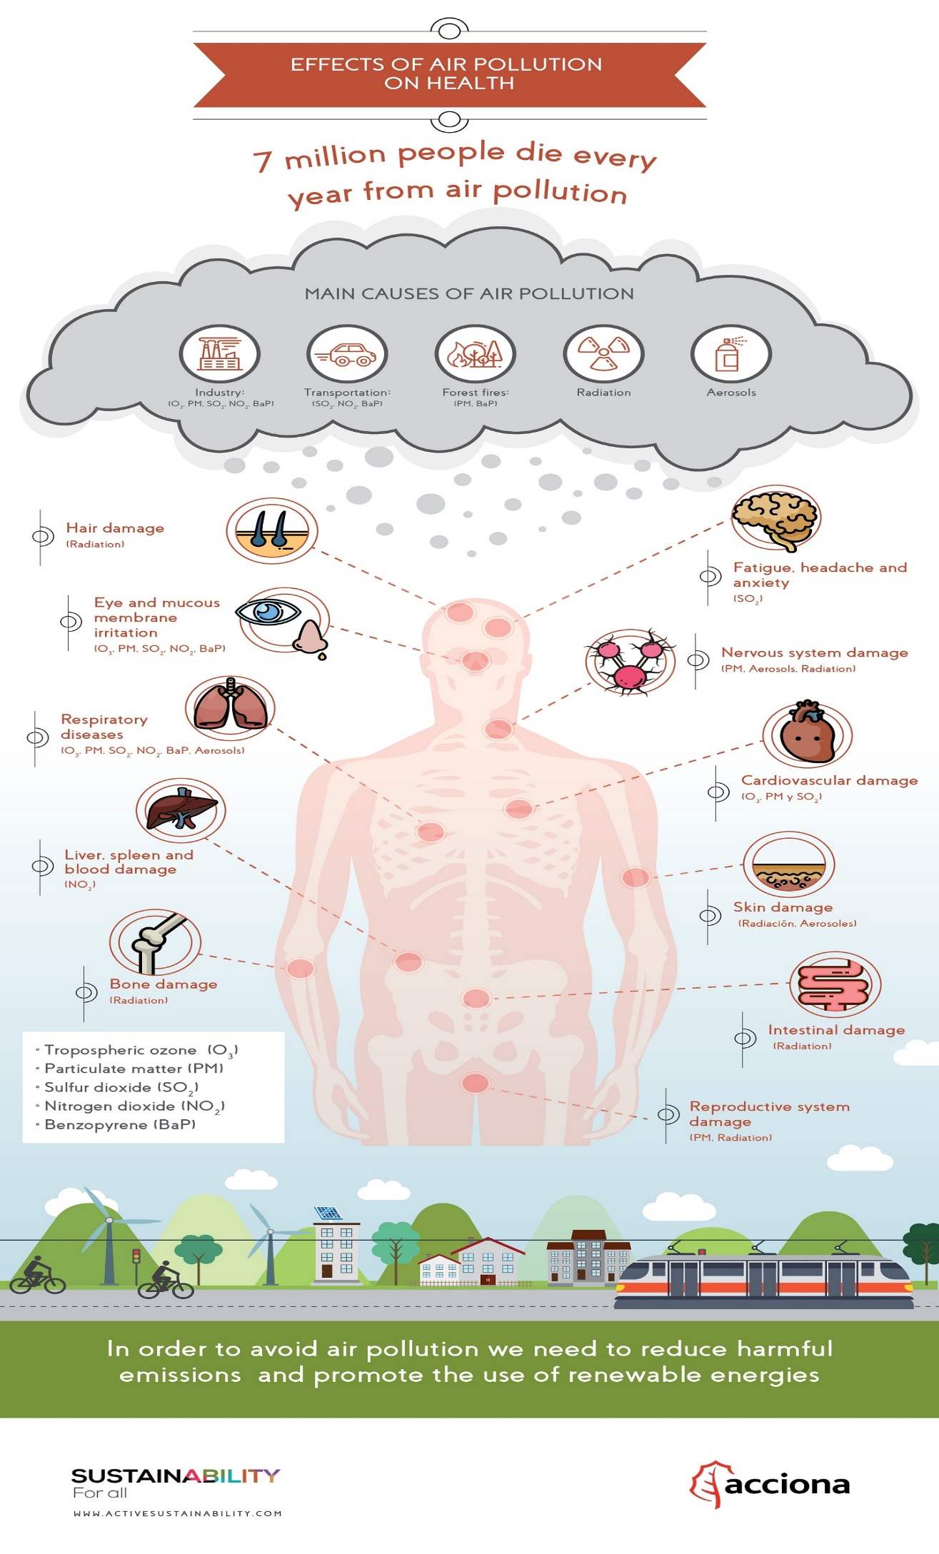

Slide 10
HOW TO OVERCOME AIR POLLUTION
Save the environment from degradation by reducing the number of fossil fuels to be burned.
Use Clean energy technologies like solar, wind and geothermal
CONCEPT OF REDUCE, REUSE AND RECYCLE
USE PUBLIC MODE OF TRANSPORTATION
ENERGY EFFICIENT DEVICES
CONSERVE ENERGY
CLEAN ENERGY RESOURCES
You can use old jars to store cereals or pulses.
CFL lights consume less electricity
Try to make use of carpooling

Slide 11
INTRO
WHAT
IS WATER
POLLUTION?

Slide 12
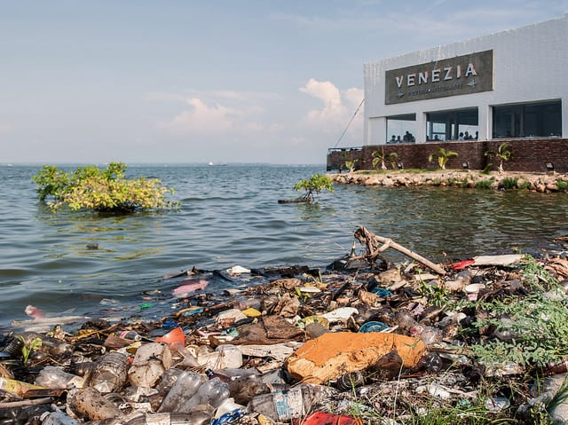
WHAT IS WATER POLLUTION?
“Water pollution is the contamination of water bodies, as a result of human activities. Water bodies include for example lakes, rivers, oceans, aquifers and groundwater.
Water pollution results when contaminants are introduced into the natural environment.”
For example, releasing inadequately treated wastewater into natural water bodies can lead to degradation of aquatic ecosystems.
Water pollution is the leading worldwide cause of death and disease, e.g. due to water-borne diseases.

Slide 13
CAUSES OF WATER POLLUTION
Pathogens are known as a common water pollutant
These items take from 2 weeks to 200 years to decompose
ACCIDENTAL OIL LEAKAGE
INDUSTRIAL WASTE
MINING ACTIVITIES
SEWAGE AND WASTEWATER
MARINE DUMPING
Many industries do not have a proper waste management system and drain the waste in the fresh water
Mining activities emit a large amount of metal waste and sulphides from the rocks which is harmful to the water
Oil spill poses a huge concern as a large amount of oil, opens problem for local marine wildlife

Slide 14
CAUSES OF WATER POLLUTION
They are useful for the plant’s growth. However, when these chemicals are mixed up with water produce harmful for plants and animals.
It increases the water temperature and results in the death of aquatic animals and marine species
LEAKAGE FROM SEWER LINES
URBAN DEVELOPMENT
CHEMICAL FERTILIZERS AND PESTICIDES
GLOBAL WARMING
The leaking water can come on to the surface and become a breeding ground for insects and mosquitoes.
increasing use of fertilizers to produce more food, increase in chemicals from industries

Slide 15
EFFECTS OF WATER POLLUTION
Pathogens are known as a common water pollutant
Disturb the food chain and food webs
ON THE ENVIRONMENT
DISEASES
EUTROPHICATION
DESTRUCTION OF ECOSYSTEMS
EFFECTS THE FOOD CHAIN
causes typhoid, cholera, hepatitis and various other diseases
Mining activities emit a large amount of metal waste and sulphides from the rocks which is harmful to the water
Thermal pollution, defined by a rise in the temperature of water bodies, contributes to global warming

Slide 16
HOW TO OVERCOME WATER POLLUTION
BETTER TREATMENT OF SEWAGE
USE ENVIRONMENTALLY FRIENDLY PRODUCTS
SAVE WATER
Simply small changes you can make domestically will make a huge difference
Treating waste products before disposing of it in a water body helps reduce water pollution on a large scale
We can reduce the amount of water pollution caused by a household

Slide 17
INTRO
WHAT
IS LAND
POLLUTION?

Slide 18
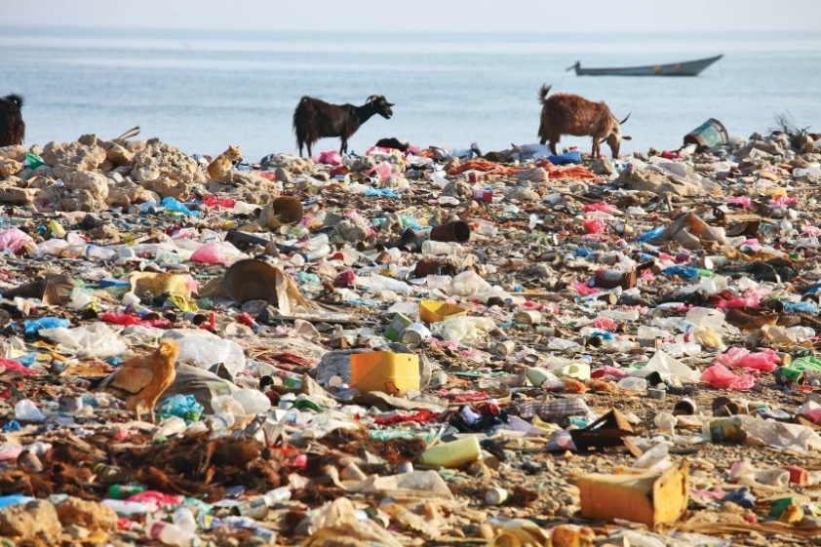
WHAT IS LAND POLLUTION?
“Land pollution is the deterioration of the earth's land surfaces, often directly or indirectly as a result of man's activities and their misuse of land resources.”
It occurs when waste is not disposed off properly, or can occur when humans throw chemicals into the soil in the form of pesticides, insecticides and fertilizers during agricultural practices.

Slide 19
CAUSES OF LAND POLLUTION
Items that can’t be recycled become a part of the landfills that hampers the beauty of the city
Nuclear plants can produce a huge amount of energy through nuclear fission and fusion
DEFORESTATION AND SOIL EROSION
INDUSTRIALIZATION
SEWAGE TREATMENT
OVERCROWDED LANDFILLS
NUCLEAR WASTE
Deforestation carried out to create dry lands-Barren Lands
To meet the demand of the growing population, more industries were developed which led to deforestation
A large amount of solid waste is leftover once the sewage has been treated

Slide 20
EFFECTS OF LAND POLLUTION
Land contaminated with toxic chemicals and pesticides lead to the problem of skin cancer
The city loses its attraction as a tourist destination as landfills, It leads to a loss of revenue for the state government
CHANGE IN CLIMATE PATTERNS
EFFECT ON WILDLIFE
SOIL POLLUTION
EFFECT ON HUMAN HEALTH
DISTRACTION FOR TOURISTS
The upper layer of the soil is damaged, Soil erosion, leads to loss of fertile land for agriculture
The constant human activity on land, is leaving it polluted, species are pushed to the verge of extinction, due to no homeland
When land is polluted, it directly or indirectly affects the climate patterns

Slide 21
HOW TO OVERCOME LAND POLLUTION
Avoid buying packages
Create dumping ground away from residential areas
Concept of Reduce, Recycle and Reuse
Reduce the use of pesticides and fertilizers
Buy biodegradable products

Slide 22
INTRO
WHAT
IS THERMAL
POLLUTION?

Slide 23
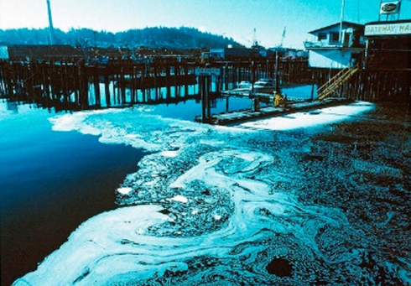
WHAT IS THERMAL POLLUTION?
“Thermal pollution is defined as sudden increase or decrease in temperature of a natural body of water which may be ocean, lake, river or pond by human influence.
This normally occurs when a plant or facility takes in water from a natural resource and puts it back with an altered temperature.”

Slide 24
CAUSES OF THERMAL POLLUTION
Consistent soil erosion causes water bodies to rise, making them more exposed to sunlight
Urban runoff discharged to surface waters from paved surfaces can make water warmer
WATER AS COOLING AGENT IN POWER
NATURAL CAUSES
DEFORESTATION
SOIL EROSION
RUNOFF FROM PAVED SURFACES
When heated water returns to the river or ocean, the water temperature rises sharply
With Deforestation, water bodies are directly exposed to sunlight, absorbing more heat and raising its temperature
Volcanoes and geothermal activity can trigger warm lava to raise the temperature of water bodies

Slide 25
EFFECTS OF THERMAL POLLUTION
There is a huge increase in toxins that are being regurgitated into the natural body of water
Excessive temperature can cause the release of immature eggs or can prevent normal development of certain eggs
DECREASE IN DO LEVELS
ECOLOGICAL IMPACT
INCREASES METABOLIC RATE
INCREASE IN TOXINS
AFFECTS REPRODUCTIVE SYSTEMS
The decrease in DO can create suffocation for plants and animals, give rise to anaerobic conditions
Small water temperature increases the level of activity while higher temperature decreases the level of activity
It disrupts the stability of food chain and alter the balance of species composition

Slide 26
HOW TO OVERCOME THERMAL POLLUTION
CONTROL TEMPERATURES IN URBAN AREAS
USE HEATED WATER AS A POWER SOURCE
PLANT MORE SHADE TREES
REDUCE ELECTRICAL CONSUMPTION
LOOK AT NO TILL FARMING OPTIONS

Slide 27
INTRO
WHAT
IS RADIOACTIVE
POLLUTION?

Slide 28
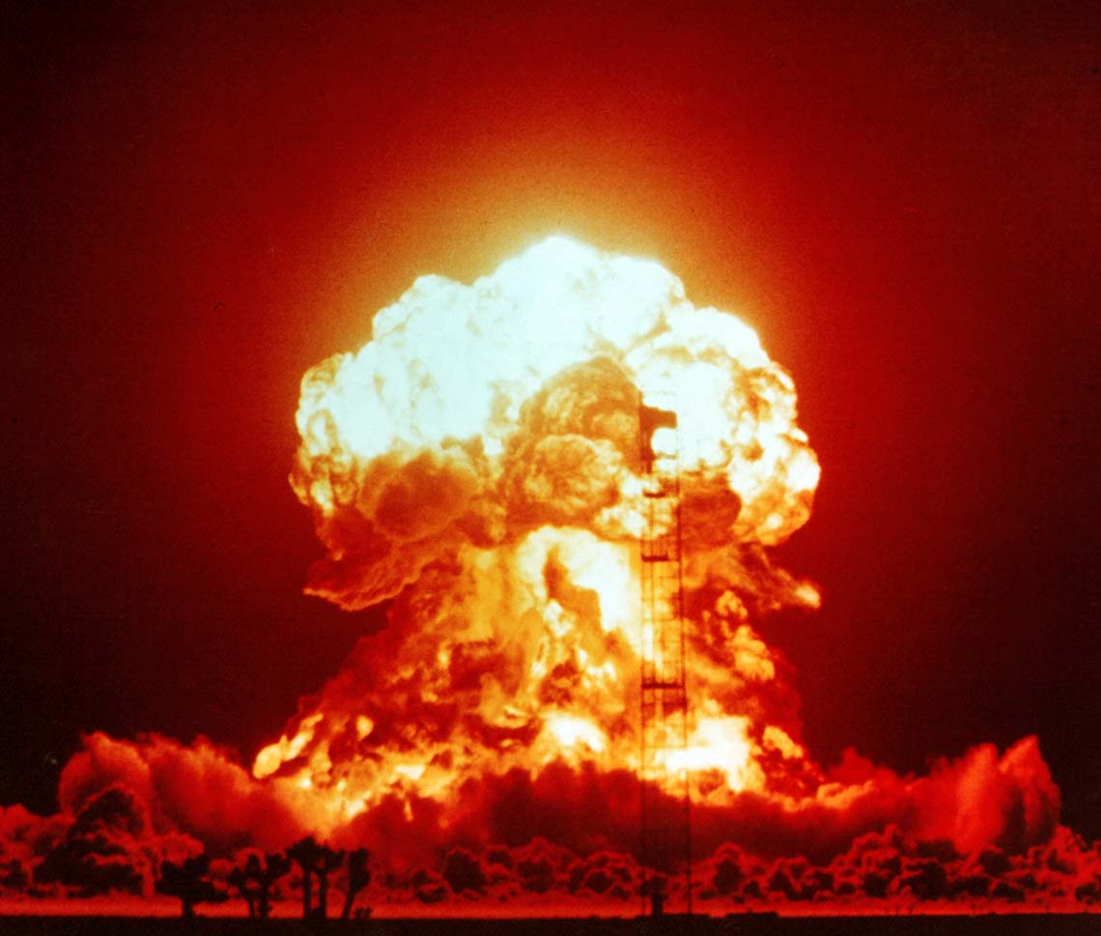
WHAT IS RADIOACTIVE POLLUTION?
“Radioactive pollution occurs when there is presence or depositions of radioactive materials in the atmosphere or environment, especially where their presence is accidental and when it presents an environmental threat due to radioactive decay.”
The destruction caused by the radioactive materials is because of the emissions of hazardous ionizing radiation.
Like beta or alpha particles, gamma rays or neurons in the environment where they exist

Slide 29
CAUSES OF RADIOACTIVE POLLUTION
Isotopes such as uranium have high concentrations of radiation in them.
Instances of spillages over oceans when ships hit glaciers end up releasing chemicals on waterways
NUCLEAR ACCIDENTS FROM NUCLEAR ENERGY GENERATION PLANTS
TESTS ON RADIATION
COSMIC RAYS
USE OF RADIO ISOTOPES
SPILLAGE OF RADIOACTIVE CHEMICALS
Nuclear energy has high latent power is due to its high level of radiation
These come from outer space to our planet with intense radiation as their nature, causing radioactive pollution
The key elements in the cure and treatment of cancer, scientists have been exposed to radiation leading to their deaths

Slide 30
EFFECTS OF RADIOACTIVE POLLUTION
Cancer, leukemia, anemia, a reduction in the life span leading to premature aging and premature deaths
Radiation distorts the cells present leading to permanent damage of the various organs and organ systems
GENETIC MUTATIONS
SOIL INFERTILITY
BURNS
DISEASES
CELL DESTRUCTION
It leads to damage of DNA strands leading to genetic break up in the course of time
Radioactive substances in the soil react together with the various nutrients leading to destruction of nutrients
The immediate presence of burns, red lesions and sores is evidence. To make it worse, this can lead to skin cancer

Slide 31
HOW TO OVERCOME RADIOACTIVE POLLUTION
Radioactive content should be labeled and the necessary precautions advised on the content of the label
Proper storage means no harm and can minimize cases of accidental leakage
DISPOSING RADIOACTIVE WASTE
BANNING OF NUCLEAR TESTS
REUSING
PROPER LABELING
PROPER STORAGE
Radioactive waste still has some level of radiation, this waste should be stored in heavy and thick concrete containers
Nuclear power has a lot of latent power that is very destructive
It is not easy to store or dispose the waste, it can be recycled

Slide 32
INTRO
WHAT
IS NOISE
POLLUTION?

Slide 33
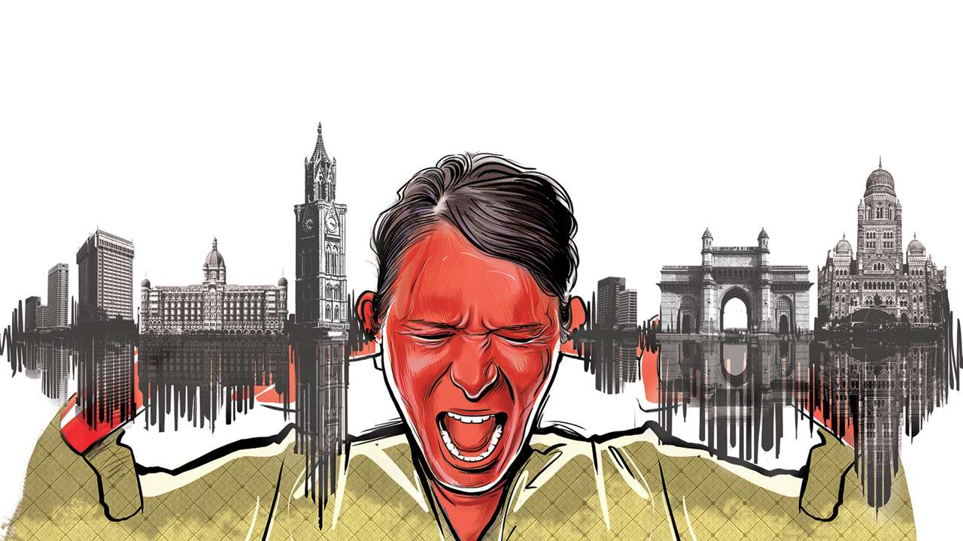
WHAT IS NOISE POLLUTION?
“By definition, noise pollution takes place when there is either an excessive amount of noise or an unpleasant sound that causes a temporary disruption in the natural balance.”
Our environment is such that it has become difficult to escape the noise

Slide 34
CAUSES OF NOISE POLLUTION
Congested houses, large families sharing small space frequent fights over basic amenities leads to noise pollution
The down point is that these construction equipment are too noisy
HOUSEHOLD CHORES
INDUSTRIALIZATION
TRANSPORTATION
POOR URBAN PLANNING
CONSTRUCTION ACTIVITIES
Most of the industries use big machines which are capable of producing a large amount of noise
A large number of vehicles produce heavy noise
We people are surrounded by gadgets and use them extensively in our daily life

Slide 35
EFFECTS OF NOISE POLLUTION
Occurrence of aggressive behavior, disturbance of sleep, constant stress, fatigue, hypertension is due to excessive noise levels
Constant sharp noise can give you a severe headache and disturb your emotional balance
SLEEPING DISORDERS
CARDIOVASCULAR ISSUES
HEARING PROBLEMS
HEALTH ISSUES
TROUBLE COMMUNICATING
Constant exposure to loud levels of noise can easily result in the damage of our eardrums and loss of hearing
Loud noise can certainly hamper your sleeping pattern and may lead to irritation and uncomfortable situations
high-intensity noise causes high blood pressure and increases heartbeat rate as it disrupts the normal blood flow

Slide 36
HOW TO OVERCOME NOISE POLLUTION
SHUT THE DOOR WHEN USING NOISY MACHINES
FOLLOW THE LIMITS OF NOISE LEVEL
USE EARPLUGS
LOWER THE VOLUME
STAY AWAY FROM NOISY AREA

Slide 37
HOW TO OVERCOME NOISE POLLUTION
USE PROPER LUBRICATION AND BETTER MAINTENANCE
USE NOISE ABSORBENTS IN NOISY MACHINERIES
GO GREEN BY PLANNING TREES
CREATE HEALTHY NOISE TO ELIMINATE UNWANTED NOISE
REGULARLY CHECK NOISE LEVELS

Slide 38
THANKYOU

