Slide 1
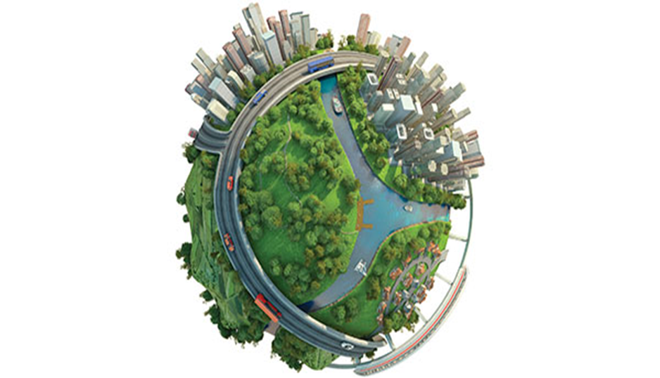
IMPACT OF URBANIZATION AND INDUSTRY ON ENVIRONMENT

Slide 2
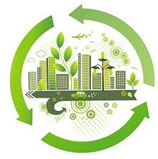
urbanization:
“Urbanization is a process whereby populations move from rural to urban area, enabling cities and towns to grow”.
It can also be termed as “the progressive increase of the number of people living in towns and cities”.

Slide 3
URBANIZATION AND URBAN GROWTH:
Usually two concepts urbanization and urban growth are used interchangeably, urbanization should be distinguished from urban growth:
urbanization is "the proportion of the total national population living in areas classed as urban",
urban growth refers to "the absolute number of people living in areas classed as urban".

Slide 4
CAUSES OF URBANIZATION:
Some major factors that cause urbanization are:
Commercialization
Social benefits and services
Employment opportunities
Modernization
Rural urban transformation
Industrialization

Slide 5
COMMERCIALIZATION:
Commerce and trade play a major role in urbanization.
The distribution of goods and services and commercial transactions in the modern era has developed modern marketing institutions and exchange methods that have tremendously given rise to the growth of towns and cities.

Slide 6
SOCIAL BENEFITS AND SERVICES:
There are numerous social benefits attributed to life in the cities and towns.
Examples include better educational facilities, better living standards, better sanitation and housing, better health care, better recreation facilities, and better social life in general.

Slide 7
EMPLOYMENT OPPORTUNITY:
In cities and towns, there are ample job opportunities. Therefore, the majority of people frequently migrate into urban areas to access well-paying jobs as urban areas have countless employment opportunities in all developmental sectors such as public health, education, transport, sports and recreation, industries, and business enterprises
Services and industries generate and increase higher value-added jobs, and this leads to more employment opportunities.

Slide 8
MODERNIZATION:
Modernization plays a very important role in the process of urbanization.
As urban areas become more technology savvy together with highly sophisticated communication, infrastructure, medical facilities, dressing code, enlightenment, liberalization, and other social amenities availability, people believe they can lead a happy life in cities.
As a result, people migrate to cities.

Slide 9
RURAL URBAN TRANSFORMATION:
In urban areas, people also embrace changes in the modes of living namely residential habits, attitudes, dressing, food, and beliefs. As a result, people migrate to cities and the cities grow by absorbing the growing number of people day after day.

Slide 11
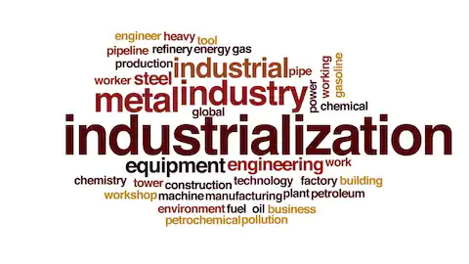
INDUSTRIALIZATION:

Slide 12
Definition:
Industrialization is the period of social and economic change that transforms a human group from an agrarian society into an industrial society, involving the extensive re-organization of an economy for the purpose of manufacturing.
In the modern era, manufacturing facilities like factories are often replaced by technology-industry hubs. These technological hubs draw workers from other areas in the same way factories used to, contributing to urbanization.

Slide 13
IMPACTS OF URBANIZATION AND INDUSTRIALIZATION:
POSITIVE EFFECTS:
Urbanization and industrialization yields several positive effects if it happens within the appropriate limits.
Some of the positive implications include:
creation of employment opportunities
technological and infrastructural advancements
improved transportation and communication
quality educational and medical facilities
improved standards of living.

Slide 14
negative impacts
Housing problems
Overcrowding
Development of slums
Water and sanitary problems
Poor health and spread of disease
Traffic Congestion
Urban Crime

Slide 15
IMPACT ON THE ATMOSPHERE AND CLIMATE:
CREATION OF HEAT ISLAND:
Materials like concrete, asphalt, bricks etc absorb and reflect energy differently than vegetation and soil. Cities remain warm in the night when the countryside has already cooled.

Slide 16
CHANGE IN AIR QUALITY:
Human activities release a wide range of emissions into the environment including carbon dioxide, carbon monoxide, ozone, sulfur oxides, nitrogen oxides, lead, and many other pollutants.
CHANGES IN PATTERN OF PRECIPITATION:
Cities often receive more rain than the surrounding countryside since dust can provoke the condensation of water vapor into rain droplets.

Slide 17
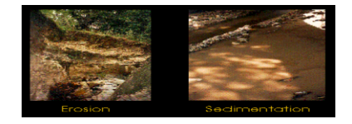
IMPACTS ON THE LITHOSPHERE AND LAND RESOURCES:
EROSION AND OTHER CHANGES IN LAND QUALITY:
Rapid development can result in very high levels of erosion and sedimentation in river channels.
POLLUTION:
Pollutants are often dispersed across cities or concentrated in industrial areas or waste sites.

Slide 18
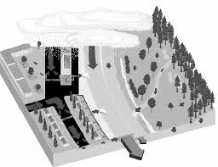
IMPACTS ON THE HYDROSPHERE AND WATER RESOURCES:
FLOW OF WATER INTO STREAM
DEGRADE WATER QUALITY
Water flow into water bodies

Slide 19
IMPACT ON BIOSPHERE:
MODIFICATION OF HABITATS:
The fertilizers that spread across lawns finds its way into water channels where it promotes the growth of plants at the expense of fish. The waste dumped into streams lowers oxygen levels during its decay and cause the die-off of plants and animals
DESTRUCTION OF HABITATS:
There is also complete eradication of habitats as an outcome of urbanization and native species are pushed out of cities.
CREATION OF NEW HABITATS:
New habitats are also created for some native and non-native species.

Slide 20
IMPACT OF INDUSTRIALIZATION ON ENVIRONMENT:
AIR:
The biggest problem is air pollution, caused by the smoke and emissions generated by burning fossil fuels.
WATER:
Water pollution is also a problem in these areas, specifically in regions where factories are built next to natural water sources.
SOIL:
Soil contamination is another problem that goes hand in hand with industrialization.

Slide 21
HABITAT:
Industrialization has led to dramatic habitat destruction.
Forests are cut down for their lumber, and ecosystems are destroyed to create roads, strip mines and gravel pits.
Destroying these habitats upsets local ecosystems and leads to plant and animal extinction if the species are unable to relocate or adapt to their new surroundings.

Slide 22
SOLUTIONS OF URBANIZATION:
BUILDING SUSTAINABLE AND ENVIRONMENT FRIENDLY CITIES:
Governments should also encourage sustainable use of urban resources and support an economy based on sustainable environment such as:
investment in green infrastructure
recycling and environmental campaigns
pollution management
renewable energy
green public transportation
water recycling

Slide 23
PROVISION OF ESSENTIAL SERVICES:
Urban stakeholders must ensure all populations within the urban areas have access to adequate essential social services namely education, health, sanitation and clean water, technology, electricity, and food.
Subsidies can also be availed by the government to lower the costs of basic healthcare, basic education, energy, public transportation, communication systems and technology.

Slide 24
CREATION OF MORE JOBS:
To lessen the negative effects of rapid urbanization while at the same time conserving natural ecosystems, private investments should be encouraged so as to utilize natural resources and create more job opportunities.
Subsidies and grants may as well be provided to foreign and private investment in environmentally friendly development projects that encourage job creation.
POPULATION CONTROL

Slide 25
REDUCTION OF RELIANCE ON PRODUCT THAT CAUSING POLLUTION:
First, industries can reduce their reliance on a product that is causing pollution.
One good example is removing lead from gasoline in the 1970s.
TREATMENT OF INDUSTRIAL WASTE:
The other option is to treat industrial waste to remove toxic components so that the rest of the waste can be disposed of safely.
However, it can help reduce the soil, air and water pollution being produced by these facilities, and also help in conservation of natural resources.

