Slide 1
Role of environment on the phenotype of organisms

Slide 2
phenotypes
observable physical properties of an organism
organism's appearance, development, and behavior.
phenotype is determined by its genotype, which is the set of genes the organism carries, as well as by environmental influences upon these genes.
Examples of phenotypes include height, wing length, and eye color.
Phenotypes also include observable characteristics that can be measured in the laboratory, such as levels of hormones or blood cells.

Slide 3
example: eye color

Slide 4
Effect of environment on Phenotype
The phenotype is the sum of the genotype and the environment.
The phenotype can also be seen as the interaction between genetics and environmental factors
some genotypes are better in one environment and others are better in another environment
In addition to genotypes, Environmental conditions, such as temperature and availability of nutrients can affect phenotypes.

Slide 5
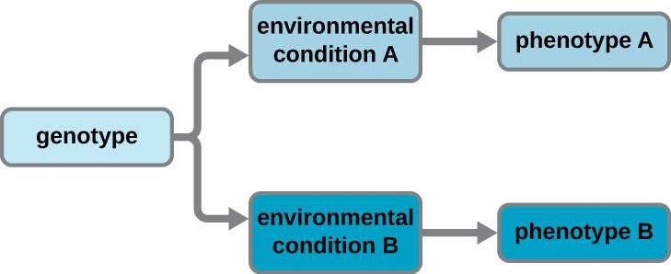

Slide 6
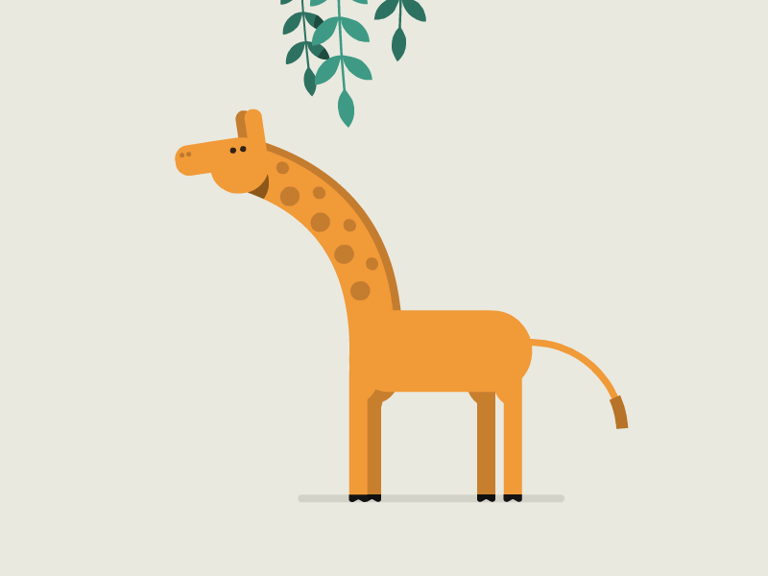
Lamarck’s theory:
Theory of Inheritance of Acquired Characteristics, first presented in 1801.
Lamarckism is the hypothesis that an organism can pass on characteristics that it has acquired through use or disuse during its lifetime to its offspring. It is also known as the inheritance of acquired characteristics or soft inheritance.

Slide 7
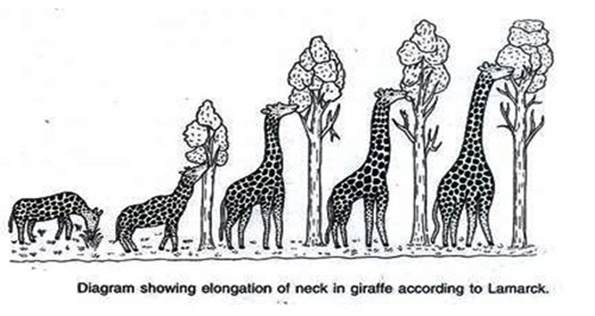
Neck elongation of giraffe:
Giraffes have adaptations, which are physical traits or behaviors that help animals survive in their natural habitat.
Giraffes have a long neck that helps them reach their favorite food and look out for predators.
•Darwin rejected the Lamarck’s theory by giving genetic basis of inheritance.

Slide 8
phenotypic plasticity
The ability of individual genotypes to produce different phenotypes when exposed to different environments.
Phenotypic plasticity is considered one of the major means by which plants can cope with environmental changes.
Involve the wing patterns of butterflies.

Slide 9
Environmental factors that influence the expression of a genetically determined phenotype
diet
temperature
oxygen levels
Carbon dioxide level
humidity
altitude
light cycles
presence of mutagens
can all impact which of an animal's genes are expressed, which ultimately affects the animal's phenotype.

Slide 10
Effect of temperature on phenotype
For example: temperature affects coat color in Siamese cats.
Siamese cats are cooler at their paws, nose, and tail, making their fur darker there as well.
To make sure the scientists hypothesized that if they kept an area of the cat's body that had dark fur warm, then it would become lighter.
The darker color comes from a special gene that is trying to regulate the cat's body temperature.

Slide 11
Siamese cat
Their fur is white or cream-colored fur through most of their body, but darker in the ears, face, paws and tail

Slide 12
Effect of altitude on phenotypes:
Many plants produced with identical genotypes were collected.
three cuttings were taken from each plant.
One cutting from each plant placed at all three elevations.
a) low elevation (30 meters above sea level)
b) medium elevation (1400 m)
c) high elevation (3050 m)
3050m
1400m
30m
Yarrow plant, Achillea millefolium

Slide 13
normally all the plants grew poorly at the medium elevation.
the cutting of plant 4 grew best at the medium elevation.
Plant 1 showed the best growth at low and high elevations but showed the poorest growth at the medium elevation.
Plant 6 showed the second-worst growth at low elevation and the second-best at high elevation.

Slide 14
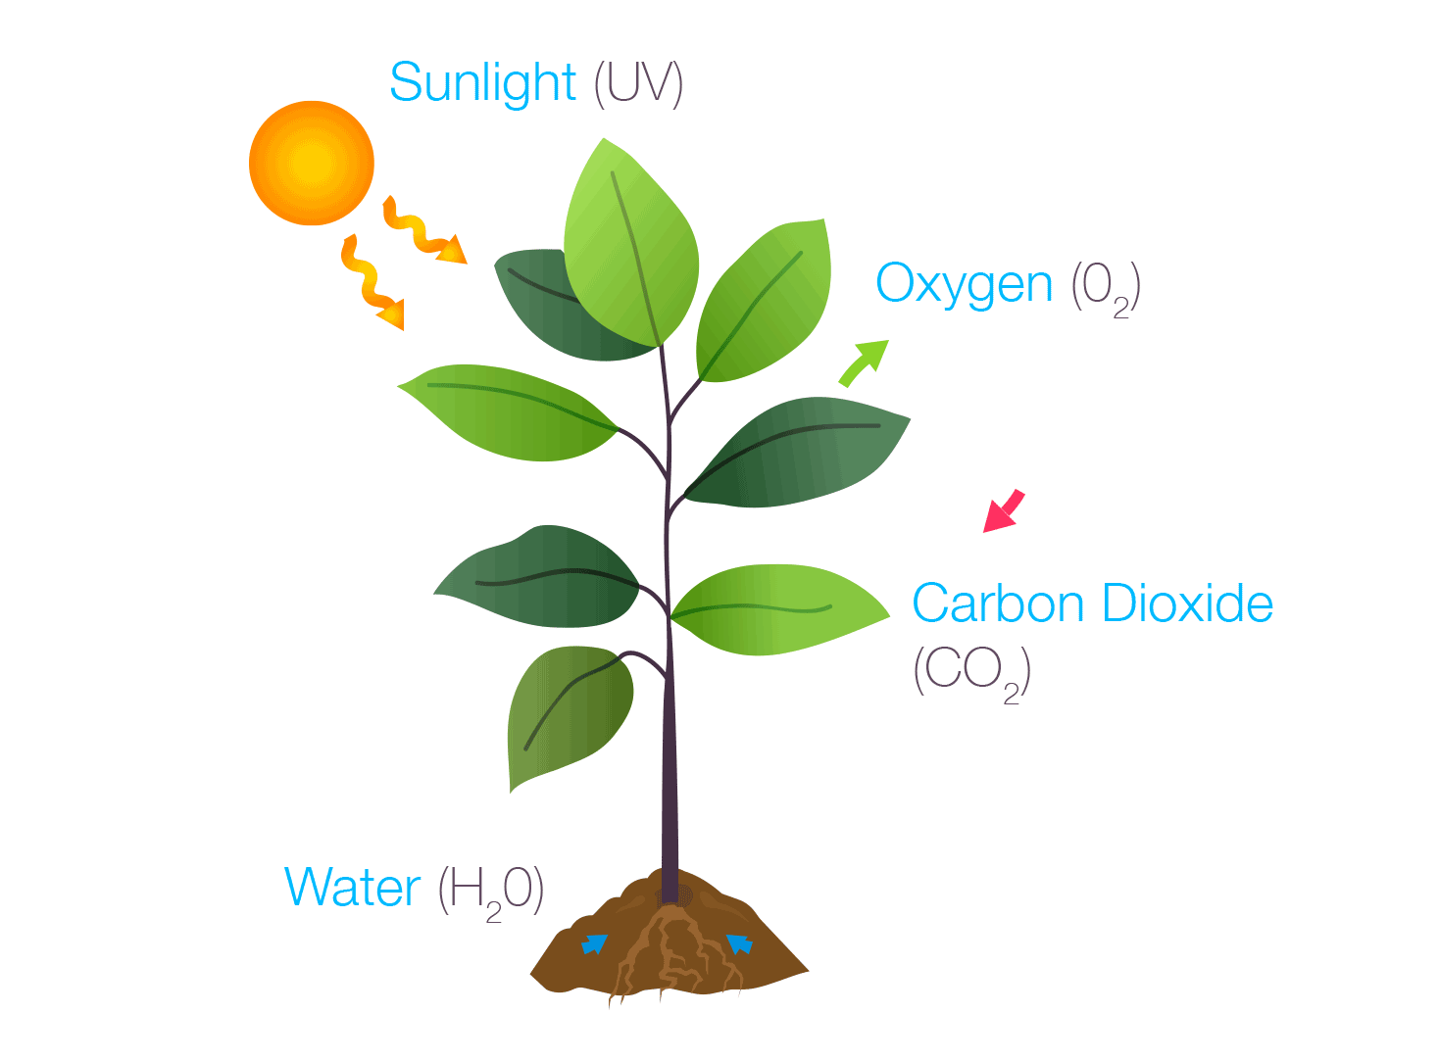
Effect of carbon dioxide on the phenotype
Carbon dioxide level in environment cause a change in stomata density in an individual due to phenotypic plasticity.
When the amount of CO2 is higher the individual plant develops with low stomata density.
When the amount of CO2 is lower the individual plant develops with high stomata density.

Slide 15
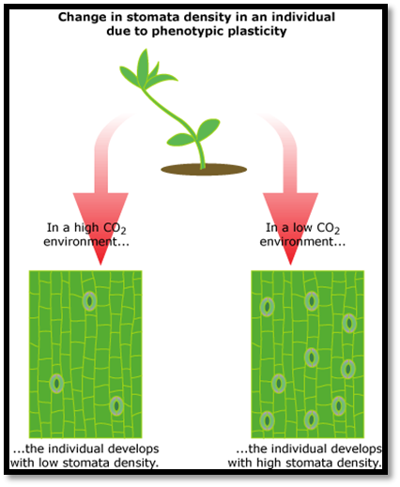

Slide 16
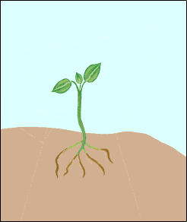
effect of light on phenotype
Shade leaves are thinner and much larger in surface areas than sun leaves.
Actually the genes which determine the shape of leaf are sensitive to light.
Higher leaves
Red light(680 nm)
Shaded leaves
Far red light (710- 780 nm)

Slide 17
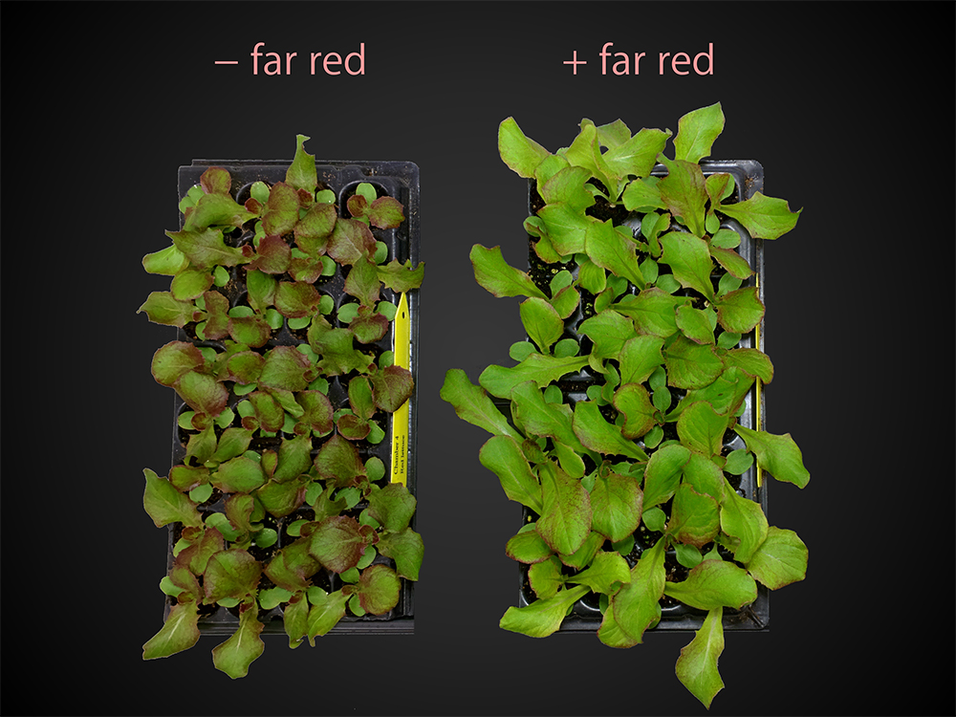
so when the ratio of FRL to RL exceeds critical level the leaf will be formed like shaded leaves with large surface area to absorb more light.

Slide 18
effect of chemical signal
workers exposed some Nucella lamellosa (dogwhelk)
a snail in rocky coasts

Slide 19
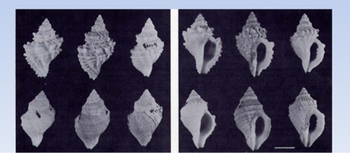
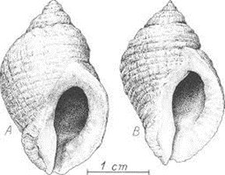
dogwhelks exposed to cancer products and metabolites have increased length of apertural teeth (outerlip teeth) for better prey handling.

Slide 20
Conclusion
Degree to which an organism phenotype changes depends upon its current and past environment.
it involve the regulatory genes which switch on and off the structural genes in accordance with the stimuli.
Environment affects the genotype which eventually change the phenotype.

