Slide 1
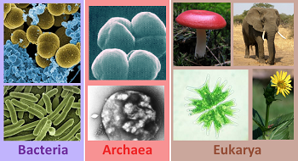
Features And Characteristics Of Archaea, Bacteria And Eukaryotes

Slide 2
Three Domain System
The Three Domain System, developed by Carl Woese in 1997
Based on differences in ribosomal RNA (rRNA) structure
Organisms are classified into three domains and six kingdoms. The domains are
Archaea
Bacteria
Eukarya
The kingdoms are Archaebacteria (ancient bacteria), Eubacteria (true bacteria), Protista, Fungi, Plantae, and Animalia.

Slide 3
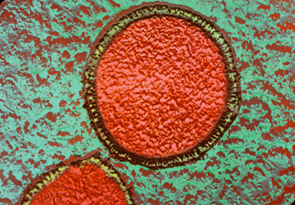
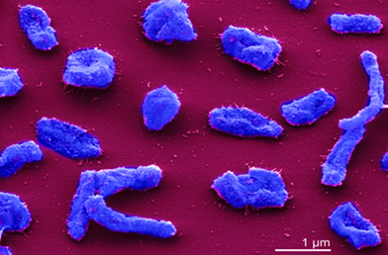
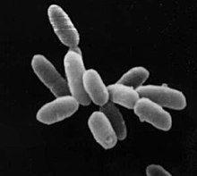
Domain Archaea
This domain contains single-celled organisms known as archaea.
Genes are similar to both bacteria and eukaryotes.
Archaea often live in extreme environments such as hot springs and deep-sea vents are called extremophiles.

Slide 4
Cell Structure
Cell Wall | Contain carbohydrates that are different from those of bacteria cell walls, and some contain proteins and lipids to give them strength and resistance to chemicals.
Cell Membrane | Archaea cell membrane is made up of phospholipids with fatty acid chains, but in archaea cells, the bilayer has ether bonds. Fatty acids are branched, and glycerol is L-glycerol. Ether bonds are more resistant to chemical activity and allow archaea cells to survive in extreme environments.

Slide 5
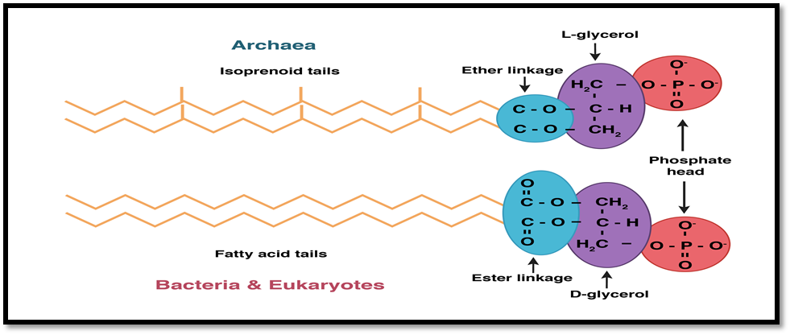

Slide 6
Cytoplasm | It has no membrane bounded organelles. DNA exists as a single loop called a plasmid. tRNA has features that are different from all other living things. Bacterial ribosomes are sensitive to chemical inhibiting agents, archaeal are not.
Flagella | Used for locomotion. The structure and operating mechanism are similar but how they evolved and how they are built differ. In archaea, it extends from base.
Reproduction | They reproduce by binary fission. DNA replicates and two strands are pulled apart as cell grows. Using DNA polymerase that resembles eukaryotic enzyme. Proteins that direct cell division (FtsZ) resembles with bacteria.

Slide 7
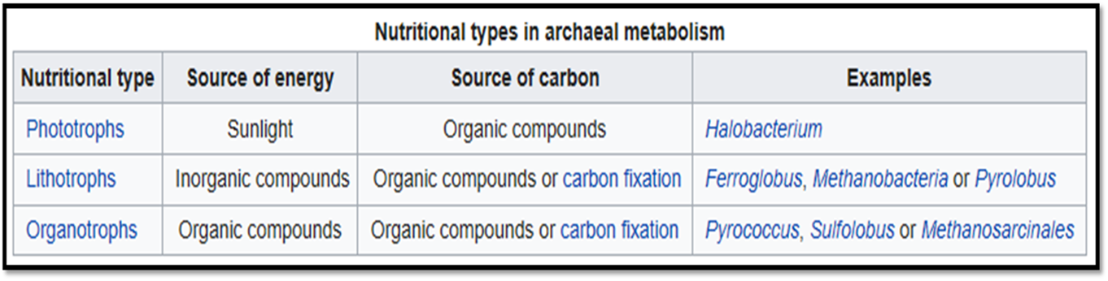
Metabolism

Slide 8
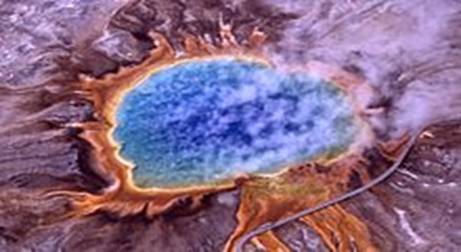
Where Do Archaea Survive?
The archaea cells able to live in extreme environments can be classified
Tolerance for high temperatures: hyperthermophilic.
Able to survive acidic environments: acidophilic.
Can survive in highly alkaline liquids: alkaliphilic.
Tolerance for high salt content: halophilic.

Slide 9
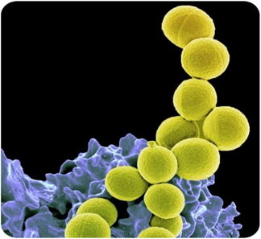
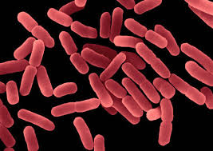
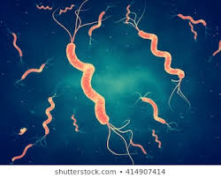
Domain Bacteria
Bacteria are single-celled microorganisms with prokaryotic cells, that do not have organelles or a true nucleus and are less complex than eukaryotic cells.
Bacteria are extremely numerous, and the total biomass of bacteria on Earth is more than all plants and animals combined.

Slide 10
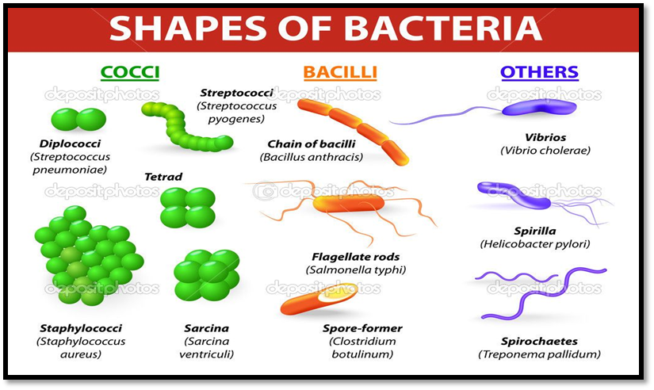
Features and characteristics of Bacteria
Shapes of bacteria
Cocci are bacteria that are spherical or ovoid in shape.
Spiral bacteria are, as the name suggests, spiral-shaped.
Spirillums are thick, tough spirals.
Spirochetes are spirals that are thin and flexible.
Vibrios are comma-shaped rods with a small twist.
Bacilli are rod-shaped bacteria.

Slide 11
Structure of Bacterial cell
Cell wall | Bacterial cell wall is made of different substances like glycoproteins, lipopolysaccharides and lipoproteins.
Cell membrane | Present immediately below the cell wall. Bacteria especially the gram-negative ones have an extra membrane called periplasm which lies bellow cell wall but above the cell membrane.
Cytoplasm | DNA is directly present in it and not surrounded by membrane. Other cell organelles like mitochondria, Golgi bodies, endoplasmic reticulum are absent in a bacterial cell. The protein-making machinery has 70S ribosome which is of two sub-units as 50S and 30S. The region of cytoplasm containing DNA is called nucleoid. Plasmids are small DNA fragments carrying between two and thirty genes.

Slide 12
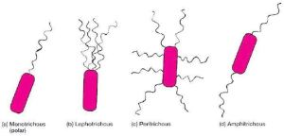
Pilli | These are small and tube-like projections from the bacterial surface. They are the organelles of sexual reproduction and are involved in the exchange of genetic material.
Flagella presence | Bacilli type have flagella. These are the organs of locomotion. (Monotrichous, Lophotrichous, Peritrichous, Amphitrichous)

Slide 13
Food dependence
Phototrophs synthesize their food like plants by use of sunlight.
Other derive food energy from chemical sources around them (chemotrophs) — sulfur bacteria, hydrogen bacteria, etc.
Few of them are parasites which live on alive plants and animals.
Many bacteria are saprophytes which means, they live on dead and decaying matter.
While others are symbiotic. They live in a give and take relationships with other animals. Example: rhizobium in roots.

Slide 14
Respiration
Bacteria do not have mitochondria, however, they derive energy by aerobic respiration.
Reproduction
a) Asexual reproduction: The bacteria produce two bacteria by binary fission.
b) Sexual reproduction: In transformation, one bacteria release naked DNA strand into the surroundings. The other bacteria take it up and incorporate into their genome.Conjugation takes place through a pilus. Transduction happens due to a virus.

Slide 15
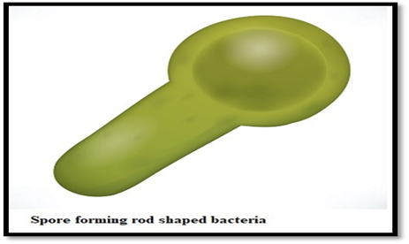
Spore formation
When the environmental conditions around are harsh, the bacteria convert to a hard spore form. This spore is highly resistant to heat, chemicals and drought conditions.
Cosmopolitan distribution
Bacteria are present in air, water, soil, snow, etc. They are present at very cold temperature regions and also very high-temperature regions. They can live in an acidic environment (Helicobacter pyroli) and even alkaline environment (iron bacteria) and in salty environment.

Slide 16
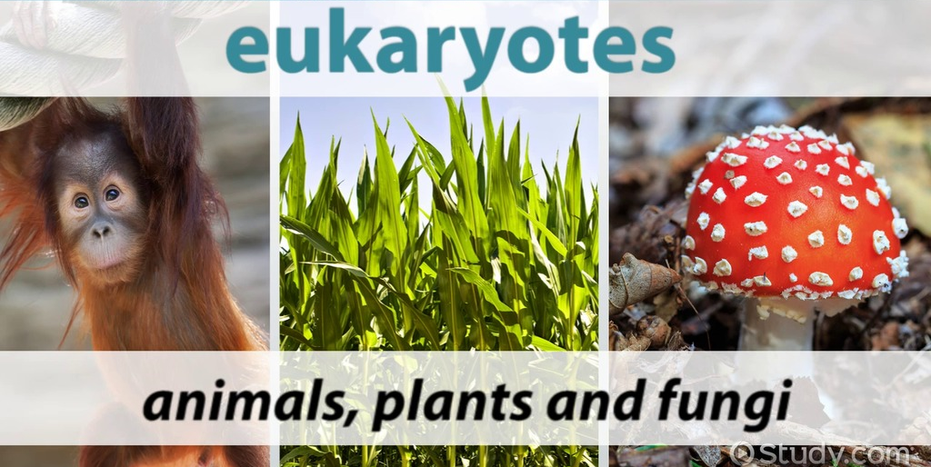
Domain Eukarya
Contains all the organisms that are eukaryotic or contain membrane-bound organelles and nuclei.

Slide 17
Eukaryotic Microorganisms
•Prominent members of ecosystems
•Useful as model systems and industry
•Some are major human pathogens
•Two groups of eukaryotes commonly possess microbial members
–protists
–fungi

Slide 18
Common Features of Eukaryotic Cells
•Membrane-delimited nuclei
•Membrane-bound organelles that perform specific functions
•Intracytoplasmic membrane complex serves as transport system
•More structurally complex and generally larger than bacterial or archaeal cells

Slide 22
Eukaryotic Cell Envelopes
•Consists of the plasma membrane and all coverings external to it
•Plasma membrane is a lipid bilayer
–major membrane lipids include phosphoglycerides, sphingolipids, and cholesterol, all of which contribute to strength of membrane
–microdomains participate in variety of cellular processes

Slide 23
The Cytoplasm of Eukaryotes
•Consists of liquid, the cytosol, and many organelles
•Cytoskeleton
–vast network of interconnected filaments within the cytoplasmic matrix
–filaments that form the cytoskeleton: microfilaments (actin), microtubules, intermediate filaments, and motor proteins
–plays role in both cell shape and cell movement

Slide 25
Secretory Endocytic Pathway
•Intricate complex of membranous organelles and vesicles that move materials into the cell from outside, from inside to outside, and within the cell
•Endoplasmic reticulum (ER)
•Golgi apparatus
•Lysosomes

Slide 26
The Secretory Pathway
•Used to move materials to various sites within the cell, as well as to either the plasma membrane or cell exterior
•Proteins destined for the cell membrane, endosomes, and lysosomes or secretion are synthesized by ribosomes on rough endoplasmic reticulum (RER)
•Targeted to RER lumen and are released in small budding vesicles from RER
Organelles Involved in Genetic Control of the Cell
•Nucleus
•Ribosomes
Organelles Involved in Energy Conservation
•Mitochondria
•Chloroplasts

Slide 27
Comparison of Bacterial, Archaeal, and Eukaryotic Cells
•Differences in eukaryotic cells
–eukaryotic nucleus
–larger, more complex
–meiosis, mitosis
–complex processes
•Molecular unity basic to all three cells
–biochemical processes, metabolic pathways
–genetic code

