Slide 1
Comparative study of life forms
Ayesha seerat………….13
Sehar Naeem…………47

Slide 2
Life
The condition that distinguishes animals and plants from inorganic matter, including the capacity for growth, reproduction, functional activity, and continual change preceding death.
Origin of life
Life today evolved by common descent from a single primitive lifeform.
Natural process which took place perhaps 3,900 million years ago.

Slide 3
Theories of life
Theory of special creation.
Theory of spontaneous generation.
Theory of biochemical evolution.
Theory of panspermia.
Deep sea hydrothermal vent theory.

Slide 4
Theory of special creation
IN HINDUS
LORD BARHAMAN created universe in one stroke.
IN MUSLIMS AND CHRISTANS
He created universe, all animals, plants and human beings in six days.

Slide 5
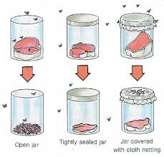
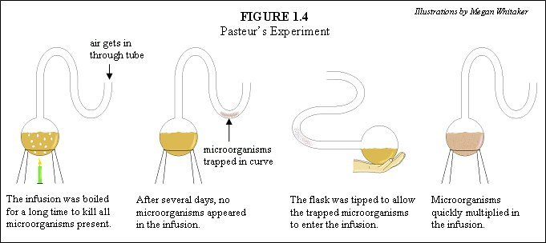
Theory of spontaneous belief
Jan Baptista van Helmont,
proposed that mice could arise from rags
and wheat kernels left in an open container
for 3 weeks.
An Italian physician Francesco Redi (1626–1697),
performed an experiment on maggots.
In 1858, Pasteur made a series of flasks
with long, twisted necks experiment.

Slide 6
Theory of biochemical evolution
Oparin-Haldane hypothesis: that life on Earth could have arisen step-by-step from non-living matter through a process of “gradual chemical evolution.”
organic molecules could be formed from abiogenic materials.
The primitive atmosphere was reducing and contained ammonia and water vapour.
reducing atmosphere non- reducing atmosphere

Slide 7
Theory of panspermia
Panspermia suggests that seed comes from outer space and planets exchange life.
Types of Panspermia
Lithopanspermia
Radiopanspermia
Directed panspermia

Slide 8
Deep sea hypothermal vent theory
Many scientists think life got its start around 3.7 billion years ago in deep-sea hydrothermal vents.
carbon dioxide and hydrogen to create the building blocks of life, such as amino acids and nucleotides.
At the time of life's origin, the early ocean was acidic and filled with positively charged protons, while the deep-sea vents spewed out bitter alkaline fluid, which is rich in negatively charged hydroxide ions.
"It's a little bit like a battery,"

Slide 9
History of Earth's atmosphere
First two billion years of Earth’s existence, the atmosphere was anoxic.
Cyanobacteria evolved from simple phototrophs one billion years later.
It also opened up the land to increased colonization, because some O₂ is converted into O₃ (ozone) and ozone effectively absorbs the ultraviolet light.
Ultimately, the increase in O₂ concentrations allowed the evolution of other life forms

Slide 10
First life on earth
The earliest known life forms on Earth are putative fossilized microorganisms found in hydrothermal vent precipitates.
Two types of cells evolved from common ancestor.
Prokaryotes
Eukaryotes.

Slide 13
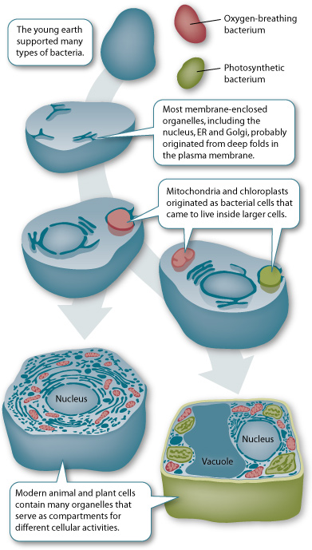
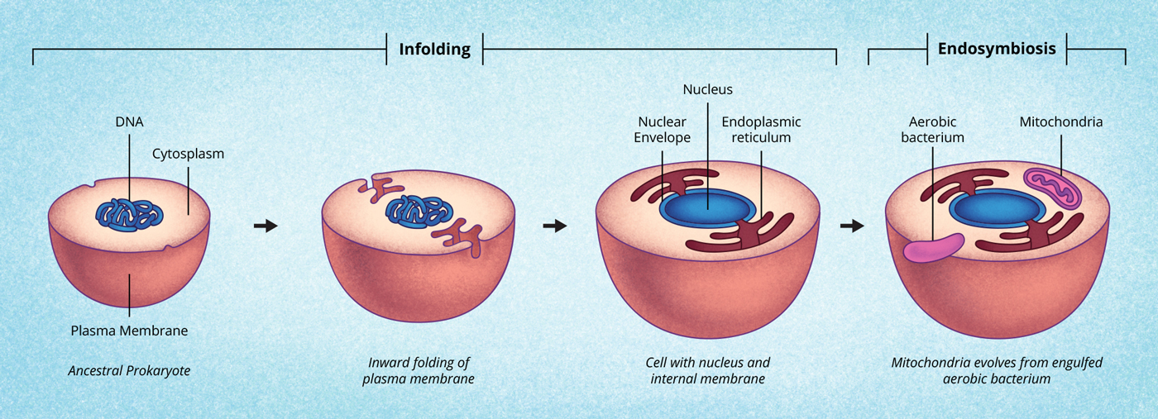
Eukaryotes
Evolove by:
Endosymbiosis.
Membrane infolding.

Slide 14
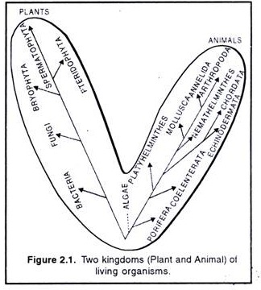
Two Kingdoms Classification
in 1735, Carolus Linnaeus distinguished two kingdoms of living things:
Animalia for animals
Plantae (Vegetabilia) for plants.

Slide 15
Three Kingdom of Classification
In the 1860s, the German investigator Ernst Haeckel proposed a three-kingdom system of classification.
Animalia
Plantae
Protista.
Members of the kingdom Protista included the protozoa, fungi, bacteria, and other microorganisms.

Slide 16
Five Kingdoms Classification
R.H. Whittaker (1969), an American Taxonomist, classified all organisms into five kingdoms:
Monera, Protista, Fungi, Plantae and Animal.
Criteria
(i) Complexity of cell structure.
(ii) Complexity of body organization.
(ii) The mode of nutrition.
(iv) Life style (ecological role).
(v) Phylogenetic relationship.

Slide 18
Six Kingdoms and Three Domains Classification
In 1990, Carl Woese proposed that the Eubacteria, Archaebacteria, and Eukarvota represent three primary lines of descent and accordingly he promoted them to domains, naming them Bacteria, Archaea, and Eukarya.
The six Kingdoms are:
Archaebacteria.
Eubacteria.
Fungi.
Protista.
Plants.
Animals.

Slide 19
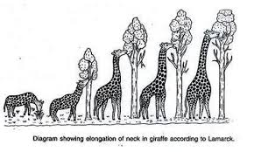
Inheritance of acquired characters
Lamarckism is the hypothesis that an organism can pass on characteristics that it has acquired through
First Law _Use and Disuse.
Second Law_ Soft Inheritance.

Slide 20
Darwins origin of species
In this book Darwins made two main points;
Descent with modification.
Natural Selection and Adaptation.
Neo-Darwinism- the modern evolutionary synthesis
the combination of natural selection and genetics.
It is called synthesis because it integrated discoveries and ideas from many different fields, including paleontology, taxonomy, biogeography, and population genetics.

Slide 21
Evidence of evolution
Biogeography
Combination with the movement of tectonic plates over geological time.
For example, broad groupings of organisms that had already evolved before the breakup of the supercontinent Pangaea (about 200200200 million years ago) tend to be distributed worldwide. In contrast, broad groupings that evolved after the breakup tend to appear uniquely in smaller regions of earth.

Slide 22
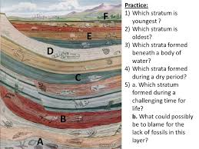
Fossil record
Fossils are often contained in rocks that build up in layers called strata.
the strata provide a sort of timeline.

Slide 23
Comparative anatomy
"descent with modification," a process in which species change and give rise to new species over many generations.
Darwin proposed that the evolutionary history of life forms a branching tree with many levels, in which all species can be traced back to an ancient common ancestor

Slide 24
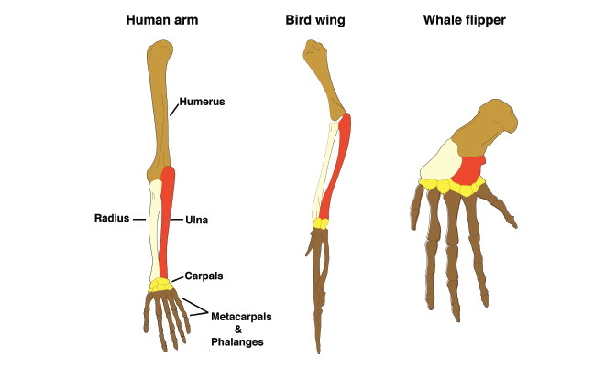
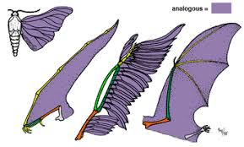
Anatomy
Homologous features
Analogous features

Slide 25
Comparatively Embryology
Like adults, embryos show similarities which can support common ancestry. For example, all vertebrate embryos have gill slits and tails, . The “gill slits” are not gills, however. They connect the throat to the outside early in development but eventually close in many species; only in fishand larval amphibiansdo they contribute to the development of gills. In mammals, the tissue between the first gill slits forms part of the lower jaw and the bonesof the inner ear.

Slide 26
Comparative Molecular biology
At the most basic level, all living organisms share:
The same genetic material (DNA)
The same, or highly similar, genetic codes
The same basic process of gene expression (transcription and translation)

Slide 27
Homologous genes
The basic idea behind this approach is that two species have the "same" gene because they inherited it from a common ancestor.
In general, the more DNA differences in homologous genes between two species, the more distantly the species are related.

