Slide 1
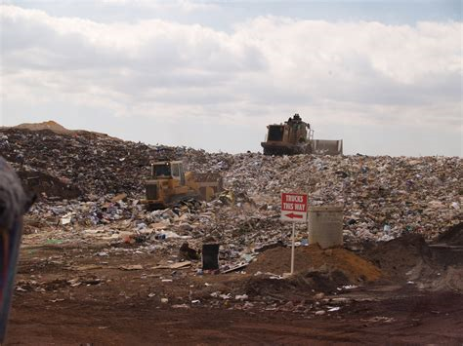
LANDFILLS

Slide 2
LANDFILLS
“A landfill site (also known as a tip, dump, rubbish dump or dumping ground) is a site for the disposal of waste materials by burial”.
and is the oldest form of waste treatment.

Slide 3
Historically, landfills have been the most common methods of organized waste disposal and remain so in many places around the world.
Some landfills are also used for waste management purposes, e.g.,
the temporary storage,
consolidation and transfer,
processing of waste material (sorting, treatment or recycling).

Slide 4
A landfill also may refer to “ground that has been filled in with rocks instead of waste materials”, so that it can be used for a specific purpose, such as for building houses. Unless they are stabilized, these areas may experience severe shaking or liquefaction of the ground in a large earthquake.

Slide 5
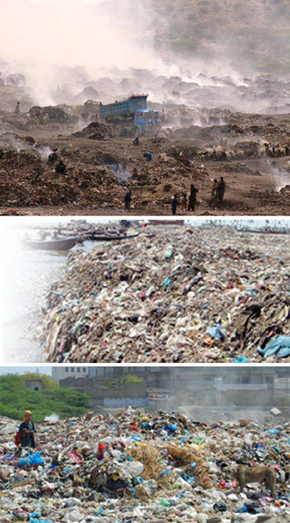

Slide 6
OPERATIONAL SITES FOR LANDFILLS
There are three kinds of operational landfill sites categorized by the types of waste they are authorized to take. These are:
1. Inert wastes: These sites take only inert wastes such as excavation wastes. They have a low impact on the environment. Inert wastes are unlikely to react with other wastes.
2. Non-hazardous wastes: These sites take a mix of inert waste and biodegradable wastes. They may also be allowed to make special provision for some hazardous waste such as asbestos.
3. Hazardous wastes: These sites take hazardous wastes such as contaminated soils and asbestos.

Slide 7
COMPOSITION OF A LANDFILL
There are four critical elements in a secure landfill:
1). a bottom liner,
2). a leachate collection system,
3). a cover,
4). the natural hydrogeologic setting.
The natural setting can be selected to minimize the possibility of wastes escaping to groundwater beneath a landfill.
The three other elements must be engineered. Each of these elements is critical to success.

Slide 8
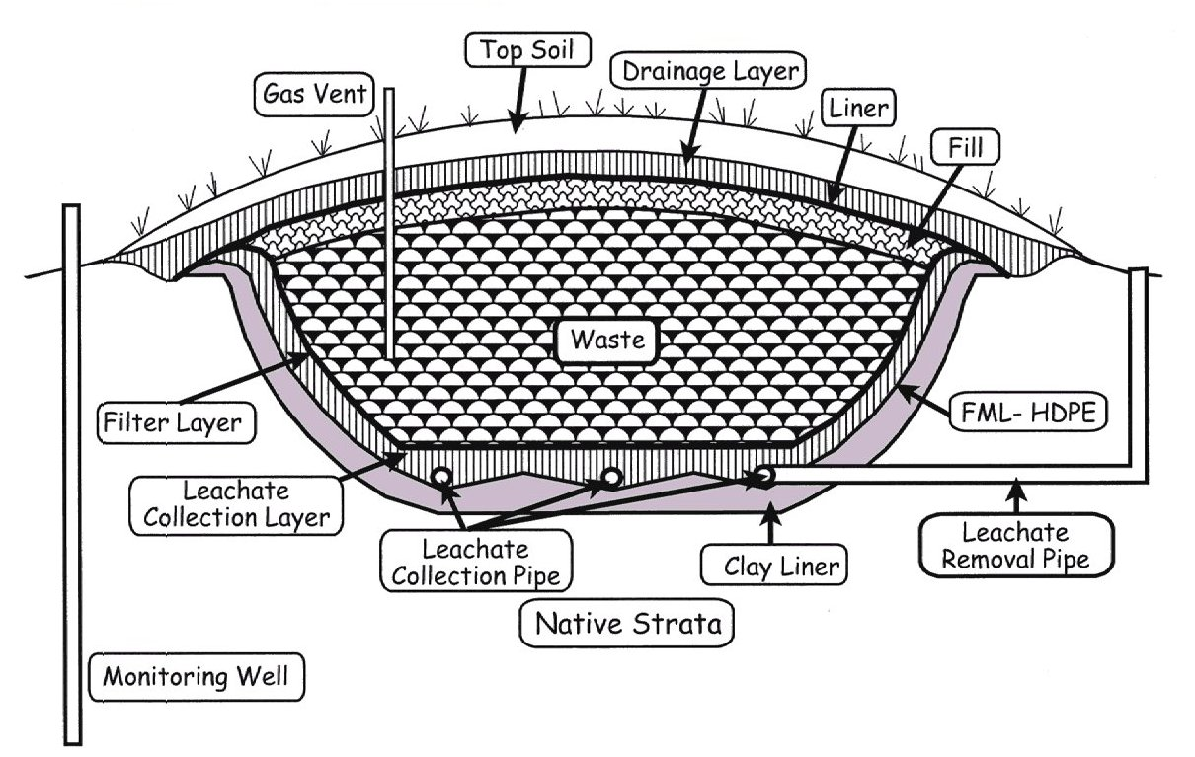

Slide 9
PROCESS
Most non-hazardous wastes gradually degrade in a landfill. As they do so they produce gas, which is known simply as landfill gas.
As rainwater seeps through the landfill a liquid is formed known as leachate.
Landfill gas and leachate must be safely extracted and treated.

Slide 10
Operations
Typically, operators of well-run landfills for non-hazardous waste meet predefined specifications by applying techniques to:
1. confine waste to a small area
2. compact waste to reduce volume
3. cover waste with layers of soil

Slide 11
1. Confine waste to as small an area as possible
During landfill operations, a scale or weighbridge may weigh waste collection vehicles on arrival and personnel may inspect loads for wastes that do not accord with the landfill's waste-acceptance criteria.
Afterward, the waste collection vehicles use the existing road network on their way to the tipping face or working front, where they unload their contents.

Slide 12
2. Compact waste to reduce volume
After loads are deposited, compactors or bulldozers can spread and compact the waste on the working face. Before leaving the landfill boundaries, the waste collection vehicles may pass through a wheel-cleaning facility.
Waste compaction is critical to extending the life of the landfill.

Slide 13
3. Covering of waste
the compacted waste is covered with soil or alternative materials daily. Alternative waste-cover materials include chipped wood or other "green waste".
The space that is occupied daily by the compacted waste and the cover material is called a daily cell.

Slide 14
Landfill, Hong Kong

Slide 15
Why do we need landfills?
Around 300 million tonnes of waste are produced each year in a country all of which needs managing in a way that protects people and the environment.
Although some of this waste is reused or recycled and the percentage is rising all the time – some of it still needs to be disposed of.
As well as reuse and recycling there are other techniques and technologies being developed to reduce the amount of rubbish sent to landfill each year.
These include producing energy from waste by incineration or by anaerobic digestion.

Slide 16
Legislation & landfill activity
Anyone who operates a landfill site must have an environmental permit to do so. Landfill operators must now comply with the European Directive on the Landfill of Waste, the Environmental Permitting Regulations and some additional directives.
Regulations set standards for the location, design, monitoring and operation of landfills.
When it is time to close the site the operator has to agree with us how they are going to do this and agree a plan for its monitoring and management. This is known as aftercare. The aftercare will continue until we are satisfied that there is no risk to the environment. Aftercare can last 100 years or more.

Slide 17
JOB of Environment Agency (EA)
When a landfill site is proposed, the local planning authority consults EA on a planning application. EA make sure any new landfill is in an area which has the least impact on the environment.
EA check the proposal against our groundwater protection policy, among other things. The landfill operator must apply to us for his environmental permit to open and operate the landfill.
EA check that the operator has assessed the risks and whether he can manage them. EA consult other bodies on the application, and advertise it to the public on website. EA decide whether to permit or refuse the application. EA will refuse if it does not meet with environmental, technical or legal requirements.
It is the operator’s responsibility to manage the site. When a site is up and running EA inspect it regularly to make sure it is operating within the conditions of the permit.

Slide 18
Are landfills safe?
Yes.
All landfill sites must operate without causing pollution of the environment or harm to human health. They are carefully managed to keep risks to a minimum.

Slide 19
Advantage
Landfills are often the most cost-efficient way to dispose of waste, especially in countries like the United States with large open spaces.
In addition, landfill gas can be upgraded to natural gas—landfill gas utilization—which is a potential revenue stream.
Another advantage is having a specific location for disposal that can be monitored, where waste can be processed to remove all recyclable materials before tipping.

Slide 20
Social and environmental impact
NO
Landfills will only become more of a public issue as time goes on.
The negative effects are most commonly placed into two distinct categories:
a). Atmospheric effects
B). Hydrological effects.
While these effects are both of equal importance,

Slide 21
a). Atmospheric effects
Methane and carbon dioxide are the major gases produced and make up to 90 to 98% of landfill gas. Nitrogen, oxygen, ammonia, hydrogen sulfides, hydrogen and various other gases are also produced in small volumes.
According to New York State's Department of Health, these are the following impact of the gases:
Bleach and ammonia in landfills can produce toxic gases and odor that can significantly impact the quality of air in the vicinity of the landfill. HS produced in landfills smells similar to rotten eggs.
Landfill gases do not remain on-site. When released in the air, gases find their way into homes and other buildings through windows and doors, or through soil underground into basements etc.
LFG can also impact health causing problems that can be acute or chronic.

Slide 22
Operator of landfill, New York

Slide 23
Climate Change
Methane and carbon dioxide produced in landfills are greenhouse gases leading to global warming.

Slide 24
Hydrological Effects
Landfills also create a toxic soup of industrial and home-cleaning chemicals. People throw away everything from industrial solvents to household cleaners in landfills, and these chemicals accumulate and mix over time and cause water pollution.
Groundwater contamination
Surface water pollution

Slide 25
Groundwater contamination
Landfills are a major source of groundwater contamination.
U.S. Geological Survey's Toxic Substances Hydrology Program reports leachates from landfills can have heavy metals like "lead, barium, chromium, cobalt, and nickel," as well as organic compounds like "bisphenol A, pharmaceuticals, pesticides, disinfectants“. These can enter the soil and into the groundwater contaminating it.

Slide 26
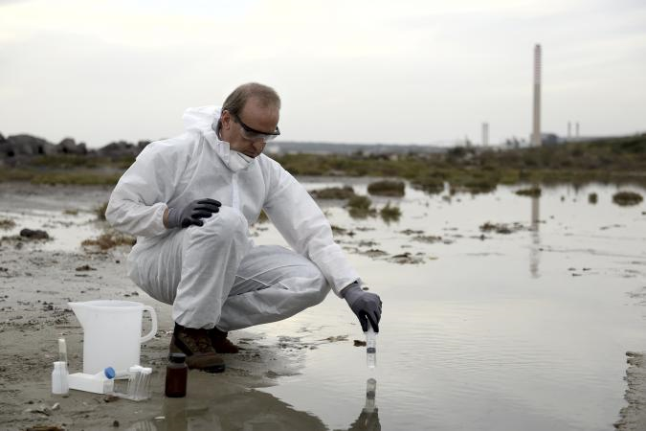
Surface water pollution
Leachates from landfills have
polluted rivers and other surface water sources.
Ammonia which is common in landfills converts to nitrogen and causes eutrophication, where algal growth increases and uses all the oxygen in water, killing other fish life.
Moreover, toxins in leachates can kill wild and domestic animals that drink these waters.
In people, they can cause skin rashes, nausea, stomach pains, headaches and fever."

Slide 27
Solution????? Alternatives
There are various alternatives to landfills, including
Recycling strategies and composting,
Mining.

Slide 28
Thanks

