Slide 1
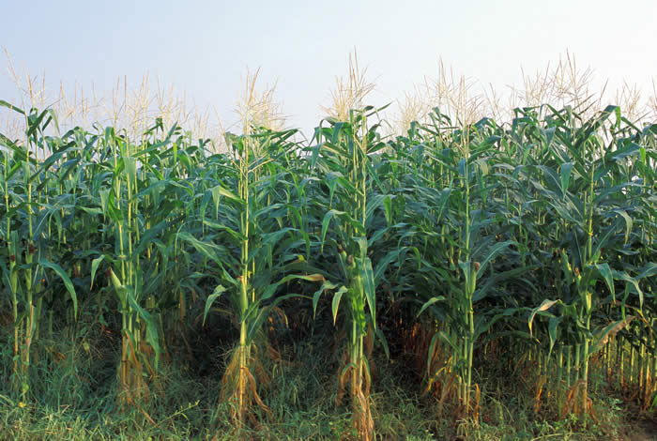
Herbicide Resistance in crops

Slide 2
Introduction
Herbicide tolerance is the predominant GM trait.
It was one of the first GM trait to be tested in the
Field, and subsequently for commercial production.
Most frequent transgenic traits in commercial
plantings are as follows.
Herbicide tolerance
Insect tolerance
Herbicide tolerance + Insect resistance

Slide 3
WHAT ARE WEEDS?
All the plants in the cultivated field giving harm rather than benefit.
Different ways to fight weeds:
Mechanical: Hoeing, Hand Plucking
Physical: heat and Light
Biological : Use of living organism
Chemical: Use of herbicides

Slide 4
The use of herbicides in modern agriculture
Herbicides are used to control Unwanted plants.
About 60% of pesticides used in U.S. are herbicides.
Weeds Compete with crops for soil nutrients.
Thus weeds are one of the three classes of biotic stress that have a major impact on the proportion of world crop yield available for human consumption.
Modern agriculture has developed range of effective Herbicides to tackle the effect of weed on crop yield.

Slide 5
What is herbicide resistance in plants?
The herbicide resistance is the ability, trait or quality of a population of plants within a species of plant cells in culture, to withstand a particular herbicide at a dosage that is substantially greater than the wild type of that plant is able to withstand, with a near normal life cycle.

Slide 6
Problems in application of herbicides
Lack of tolerance to the chemical by one or more of the famous world crops
Use of multiple types of herbicides to broaden the spectrum of the affected weeds, which in turn increase the possibility that the crop is injured also.
Lack of high toxicity to weeds while crops are not affected

Slide 7
Broad-spectrum herbicides
Active against wide range of weeds
Only use when crop is not itself vulnerable to herbicide.
The development of herbicide tolerant crops offers the opportunity to spray the crops at most effective time to kill the weed species without damaging the crops.
Some of the crop plants are naturally resistant to certain herbicides, and that tolerant strains may appear through the processes of mutation and natural selection.

Slide 8
First herbicide
the first major breakthrough was the result of research conducted in both the UK and the US during the Second World War into the potential use of herbicides in war.
The first modern herbicide, 2,4-D, was first discovered and synthesized by W. G. Templeman at Imperial Chemical Industries.
In 1940, he showed that "Growth substances applied appropriately would kill certain broad-leaved weeds in cereals without harming the crops”.

Slide 9
What types of compounds are herbicides ?
Properties of herbicides
Herbicides are much more toxic to the plants than to the animals.
Inhibitors of plant specific processes.
Plants are autotrophic, they synthesize all their macromolecular components denovo.
Example: The compounds that are essential in human Diet
(vitamins, amino acids etc ) are synthesized by Plants, and these biosynthetic pathways are therefore possible targets for herbicides . These pathways are located in Chloroplast.

Slide 10
Herbicidal activity of herbicides results from the specific inhibition of a single enzyme/protein.
Belong to a wide range of different chemical families. 15 broad classes of mode of activity.
Most herbicides have one mode of action.
Certain enzymes are vulnerable to herbicidal activity.
Example:
5 chemical families of herbicides target the Enzyme acetolactate synthase (ALS).
ALS catalyze first reaction in biosynthetic pathway of branched chain Amino acids.

Slide 11
The widely varied chemical properties of herbicides means that they also differ in their toxicity, Environmental persistence and biodegradability.
Herbicides are also classified according to their
1) Site of uptake into plant
2) Degree of translocation into plant
3) Time of application (preplanting or preharvesting).

Slide 12
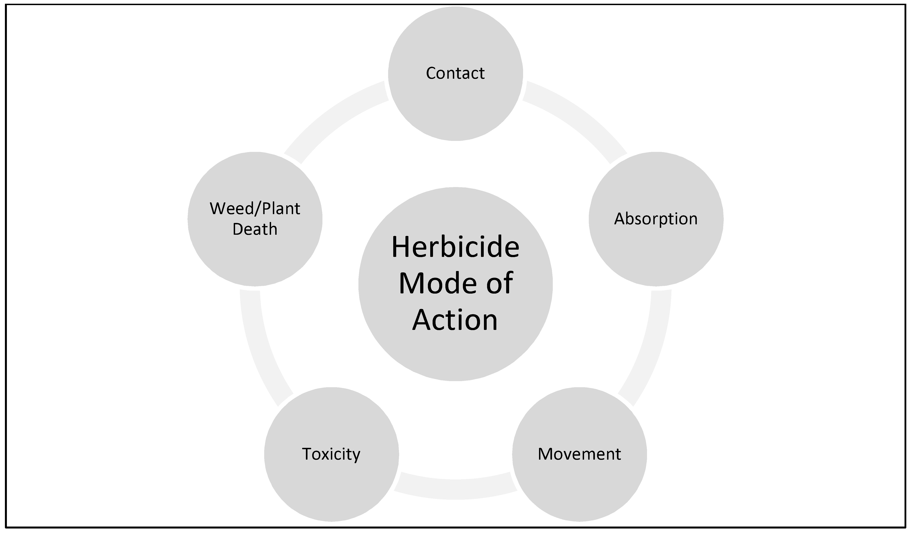

Slide 13
Mode Of Action Of Glyphosate
Glyphosate specifically binds and blocks the activity of EPSPS (enolpyruvateshikimate-3-phosphate synthase).
EPSPS is an enzyme of the aromatic amino acid biosynthetic pathway.
Glyphosate inhibition of EPSPS prevents the plant from synthesizing the aromatic amino acids essential for protein synthesis.

Slide 14
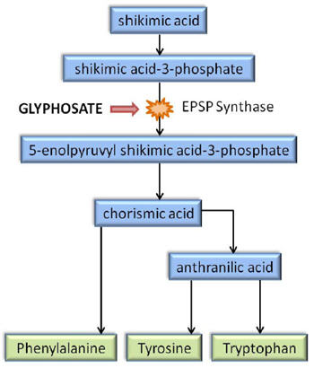

Slide 15
THANKS

