Slide 1
International rules and regulations for biosafety and GMOs

Slide 2
Modern Biotechnology has led to the development of new products/processes which manifest distinct advantages for the prevention and treatment of diseases, in the increased production of medically important compounds and improved vacancies.
Recent breakthroughs include microbial production of human insulin, growth hormone, interferon, urokinase betaendorphin (clot-busting drug), thymosin, alpha-3 somatostatin (pancreas), tissue plasminogen activator (heart and stroke).
The list of biologically active compounds which can be made by Genetically Modified Organisms (GMOs) is increasing every day and it is believed that in the next 15-20 years, we will be able to produce all biological proteins by Genetically Modified Organisms.

Slide 3
Through the use of powerful gene cloning and molecular immunological techniques, vaccines against malaria and hepatitis B have been prepared.
Vaccines for trypanosomes (sleeping sickness), schistomyces, and leprosy are in the final stages of preparation.
Monoclonal antibodies are being used for diagnostic and therapeutic purposes and this has made possible early diagnosis and cure of many diseases.
Prenatal diagnosis has paved the way to bring down the incidence, of such genetic diseases as beta-thalassemia.
Since heredity plays a part in virtually all diseases, including diabetes, cancer, cardiovascular disorders, arthritis, and a number of other disorders known to run in families, efforts are being made to sequence the causative genes to use this information in prenatal diagnosis in order to reduce the incidence, if not, completely eliminate these diseases.

Slide 4
In the industrial sector, modern biotechnology has paved the way for
bacterial desulphurization of coal and petroleum;
microbial production of fructose,
polypropylene glycol, olefins and parafins;
enrichment of precious metals,
enhanced oil recovery,
clearing of oil spills,
sewage treatment and pollution control.

Slide 5
Traditional plant breeding techniques are limited by sexual incompatibility barriers.
In addition, valuable traits such as tolerance to specific herbicides and nitrogen fixation do not exist in plants. Biotechnological methods allow to overcome the genetic incompatibility barriers.
Genes can be isolated from bacteria, viruses, fungi, plants or animals and made to express in easy and quick growing organisms. Genetically Modified Organisms (transgenic plants, animals and microorganisms) have been produced and used commercially.
Globally over 70 different commercially important species of plants have been modified to incorporate mainly seven transgenic traits. The important crops include maize, soybean, cotton, tomato, potato, alphalpha, petunia, mustard, rice, wheat, beet, barley, chickpea (gram), cabbage and tobacco.

Slide 6
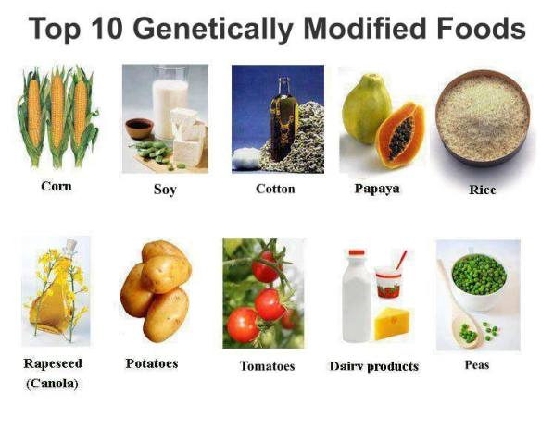

Slide 7
Seven transgenic traits
Herbicide tolerance
Insect resistance
Viral disease tolerance
Fungal disease tolerance
Product quality improvements
Others (production of metabolites/ chemicals, improvement of nutritional traits, incorporation of marker genes, stress resistance properties etc.)

Slide 8
REASON FOR CONCERN
ETHICAL ISSUES
HUMAN HEALTH SAFETY
LABELING
DOMINATION OF FOOD PRODUCTION BY FEW COMPANIES
LOSS OF FLORA AND FAUNA BIODIVERSITY

Slide 9
NEED FOR BIOSAFETY GUIDELINES/REGULATIONS
The use of transgenic organisms in the open environment has raised the need to develop and adopt safety protocols during laboratory experimentation as well as during eventual use of Genetically Modified Organisms (GMOs) and the products.
As a rule, research on GMOs is carried out by competent researchers who are fully conscious of good laboratory practices and the acceptable safety of releasing the GMOs into the environment.

Slide 10
International agreements
Convention on Biological Diversity (CBD)
One of the major international instruments relevant to biosecurity is the Convention on Biological Diversity (1992) and its Cartagena Protocol on Biosafety (2000). The Convention has three objectives;
conservation of biological diversity,
the sustainable use of its components
the fair and equitable sharing of the benefits arising out of the utilization of genetic resources.

Slide 11
Pakistan signed the convention on 5th June 1992 and became the party to the convention.
The agreement covers all ecosystems, species, and genetic resources.
It links traditional conservation efforts to the economic goal of using biological resources.
It sets principles for the fair and equitable sharing of the benefits arising from use of genetic resources
It also covers rapidly expanding field of biotechnology through its Cartagena Protocol on Biosafety, addressing technology development and transfer, benefit sharing and biosafety issues.

Slide 12
Cartagena Protocol on Biosafety
The Protocol was adopted in 2000 and entered into force by September, 2003.
It is the first global legally binding instrument focusing on LMOs.
The purpose of the Protocol is to ensure adequate levels of protection in the field of safe transfer, handling and use of LMOs resulting from modern biotechnology that may have adverse effects on the conservation and sustainable use of biodiversity or pose a risk to human health.
The Protocol is applicable to all LMOs apart from those that are pharmaceuticals for humans that are addressed by other international agreements.

Slide 13
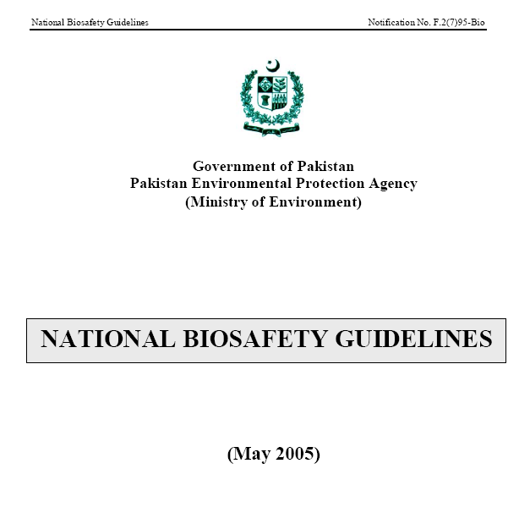

Slide 14
GMOs Fate in Pakistan and Role of Ministry of Environment
After notification of Biosafety Rules 2005, National Biosafety guidelines 2005 were developed which establishes proper procedures and forms to carry out GMOs related activities (manufacture, storage, sale, purchase, import, export, field trial and commercial release of GMOs) under safety limits.

Slide 15
The implementation of bio-safety practices in genetic engineering and biotechnological work will be supervised by
1) Institutional biosafety Committee (IBC)
2) Technical Advisory Committee (TAC)
3) National Biosafety Committee (NBC)

Slide 16
1) Institutional biosafety Committee (IBC)
All applications/request of any such activity related to GMOs will be submitted to the relevant IBC which is monitoring, implementing and regulatory authority at baseline level

Slide 17
2) Technical Advisory Committee (TAC)
Then these requests must be transferred to TAC for assessment and on its recommendations, NBC will take further necessary actions.

Slide 18
3) National Biosafety Committee (NBC)
NBC is headed by Secretary Ministry of Environment, is responsible to oversee all laboratory work, field trial, commercial release, import, export, sale and purchase of GMOs

Slide 19
Project “National Biosafety Centre”
by NBC
Objective of this Centre is to provide safety against undesirable effects of the GMOs.
For awareness raising abt GMOs and risk for human health and environment, public notices, workshops and seminars may be arranged country wide on federal as well as provincial levels

Slide 20
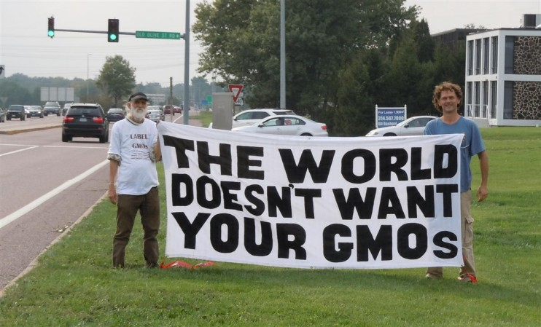
Thanks

