Slide 1
Ethical issues in genetically modified organisms- food and crops

Slide 2
Genetically Modified Organisms
Definition
Genetically Modified Organisms, are the ones in which the genetic material (DNA) has been altered in order to get the required result.
Technology ----- ‘gene technology’, or
‘recombinant DNA technology’ or
‘genetic engineering’
Resulting organism ------- ‘genetically modified, or genetically engineered’ or ‘transgenic’ organisms.

Slide 3
Genetic engineering…..process
All living organisms, from viruses to human beings, are made up of cells, with a nucleus at the centre, which contains a unique set of instructions regarding their size, strength and other qualities. These instructions are found on a long molecule called DNA which is divided into small sections called genes. It is the sequencing of genes on DNA that determines an organism’s characteristics.
The process of isolating gene(s) from the genome of one organism and inserting the same into the genome of another organism is known as Genetic Engineering.
In nature, exchange of genes happens only between compatible or closely related species. However, the modern technique of genetic engineering facilitates the removal of group of genes from one species and insertion into another, there being no need for compatibility.

Slide 4
Method
The transfer process involves shifting the desired gene from the chromosome of a particular plant or animal or any other organism into a cell. This genetically modified cell is then regenerated to produce a ‘genetically modified organism’ (GMOs). The modified organism passes the new gene onto its progeny. Such methods are now being used to create GM plants, of desired quality, growth and strength.
Basic idea is to have plant varieties with high yield, pest disease resistant, or other such qualities mainly for better marketability and durability.
This is different from the processes of modifying crops/plants from their wild ancestors through selective breeding or mutation breeding, which have been practised by farmers as part of their regular farming.

Slide 5
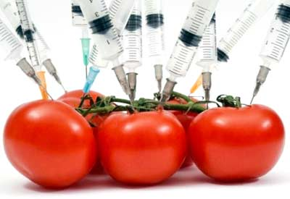
First GM crop/food history
The first commercially grown GM food was
Tomato (called Flavr Savr), by a Californian
company which took the initiative to obtain
approval for its release in 1994.
In 2006, 252 million acres of transgenic crops were planted in 22 countries by 10.3 million farmers.
e.g. crops were soybeans, corn, cotton, canola, and alfalfa.
Other crops grown commercially or field-tested are a
sweet potato resistant to virus,
rice with increased iron and vitamins

Slide 6
Cont…..
Bananas that produce human vaccines against infectious diseases such as hepatitis B
fish that mature more quickly
cows that are resistant to bovine spongiform encephalopathy (mad cow disease)
fruit and nut trees that yield years earlier,
Thus genetically modified crops enhance either their yield, or size, or durability, etc

Slide 7
Best example
Production of human insulin

Slide 9
Objective for developing GM plants
The initial objective for developing GM plants was to improve crop protection. The GM crops currently in the market are mainly aimed at an increased level of crop protection through the use of one of the three basic traits:
resistance to insect damage
resistance to viral infections
tolerance towards herbicides
All the genes used to modify crops so far are derived from micro-organisms

Slide 10
In Future…..
Scientists are also working on crops which they hope will be useful for industry, such as
plants that produce oil for the cosmetics industry,
crops with altered nutritional value,
crops that produce pharmaceutical drugs.

Slide 11
GM crops required traits
Pest resistance
Herbicide resistance
Disease resistance
Enhanced the taste and quality
Stress resistance
Fruit ripening
Enhancement of nutritional value
Oil production
Edible vaccine

Slide 12
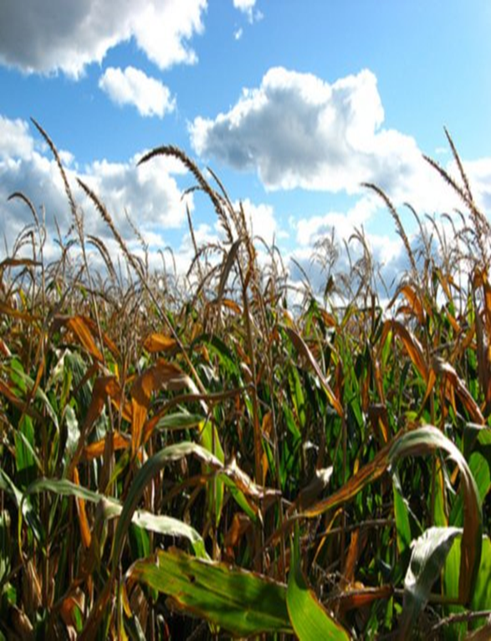
Benefits of the GM products
Crops
Enhanced taste and quality
Reduced maturation time
Improved resistance to disease, pests and herbicides
Increased nutrients, yields, quality and stress tolerance
Food with greater shelf life or food with medicinal benefits, such as
edible vaccines—for example, bananas with bacterial or rotavirus antigens
Animals
Increased resistance, productivity and feed efficiency
Better yields of meat, eggs, and milk
Improved animal health and diagnostic methods
Remove genes that trigger allergies
Environment
Eco-Friendly bio herbicides and bio insecticides
Conservation of soil, water and energy
Society
Increased food security for growing populations
Provides more food in less land

Slide 13
Issues of concern (Human health risks and environmental safety)
GMO crops could potentially have negative effects on human health as well.
Allergies
When splicing genes between species, there are examples in which consumers have developed unexpected allergic reactions.
e.g. Researchers used a gene from the Brazil nut to increase the production of Methionine in soya beans. The insertion of this gene inadvertently caused allergic reactions to the soya bean in those with known nut allergies, but no previous allergy to the soya bean, according to the product developer

Slide 14
Cont…..
Long-Term Effects
GMO technology has been available for such a short amount of time, there is relatively little research which has been conducted on the long-term effects on health. The greatest danger lies not in the effects that we have studied, but in those which we cannot anticipate at this point.

Slide 15
Cont…..
New Proteins
Proteins which have never been ingested before by humans are now part of the foods that people consume every day. Their potential effects on the human body are as of yet unknown.
Food Additives
GMOs also present us with possibilities of introducing additional nutrients into foods, as well as antibiotics and vaccines. This availability of technology can provide nutrition and disease resistance to those countries that don’t have the means to provide these otherwise. The distribution of these foods is more feasible than mass inoculations for current diseases. However, even these possibilities carry with them potential negative effects such as the creation of antibiotic and vaccine-resistant strains of diseases.

Slide 16
Effects on the Environment
Herbicide Use and Resistance
Effects on the environment are a particular concern with regard to GMO crops and food production. One area of development involves adding the ability to produce pesticides and resistance to specific herbicides. which will have a larger negative effect on the surrounding environment. Also unintended hybrid strains of weeds and other plants can develop resistance to these herbicides through cross-pollination, thus negating the potential benefit of the herbicide.
Effects on Untargeted Species
Bt corn, which produces its own pesticide, is also in use today. Concerns have been raised regarding adverse effects on butterfly populations, which are not the original target of the pesticide. Although the pesticide can protect crops against unwanted insects, they can also have unintentional effects on neutral or even beneficial species.
Potential impact on biodiversity.
loss of flora and fauna biodiversity.

Slide 17
Ethical concerns
Violation of natural organisms’ intrinsic values by mixing among species
Tampering with nature by mixing genes among species
Objections to consuming animal genes in plants
Reduce Genetic Diversity
Violation of human rights

Slide 18
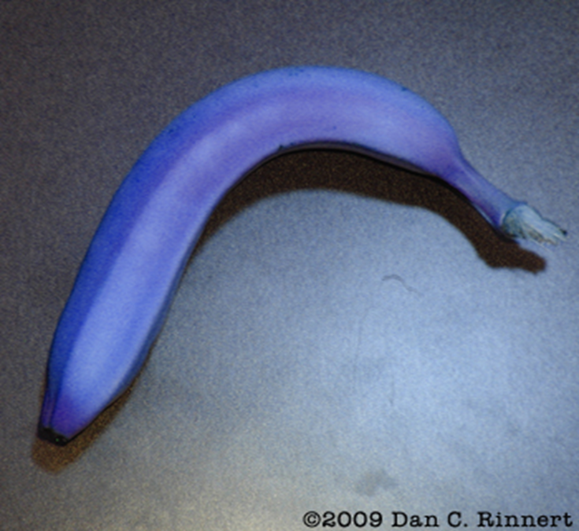
It is a violation of natural organisms intrinsic values
The food product will not be natural anymore.
The original food product may become extinct.

Slide 19
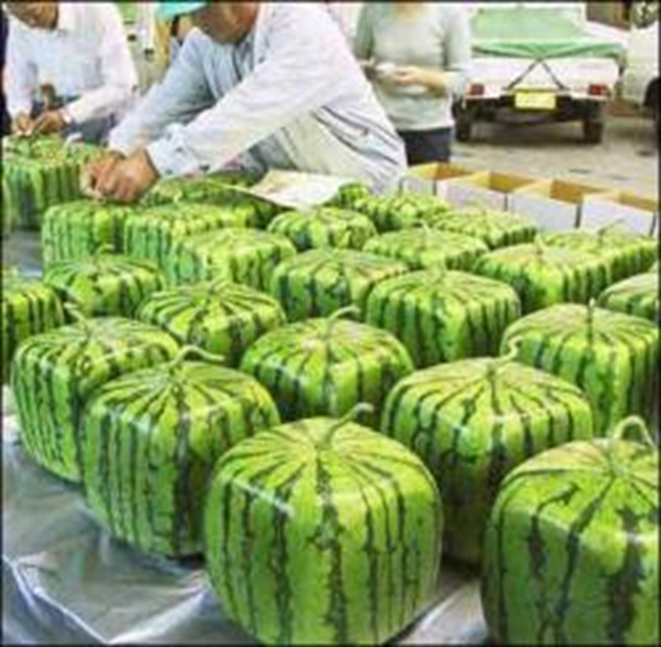
Tampering with Nature
Mixing Genes among species.
Creating something that was never meant to be.
Could negatively effect many different parts of nature.

Slide 20
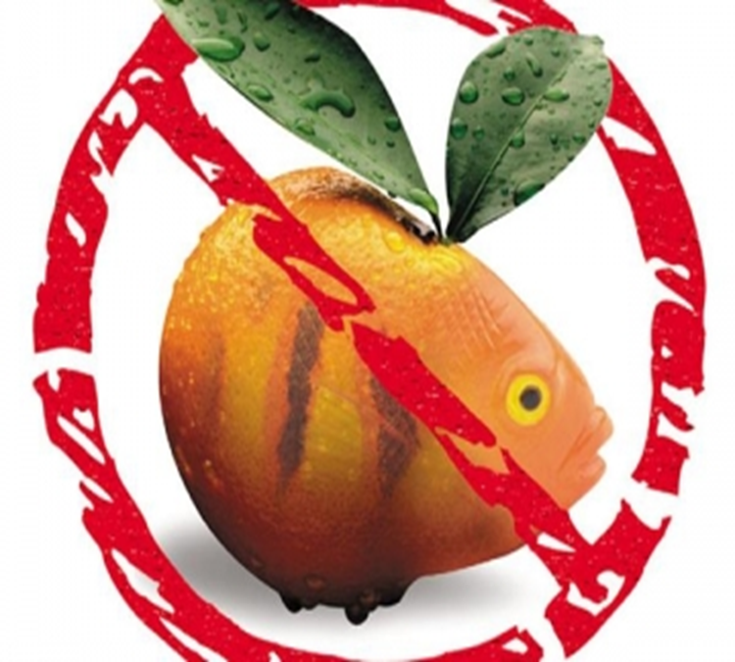
Objections to consuming animal genes in food
Vegetarians will eat animal genes against their will or with out them knowing.
Different Religious groups may consume something that is against their believes to eat.

Slide 21
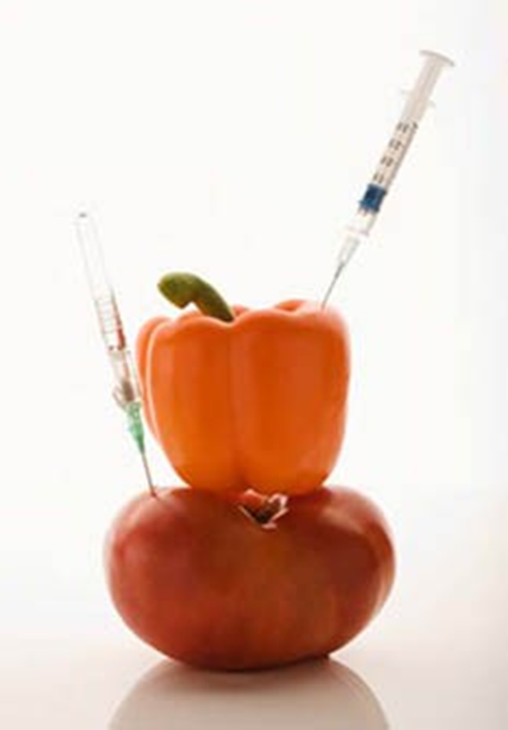
Reduce Genetic Diversity
Reduces the chances for many things to survive because their nutritional importance can be re-created and put in to other foods.
Also GM food can breed with other species

Slide 22
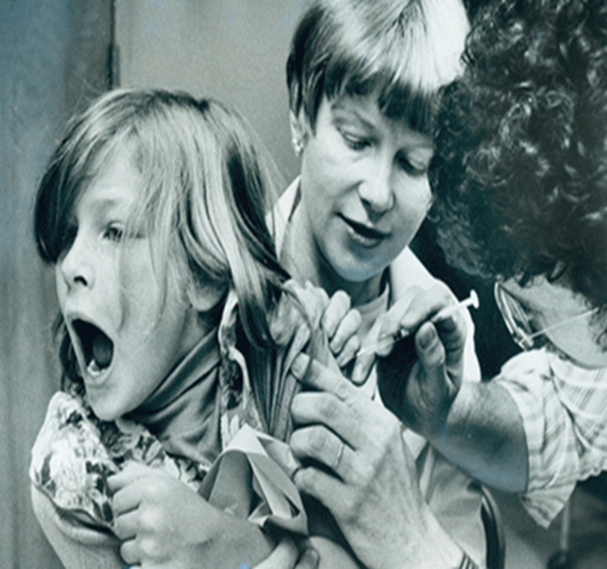
Violation of human rights
Vaccinations could be placed in food
Pharmaceuticals could be placed in food
Many people don't believe in those are healthy to be consumed.

Slide 27
THANKS

