Slide 1
Biosafety cabinets

Slide 2
Biosafety cabinets
Biosafety cabinets (BSCs) are primary means of containment, developed for working safely with infectious microorganisms
an enclosed, ventilated laboratory workspace for safe working
Biological safety cabinet or microbiological safety cabinet
BSCs are only one overall part of biosafety program, which requires consistent use of
- Good microbiological practices
- Primary containment equipment
- Primary containment facility design

Slide 3
The primary purpose of a BSC is to serve as a means to protect the laboratory worker and the surrounding environment from pathogens.
All exhaust air is HEPA-filtered as it exits the biosafety cabinet, removing harmful bacteria and viruses.
BSCs first became commercially available in 1950.
Several different types of BSC exist, differentiated by the degree of biocontainment required.

Slide 4
HEPA filters
High efficiency particulate air
(HEPA) filters
Collect particles----0.3 microns (0.0003 mm) in diameter
Made up of single sheet of borosilicate glass fibers

Slide 5
Classification of Biosafety cabinets
Class I:
Personnel and environment protection.
Product is not protected.
Class II:
Personnel, product and environment are protected.
Class III:
Maximum protection to personnel, product and environment

Slide 6
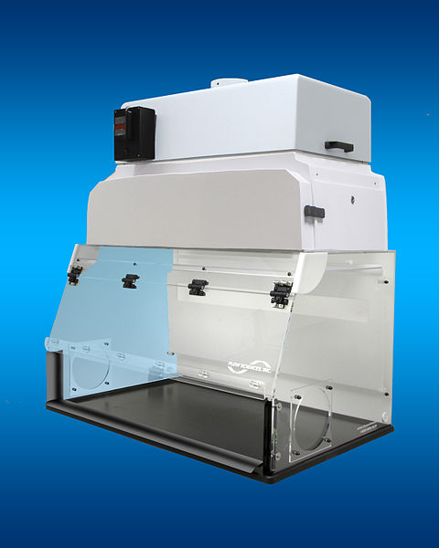
Biosafety cabinet Class I
It provide personnel and environmental protection but no product protection
the inward flow of air can contribute to contamination of samples.
Inward airflow is maintained at a minimum velocity of 0.38 m/s (75 ft/min).

Slide 7
It is similar in terms of air movement to a chemical fume hood, but has a HEPA filter in the exhaust system to protect the environment.
These BSCs are commonly used to enclose specific equipment (e.g. centrifuges) or procedures (e.g. aerating cultures) that potentially generate aerosols.
BSCs of this class are either ducted (connected to the building exhaust system) or unducted (recirculating filtered exhaust back into the laboratory)

Slide 8
Biosafety cabinet Class II
Class II cabinets provide both kinds of protection (of the samples and of the environment).
As biomedical researchers began to use sterile animal tissue and cell culture systems, particularly for the propagation of viruses, cabinets were needed that also provided product protection. In the early 1960s, the “laminar flow” principle evolved.
HEPA filter in the class II cabinet protects the environment by filtering air before it is exhausted.

Slide 9
Biosafety cabinet Class II
All Class II cabinets are designed for work involving microorganisms assigned to biosafety levels 1, 2, 3 and 4.
Class II cabinets are the commonly used cabinets in clinical and research laboratories.
It has microprocessor based controllers with digital display of all key parameters.
BSC class II is portable and easy to operate.

Slide 10
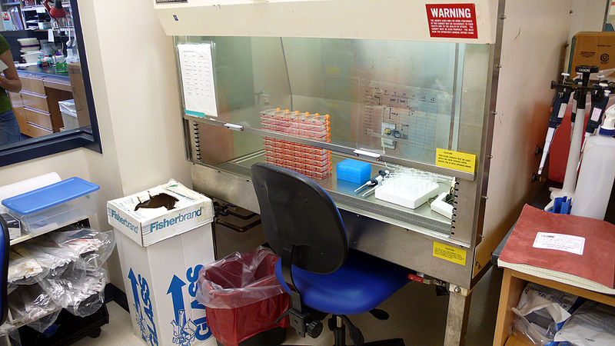
Biosafety cabinet Class II

Slide 11
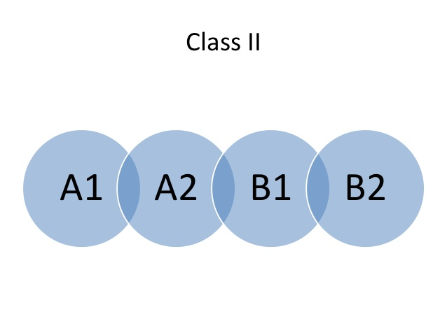
Types of BSC class II

Slide 12
Class II- A1 type
Internal fan- draws room air - 75 ft/m velocity
Air flows through HEPA filters
30 % of the air - exhaust HEPA filter
70 % of the air - recirculate through HEPA filter back into the work zone of the cabinet
Not to be used for working involving volatile toxic chemicals
Exhaust the air outside the building (through use of canopy hood)
Class II - A2
Inflow air velocity 100 ft/m
Exhaust air is hard ducted

Slide 13
Class II - B1
For hazardous chemicals and carcinogens
HEPA filters
Inflow air velocity 100 ft/m
Airflow -- 60% of air is exhausted and only 40% is recirculated
Class II - B2
Inflow air velocity 100 ft/m
Simultaneous biological and chemical containment
Total exhaust cabinet
No air recirculation

Slide 14
Biosafety cabinet Class III
The Class III cabinet is specifically designed for work with BSL-4 pathogenic agents, providing maximum protection.
The enclosure is gas-tight, and all materials enter and leave through a dunk tank or double-door autoclave.
Long, heavy-duty rubber gloves attached to the front prevent direct contact with hazardous materials (Class III cabinets are sometimes called glove box).

Slide 15
Both supply and exhaust air are HEPA filtered on a Class III cabinet.
Exhaust air must pass through two HEPA filters, or a HEPA filter and an air incinerator, before discharge directly to the outdoors.
Class III cabinets are not exhausted through the general laboratory exhaust system.
Wait for minimum of four minutes to switch off the blowers after the work is over.

Slide 16
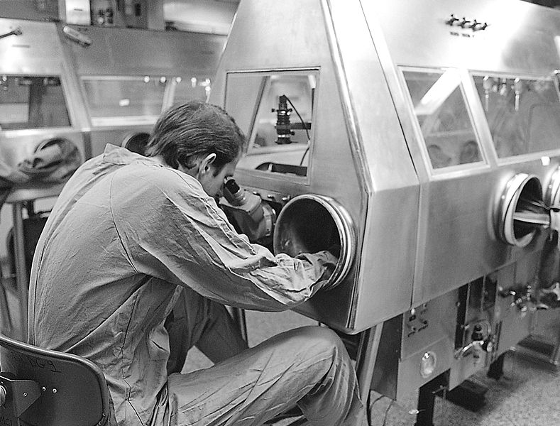
Biosafety cabinet Class III

Slide 17
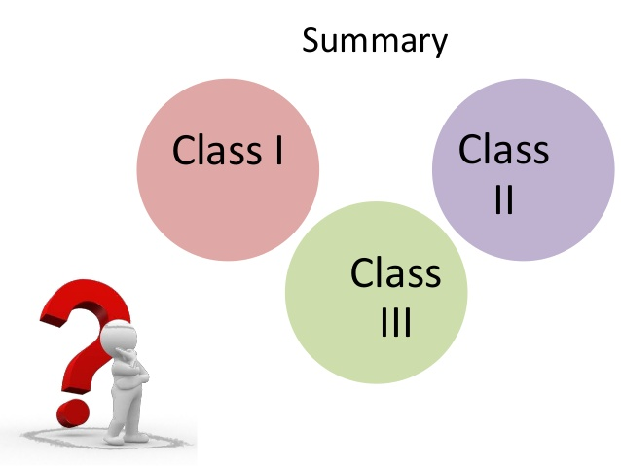

Slide 18
Thank YOU

