Slide 1
Biohazardous waste

Slide 2
Biohazards
Definition:
Biological substances that pose a threat to the health of living organisms, primarily that of humans.
Biohazards ------------- biological hazards
Examples
medical waste or
samples of a microorganisms,
virus
toxin (from a biological source) -------- human health

Slide 3
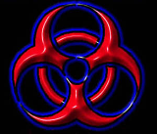
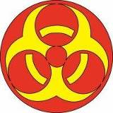
Biohazard symbols

Slide 4
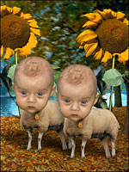
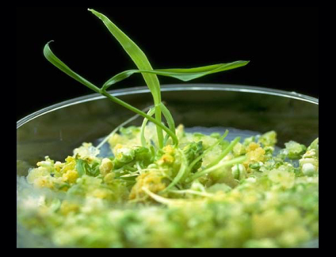
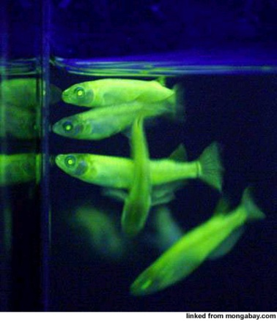
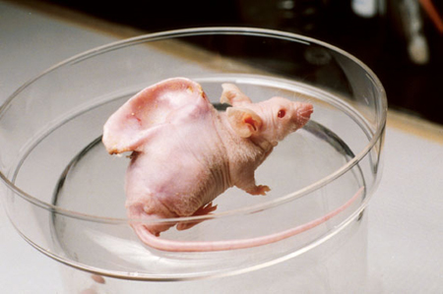
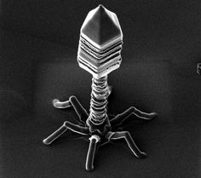
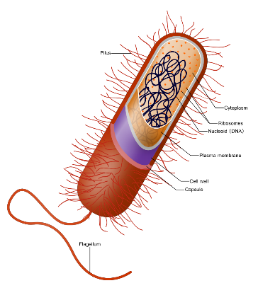
Biohazardous materials
Transgenic Plants, Animals, virus, bacteria, fungi and Insects

Slide 5
Biohazardous waste categories
Main Four categories
Solid Biohazardous waste
Liquid Biohazardous waste
Biohazardous sharps waste
Pathological waste
Each form must be segregated, identified, decontaminated and disposed of in an appropriate manner in order to minimize risks

Slide 6
1. Solid Biohazardous waste (non-sharps)
Gloves and other disposable PPE contaminated with culture material
Plasticware
(pipettes or pipette tips, culture plates, specimen vials)
Cont. bacterial and cell culture material
Towels and bench paper
All culture or sample containers that are contaminated with biological materials
Vials of blood
(glass blood vials -------break easily --------- as sharps waste)

Slide 7
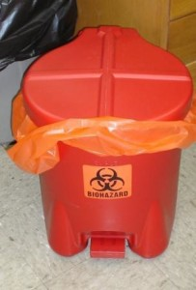
Storage
leak-proof container lined with an autoclave bag of moderate thickness
Container ----------lid
Container ------- labeled -------- biohazard symbol
Bench top containers (Small plastic containers)
--------- suitable-----For small quantities of
contaminated dry goods
(pipette tips, centrifuge tubes)
Daily disposal of ------- into a larger container
strongly recommended.

Slide 8
Wastes Requiring Special Considerations
Breakable Biohazardous Wastes
tubes of blood ------- create trouble
treated as ------sharp waste
Serological pipettes
All plastic pipettes------------ segregated ----- puncture

Slide 9
Treatment and Disposal
The purpose of solid biohazardous waste treatment is biological inactivation in a manner that reduces hazardous exposure risk for lab workers and the environment.
This is generally achieved by autoclave treatment of waste or treatment and disposal through a medical waste disposal contractor who will autoclave or incinerate the waste.

Slide 10
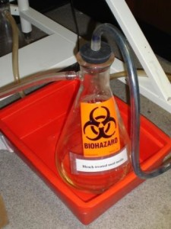
2. Liquid Biohazardous waste
bulk quantities of blood,
blood products,
body fluids from human and animal research
contaminated culture media
If less 25ml -------solid waste
Storage
Closed, leak proof containers
Collection vessels ------ must be
In a bucket or deep tray
Labeled

Slide 11
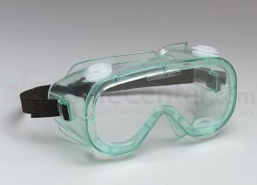
Treatment and Disposal
Chemical treatment of liquids with disinfectant; disposal via lab sink
Disinfectants --- used for treatment of liquid biological waste.
Add household bleach ---- makes 10% of final volume ---- at least 30 min. Discard the mixture -------- lab sink. Rinse down the sink with water.
splash goggles, gloves, and a lab coat for handling of bleach
Autoclave treatment of liquids; disposal via lab sink
Place the collection vessel in a secondary container and autoclave. Treat by autoclave using the liquids cycle.
Discard through lab sink.
loose the lid on the vessel before placing in autoclave

Slide 12
3. Biohazardous sharps waste
Any device that is sharp enough to puncture the skin ------- contaminated with a biological material that is an infectious disease transmission risk.
Examples
Needles,
disposable syringes
capillary tubes
scalpels
Microscope slides
Pasteur pipettes
Small glass/broken tubes of blood cultures

Slide 13
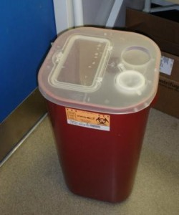
Storage
Specifically designed container
constructed of puncture-resistant material
leak-proof on the sides and bottom
marked -------- biohazard symbol
has a restricted opening to prevent
items from coming back out of the
container, and to prevent someone
from sticking their hand inside.

Slide 14
Treatment and Disposal
Medical Waste disposal Contractor
Departments ----- contract for pickup and disposal of waste
Sharps containers must be permanently closed and wiped down with a disinfectant prior to removal from the lab and for disposal
If any liquids ------------ biohazardous sharps container, it must be placed in a leak-proof secondary container with a secure lid

Slide 15
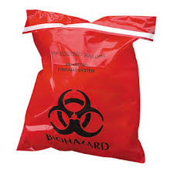
4. Pathological waste
all unfixed human organs,
tissues and body parts
unfixed animal tissues
carcass
Storage, Treatment and Disposal
double-bagged in biohazard bags -------- Symbol
Stored --------- minimize the release of fluids during handling
Storage of bags in a tray, or secondary storage of bags in a plastic zipper bag ----------------- strongly recommended.
A medical waste disposal contractor ----------- pickup and disposal

