Slide 1
Patenting and its benefits

Slide 2
What is patent?
• - A form of Intellectual Property right to an invention of a technical product or process.
A patent is a property right granted by the U.S. Patent and Trademark Office (USPTO).
– A patent gives its owner the right to exclude others from making, using, selling, offering for sale or importing the claimed invention for a limited period of time, usually twenty years.

Slide 3
The term "intellectual property" broadly refers to ideas and concepts that are unique and potentially valuable, such as an invention or a work of fiction, and the determination of who owns these ideas or concepts.
There are three distinct types of intellectual property -- patents,
trademarks
copyrights

Slide 4
Patents
– Patents are granted by national or regional patent offices.
A given patent is therefore only useful for protecting an invention in the country in which that patent is granted.
In other words, patent law is territorial in nature.

Slide 5
Example

Slide 6
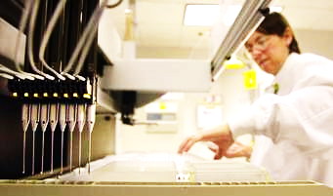
Protection of an invention
Patent rights protect inventions.
If you have a patent, others are in principle not permitted to make, use, resell, rent out, supply, import or stock your invention, or offer it to someone else.

Slide 7
What are the Basic Requirements for a Patent?
In the United States, there are five elements of patent eligibility. The USPTO states the following:
for your invention, In order to qualify for patent eligibility, it must cover subject matter that Congress has defined as patentable. The USPTO defines patentable subject matter as any "new and useful" process, machine, manufacture or composition of matter. Machines or processes are patentable subject matter, but the laws of nature are not. So, you can patent a machine for sorting packages, but you can't get a patent for sunlight.

Slide 8
The invention must have a "utility," or in other words, be useful. Note that this requirement is only for utility patents.
The invention must be "novel," or new.
The invention must be "non-obvious," meaning its use or function can't be something that is simply the next logical step of an already patented invention. Much of the argument between the USPTO and patent applicants revolves around the issue of non-obviousness.

Slide 9
The invention must not have been "disclosed" to the public prior to the application for the patent. For example, if you've written an article describing the invention before you apply for the patent, the USPTO may deny the application because you've already disclosed the patent and therefore it's public knowledge.

Slide 10
Process of patenting

Slide 11
Types of patent
Utility Patents
Term 20 years from Filing
Design Patents
Term 14 years from the date of the Patent Grant
Plant Patents
Term 20 years from Filing

Slide 12
Utility patent
Granted for new, non-obvious, and useful inventions for processes, machines, manufactures, composition of matter, or if the invention makes an improvement on a previous invention.

Slide 13
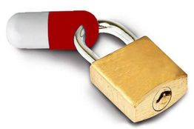
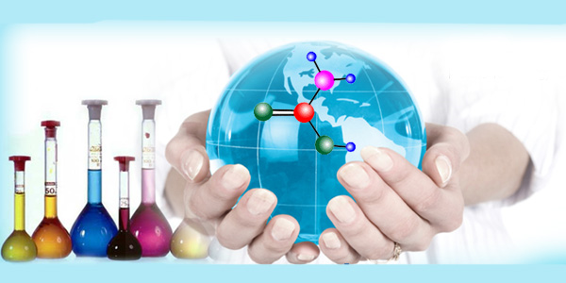
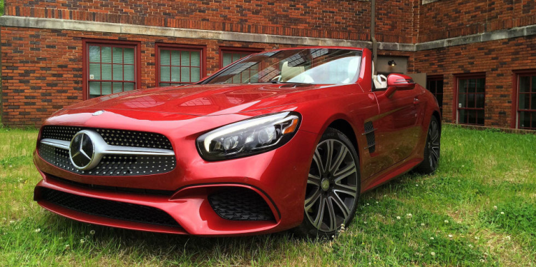
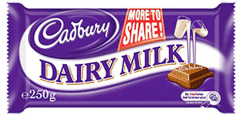
Design patent
Granted for new and original ornamental designs of a manufactured product.
The appearance of the object receives protection instead of its functionality.

Slide 14
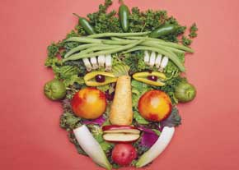
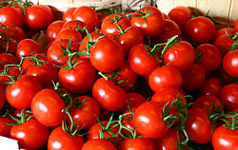
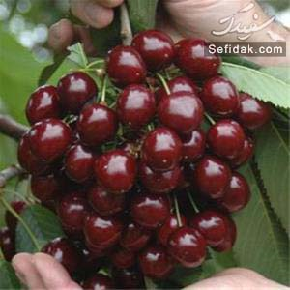
Plant patent
A patent for the invention or discovery of an asexually reproducible plant that is distinct and new.
Using the claimed plant for a period of 20 years from the application filing date.

Slide 15
Parts of U.S. patents
Specification – detailed description of invention and background
Drawings – diagrams, flow charts, data (e.g. NMR, IR, etc.)
Claims – define “metes and bounds” of invention

Slide 17
Biotech Inventions
What is patentable?
Purification from
T. aquaticus
Novel?
Obvious?
Useful?
Taq polymerase
PCR
naturally-occurring
Recombinant form
of Taq polymerase
Confidential

Slide 18
Biotech Inventions
Gene Inventions and exemplary claims
Nucleotide, Protein sequences
Promoters
Vectors
Epitope sequences and Antibodies
Processes used for making the protein
Method of Use(s): diagnostic, treatment, screening
Pharmaceutical Product
Confidential

Slide 19
Life is not patentable

Slide 20
Copyrights
Patents refer to an invention, whereas copyrights refer to the expression of an idea, such as an artistic work.
Copyrights protect the expression of ideas. Artistic works are generally considered to be expressions of ideas – books, paintings, songs, movies, and computer programs are examples.
Copyright will not protect the process through which a particular work was created or the use of information within it

Slide 21
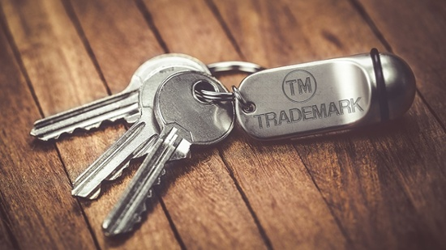
Trademarks
trademarks are not concerned with the functionality of a product.
Trademarks are used to identify the source of a product or service, or to differentiate the source of the product or service from others. These identifying marks may include words, phrases, symbols, logos, or other devices
Trademarks give you the right to prevent others from unfairly competing with you by using “confusingly similar” marks.

Slide 22
Examples
Software:
You can patent its functionality,
trademark the name or logo of the company producing the software,
copyright the code itself.
Company logo:
You can trademark the logo itself (as it indicates the source of the company’s products and services), and copyright the creative and artistic aspects of the logo.
Laptop:
You can patent the computer technology itself,
trademark the brand that’s producing the laptop, copyright the code for the laptop’s operating system.

