Slide 1
Ethical Issues in Reproductive Technologies

Slide 2
reproductive technologies
Refers to various medical procedures that are designed to alleviate infertility, or the inability of a couple to produce a child of their own.
Treatments or procedures that include the handling of human eggs and sperm or embryos for the purpose of establishing a pregnancy

Slide 3
Infertility
Infertility is the inability of a person, animal or plant to reproduce by natural means.

Slide 4
Types of reproductive technologies
Some common types of reproductive technologies are:
In-Vitro Fertilization (IVF)
Surrogacy
Intracytoplasmic sperm injection
Artificial insemination

Slide 5
In-Vitro Fertilization (IVF)
Technique whereby egg cells are fertilized by a sperm outside a woman’s womb.
IVF involves combining eggs and sperm outside the body in a laboratory. Once an embryo or embryos form, they are then placed in the uterus. This procedure was once known as "test-tube babies”
Louise brown, England 1978

Slide 6
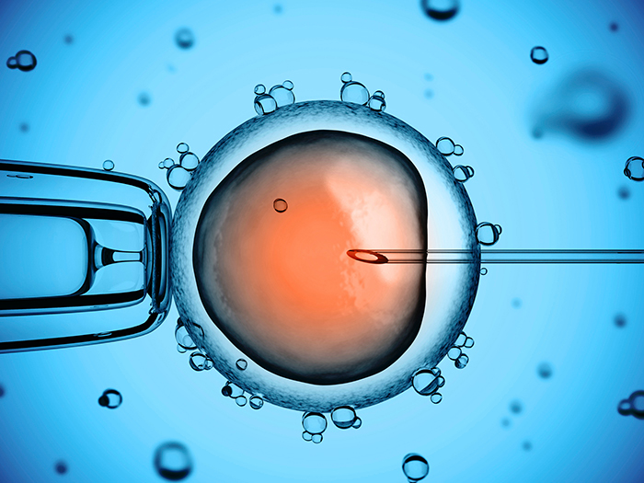
Advantages
IVF allowed women to be pregnant even in their 50s-60s.
Even after Menopause, Uterus is still available to carry out this function (IVF).

Slide 7
disadvantages
IVF is opposite from traditional father-mother model
Children not genetically related to parents
Psychological problems for the child
Same sex couples can have children i.e : lesbian couple

Slide 8
surrogacy
practice in which a woman (the surrogate mother) bears a child for a couple unable to produce children, Via artificial insemination (usually with the sperm of the husband) or through the implantation of an embryo produced by in vitro fertilization.

Slide 9
Advantages
allows women unable to give birth to have their biological child , even if someone else is carrying the child during the gestation period.

Slide 10
disadvantages
The surrogate mother might refuse to cede custody to the intended biological parents

Slide 11
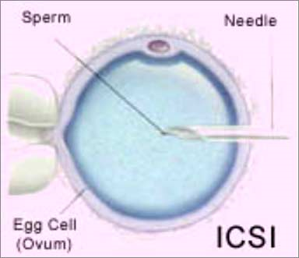
Intracytoplasmic sperm injection
Is a micromanipulation procedure in which a single sperm is injected directly into an egg to attempt fertilization, used with male infertility or couples with prior IVF fertilization failure.

Slide 12
Advantages
ICSI is a procedure which effectively eliminates male infertility by introducing sperm cells directly into an egg.

Slide 13
disadvantages
ICSI’s method of directly introducing sperm into an egg defeats the natural process of selecting, natural selection makes sure that the best sperm with the best genetic material get the chance to fertilize.
Removing that selection process can lead to an increase risk of developmental and health issues for ICSI children, as well as a higher risk of miscarriage because of the poorer genetic material involved
children conceived through ICSI are infertile or sub-fertile as a consequence of the procedure

Slide 14
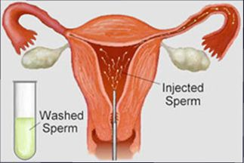
Artificial insemination
Is the procedure when sperm are inserted directly into a woman's cervix, fallopian tubes, or uterus. This makes the trip shorter for the sperm and bypasses any possible obstructions.

Slide 15
Advantages
Increase the chances of becoming pregnant and having a family of own.
The sperm will be tested. It means that genetic disorders will be able to decreased.

Slide 16
disadvantages
Women will have complications with the pregnancy
women may suffer from vaginal discharge
lower abdomen pain—headaches—cramping—depression

Slide 17
Ethical issues

Slide 18
Social issues
Undergoing reproductive treatments is very costly and these treatments do not guarantee that a child will result.
Reproductive Technology practices selective reduction which aborts some implanted, developing embryos so the others have a better chance to survive, because if not, it may lead to multiple pregnancy.
Surrogates receive payment for producing a child beyond expenses they incur. Like the selling of organs, such arrangements wrongly commercialize the body.

Slide 19
Ethical issues
Reproductive Technology violates the "one flesh" model of marriage in Scripture
Human procreation means that children should come into being as a direct result of the love-making of their parents, where they are accepted as a ‘gift’ and blessing and not as a ‘product’ of doctors and technicians.
Surrogacy is an experiment in child welfare. It also weakens the integrity and functionality of the family by confusing relationships
“You created every part of me, you put me together in my mother’s womb”. (Psalms 139:13)

Slide 20
Ethical issues
The marital act is not a manufacturing process, and children are not products.
Legal battles between the sets of parents involved in one child’s life are emerging.
The expansive use of reproductive technology also means that more and more children begin life with a single parent or a combination of ‘genetic’, ‘gestational’ or ‘social’ parents. This deprives them of the right to be conceived, carried in the womb, brought into the world and brought up within marriage.

Slide 21
conclusion
Ethical issues of medical technology can be confusing and at times frustrating
God alone can give life. He made human beings according to His own image and children are His gift to them. not as a ‘product’ of doctors and technicians.
“for everything there is a season and time for every Matter under heaven, a time to be born and a time to be die” (Ecclesiastes 3:1-2)

Slide 22
THANKS

