Slide 1
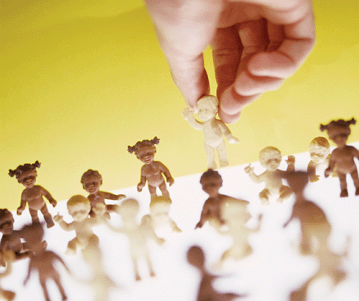
EUGENICS

Slide 2
Eugenics
is a set of beliefs and practices that aims at improving the genetic quality of the human population.
Greek word – eugenes means “ well born”
eu means good/well
genos means race, stock

Slide 3
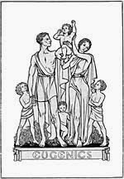
Science of breeding
“better” humans
“Science of well-born”

Slide 4
Types of eugenics
Positive eugenics
Eugenics which encourage reproduction by persons presumed to have inheritable traits
Negative eugenics
Eugenics especially by discouraging reproduction by persons having genetics defects/disorders or presumed to have inheritable traits

Slide 5
Implementation methods
According to Richard Lynn, eugenics may be divided into two main categories based on the ways in which the methods of eugenics can be applied.
1). Classical eugenics
a) Negative eugenics by provision of information and services, i.e. reduction of unplanned pregnancies and births.
Advocacy for sexual abstinence
Sex education in schools
School-based clinics.
Promoting the use of contraception.
Emergency contraception.
Research for better contraceptives.
Voluntary sterilization
Abortion

Slide 6
b) Negative eugenics by incentives, coercion and compulsion.
Incentives for sterilization
The Denver Dollar-a-day program, i.e. paying teenage mothers for not becoming pregnant again.
Incentives for women on welfare to use contraceptions
Payments for sterilization in developing countries.
Curtailment of benefits to welfare mothers.
Compulsory sterilization of the "mentally retarded".
Compulsory sterilization of female criminals.
Compulsory sterilization of male criminals.

Slide 7
c) Licences for parenthood.
d) Positive eugenics.
Financial incentives to have children
Selective incentives for childbearing
Taxation of the childless
Ethical obligations of the elite.
Eugenic immigration

Slide 8
2). New eugenics
Artificial insemination by donor
Egg donation
Prenatal diagnosis of genetic disorders and pregnancy terminations of defective fetuses
Embryo selection
Genetic engineering
Gene therapy
Cloning

Slide 9
History of eugenics
In 1883, Sir Francis Galton, British scholar, cousin of Charles Darwin, first used the term eugenics, meaning “well-born.”
Galton believed that the human race could help direct its future by selectively breeding individuals who have “desired” traits.
Galton concluded that an elite position in society was due to a good genetic makeup.
The eugenics movement began in the U.S. in the late 19th century.

Slide 10
During the 20th century, a total of 33 states had sterilization programs.
While at first sterilization efforts targeted mentally ill people exclusively.
later the traits deemed serious enough to sterilization included alcoholism, chronic poverty, blindness, deafness, feeble-mindedness.
Three International Eugenics Conferences ---- in 1912 in London, and in 1921 and 1932 in New York City.

Slide 11
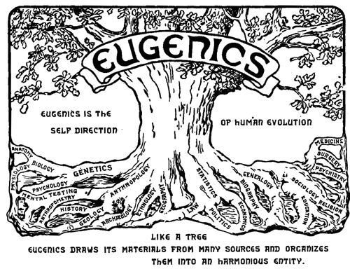
Logo of the second international congress of eugenics, 1921

Slide 12
Some people say that eugenics is all-negative because selection is always determined by who is in power, and that it violates every human being’s right to reproduction.
Eugenics is the belief that selecting the mating partners and controlling the offspring improves the quality of human life.
Partner must have eugenics certificate

Slide 13
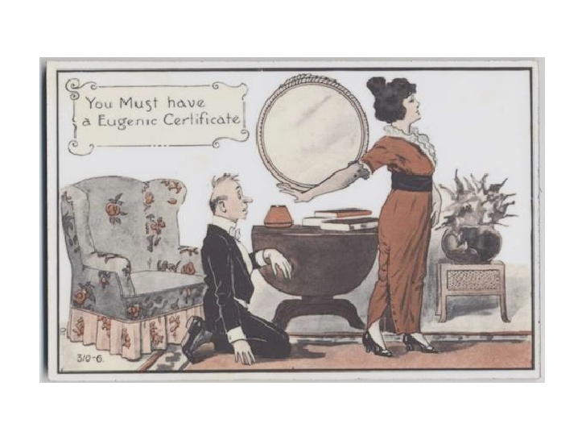

Slide 14
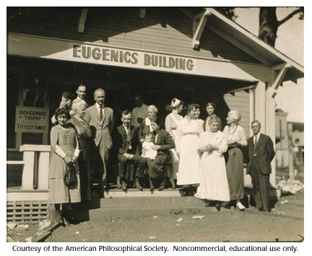
Fitter family competition------positive eugenics for babies
First appearing in 1920 at the Kansas Free Fair.
Size of the family,
overall attractiveness,
health of the family,

Slide 15
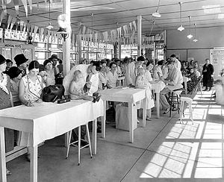
Better Baby Contest at Indiana State Fair 1931

Slide 16
Pros of Eugenics
It Assesses a Child’s Medical Needs With eugenics, parents already know the DNA makeup of their unborn child and are prepared to meet his or her future medical needs.
It Prevents Negative Hereditary Conditions Through engineering the genetic makeup of a child can eliminate hereditary conditions that lead to mental and physical problems.
It Helps to Control Gender It helps to control the gender of offspring, parents who want to have a male or female child can do.

Slide 17
It Creates Better Individuals By altering the DNA makeup of babies, these mental processes can be controlled – kinder, hardworking, smarter, etc.
It is a Room for Medical Advancement What is next? It is always a question for scientific researchers. But eugenics is an age-old concept that is yet to be perfected, and it could potentially become a great frontier for medical innovation.

Slide 18
Cons of eugenics
It is very expensive
It kills human diversity
It creates extreme discrimination
It may multiply not prevent genetic mistakes
Negative eugenics is considered to be a violation of basic human rights, which include the right to reproduction.

Slide 19
Ethical issue ----- People are against the eugenics because they consider that man is trying to
do the role of ALLAH.

Slide 20
Artificial selection
like eugenics is doubtful
because no one has ever succeeded
at manipulating nature.

