Slide 1
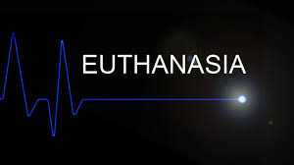

Slide 2
Euthanasia
Euthanasia comes from Greek words
Eu means good
Thanatosis means death
It means “Good Death” OR “Gentle and Easy death”
This word has come to be used for “Mercy killing”
Definition
It is the practice of intentionally ending a life in order to relieve pain and suffering.

Slide 3
There are different euthanasia laws in each country.
The British House of Lords Select Committee on Medical Ethics defines euthanasia as "a deliberate intervention undertaken with the express intention of ending a life, to relieve intractable suffering".
The Dutch law however, does not use the term 'euthanasia' but includes it under the broader definition of "assisted suicide and termination of life on request“.

Slide 4
In the Netherlands, euthanasia is defined as
“termination of life by a doctor at the request of a patient”
The word "euthanasia" was first used in a medical context by Francis Bacon in the 17th century, to refer to an easy, painless, happy death, during which it was a "physician's responsibility to alleviate the 'physical sufferings' of the body.
Controversial issue – ethically wrong

Slide 5
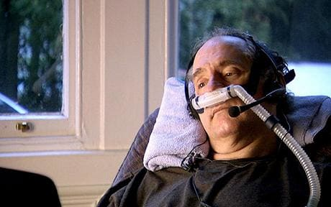
Craig Ewert

Slide 7
Forms of euthanasia
On the basis of consent, as
Voluntary euthanasia
Non voluntary euthanasia
Involuntary euthanasia
On the basis of nature of act being done, as
Passive euthanasia
Active euthanasia

Slide 8
Voluntary euthanasia
Euthanasia conducted with the consent of patient.
Since 2009 voluntary euthanasia has been legal in
Belgium, The Netherlands, Switzerland, and the states of Oregon (USA) and Washington (USA).

Slide 9
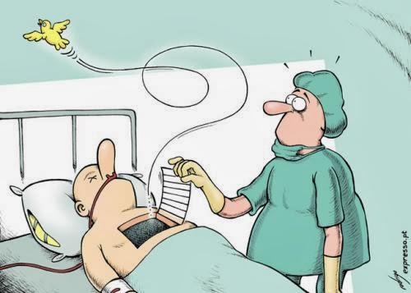
Non -voluntary euthanasia
Euthanasia is conducted without consent of patient.
The decision is made by another person because the patient is incapable to doing so himself/herself.
e.g. child euthanasia
Non-voluntary euthanasia (patient's consent unavailable) is illegal in all countries.

Slide 10
Involuntary euthanasia
Involuntary euthanasia is conducted against the will of the patient.
Involuntary euthanasia (without asking consent or against the patient's will) is also illegal in all countries and is usually considered “murder”.

Slide 12
In some countries there is a public controversy over the moral, ethical, and legal issues of euthanasia.
Passive euthanasia is legal under some circumstances in many countries.
Active euthanasia however is legal in only a handful of countries (e.g. Belgium, Canada, Switzerland) and is limited to specific circumstances and the approval of councilors and doctors or other specialists.
In some countries such as Nigeria, Saudi Arabia and Pakistan, support for active euthanasia is almost non-existent.

Slide 13
Pros
Provides a way to relieve extreme pain
Painless death
Saves family’s money
Organs can be put to good use
Frees up medical funds to help other people
Relieve mental suffering for the patient and his relatives

Slide 14
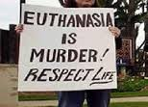
Cons of euthanasia
Devalues human life
Murder ----- Assisted suicide
Discourages scientists who
are looking for cure against
incurable diseases
Reduces palliative care

Slide 15
Religious view- euthanasia in Islam
Muslims are against euthanasia.
They believe that all human life is sacred because it is given by Allah, and that Allah chooses how long each person will live.
Human beings should not interfere in this.
Do not take life, which Allah made sacred, other than in the course of justice. Qur'an 17:33

Slide 16
Destroy not yourselves. Surely Allah is ever merciful to you. Qur'an 4:29
And no person can ever die except by Allah's leave and at an appointed term.
Qur'an 3:145

Slide 18
What is your opinion about euthanasia?

