Slide 1
Medical Biotechnology
Drug delivery

Slide 2
Drug Delivery
Drug delivery refers to approaches, formulations, technologies, and systems for transporting a pharmaceutical compound in the body as needed to safely achieve its desired therapeutic effect.
A drug delivery system is a system that is used as a carrier for administering a pharmaceutical product to a patient.

Slide 3
Drug delivery
oral
ophthalmic
otologic
nasal
urogenital
Rectal
Dermal
Injection/ Infusion

Slide 4
Drug Delivery Forms
Pills
Tablet
Capsules
Dry Powder
Ointment
Sprays
Masks
Cannulas
Drops
Intravenous, intra muscular injections
Gels
Lotions
Balms etc.

Slide 5
Drug Delivery Systems
Drug delivery systems control the rate at which a drug is released and the location in the body where it is released.
Drug delivery systems combine one or more traditional drug delivery methods with engineered technology. These systems create the ability to specifically target where a drug is released in the body and/or the rate at which it gets released. This ability benefits patients in multiple ways.

Slide 6
Drug Delivery Route
Oral route: this is the oldest route which has been used for conventional and novel drug delivery. The main two reasons for considering this route is the highly preferred one are ease of administration and the highly accepted and/ or comfortable for the patients
Parenteral route: This route or term means the introduction of medical therapy into the patient body through different routes other than oral route, these routes include intramuscular, intravenous, intra-arterial and subcutaneous route. This route considered as a very important role in the medical field and many drugs now a day’s synthesis to be administered by this route.

Slide 7
Drug Delivery Route
Transdermal route: In this route the medical treatment will apply on the body surfaces such as the skin and / or mucous membrane. This route of administration significantly associated with local effect rather than systemic effect. Moreover, this route will transfer the active ingredients directly to the systematic circulation without gastrointestinal and/ or liver metabolism.
Inhalation route: In this type of medical treatment application route, the medical treatment will directly reach the lungs, by this way this route considers the route of choice to avoid systemic effect i.e., increase the bioavailability of the drug in the system. This route consider as the first choice in the treatment of respiratory diseases.

Slide 8
BEADED DELIVERY SYSTEMS
the beaded system consists of multiple, small beads that are composed of inert substances (such as polystyrene). The active drug is overlaid on the beads and encased in a delivery capsule. The drug delivery from this system is acid sensitive, in that drug levels are dependent on gastric acidity for release
advantages are seen for both efficacy (improved incontinence rates) and tolerability

Slide 9
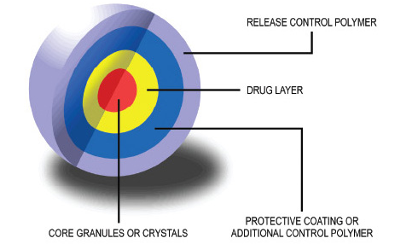
Beaded Drug Delivery System

Slide 10
LIPOSOMAL AND TARGETED DRUG DELIVERY SYSTEM
Drug delivery systems can in principle provide enhanced efficacy and/or reduced toxicity for anticancer agents. Long circulating macromolecular carriers such as liposomes can exploit the ‘enhanced permeability and retention’ effect for preferential extravasation from tumor vessels.
The next generation of delivery systems will include true molecular targeting; immunoliposomes and other ligand-directed constructs represent an integration of biological components capable of tumor recognition with delivery technologies.
currently approved liposomal drug delivery systems provide stable formulation, provide improved pharmacokinetics, and a degree of ‘passive’ or ‘physiological’ targeting to tumor tissue.
However, these carriers do not directly target tumor cells. The design modifications that protect liposomes from undesirable interactions with plasma proteins and cell membranes, and which contrast them with reactive carriers such as cationic liposomes, also prevent interactions with tumor cells. Instead, after extravasation into tumor tissue, liposomes remain within tumor stroma as a drug-loaded depot. Liposomes eventually become subject to enzymatic degradation and/or phagocytic attack, leading to release of drug for subsequent diffusion to tumor cells. The next generation of drug carriers under development features direct molecular targeting of cancer cells via antibody-mediated or other ligand-mediated interactions.

Slide 11
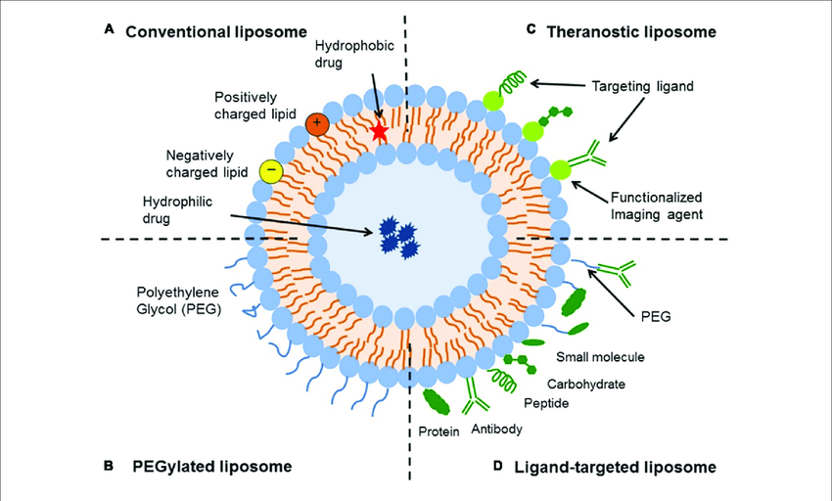
Liposomal Drug Delivery System

Slide 12
Nanoparticulate systems for brain delivery of drugs
One of the possibilities to deliver drugs to the brain is the employment of nanoparticles. Nanopartiacles are polymeric particles made of natural or artificial polymers ranging in size between about 10 and 1000 nm (1 mm). Drugs may be bound inform of a solid solution or dispersion or be adsorbed to the surface or chemically attached. Poly (butylcyanoacrylate) nanoparticles represent the onlynanoparticles that were so far successfully used for the in vivo delivery of drugs to the brain. The first drug that was de-livered to the brain using nanoparticles was the hexapeptidedalargin (Tyr-D-Ala- Gly- Phe-Leu-Arg), a Leu-enkephalin analogue with opioid activity.

Slide 13
The main goals are to improve their stability in the biological environment, to mediate the bio-distribution of active compounds, improve drug loading, targeting, transport, release, and interaction with biological barriers.
Cytotoxicity of nanoparticles or their degradation products remains a major problem, and improvements in biocompatibility obviously are a main concern of future research.
The exact mechanism of nanoparticle transport into brain is not understood, but it is thought to depend on the particles size, material composition, and structure.

Slide 14
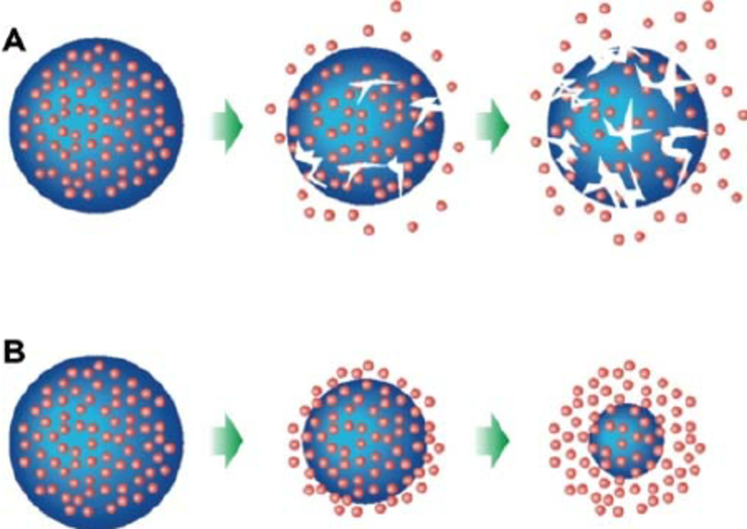
Mechanisms of degradation: bulk (A) and surface (B) degradation.

Slide 15
The nanotechnology includes:
Coated nanoparticles
Pegylated nanoparticles
Solid Lipid Nanoparticles (SLN)
Nanogels

Slide 16
OTHER CONTROLLED DRUG DELIVERY SYSTEMS
Extended release, slow release and sustained release preparation have been developed by pharmaceutical industry and pharmacy departments and investigated in vitro for release pattern and in vivo for bio-equivalence.
Dental product
Colon-specific drug delivery

Slide 17
What are some important areas for future research in drug delivery systems?
Crossing the Blood-Brain Barrier (BBB) in Brain Diseases and Disorders
Enhancing Targeted Intracellular Delivery
Combining Diagnosis and Treatment

