Slide 1
EXPERIMENT FOR RNA

Slide 2
TMV EXPERIMENT
Fraenkel-Conrat and coworkers first discovered that RNA was the genetic molecule for the tobacco mosaic virus (TMV).
They separated the protein and RNA of the virus and used both separately to try to infect plant cells.
They mixed the protein from one strain with the RNA of another to reconstitute infectious particles.
The RNA not the protein determined the kind of protein that was made by the replicating virus.

Slide 3
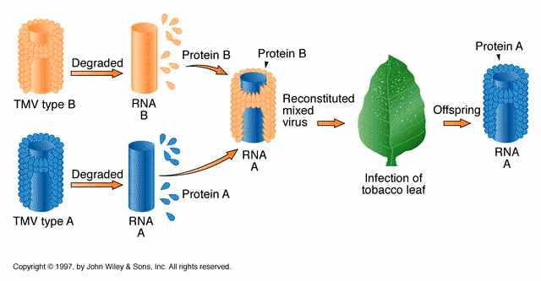

Slide 4
PRIONS
Prions are proteinaceous, are infectious particles, smaller than viruses, that contain no nucleic acids (neither DNA nor RNA).
Historically, the idea of an infectious agent that did not use nucleic acids was considered impossible, but pioneering work by Nobel Prize-winning biologist Stanley Prusiner has convinced the majority of biologists that such agents do indeed exist.

Slide 5
Fatal neurodegenerative diseases, such as kuru in humans and bovine spongiform encephalopathy (BSE) in cattle (commonly known as "mad cow disease"), were shown to be transmitted by prions.
The disease was spread by the consumption of meat, nervous tissue, or internal organs between members of the same species.

Slide 6
VIROIDS
Viroids are plant pathogens: small, single-stranded, circular RNA particles that are much simpler than a virus.
They do not have a capsid or outer envelope, but, as with viruses, can reproduce only within a host cell.
Viroids do not, however, manufacture any proteins.
They produce only a single, specific RNA molecule.
Human diseases caused by viroids have yet to be identified.

Slide 7
Viroid-infected plants are responsible for crop failures and the loss of millions of dollars in agricultural revenue each year.
Some of the plants they infect include potatoes, cucumbers, tomatoes, chrysanthemums, avocados and coconut palms.

Slide 8
Potatoes infected by a viroid
Notes:
These potatoes have been infected by the potato spindle tuber viroid (PSTV). It is typically spread when infected knives are used to cut healthy potatoes, which are then planted.

