Slide 1
Introduction to Biostatistics for Health Sciences I
Reference of Slides used: https://sites.google.com/site/mdotarif/teaching/pbs
由NordriDesign提供
www.nordridesign.com

Slide 2
ANOVA
A technique whereby the total variation present in a set of data is partitioned into two or more components. Associated with each of these components is a specific source of variation, so that in the analysis it is possible to ascertain the magnitude of the contributions of each of these sources to the total variation.

Slide 3
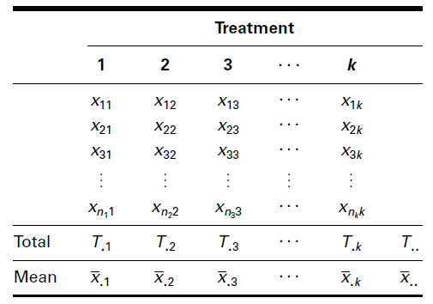
Applications
Widest application in the analysis of data derived from experiments
Purposes
To estimate and test hypotheses about population variances, and
To estimate and test hypotheses about population means.
There must be at least three groups of data

Slide 4
Procedure
Data.
Assumptions.
Normal distribution of the data
Independent simple random samples
Constant variance
Hypotheses.
Test statistic.
Distribution of test statistic: V.R. is distributed as the F distribution with and d.f.
Decision rule. A large value of F indicates rejection of H₀.
Calculation of test statistic. Using SPSS
Statistical decision. Reject the null hypothesis if the computed value of V.R. is equal to or greater than the critical value of F for the chosen level.
p value.
Conclusion:

Slide 5
Normality
Hypotheses.
Ho: Dependent Variable follows normal distribution
HA: not Normal
Test statistic. Kolomogrove Smirnove Test or Shappiro Wilks Test
Calculations: SPSS
p value. Compare with =0.05
Conclusion: If p-vlaue less than reject Ho

Slide 6
Equality of Variance
Hypotheses.
Ho: Variances are equal
HA: not equal
Test statistic. Levene’s Test
Calculations: SPSS
p value. Compare with =0.05
Conclusion: If p-vlaue less than reject Ho

Slide 7
Example
Game meats, including those from white-tailed deer and eastern gray squirrels, are used as food by families, hunters, and other individuals for health, cultural, or personal reasons. A study by David Holben (A-1) assessed the selenium content of meat from free-roaming white-tailed deer (venison) and gray squirrel (squirrel) obtained from a low selenium region of the United States. These selenium content values were also compared to those of beef produced within and outside the same region. We want to know if the selenium levels are different in the four meat groups.

Slide 8
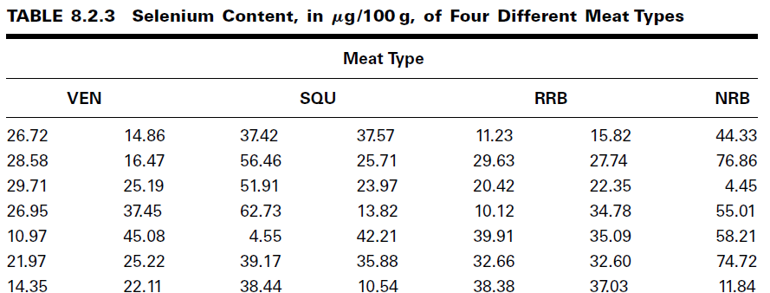
Data

Slide 9
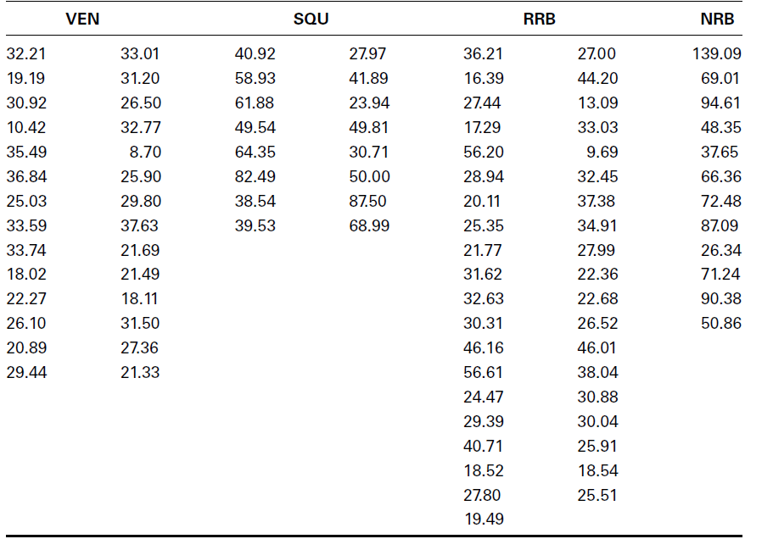
Data

Slide 10
Assumptions.
Independence Random Sample from 4 populations
Normality
Equality of Variance

Slide 11
Procedure
Data. From Statement
Assumptions. Fulfilled
Hypotheses.
Test statistic.
Distribution of test statistic: V.R. is distributed as the F distribution with 4-1=3 and 144-4=140 d.f.
Decision rule. A large value of F indicates rejection of H₀.
Calculation of test statistic.
Statistical decision. Reject the null hypotheses as Fc=27 7with with =0.01
p value.
Conclusion:Since we reject we conclude that the alternative hypothesis is true. That is, we conclude that the four meat types do not all have the same average selenium content.

Slide 12
Testing for Significant Differences Between Individual Pairs of Means
Tukey’s HSD Test
Tukey’s Test for Unequal Sample Sizes
Bonferroni’s Method

Slide 13
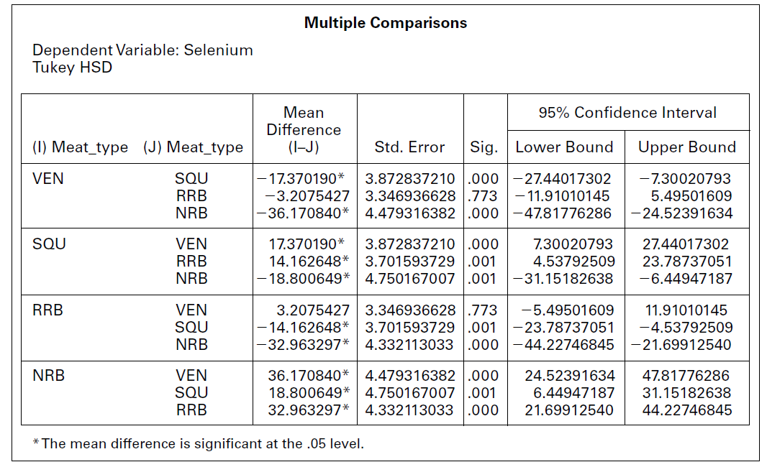
Tukey’s Test

Slide 14
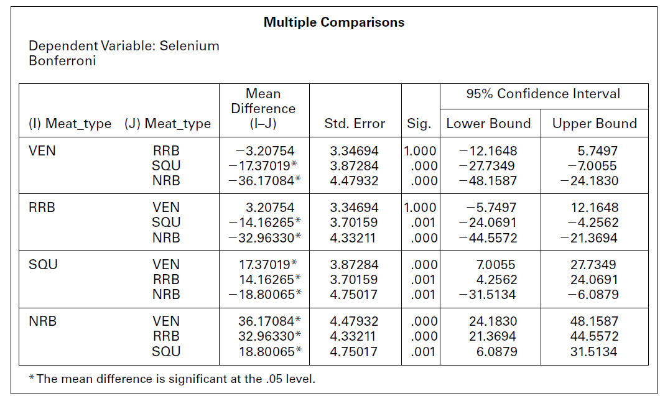

Slide 15
In Home Excercise
Odd Number of Questions (Exercise Chapter 6 from Biostatistics by Wayne W. Daniel)
Q8.2.1-8.2.9

Slide 16
Experimental Design

Slide 17
THE COMPLETELY RANDOMIZED DESIGN
Completely randomized designs are the simplest in which the treatments are assigned to the experimental units completely at random. This allows every experimental unit, i.e., plot, animal, soil sample, etc., to have an equal probability of receiving a treatment. An example of a completely randomized design is shown on the attached figure. Note, that the 4 replicates of the 4 treatments are assigned at random to the 16 experimental units. This may be done using a table of random numbers, or by pulling numbered slips out of a hat. The analysis of variance table is also shown for this design.

Slide 18
THE COMPLETELY RANDOMIZED DESIGN (Layout)

Slide 19
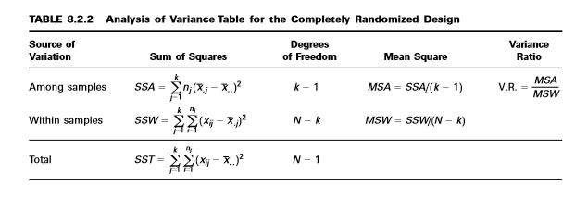
Analysis of Variance Table for the Completely Randomized Design

Slide 20
Advantages and Disadvantages: CR Design
Advantages of completely randomized designs
1. Complete flexibility is allowed - any number of treatments and replicates may be used.
2. Relatively easy statistical analysis, even with variable replicates and variable experimental errors for different treatments.
3. Analysis remains simple when data are missing.
4. Provides the maximum number of degrees of freedom for error for a given number of experimental units and treatments.
Disadvantages of completely randomized designs
1. Relatively low accuracy due to lack of restrictions which allows environmental variation to enter experimental error.
2. Not suited for large numbers of treatments because a relatively large amount of experimental material is needed which increases the variation.

Slide 21
Appropriate use of completely randomized designs
Under conditions where the experimental material is homogeneous, i.e., laboratory, or growth chamber experiments.
Where a fraction of the experimental units is likely to be destroyed or fail to respond.
In small experiments where there is a small number of degrees of freedom.
The completely randomized design is seldom used in field experiments where the randomized complete block design has been consistently more accurate since there are usually recognizable sources of environmental variation.

Slide 22
THE RANDOMIZED COMPLETE BLOCK DESIGN
The randomized complete block design is a design in which the units (called experimental units) to which the treatments are applied are subdivided into homogeneous groups called blocks.
so
that the number of experimental units in a block is equal to the number (or some multiple of the number) of treatments being studied.
The treatments are then assigned at random to the experimental units within each block.
It should be emphasized that each treatment appears in every block, and each block receives every treatment.

Slide 23
OBJECTIVE: RCBD
Isolate and remove from the error term the variation attributable to the blocks, while assuring that treatment means will be free of block effects.
In animal experiments, the breed of animal may be used as a blocking factor.
In experiments involving human beings, if it is desired that differences resulting from age be eliminated, then subjects may be grouped according to age so that one person of each age receives each treatment.
The randomized complete block design also may be employed effectively when an experiment must be carried out in more than one laboratory (block) or when several days (blocks) are required for completion.

Slide 25
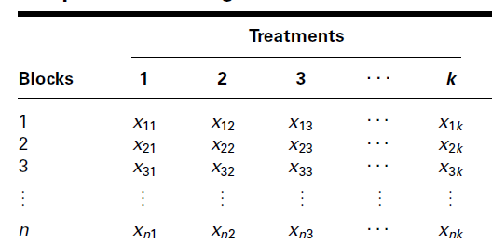
Data Display

Slide 26
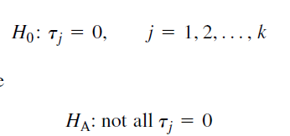
Hypotheses

Slide 27
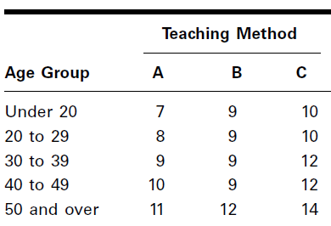
EXAMPLE 8.3.1
A physical therapist wished to compare three methods for teaching patients to use a certain prosthetic device. He felt that the rate of learning would be different for patients of different ages and wished to design an experiment in which the influence of age could be taken into account.

Slide 28
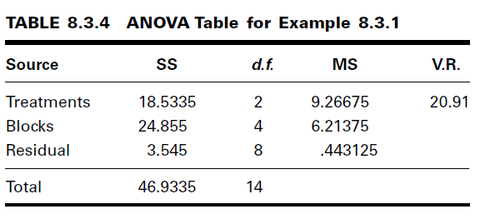
Solution
Hypotheses
Test statistic
Calculation
Statistical decision
p value=0.001
Conclusion. We conclude that not all treatment effects are equal to zero, or equivalently, that not all treatment means are equal.

Slide 29
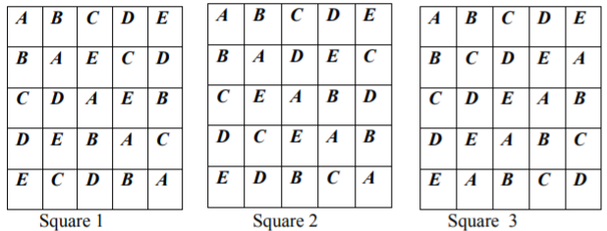
Latin Square Design
The RCBD allows us to control for one extraneous source of variation. • The RCBD is used when we expect trend in one direction (day of the week, plots, etc.).
We will consider designs that allow us to control for two extraneous sources of variation.
When the experimental material is divided into rows and columns and the treatments are allocated such that each treatment occurs only once in each row and each column, the design is known as L S D. In LSD the treatments are usually denoted by A B C D etc. For a 5 x 5 LSD the arrangements may be

Slide 30
Advantages and Disadvantages
Advantages:
We can control for two sources of variation.
Controlling two sources reduces experimental error.
Easy to analyze.
Disadvantages:
Restricted since # treats. equals the # rows and # of cols.
Difficult to achieve homogeneous blocking in two directions.
The design is usually small (because of 1 and 2)
Because of 3, we have low power
Assumes no row by treat or col by treat interaction.
Note: The solution to disadvantages 3 and 4 is to have replicated Latin squares!

Slide 31
ANOVA Table LSD

Slide 32
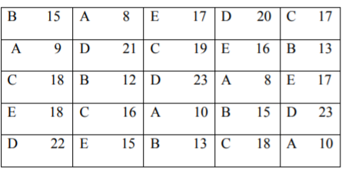
Problem 1
Below are given the plan and yield in kgs/plot of a 5x5 Latin square experiment on the wheat crop carried out for testing the effects of five, manorial treatments A, B, C, D, and E. ‘A’ denotes control.

Slide 33
Solution

Slide 34
Problem 2

Slide 35
THE FACTORIAL EXPERIMENT
In the experimental designs that we have considered up to this point, we have been
interested in the effects of only one variable—the treatments.
Frequently, however, we may be interested in studying, simultaneously, the effects of two or more variables.
We refer to the variables in which we are interested as factors.
The experiment in which two or more factors are investigated simultaneously is called a factorial experiment.
The different designated categories of the factors are called levels.

Slide 36
Example
Suppose, for example, that we are studying the effect on reaction time of three dosages of some drug.
The drug factor, then, is said to occur at three levels.
Suppose the second factor of interest in the study is age, and it is thought that two age groups, under 65 years and 65 years and older, should be included.
We then have two levels of the age factor.
In general, we say that factor A occurs at a levels and factor B occurs at b levels.
In a factorial experiment we may study not only the effects of individual factors but also, if the experiment is properly conducted, the interaction between factors.

Slide 37
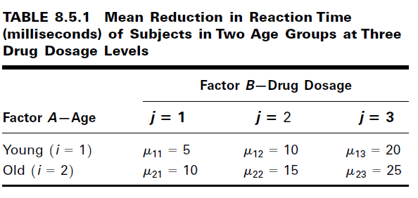
EXAMPLE 8.5.1
Suppose, in terms of effect on reaction time, that the true relationship between three dosage levels of some drug and the age of human subjects taking the drug is known. Suppose further that age occurs at two levels—“young” (under 65) and “old” (65 and older). If the true relationship between the two factors is known, we will know, for the three dosage levels, the mean effect on reaction time of subjects in the two age groups.

Slide 38
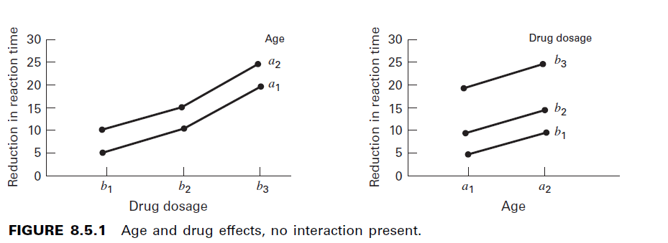
Age and Drug Effect (No Interaction)

Slide 39
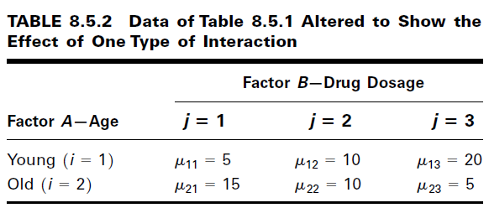
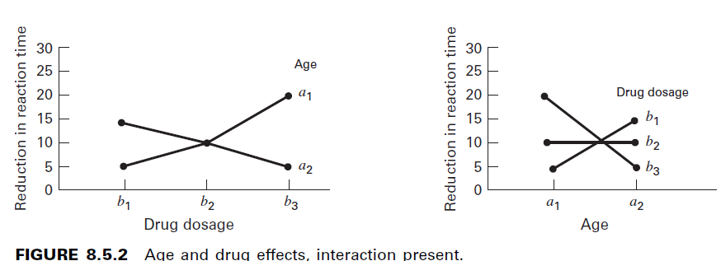
Age and Drug Effect (with interaction)

Slide 40
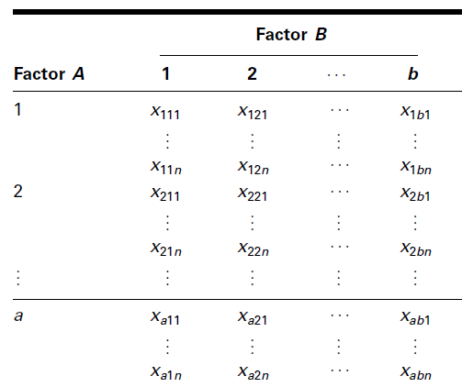
The Two-Factor Completely Randomized Design

Slide 41
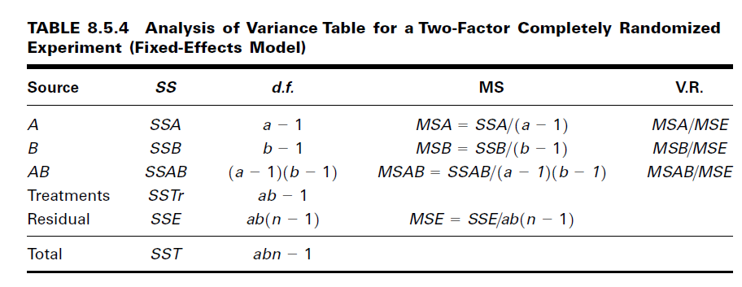
ANOVA Table

Slide 42
EXAMPLE 8.5.2
In a study of length of time spent on individual home visits by public health nurses, data were reported on length of home visit, in minutes, by a sample of 80 nurses. A record was made also of each nurse’s age and the type of illness of each patient visited. The researchers wished to obtain from their investigation answers to the following questions:
Does the mean length of home visit differ among different age groups of nurses?
Does the type of patient affect the mean length of home visit?
Is there interaction between nurse’s age and type of patient?

Slide 43
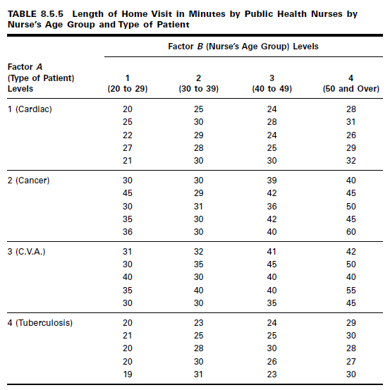
Data

Slide 44
Solution
Hypotheses
Level of Significance 5%
Test statistic. The test statistic for each hypothesis set is V.R.
Calculations.
Conclusion

