Slide 1
Hybridization and Gene Flow
Presented by: Laiba Mahmood

Slide 2
What is Hybridization?
Hybrid defined as an individual, results from the crossing of two individuals differing in atleast one set of characters. Process of crossing which results in a production of hybrid is called Hybridization.

Slide 3
Types of Hybrid
There are four different types of hybrids that
are as under;
Intraspecific Hybridization
Interspecific Hybridization
Intergeneric Hybridization
Interogressive Hybridization

Slide 4
Interspecific Hybridization
Crossing between different species of same
genus.
Hibiscus syriacus and Hibiscus paramutabils
F1 are tetraploids but F2 are 50% hexaploids.

Slide 5
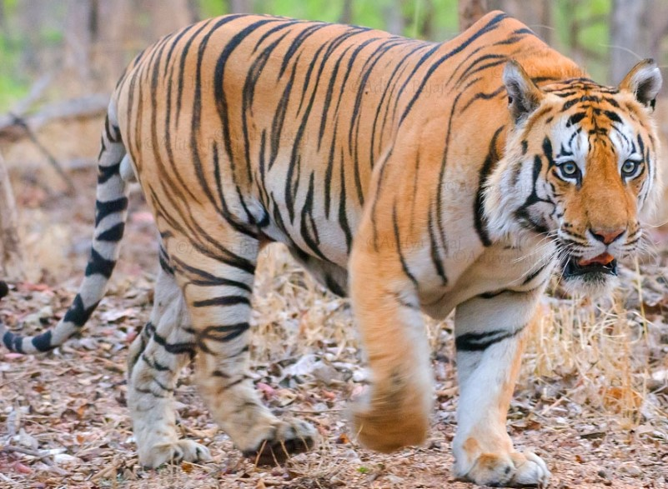
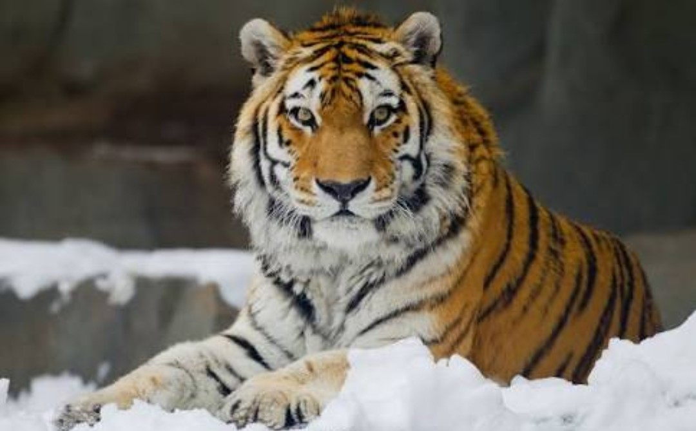
Intraspecific Hybridization
It is a cross between two varieties of same
species.
Cross between a Bengal tiger and Amur
(Siberian) tiger.

Slide 6
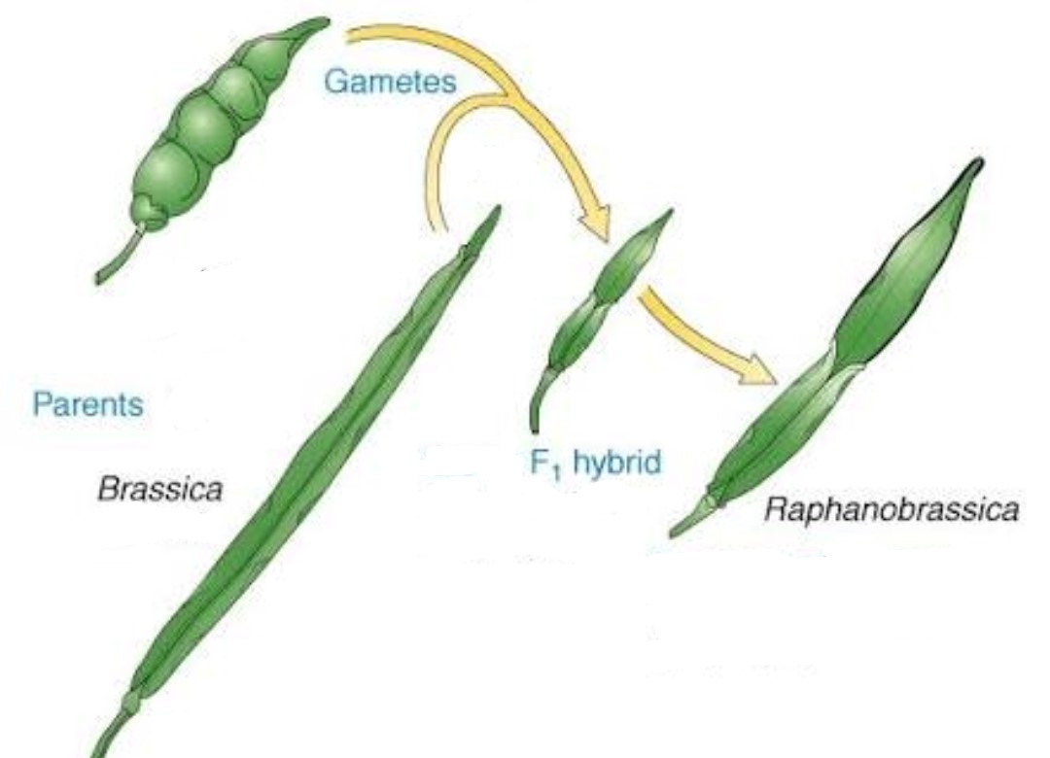
Intergeneric Hybridization
A cross between two different genera or
more than two different genera.
Cross between cabbage top and Radish root
a new specie come Raphano-Brassica.

Slide 7
Interogressive Hybridization
Introduces some genes of one specie to gene
pool of another specie.
It is a backcrossing phenomena.
Cross F1 hybrids to A, raise R2 generation, out
of R2 select those with desired characteristics of
B. Backcross selected R2 with A and raise R3, till
a type reached with high yield of A and hardness
of B.

Slide 8
Gene Flow
A change in allele frequencies is due to
Immigration and Emigration, between
Populations.
Example
Baboons in Africa lives in troop, each troop
having different gene pool can migrate away
and produce offspring.

Slide 9
Gene Flow by Migration
Migration is an important factor in gene
flow.
Extends genetic combinations and increase
genetic variability.
Spores/Pollens when carried away long
distances by winds, gene flow can occur from
one to another generation.

Slide 10
Gene Flow as Mutation
It can introduce new alleles into population
which may have large effects.
In case of mosquito Culex pipiens a newly
mutated gene made a mosquito resistant to
insecticides, spread by gene flow across three
continents
This spread of mutation allele allowed billions
of mosquitos to survive the application of
insecticides.

