Slide 1
PEARL CULTURE
Pearl producing organisms
Pearls are formed by saltwater or freshwater mollusks (Pinctada roding)
—a diverse group of animals that includes oysters, mussels, clams, conchs, and gastropods.
Pearls form inside a mollusk which is an invertebrate with a soft body, often protected by a shell such as a clam, oyster or mussel. Any mollusk is capable of producing a pearl, although only those mollusks that have shells lined with nacre produce pearls.

Slide 2
Cultured pearls
Cultured pearls are real, genuine pearls that are formed inside a living oyster When a nucleus is surgically implanted in the oyster's flesh, the oyster recognizes it as an irritant and begins to coat it with smooth layers of nacre.
Over time, the growing pearl gets completely covered with the beautiful iridescent substance we call nacre, or MOTHER-OF-PEARL.
All pearls sold today are cultured pearls.

Slide 3
Forms of pearls
Pearls can be formed in three ways.
“Ampulla pearls” are formed in the pockets or ampulla of the epidermis.
“Muscle pearls” are formed around calcospherules at the insertion of the muscles.
“Cyst pearls” are formed when parasitic worms build cysts, located in the connective tissue of the mantle (outer layer) and within the soft tissues of the body, around which concentric layers of nacre are deposited.

Slide 4
HISTORY OF PEARLS
Pre-historic times
Pearls shells as decorative objects in Egypt
Religious texts; Bible
Mythological and cosmological terms
1893-first cultured pearl-by Koki chi mikimoto
Introduced irritant in oyster to stimulate pearl formation

Slide 5
MODERN INDUSTRY
PEARL PRODUCTION INDUSTRIES in more than 30 countries
China has largest production
Analysis of FAO global statistics-in past decade-Chinese pearls -3540 tons weigh-worth 15 million$

Slide 6
Japan has been the world’s major marine pearl producer for over a century
average annual-Japan was 127 million$, accounting for 51.6% of global pearl output value
global pearl production fell by 60% while output value fell by 39% over the past decade.

Slide 7
Cultured South Sea Pearls – These are considered to be the most valuable type of cultured pearl on the market. One strand of South Sea pearls can range between $1,000 to $100,000.

Slide 8
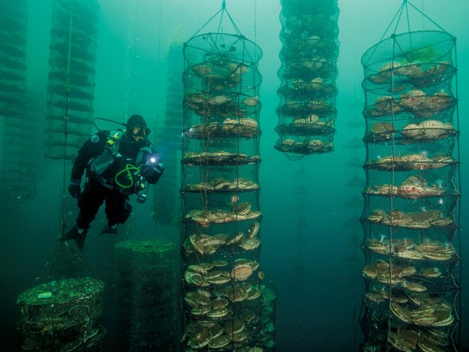
Rearing or Farming Of Oyster
Oyster farming is an aquaculture practice in which oysters are bred and raised mainly for their pearls, shells and inner organ tissue, which is eaten Oyster farming was practiced by the ancient Romans as early as the 1st century BC on the Italian peninsula and later in Britain for export to Rome

Slide 9
rearing OF OYSTER
Steps
Temperature and salinity of water are controlled
Conditioning broodstock
Putting oysters in tray
After spawning initiation they can be placed in containers
After two weeks oyster will be ready to set
Putting larvae in a system
Spat formation

Slide 10
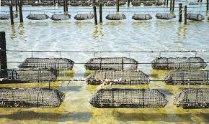
Methods Of Cultivation
Bottom culture
Traditional method
bottom culture method means the oysters are growing on the ocean bottom

Slide 11
Rack and Bag method
Using steel racks placed into the sand or mud bottom, plastic mesh bags filled with small oysters are laid across the tops of the racks
By elevating the bags of oysters off of the bottom, the oysters are able to feed better and grow faster; the bags also protect the young oysters from predators
Suspended tray method
Oysters which are cultivated by the suspension method are the prima donnas of oyster
They are suspended, in mesh trays or a Japanese lantern shaped nets, in deep water their entire lives, protected from predators, mud, sand and silt
they can hang below the surface of the water 24 hours per day allowing for the oysters to grow very fast.

Slide 12
COMPOSITION OF Pearl
Ideal pearl is round and smooth but
many other shapes are present
Organic matter =5.94%
Carbonate of lime =91.72%
Water =2.34%
Quality of pearls is determined by its
keratin content and color.
CaCo3 is in the form of minute crystalline form, which has deposited in concentric layers

Slide 13
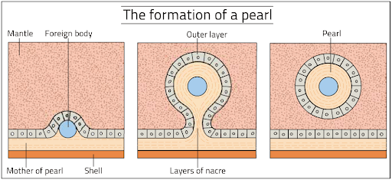
FORMATION OF PEARL
Stages in the pearl formation
Preparation of host cell
Nucleus insertion
Convalescence
Pearl formation
Harvesting
Processing of pearls

Slide 14
Preparation of Host Shell
In nature pearls may be formed in different region of the body namely the region of adductor muscles, mantle margin, pallial zone
The best side for pearl production is considered to be the gonadal region, spent individuals serves as good host
Nucleus is inserted in the gonadal region

Slide 15
Nucleus Insertion
It involves selection of suitable donor shell or any other
object for obtaining the nucleus material and donor oyster or mussel for obtaining graft tissue
The size of the nucleus determines the size of the graft tissue
After obtaining the nucleus and graft tissue the recipient
oyster will be operated upon and the nucleus implanted in the gonadal region
The time and number of nuclei to be implanted will be determined in advance

Slide 16
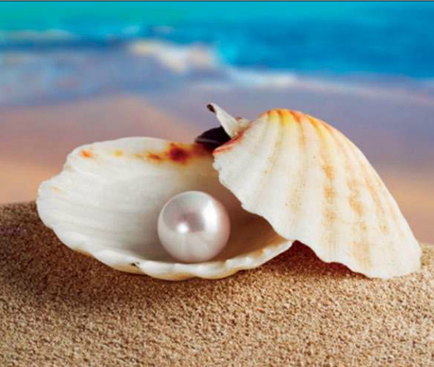
Convalescence and pearl formation
After operation the mussel are allowed to be recover the disturbance caused and then oyster are kept in cages
The graft tissue on the nucleus grows into a pearl sac
The epithelial cells of the pearl sac deposit nacreous layer around the nucleus, which ultimately leads to the formation of pearl
In pearl oyster it takes 3 to 4 years of commercial value to develop
In freshwater mussel pearls are harvested 2-3 years after implantation

Slide 17
Harvesting of Pearls
Oysters or mussel with pearls are brought to the laboratory
The valves are open and the fleshy parts are extracted out and then pearls are obtained by pulverizing the extracted parts
Pearls are almost harvested in winter and during cold month the metabolism of host oyster has decreased
After the pearls harvested than pearls can be cleaned and polished before treating
A good harvest is determined by the number of marketable pearls produced

Slide 18
Processing of Pearls
Soon after their separation from the meat, pearls are washed with water.
to remove the mucilaginous matter and maintain the luster.
The pearls are then graded according to size.

Slide 19
Process of pearl culturing
Following are the steps of pearl culturing.
Construction of pearl farm.
Collecting oyster
Seeding
Carving the oyster

Slide 20
Construction of farm and collection of oyster
Construction of farm require :
Selection of farm site.
Preparation of farm.
Well planned work schedule.
Next step is to collect oyster.
Oyster are located at the bottom of flat rock.
They are covered with a layer of animals and slit layer.

Slide 21
Methods in pearl culturing
There are mainly two steps of pearl culturing.
Harvesting ( it is necessary to harvest early to determine whether pearls have sufficient coating or not).
Sorting pearls (the pearls are sorted in order to check that they can be used in industry or not) .

Slide 22
Pearl culturing and biological environment
Environmental pollution is putting severe effects on pearl culturing.
The main reason of pearl farms deterioration is the occurrence of red tides .
Because of infectious diseases like herpes, avian influenza pearl industry is disrupting day by day.
Japan dominated the world’s cultured pearl but it is declining drastically now a days.

Slide 23
USES OF PEARLS
Digestive tract, skin and muscular problems
Mixed with herbal powders and potions
Balance hormonal level in human body
Skincare agent
Anti-aging and anti-acne
Spiritual healer
Strengthen the emotional powers
In ancient times Gem Therapy has also been used to reinforce nervous system

