Slide 1
COURSE TUTOR: DR. SHAGHUFTA NAZ
TOPIC: TRANSPOSABLE ELEMENTS
Course :Genetics

Slide 2
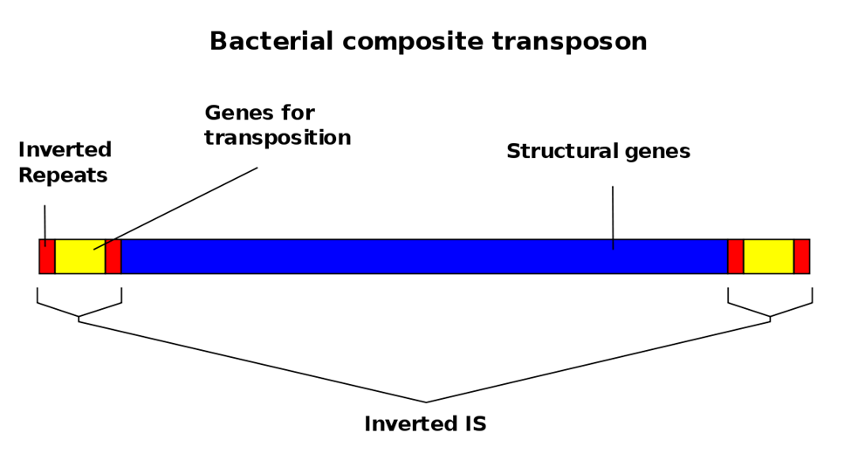
TRANSPOSONS
A transposable element is a DNA sequence that can change its position within a genome it is also called as TE, transposon, or jumping gene. Transposition often results in duplication of the same genetic material.

Slide 3
DISCOVERY:
Barbara McClintock was an American scientist. Barbara McClintock's discovery of them earned her a Nobel Prize in 1983.

Slide 4
EXPERIMENT:
In the winter of 1944–1945, McClintock planted corn kernels that were self-pollinated. As the maize plants began to grow, McClintock noted unusual color patterns on the leaves. For example, one leaf had two albino patches of almost identical size, located side by side on the leaf. McClintock hypothesized that during cell division certain cells lost genetic material, while others gained what they had lost.However, when comparing the chromosomes of the current generation of plants with the parent generation, she found certain parts of the chromosome had switched position

Slide 5
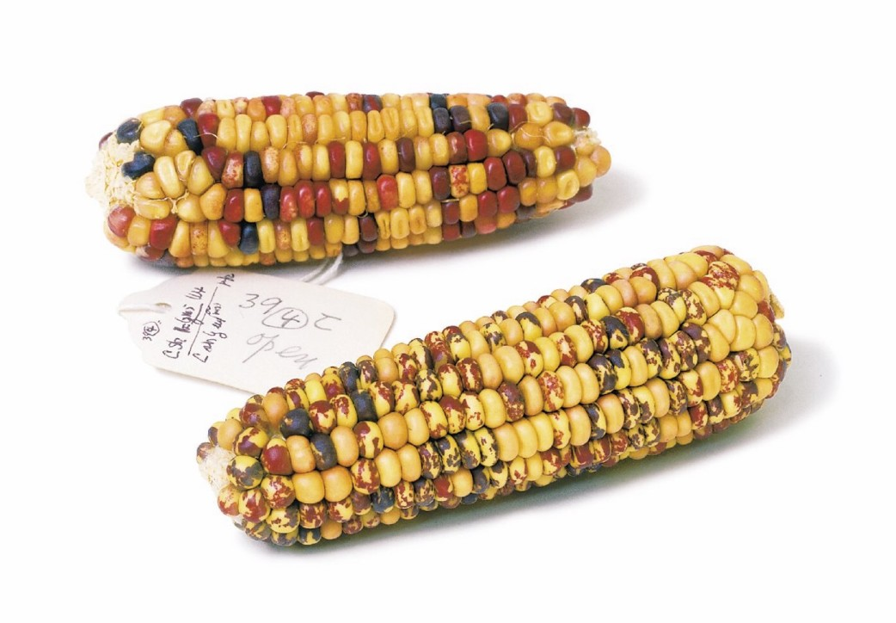
. This refuted the popular genetic theory of the time that genes were fixed in their position on a chromosome. McClintock found that genes could not only move, but they could also be turned on or off due to certain environmental conditions or during different stages of cell development.

Slide 6
CLASSIFICATION:
Retrotransposon (Class 1):Class I TEs are copied in two stages: firstly, they are transcribed from DNA to RNA, and the RNA produced is then reverse transcribed to DNA. Secondly This copied DNA is then inserted back into the genome at a new position. The reverse transcription step is catalyzed by a reverse transcriptase, which is often encoded by the TE itself.

Slide 8
DNA transposons (class 2):
The cut-and-paste transposition mechanism of class II TEs does not involve an RNA intermediate. The transpositions are catalyzed by several transposase enzymes. Some transposases non-specifically bind to any target site in DNA. . The transposase makes a staggered cut at the target site producing sticky ends, cuts out the DNA transposon and ligates it into the target site. A DNA polymerase fills in the resulting gaps from the sticky ends and DNA ligase closes the sugar-phosphate backbone. This results in target site duplication

Slide 9
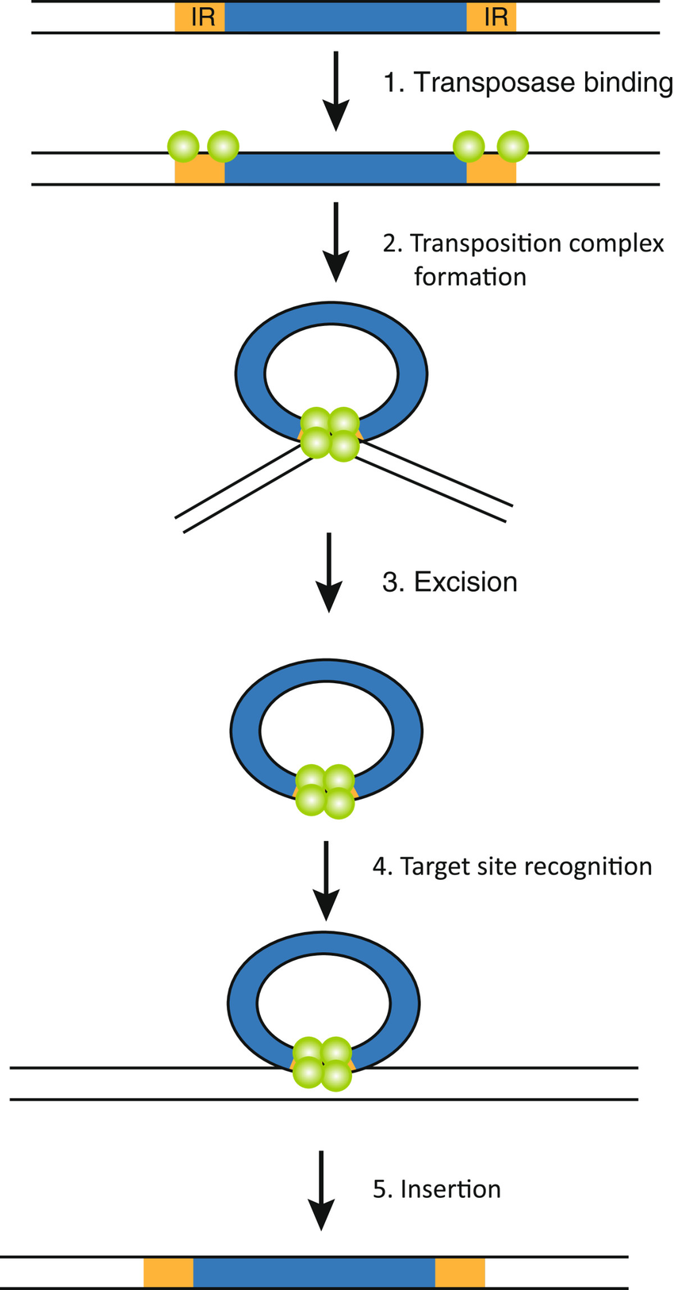
Cut-and-paste TEs may be duplicated if their transposition takes place during S phase of the cell cycle, when a donor site has already been replicated but a target site has not yet been replicated.

Slide 10
Autonomous and non-autonomous:
Transposition can be classified as either "autonomous" or "non-autonomous“ Autonomous TEs can move by themselves, whereas non-autonomous TEs require the presence of another TE to move. This is often because dependent TEs lack transposase (for Class II) or reverse transcriptase (for Class I).

Slide 11
Negative Effects of Transposons:
Transposons also have mutagenic effects on genomes leading to disease and malignant genetic alterations. Mechanisms of Mutagenesis
TEs are mutagens and their movements are often the causes of genetic disease. They can damage the genome of their host cell in different ways:
•A transposon or a retrotransposon that inserts itself into a functional gene can disable that gene.
•After a DNA transposon leaves a gene, the resulting gap may not be repaired correctly

Slide 12
Diseases:
• Hemophilia A and B
• Severe combined immunodeficiency
• Porphyria
• Predisposition to cancer
• Duchenne muscular dystrophy.
Transposable element dysregulation can cause neuronal death, leading to neurodegenerative disorders.

