Slide 1
POPULATION GENETICS
BS Genetics Course
Dr.Shagufta Naz
Department of Zoology

Slide 2
Population genetics:
Study of change in frequency of allele and genotype within a population.
Genetic variation:
Difference in DNA among individuals.
multiple sources of genetic variation
mutation
genetic recombination.

Slide 3
Genetic variations
Genetic variation can be defined as the genetic makeup of organisms within a population change.
Genes are inherited segments of DNA that contain codes for the production of proteins.
Genes exists in alternate versions, or alleles that determine distinct traits that can be passed on from parents to offspring.
Genetic variation is important to the processes of natural selection and biological evolution.
The environment determines which genetic variations are more favorable or better suited for survival.
As organisms with these environmentally selected genes survive and reproduce, more favorable traits are passed on to the population as a whole.

Slide 4
Measurement
Genetic variation within a population is commonly measured as :
The percentage of gene loci that are polymorphic or
The percentage of gene loci in individuals that are heterozygous.

Slide 5
Causes of genetic variation
Genetic variation occurs mainly through
DNA mutation
Gene flow (movement of genes from one population to another)
Sexual reproduction
Due to the fact that environments are unstable, populations that are genetically variable will be able to adapt to changing situations better than those that do not contain genetic variation.

Slide 6
Forms
Genetic variation can be divided into different forms
Small-scale sequence variation (<1 kilobase, kb)
Large-scale structural variation (>1 kb) can be either copy number variation (loss or gain), or chromosomal rearrangement (translocation, inversion,).

Slide 7
Why Allele frequency changes?
Five evolutionary forces can significantly alter the allele frequencies of a population which are given below:
Mutation
2. Migration
3. Genetic drift
4. Non random mating
5. Selection

Slide 8
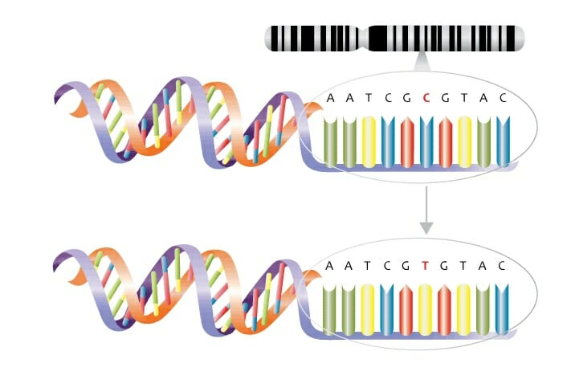
Mutation:
Errors in DNA replication
The ultimate sources of new variation

Slide 9
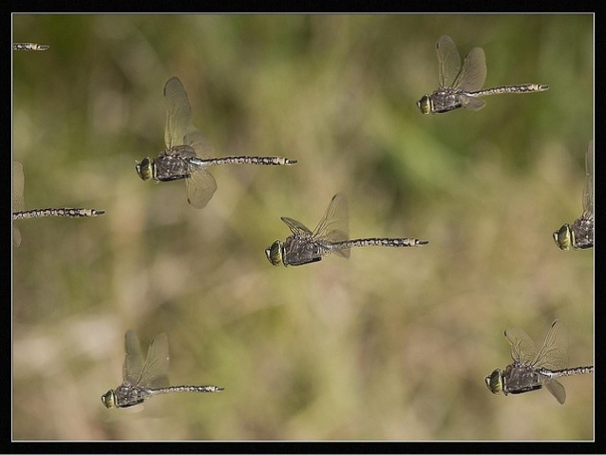
2 Migration:
Movement of individuals from one population to another.
occupy in mobile organism i.e insects
There are two types of migration in population.
Immigration (movement into a population)
Emigration(movement out of a population)

Slide 10
3. Genetic drift:
Random loss of alleles
More likely to occur in smaller population
Founder effect (when population is intially small)
Bottleneck effect (population drastically reduced to small)

Slide 11
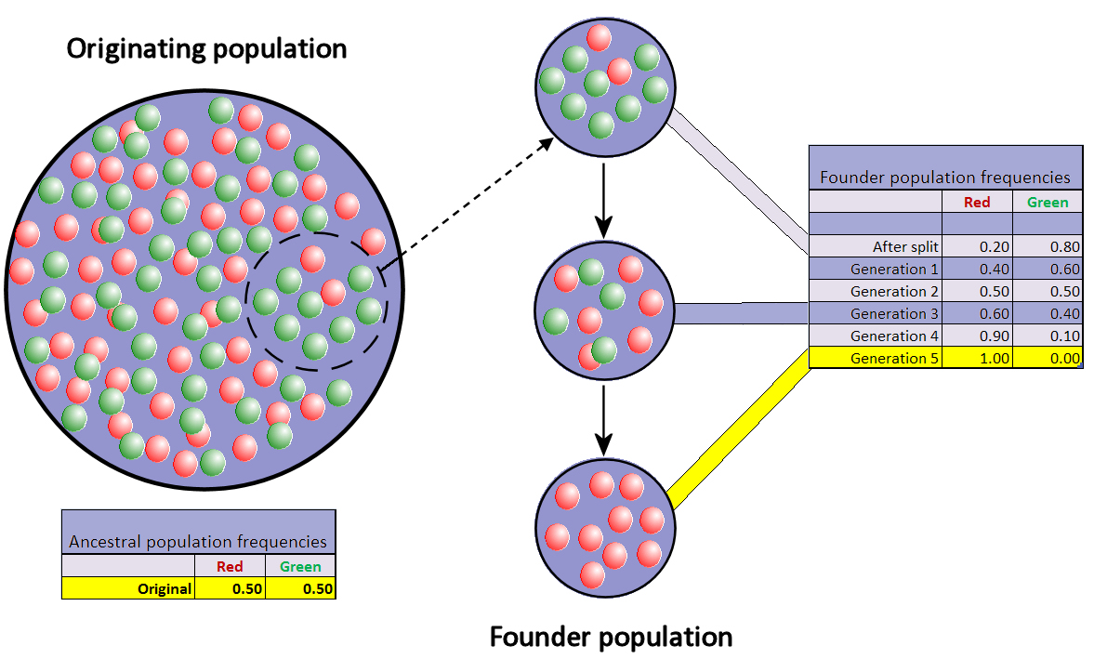
Founder effect:
Small group of individuals establishes a population in a new location

Slide 12
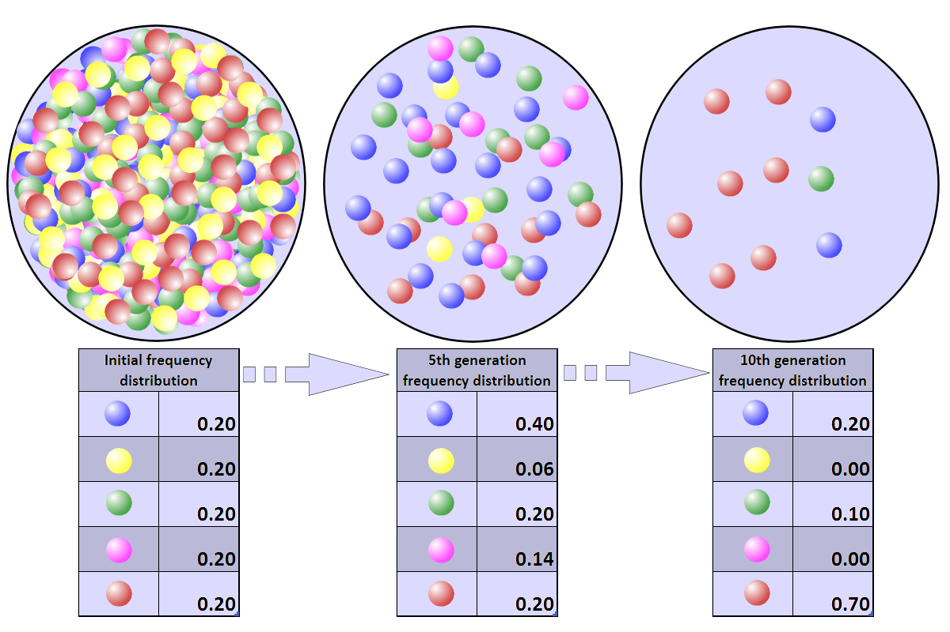
Bottleneck effect:
A sudden decrease in population size to a natural forces

Slide 13
4. Non random mating:
Mating that occurs more or less frequently than expected by chance
Inbreeding:
mating with relatives
increase homozygosity
Out breeding:
mating with non- relatives
increase heterozygosity

Slide 14
5. Selection:
Some individuals leave behind more offspring than others.
Artificial selection
Breeder select for desired characteristics
Natural selection
Environment selects for adapted characteristics

Slide 15
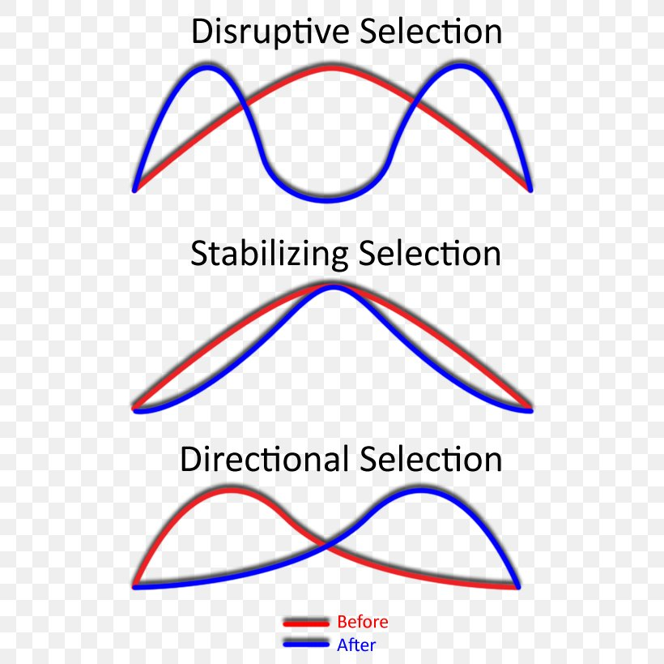
Types of natural selection:
Three types of natural selection have been identified.
Stabilizing selection
Disruptive selection
Directional selection

Slide 16
1. Stabilizing selection:
Genetic diversity decreases as the population stabilizes on a particular trait value.
Example:
Birth weight of human body

Slide 17
2. Disruptive selection:
In Disruptive selection, describe change in population genetics in which extreme vaue for trait are favour overintermediate values.

Slide 18
3. Directional selection:
Directional selection is a mode of natural selection in which a single phenotype is favoured , causing the allele frequencies continuously shift in one direction.
Example:
industrial melanism

Slide 19
Types of variation:
Phenotypic variation
2. Genetic variation

Slide 20
1. Phenotypic variation:
It’s a genetical basis morphological variation it’s sometime continuous sometime discontinuous.
2. Genetic variation:
The variation i.e due to variation among individuals in the allele that they have, excludes environmentally-caused variation.

Slide 21
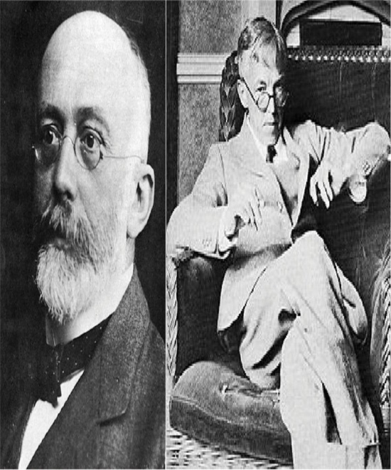
Hardy Weinberg law
This law states that:
In infinitely, random mating population, the frequency of genes and genotypes remain constant generation after generation, if there is no selection, mutation, migration, and random genetic drift.

Slide 22
The Hardy-Weinberg is a principle stating that the genetic variation in a population will remain constant from one generation to the next in the absence of disturbing factors. When mating is random in a large population with no disruptive circumstances, the law predicts that both genotype and allele frequencies will remain constant because they are in equilibrium.
The Hardy-Weinberg equilibrium can be disturbed by a number of forces, including mutations, natural selection, nonrandom mating, genetic drift, and gene flow. For instance, mutations disrupt the equilibrium of allele frequencies by introducing new alleles into a population.

Slide 23
When a population meets all the Hardy-Weinberg conditions, it is said to be in Hardy-Weinberg equilibrium (HWE). Human populations do not meet all the conditions of HWE exactly, and their allele frequencies will change from one generation to the next, so the population evolves. How far a population deviates from HWE can be measured using the “goodness-of-fit” or chi-squared test (χ2)

Slide 24
The distribution of genotypes in a population in Hardy-Weinberg equilibrium can be graphically expressed as shown in the accompanying graph. The x-axis represents a range of possible relative frequencies of A or B alleles. The coordinates at each point on the three genotype lines show the expected proportion of each genotype at that particular starting frequency of A and B.

Slide 25
Consider a single biallelic locus with two alleles A and B with known frequencies (allele A = 0.6; allele B = 0.4) that add up to 1.
Possible genotypes: AA, AB and BB
Assume that alleles A and B enter eggs and sperm in proportion to their frequency in the population (i.e., 0.6 and 0.4)
Assume that the sperm and eggs meet at random (one large gene pool).

Slide 26
Calculation of Genotypic Frequency
The probability of producing an individual with an AA genotype is the probability that
an egg with an A allele is fertilized by a sperm with an A allele, which is 0.6 × 0.6 or
0.36 (the probability that the sperm contains A times the probability that the egg contains A).
Similarly, the frequency of individuals with the BB genotype can be calculated (0.4 × 04 = 0.16).
The frequency of individuals with the AB genotype is calculated by the probability
that the sperm contains the A allele (0.6) times the probability that the egg contains the
B allele (0.4), and the probability that the sperm contains the B allele (0.6) times the
probability that the egg contains the A allele. Thus, the probability of AB individuals is (2 × 0.4 × 0.6 = 0.48).

Slide 27
Genotypes of the next generation can be given as shown in the accompanying table.
Allele | Allele Frequency | Genotype | Frequency | Counts for 1000
A (p) | 0.6 | AA | 0.36 | 360
B (q) | 0.4 | AB | 0.48 | 480
General formula of HW equation: p² + 2pq + q² = 1 |  | BB | 0.16 | 160
 |  | Total | 1 | 1000

Slide 28
Conclusion of Hardy Weinberg
Allele frequencies in a population do not change from one generation to the next only as the result of assortment of alleles and zygote formation.
If the allele frequencies in a gene pool with two alleles are given by p and q, the genotype frequencies is given by p2, 2pq, and q2.
The HWE principle identifies the forces that can cause evolution.
If a population is not in HWE, one or more of the five assumptions is being violated.

Slide 29
Assumptions
Random selection: When individuals with certain genotypes survive better than others, allele
frequencies may change from one generation to the next.
No mutation: If new alleles are produced by mutation or if alleles mutate at different rates, allele frequencies may change from one generation to the next.
No migration: Movement of individuals in or out of a population alters allele and genotype frequencies.
No chance events: Luck plays no role in HWE. Eggs and sperm collide at the same
frequencies as the actual frequencies of p and q. When this assumption is violated and by
chance some individuals contribute more alleles than others to the next generation, allele frequencies may change. This mechanism of allele change is called genetic drift.
Individuals select mates at random: If this assumption is violated, allele frequencies do
change, but genotype frequencies may.

Slide 30
Applications of the Hardy-Weinberg Law
Complete Dominance
When Hardy-Weinberg equilibrium exists, allele frequencies can even be found out in presence of complete dominance where two genotypes cannot be distinguished. If two genotypes AA and Aa have the same phenotype due to complete dominance of A over a the allele frequencies can be determined from the frequencies of individuals showing the recessive phenotype aa.
When aa phenotype is 0.25 in the population, then it follows that the frequency of the recessive allele a is √0.25 – 0.5. The frequency of the dominant allele A would be 1 – q or 1 – 0.25 = 0.75.

Slide 31
Frequencies of Harmful Recessive Alleles
The Hardy-Weinberg Law can also be used to calculate the frequency of heterozygous carriers of harmful recessive genes. If there are two alleles A and a at an autosomal locus with frequencies p and q in the population and p + q = 1, then the frequency of AA, Aa, and aa genotypes would be p2 + 2pq + p2.
If the aa genotype expresses a harmful phenotype such as cystic fibrosis, then the proportion of affected individuals in the population would be q2, and the frequency of the heterozygous carriers of the recessive allele would be 2pq.

Slide 32
Multiple Alleles
The Hardy-Weinberg Law permits calculation of genotypic frequencies at loci with more than two alleles, such as the ABO blood groups. There are 3 alleles I^{A}, I^{B} and I° with frequencies p, q and r. Here p + q + r = 1. The genotypes of a population with random mating would be (p + q + r)².
Sex-Linked Loci
It is possible to apply Hardy-Weinberg Law for calculating gene frequencies in case of sex-linked loci in males and females. Red green color blindness is a sex- linked recessive trait. Let r denote the recessive allele which produces affected individuals, and R the normal allele. The frequency of R is p and of r is q where p
+ q = 1. The frequencies of females having RR, Rr, rr genotypes would be p2, 2pq, q2 respectively.

Slide 33
Linkage Disequilibrium
Consider two or more alleles at one locus and another locus on the same chromosome with two or more alleles. Due to genetic exchange by recombination occurring regularly over a period of time, the frequencies of the allelic combinations at the two syntenic loci will reach equilibrium.
If equilibrium is not reached, the alleles are said to be in linkage disequilibrium. The effect is due to tendency of two or more linked alleles to be inherited together more often than expected. Such groups of genes have also been referred to as supergenes.

Slide 34
Thanks

