Slide 1
Heterosis
Course Genetics
Dr.Shagufta Naz

Slide 2
Heterosis
Definition: Superiority of F1 hybrids over its parents. Hybrids
are usually robust, vigorous, productive and taller.
Term Dr. G. H.Shull (1914).Heteros mean Different and
Osis mean Condition.
Synonyms:
1. Hybrid Vigour
2. Outbreeding Enhancement

Slide 3
Outbreeding Enhancement
Heterosis is the opposite of inbreeding depression.
Inbreeding depression occurs when related parents have children with traits that negatively influence their fitness largely due to homozygosity.
Outcrossing should result in heterosis.
when a hybrid inherits traits from its parents that are not fully compatible, fitness can be reduced. This is a form of outbreeding depression.

Slide 4
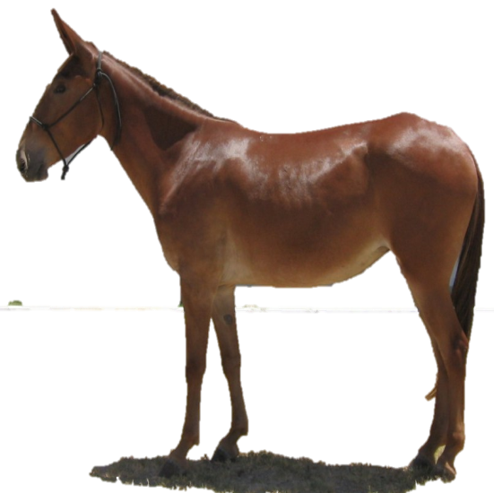
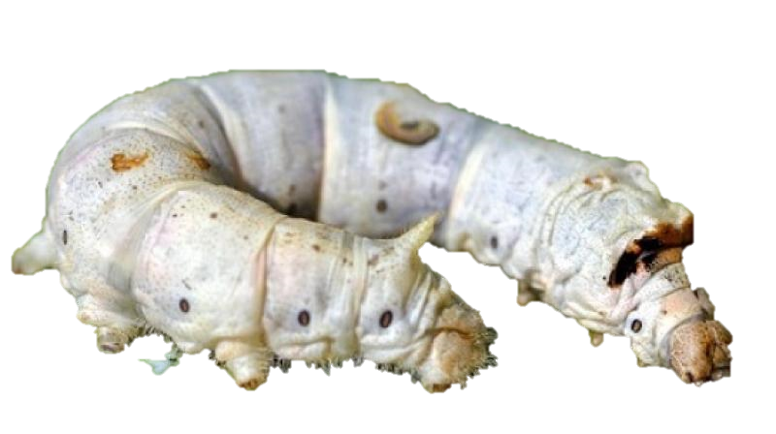
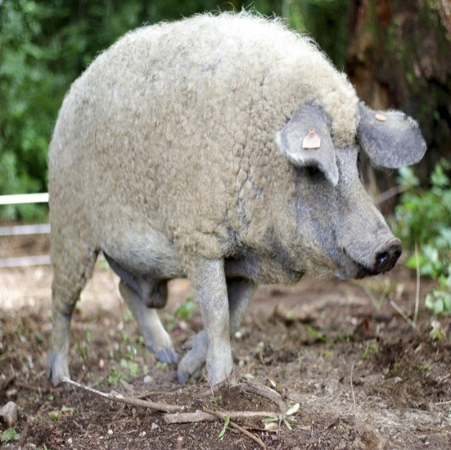
Examples of Heterosis
Hybrid Mule
Hybrid Hen
Hybrid Silk worm
Hybrid Pig

Slide 5
Types of Heterosis
1.True Heterosis
2.Pseudo-Heterosis
Mutational True Heterosis
It is the shadowing of the deleterious, unfavorable , recessive mutant genes by their adaptively superior dominant alleles.
b) Balanced True Heterosis
Balanced gene combinations with better adaptive value and agricultural usefulness.

Slide 6
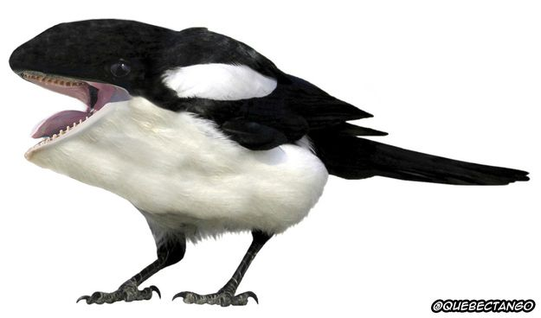
2.Pseudo Heterosis
It is also called luxuriance.
Crossing of the two parental forms brings in an accidental and un-adaptable expression of temporary vigour and vegetative
overgrowth.

Slide 7
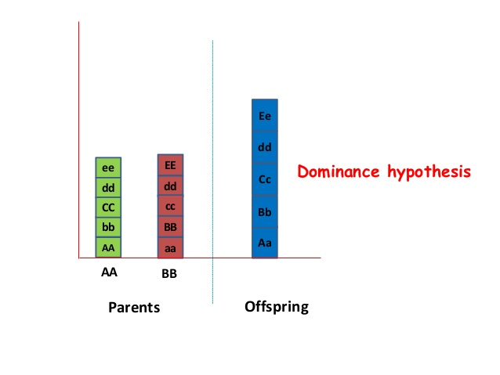
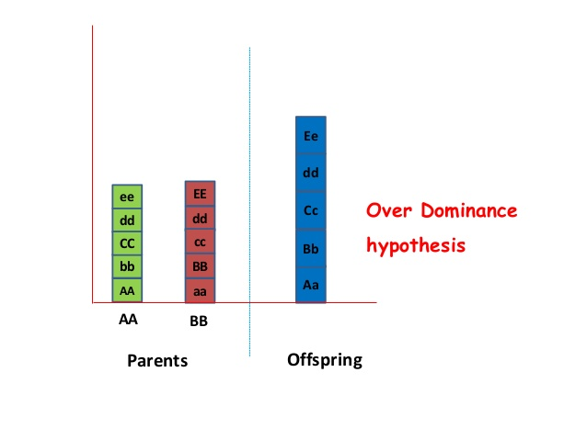
Theories of Heterosis
(I) Dominance Hypothesis
(ii) Over-dominance Hypothesis

Slide 8
Dominance Hypothesis
Genes that are favorable for vigour and growth are dominant.
Genes that are harmful to the individual are recessive.
Dominant genes ABCDE are favorable for good yield.
Inbred A x Inbred B
AA BB cc dd aa bb CC DD
F1 Hybrid
Aa Bb Cc Dd
Heterosis ∝ No of dominant genes

Slide 9
Over Dominance Hypothesis
Hypothesis was given by Shull and East independently.
Hybrid vigour on the basis of heterozygosity is superior to homozygosity.
Inbred A x Inbred B
AA BB cc dd aa bb CC DD
F1 hybrid
Aa Bb Cc Dd
Heterosis ∝ Amount of heterozygosity

Slide 10
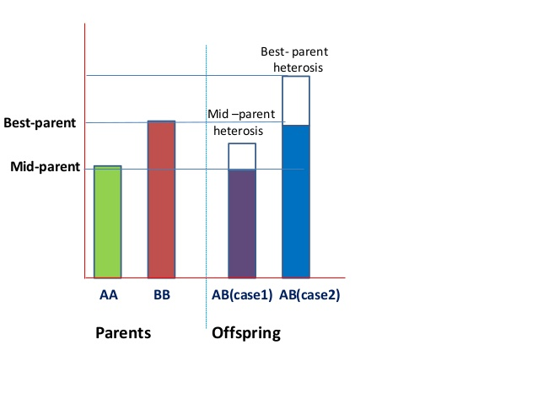
Methods for Estimation of Heterosis
Mid Parent Heterosis
Better Parent Heterosis
Standard Heterosis

Slide 11
Methods for Estimation of Heterosis
Mid Parent Heterosis
When the heterosis is estimated over the mean value or average of the two parents is known as mid parent heterosis.
It is also known as relative heterosis.
Mid Parent Heterosis = ( F1 – MP ) / 100 x MP
Better Parent Heterosis
When Heterosis is estimated over better parent is known as better parent heterosis. It is also known as heterobeltiosis.
Heterobeltiosis = ( F1 - BP ) / 100 x BP

Slide 12
Methods for Estimation of Heterosis
Standard Heterosis
It refers to the superiority of F1 over the standard check variety. It is also known as economic heterosis.
Heterosis leads to increase in yield, reproductive ability , vigor , quality. For most of characters , the desirable heterosis is positive.
Standard Heterosis = ( F1 – Check ) / 100 x Check

Slide 13
Significance of Heterosis
Hybrids are vigorous, larger, healthier and faster growing than the parents.
Hybrids usually have increased yield.
Hybrids show improved quality
Some hybrids show greater resistance to insects or diseases than parents.
Hybrids are usually less susceptible to adverse environmental conditions.
An increase in fertility and survival ability

