Slide 1
Course Tutor: Dr. SHAGUFTA SUBJECT: Genetics
TOPIC: GEL ELECTROPHORESIS

Slide 2
Gel Electrophoresis
Gel electrophoresis is a method that separates macromolecules, either nucleic acid or protein.
Electrophoresis describes the migration of charged particles under the influence of an electric field.
A gel is a colloid in a solid form.
Gel electrophoresis refers to the technique in which molecules are forced across a span of gel, motivated by an electrical current.

Slide 3
Biological molecules exist in a solution as cation (+) or anions.
Gel electrophoresis is a technique used for separation of nucleic acid and proteins.
Separation of macro molecules depend upon two forces; charge and mass. During electrophoresis rate of movement of macromolecules through the electric field depends on the strength of the field, size and shape of the molecules, relative hydrophobicity of the sample and on the ionic strength and temperature of the buffer in which the molecules are moving.

Slide 4
Two Basic Types of Materials are used to make Gels
Agarose
Polyacrylamide
Agarose is a natural colloid extracted from sea weed.
Agarose gels can be processed faster than polyacrylamide gels.
Structure of Agarose Gel
Agarose is a linear polysaccharide made up of the basic repeat unit agrobiose, which comprises alternating units of galactose and 3, 6 anhydrogalactose.

Slide 5
Agarose gel electrophoresis
Agarose gels separated mixtures of fragments up to 20kb
It is easier to prepare than polyacrylamide gel
It separated molecules from each other on the basis of their charges
Basis of separation depends on how the gel and samples are prepared
Higher concentration of agarose facilitate separation of small DNAs and vice versa
Bands of gel are visualized by UV light source and the dye used is ethidium bromide

Slide 6
Materials required for AGAROSE gel electrophoresis
Electrophoresis chamber
Agarose gel
Gel casting tray
Buffer
Staining agent (dye)
A comb
DNA ladder
Sample to be separated

Slide 7
Agarose gel electrophoresis equipment

Slide 8
Method for agarose gel electrophoresis

Slide 9
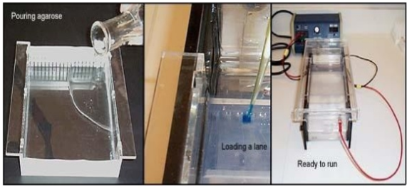

Slide 10
Polyacrylamide
PAGE technique was introduced by Raymond and Weintraub (1959).
Polyacrylamide is the same material that is used for skin electrodes and in soft contact lense.
By controlling the percentage (from 3%-30%) precise pore sizes can be obtained usually from 5 to 2000 kdal.
Gradient gels provide continuous decrease in pore size from the top to the bottom of the gel, resulting in thin bands.
Polyacrylamide gels offer greater, flexibility and move sharply defined banding than agarose gels.

Slide 11
Polyacrylamide Gel Electrophoresis System PAGE System
Different samples are loads in wells at the top of the polyacrylamide Gel.
Proteins move into the gel when an electric field is applied.
Proteins can be visualized after electrophoresis by treating the gel with the stain such as Coomassie blue.

Slide 12
Nucleic Acids
Nucleic acids transmit hereditary information and determine which proteins a cell manufactures.
DNA comprises the genes.
RNA functions in the process of protein synthesis.
Nucleic acids are large, complex molecules were first isolated by Miescher in 1970.

Slide 13
Electrophoresis of Nucleic Acids
Larger pieces of DNA collide with the gel matrix more often are slowed down, while smaller pieces of DNA move through more quickly.
By using gel electrophoresis, biologists can tell which gene is based upon the sizes f the fragments generated when a gene is treated with restriction enzyme.

Slide 14
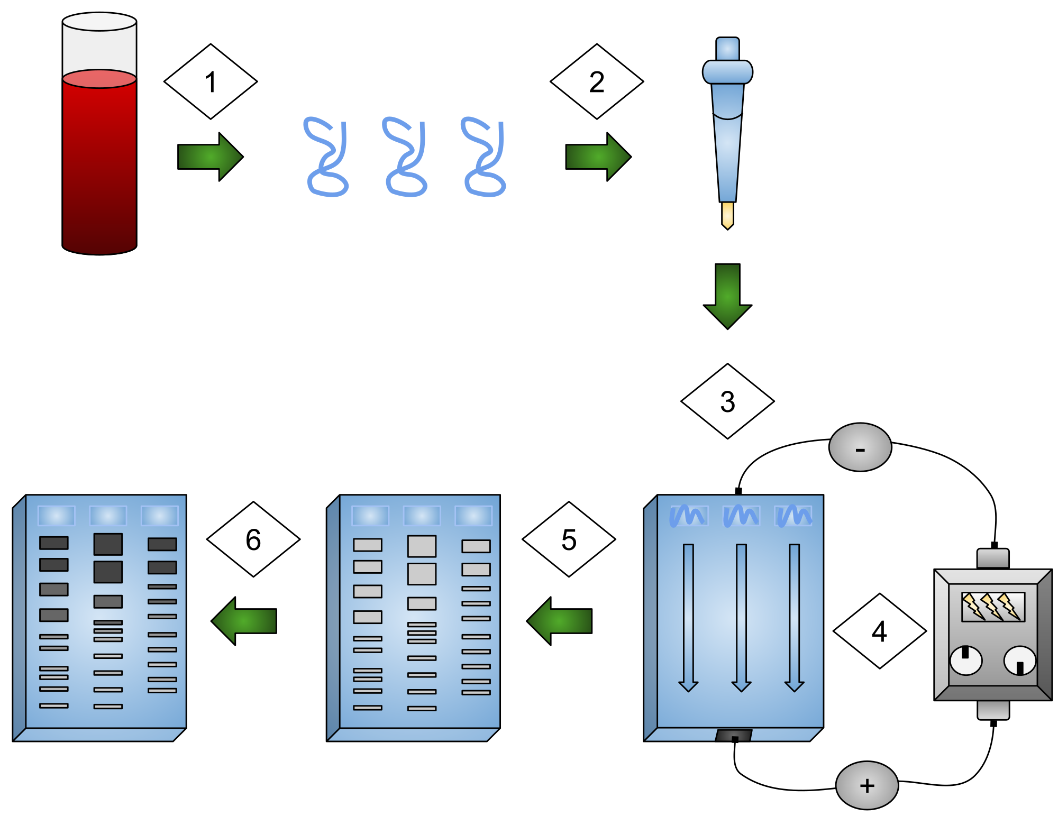

Slide 15
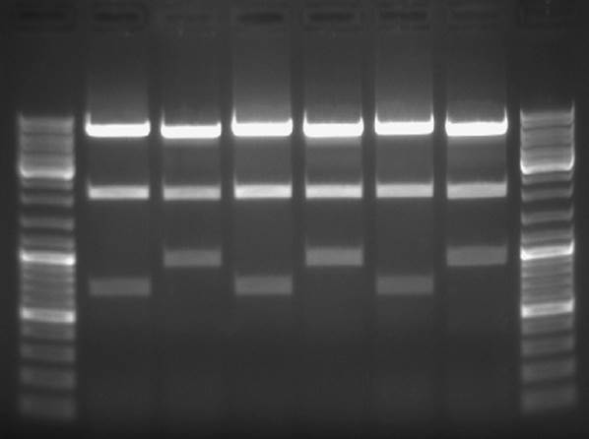
DNA Bands

Slide 16
Proteins
Proteins are of central importance in the structural and function of all living organisms.
Electrophoresis of proteins
Methods of separating proteins take advantage of properties such as charge, size and solubility.
Proteins can also be separated on the basis of their binding properties.

Slide 17
The source of protein is generally tissue or microbial cells.
Variety of methods is available for separation of proteins such as Ion exchange chromatography other chromatographic methods take advantage of differences in size binding affinity and solubility.
Another method is available for separation of proteins a process called electrophoresis.

Slide 18
Gel electrophoresis is advantageous because in this process proteins can be visualized as well as separated.
The net charge of a protein will depend on its amino acid composition.
Protein even with a variation of one amino acids will have a different overall charge and thus are electrophoretically distinguishable.
The gel results will show that some of the high molecular weight bands from the sample not treated with the disulfide reducing agent are missing in the sample treated with the disulfide reducing agent.

Slide 19
The break up of complex proteins into their respective polypeptides allows us to study the structure of proteins that result from the interaction of several genes.
A gene is a discrete unit of hereditary information that usually specifies a protein.
A single gene provides the genetic code for only one peptide.

Slide 20
Applications
DNA Fingerprinting on Trail
An individual DNA is as distinctive as a fingerprint.
DNA samples can be obtained from the trace amounts of blood or semen.
DNA samples can be separated by using gel electrophoresis.
In mid-1980s, genetic fingerprinting has rapidly become a widely used court room tool.
In 1988 the first person in the USA was executed based on DNA technology.

Slide 21
The Human Genome Project
Four complementary approaches are being used
Genetic mapping of the human genome.
Physical mapping of the human genome.
Sequencing the human genome.
Analyzing the genomes of other species.

Slide 22
We are now using biotechnology to study the basic processes of life, diagnose illnesses, and develop new treatments for diseases.
Some of the tools of biotechnology are natural components of cells.
Restriction enzymes are made by bacteria to protect themselves from viruses. They inactive the viral DNA by cutting it in specific places.
DNA ligase is an enzyme thar exist in all cells.
Restriction enzymes can be used to cut DNA at specific sequences called recognition sites.

Slide 23
Recombinant DNA sequences contain genes form two or more organisms.
By using DNA technology researchers have gained the ability to diagnose diseases such as sickle cell anemia, Hutingtons chorea early in the course of the disease.
The most important achievements resulting from recombinant DNA technology have been advances in our basic understanding of eukaryotic molecular biology.
DNA technology is in the process of revolutionizing biological research, human medicine, criminal law and agriculture.

Slide 24
Uses of Gel Electrophoresis
Identification of particular DNA molecules by the band patterns.
Viral DNA, plasmid DNA and particular segments of chromosomal DNA can all be identified in this way.
Isolation and purification of individual fragments containing interesting genes.
It determines the genetic differences and evolutionary relationship among species of plants and animals.

