Slide 1
Fates of Pyruvate
Two pyruvate molecules are produced during glycolysis
Depending on the organism and the metabolic conditions, the pyruvate takes one of the following three essential routes (catabolic):
Oxidation of pyruvate
Lactic acid fermentation
Alcoholic Fermentation
Pyruvate also serves as a precursor in many anabolic reactions

Slide 2
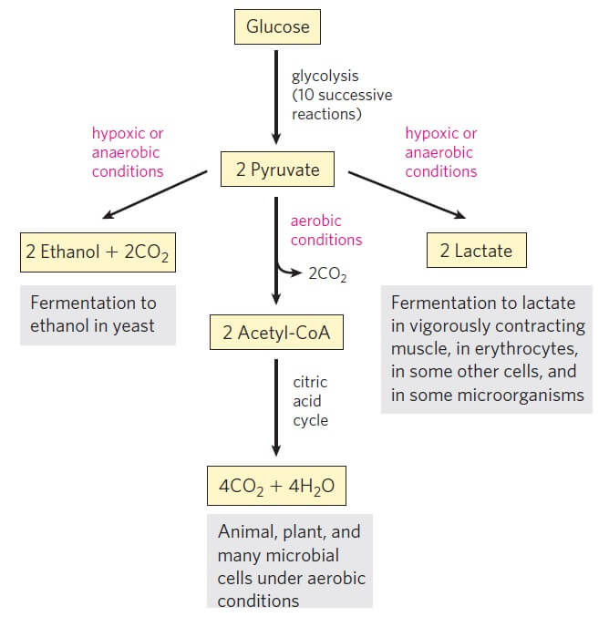
Three possible catabolic fates of the pyruvate

Slide 3
Oxidation of pyruvate
In aerobic organisms, the pyruvate is moved to the mitochondria where it is oxidized into the acetyl group of acetyl-coenzyme A (acetyl Co-A).
This process involves the release of one mole of CO₂.
Later, the acetyl CoA is completely oxidized into CO₂ and H₂O by entering the citric acid cycle.
This pathway follows glycolysis in aerobic organisms and plants.

Slide 5
2. Lactic acid fermentation
In conditions where the oxygen is insufficient, like in the skeletal muscle cells, the pyruvate cannot be oxidized due to lack of oxygen.
Under such conditions, the pyruvate is reduced to lactate by the process of anaerobic glycolysis.
Lactate production from glucose also occurs in other anaerobic organisms by the process of lactic acid fermentation.

Slide 7
3. Alcoholic Fermentation
In some microbes like brewer’s yeast, the pyruvate formed from glucose is converted anaerobically into ethanol and CO₂.
This is considered the most ancient form of the metabolism of glucose
It is observed in conditions where the oxygen concentration is low.

Slide 8
Aerobic glycolysis
Aerobic glycolysis is the process of oxidation of glucose into pyruvate followed by the oxidation of pyruvate into CO₂ and H₂O in the presence of a sufficient amount of oxygen.
Anaerobic glycolysis
Anaerobic glycolysis is the process that takes place in the absence of enough oxygen resulting in the reduction of pyruvate into lactate and reoxidation of NADH into NAD⁺.

Slide 9
Where does glycolysis occur?
Glycolysis occurs in the extramitochondrial fraction of the cell in the cytosol.
What are the products of glycolysis? The products of glycolysis are two moles of pyruvate, four moles of ATPs (net gain of 2 ATPs), and one mole of NADH.
What are the functions of glycolysis?
The primary function of glycolysis is to produce energy in the form of ATP. Similarly, glycolysis also produces pyruvate, which is then oxidized further to create more ATPs.

Slide 10
NADH produced by glycolysis
Two moles of NADH are produced by glycolysis.
ATPs formed in glycolysis
A total of four moles of ATPs are formed in glycolysis. The net gain of ATP in glycolysis is just 2 ATPs as two ATPs are utilized during the preparatory phase of glycolysis.

