Slide 1
Citric acid cycle
The citric acid cycle, also known as Krebs cycle is a cyclic series of reactions that take place in the mitochondria
It results in the oxidation of acetyl CoA (formed during glycolysis) to release carbon dioxide and hydrogen atoms that later lead to the formation of water.
This cycle is termed the citric acid cycle as the first metabolic intermediate formed in the cycle is citric acid.

Slide 2
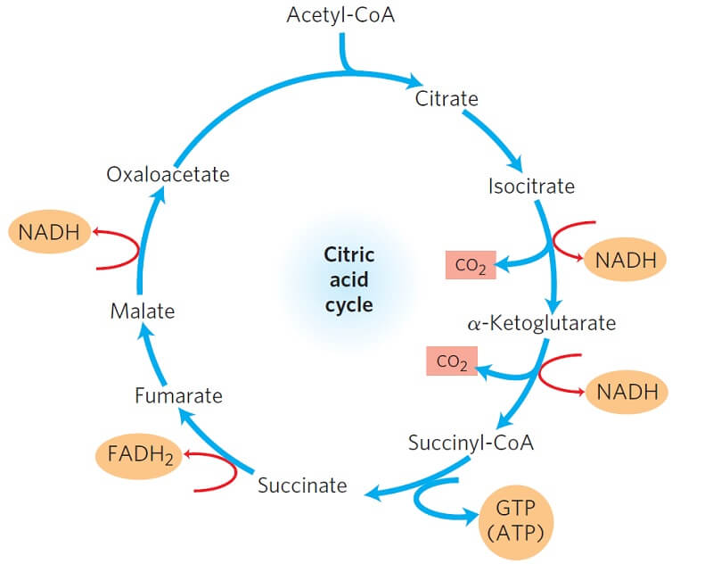
Citric acid cycle

Slide 3
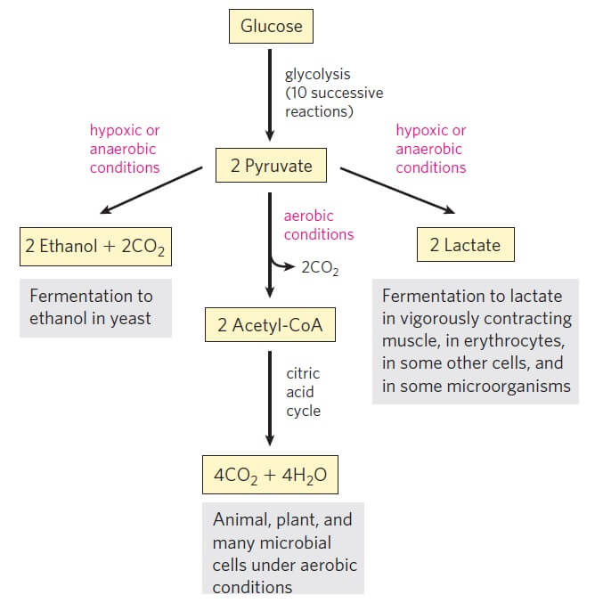
Recall….

Slide 4
Pyruvate formed at the end of glycolysis is first oxidized into Acetyl CoA which then enters the citric acid cycle.
The citric acid cycle is the final common pathway for the oxidation of all biomolecules; proteins, fatty acids, carbohydrates.
Molecules from other cycles and pathways enter this cycle through Acetyl CoA.

Slide 5
The citric acid cycle is formed of 8 enzyme-mediated reactions.
This cycle is also particularly important as it provides electrons/ high-energy molecules to the electron transport chain for the production of ATPs and water.
This cycle only occurs under aerobic conditions as energy-rich molecules like NAD⁺ and FAD can only be retrieved from their reduced form once they transfer electrons to molecular oxygen.

Slide 6
The citric acid cycle
The citric acid cycle in eukaryotes takes place in the mitochondria while in prokaryotes, it takes place in the cytoplasm.
The pyruvate formed in the cytoplasm (from glycolysis) is brought into the mitochondria where further reactions take place.
The different enzymes involved in the citric acid cycle are located either in the inner membrane or in the matrix space of the mitochondria.

Slide 7
The citric acid cycle-Equation
The overall reaction/ equation of the citric acid cycle is:
Acetyl CoA + 3 NAD⁺ + 1 FAD + 1 ADP + 1 P_{i} →
2 CO₂ + 3 NADH + 3 H⁺ + 1 FADH₂ + 1 ATP

Slide 8
Krebs cycle Enzymes
In eukaryotic cells, the enzymes that catalyze the reactions of the citric acid cycle are present in the matrix of the mitochondria except for
succinate dehydrogenase and
Aconitase
which are present in the inner mitochondrial membrane.
One common characteristic in all the enzymes involved in the citric acid cycle is that nearly all of them require Mg²⁺

Slide 9
The following are the enzymes that catalyze different steps throughout the process of the citric acid cycle:
Citrate synthase
Aconitase
Isocitrate dehydrogenase
α-ketoglutarate
Succinyl-CoA synthetase
Succinate dehydrogenase
Fumarase
Malate dehydrogenase

Slide 10
Krebs cycle Steps
The oxidative decarboxylation of pyruvate forms a link between glycolysis and the citric acid cycle.
After glycolysis, in aerobic organisms, the pyruvate molecules are decarboxylated to form acetyl CoA and CO₂ catalyzed by the pyruvate dehydrogenase complex in the mitochondrial matrix in eukaryotes and in the cytoplasm of the prokaryotes.

Slide 11
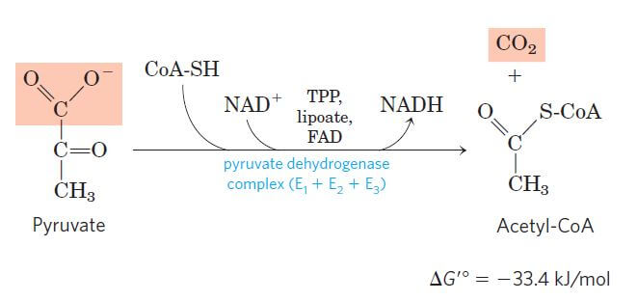
Oxidative Decarboxylation of pyruvate to Acetyl CoA

Slide 12
From one molecule of glucose, two molecules of pyruvate are formed, each of which forms one acetyl CoA along with one NADH by the end of the pyruvate oxidation.
The acetyl CoA formed from pyruvate oxidation, fatty acid metabolism, and amino acid pathway then enter the citric acid cycle.

Slide 13
Following are the eight enzyme-catalyzed reactions/ steps in the aerobic oxidation of glucose through the citric acid cycle:

Slide 14
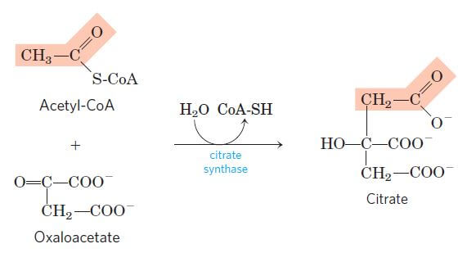
Step 1: Condensation of acetyl CoA with oxaloacetate
The first step of the citric acid cycle is the joining of the four-carbon compound oxaloacetate (OAA) and a two-carbon compound acetyl CoA.

Slide 15
The reaction is catalyzed by the enzyme citrate synthase that condenses the methyl group of acetyl CoA and the carbonyl group of oxaloacetate resulting in citryl-CoA which is later cleaved to free coenzyme A and to form citrate.

Slide 16
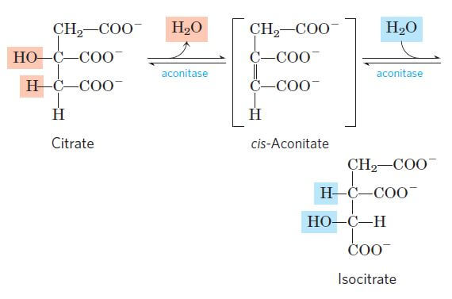
Step 2: Isomerization of citrate into isocitrate
for further metabolism, citrate is converted into isocitrate through the formation of intermediate cis-aconitase.

Slide 17
This reaction takes place by a two-step process where
the first step involves dehydration of citrate to cis-aconitase,
the second step involving rehydration of cis-aconitase into isocitrate.

Slide 18
Step 3: Oxidative decarboxylations of isocitrate
The third step of the citric acid cycle is the first of the four oxidation-reduction reactions in this cycle.
Isocitrate is oxidatively decarboxylated to form a five-carbon compound, α-ketoglutarate catalyzed by the enzyme isocitrate dehydrogenase.

Slide 19
This reaction is also a two-step reaction:
In the first step, isocitrate is dehydrogenated to oxalosuccinate
the second step involves the decarboxylation of oxalosuccinate to α-ketoglutarate.
Both the reactions are irreversible and catalyzed by the same enzyme.
The first step, however, results in the formation of NADH while the second step involves the release of CO₂.

Slide 20
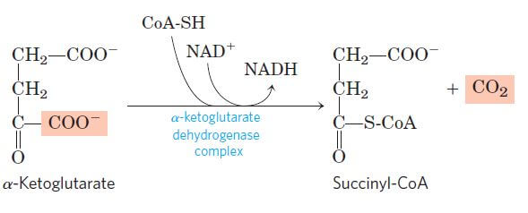
Step 4: Oxidative decarboxylation of α-ketoglutarate
This step is another one of the oxidation-reduction reactions where α-ketoglutarate is oxidatively decarboxylated to form a four-carbon compound, succinyl-CoA, and CO₂.
The reaction irreversible and catalyzed by the enzyme complex α-ketoglutarate dehydrogenase

Slide 21
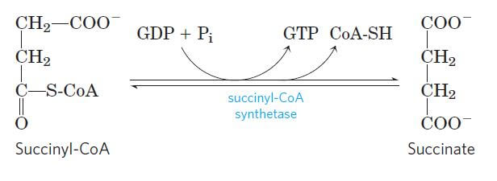
Step 5: Conversion of succinyl-CoA into succinate
In the next step, succinyl-CoA undergoes an energy-conserving reaction in which succinyl-CoA is cleaved to form succinate.

Slide 22
This reaction is accompanied by phosphorylation of guanosine diphosphate (GDP) to guanosine triphosphate (GTP).
The GTP thus formed then readily transfers its terminal phosphate group to ADP forming an ATP molecule.

Slide 23
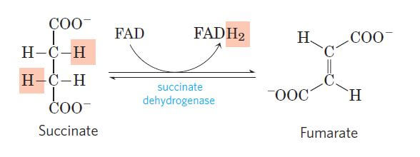
Step 6: Dehydration of succinate to fumarate
Here, the succinate formed from succinyl-CoA is dehydrogenated to fumarate catalyzed by the enzyme complex succinate dehydrogenase found in the intramitochondrial space.

Slide 24
This is the only dehydrogenation step in the citric acid cycle in which NAD⁺ doesn’t participate.
Instead, another high-energy electron carrier, flavin adenine dinucleotide (FAD) acts as the hydrogen acceptor resulting in the formation of FADH₂.
The FADH₂ then enters the electron transport chain via the complex II transferring the electrons to ubiquinone, finally forming 2ATPs.

Slide 25
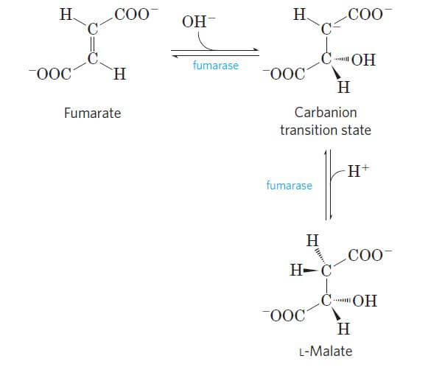
Step 7: Hydration of fumarate to malate
The fumarate is reversibly hydrated to form L-malate in the presence of the enzyme fumarate hydratase.

Slide 26
As it is a reversible reaction, the formation of L-malate involves hydration, whereas the formation of fumarate involves dehydration.

Slide 27
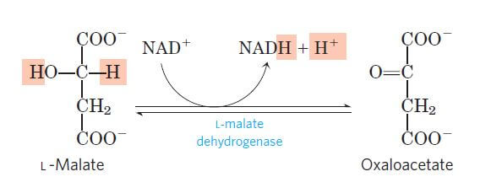
Step 8: Dehydrogenation of L-malate to oxaloacetate
The last step of the citric acid cycle is also an oxidation-reduction reaction where L-malate is dehydrogenated to oxaloacetate in the presence of L-malate dehydrogenase, which is present in the mitochondrial matrix.

Slide 28
Step 8: Dehydrogenation of L-malate to oxaloacetate
This is a reversible reaction involving oxidation of L-malate and reduction of NAD⁺ into NADH.
Oxaloacetate thus formed, allows the repetition of the cycle and NADH formed participates in the oxidative phosphorylation.
This reaction completes the cycle.

Slide 30
Since this is a cyclic process, the oxaloacetate formed at the end as it condenses with acetyl CoA in the next cycle.

Slide 31
Each turn of the cycle produces,
3 NADH,
1 FADH2,
1 GTP (or ATP),
2 CO2

Slide 32
What is the purpose of the Krebs cycle? The purpose of the Kreb’s cycle is the complete oxidation of glucose, resulting in energy-rich molecules that later produce ATPs in the electron transport chain.
Where does the Krebs cycle take place? Krebs cycle takes place in the mitochondria of eukaryote and in the cytoplasm of the prokaryotes.
How many ATP are produced in the citric acid cycle? One ATP is formed in a single citric acid cycle while two ATPs are formed from a single molecule of glucose (two molecules of pyruvate are formed from one molecule of glucose).

Slide 33
What inhibits the citric acid cycle?
Various factors like the absence of oxygen, low levels of oxaloacetate or pyruvate, necessary enzymes and coenzymes, high levels of ATP and NADH, and the accumulation of ketone bodies.

